Slide 1
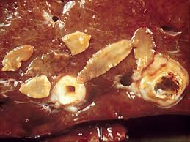
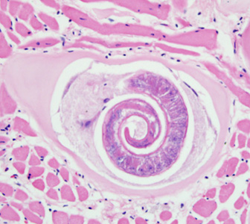
Tissue Reactions Caused
By
Parasites
Dr. AJIT KUMAR
Department of Veterinary Parasitology
Bihar Veterinary College
Bihar Animal Sciences University
Patna-800014
Image source: Google image

Slide 2
Tissue Reactions Caused by Parasites
Various types of tissue reactions occurred during parasitic infections are as follows-
Atrophy
Hypertrophy
Hyperplasia
Metaplasia
Necrosis
Nodule formation
Fibrosis
Cirrhosis
Neoplasia or Tumour
Excessive production of mucus
Enlargement of prescapular lymph nodes
Allergic and Immune reactions

Slide 3
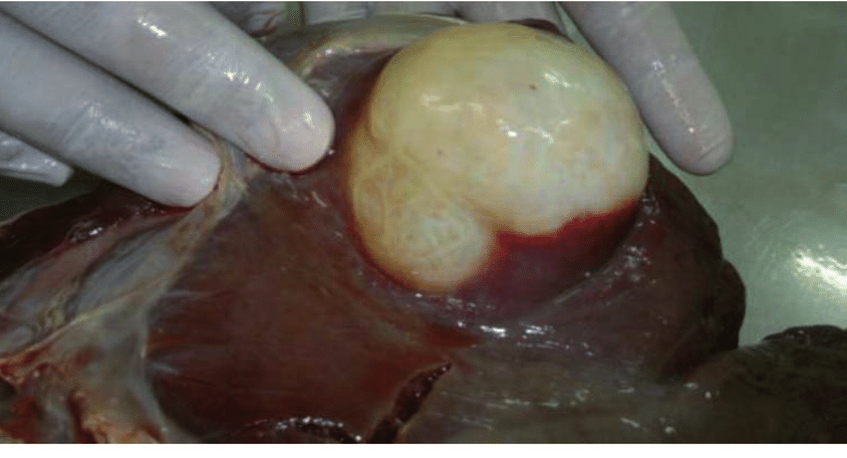
Tissue Reactions Caused by Parasites
Atrophy (Pressure atrophy) :-
Decrease in size of tissue or organ that had reached their normal size.
e.g. Hydatid cyst of Echinococcus spp.
Hydatid cyst
Liver
Liver infected with Hydatid cyst
Image source: Google image

Slide 4
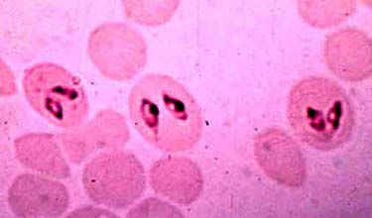
Tissue Reactions Caused by Parasites
Hypertrophy:
Increase in size of cells but their number remains same.
e.g. R.B.Cs. infected with Babesia spp.
Image source: Google image

Slide 5
Tissue Reactions Caused by Parasites
Hypertrophy:
Increase in size of cells but their number remains same.
e.g. R.B.C. infected with Plasmodium sp.
RBC
Plasmodium sp.
Image source: Google image

Slide 6
Tissue Reactions Caused by Parasites
Hyperplasia :-
Increase in number of cells by cell division.
e.g. Eimeria stiedae infected liver,
Fasciola and Dicrocoelium species infected Bile ducts etc.
Fasciola sp.
Liver infected with Fasciola
Image source: Google image

Slide 7
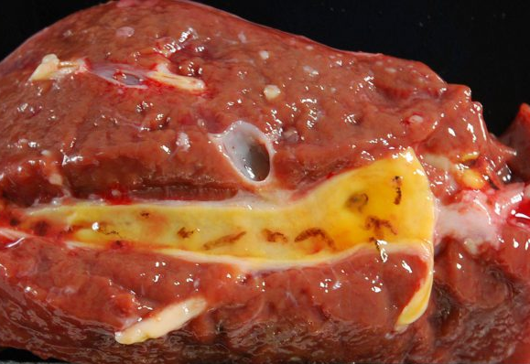
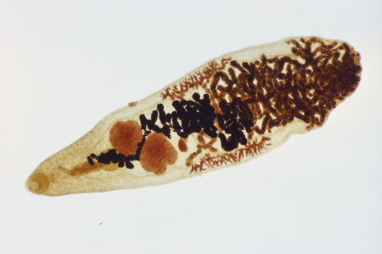
Tissue Reactions Caused by Parasites
Hyperplasia :-
Increase in number of cells by cell division.
e.g. Dicrocoelium species infected Bile ducts etc.
Dicrocoelium sp. ( Lancet fluke)
Bile ducts infected Dicrocoelium sp.
Image source: Google image

Slide 8
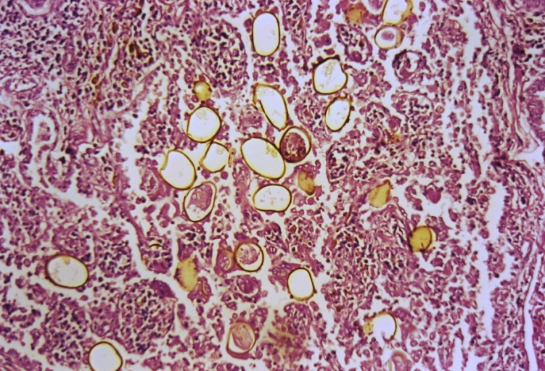
Tissue Reactions Caused by Parasites
Metaplasia :-
Transformation of tissue without alteration of the embryonic tissues.
e.g. Paragonimus westermani (lung fluke) and Ostertagia species infections.
Paragonimus westermani
Image source: Google image

Slide 9
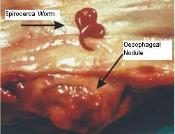
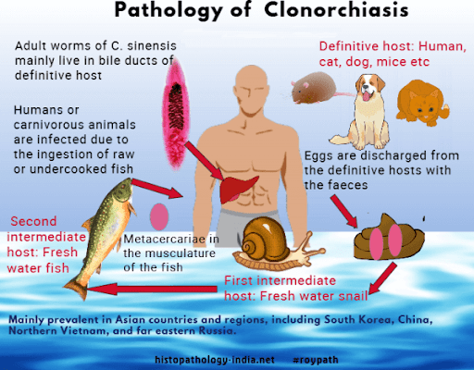
Tissue Reactions Caused by Parasites
Neoplasia :- Uncontrolled growth of the cells in a tissue to form a new structure.
e.g. Spirocera lupi infection may leads to osteosarcoma in oesophagus of dog .
Clonorchis sinensis infections may results cholangicarcinoma in man.
Image source: Google image

Slide 10
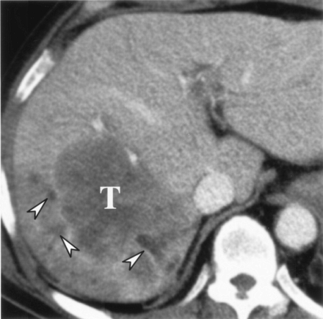
Tissue Reactions Caused by Parasites
Neoplasia :- Uncontrolled growth of the cells in a tissue to form a new structure.
Clonorchis sinensis infections may results cholangicarcinoma in man.
Cholangicarcinoma in Rt lobe of liver (T)
Image source: Google image

Slide 11
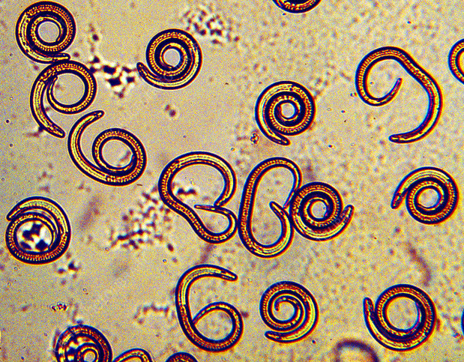
Tissue Reactions Caused by Parasites
Necrosis:
Death of tissues or cells in the living animals.
e.g. Trichinella spiralis.
Trichinella spiralis
Tissue infected with Trichinella spiralis
Image source: Google image

Slide 12
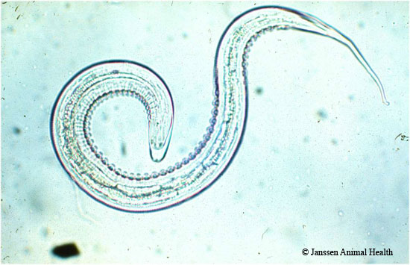
Tissue Reactions Caused by Parasites
Nodule formation :
e.g.Oesophagostomum (pimply gut), Raillietina echinobothrida infections.
Oesophagostomum sp.

Slide 13
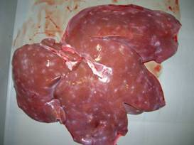
Tissue Reactions Caused by Parasites
Fibrosis –
e.g. Milk spots in liver of pig is caused by Ascaris suum infection.
Image source: Google image

Slide 14
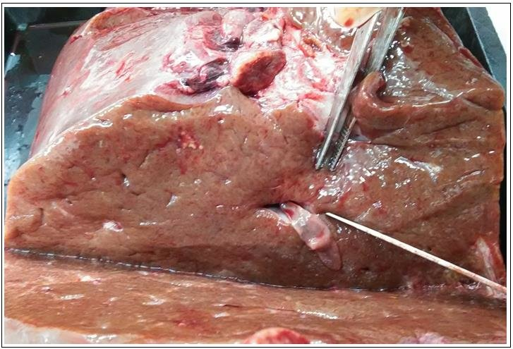
Tissue Reactions Caused by Parasites
Cirrhosis in liver and calcification of bile duct :
e.g. Fasciola spp.
Image source: Google image

Slide 15
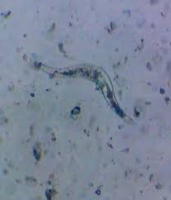
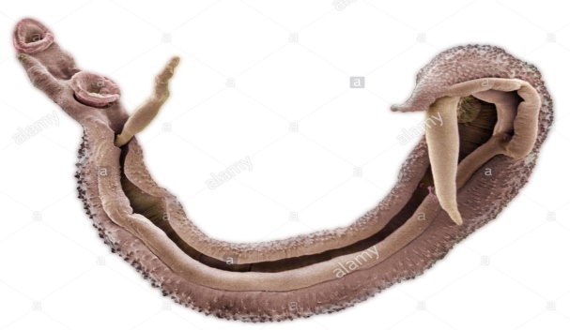
Tissue Reactions Caused
by Parasites
Granuloma formation:
e.g. Schistosoma nasale caused cauliflower like growth in nasal mucosa of infected host.
Image source: Google image

Slide 16
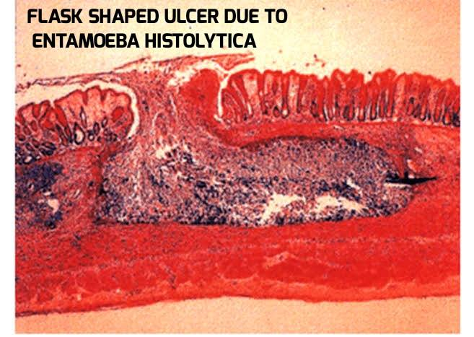
Tissue Reactions Caused by Parasites
Excessive production of mucus and Flask shaped ulcers- e.g. Entamoeba histolytica.
Image source: Google image

Slide 17
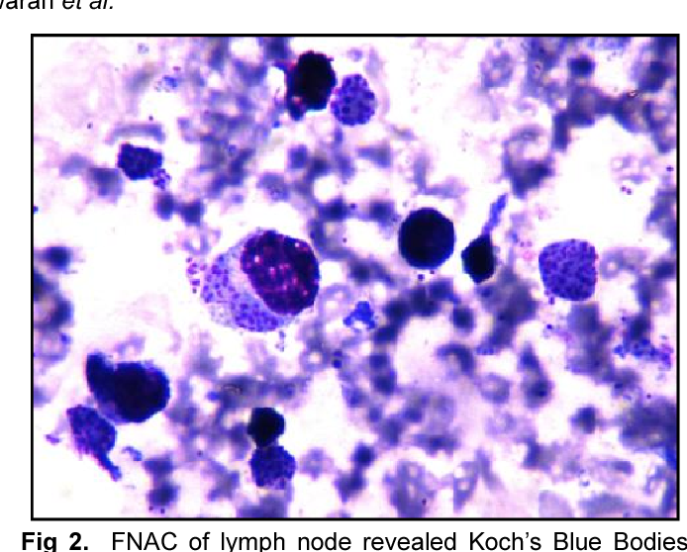
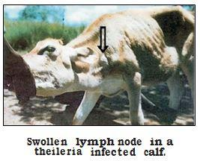
Tissue Reactions Caused by Parasites
Enlargement of prescapular lymph nodes –
e.g. Theileria annulata infection.
Lymphocyte
Koch’s blue bodies inside lymphocyte of lymph node biopsy smear
Image source: Google image

Slide 18
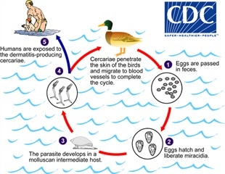
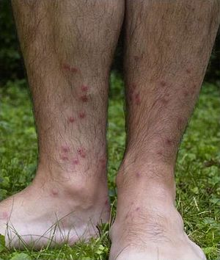
Tissue Reactions Caused by Parasites
Allergic and immune reactions –
e.g. Cercarial dermatitis, Eosinophilia in schistosomosis, anaphylactic shock due to rupture of the hydatid cyst in the body and also in Fleas infestations.
Cercarial dermatitis
Image source: Google image

Slide 19
THANK U

