Slide 1
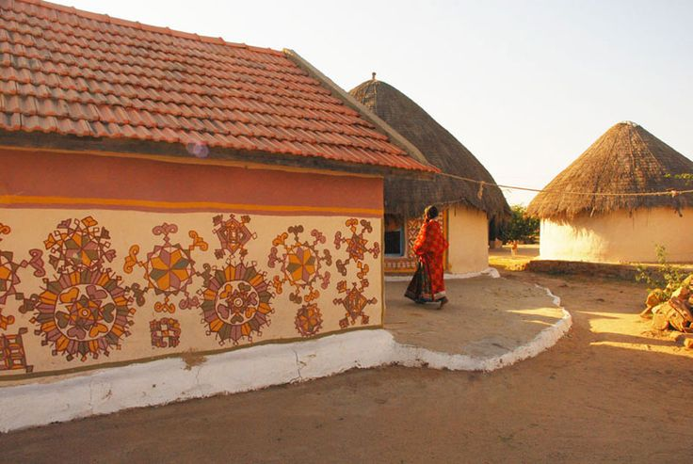
UNIT-01 (LIVESTOCK BASED LIVELIHOODS AND THEIR EVOLUTION)
Dr. Pankaj Kumar
Department of Veterinary & Animal Husbandry Extension Education, BVC

Slide 2
KINDS OF FARMING IN INDIA

Slide 3
Factors determining type of farming
Physical factors:
Climate
Soil
Topography
Social factors:
Type of community
Cooperative spirit
Economic factors
Relative Profitability
Availability of funds
Availability of labour & capital
Availability of input
Land values
Marketing costs
Marketing facilities
Cycles of over & under production
Competition between enterprises
Personal choices
Miscellaneous – seasonal availability of raw material, diseases etc.

Slide 4
Classification of farming
Based on how income is derived from a farming enterprise
Specialized farming
Diversified farming
Mixed farming
Based on mode of ownership and organization of farms
Individually owned
Co-operative farming
Collective farming
Based on scale of operations
Small scale farming
Large scale farming

Slide 5
Specialized farming
In which 50% or more income/receipts are derived from one source.

Slide 6
Advantages of specialized farming
Best suited to particular soil, climate, topography & other physical conditions like market type
Work easily get reduced to routine
Better marketing
Better management
Less equipments and labour needed
Efficiency & skill of personnel increased
Costly & efficient machinery can be kept
Farmer can secure complete mastery over the conditions, problems of production, processing & sale
Under favourable & specific conditions extremely profitable

Slide 7
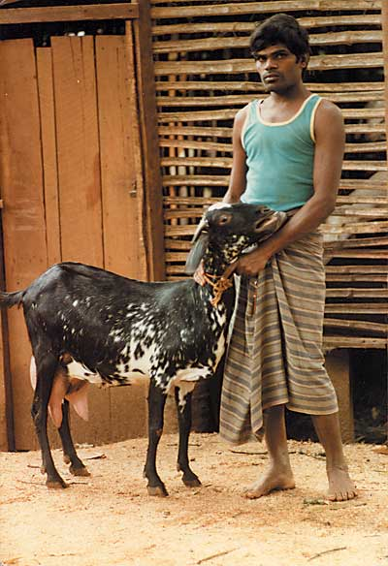
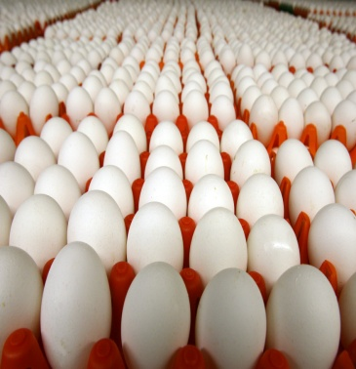
Diversified farming
When farming is organized to produce one main product but also has several other enterprises each of which itself is the direct source of income

Slide 8
Mixed farming
When crop production is combined with livestock production with minimum 10 % & maximum 49 % income derived from livestock farming, entitled as mixed farming

Slide 9
Advantages of mixed / diversified farming
Well suited for adoption round the year under Indian conditions
Income obtained throughout the year
Offer opportunity for better use of land, capital & labour
Helps in maintaining soil fertility
Reduces the risks due to failure, unfavourable market price etc.
Income is regular and quick
Cost of transportation and sale of by-products can be reduced to minimum
Offer opportunity for complete use of agricultural wastes
Provides balanced and protective farming

Slide 10
Co-operative farming
In which agricultural/livestock producers co-operate with one another to secure advantages of co-operative buying of inputs & selling of produce or they may co-operate in order to obtain credit on easier terms.

Slide 11
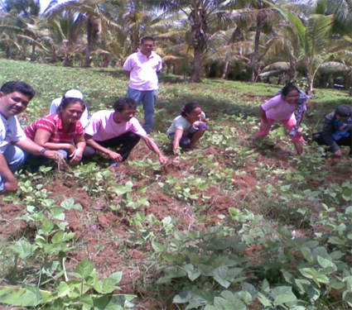
Classification of Co-operative farming societies
Co-operative better farming society: Independent land holding members “agree to follow a plan of cultivation/operation” laid down by the society
Co-operative tenant farming society: Leases out the plots to members for individual cultivation
Co-operative joint farming society: Land owners pool their lands for joint cultivation. The ownership of each member in his holding continues and is recognized by the payment of dividend in proportion to the value of his land

Slide 12
Collective farming
In collective farming societies, members do not have an individual land ownership right in the society’s land. Society holds land in free hold or leasehold and undertakes joint cultivation

Slide 13
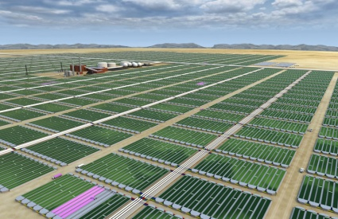
Types of collective farming societies
TYPE I Collective Farming Societies – transfer of land ownership rights by members in return for shares of equivalent value
Type II Collective Farming Societies – transfer of land ownership rights by members without any consideration
TYPE III Collective Farming Societies - Absence of the transfer of any prior land ownership rights by members

Slide 14
Large & Small scale farming
Different means of describing scale of livestock enterprise:
Quantity of produce & marketed unit within a time period
Number of animals/ birds maintained
Area of holding over which the livestock enterprise is based
The advantages of large scale production over small scale production are called Economies of scale

Slide 15
Advantages of Large-scale farming
Increased efficiency & full utilization of labour
Lower machine cost as a result of greater annual use
Building economics
Buying and selling
Management
Economics in financing
Economics in the use of by-products

Slide 16
Disadvantages of Large-scale farming
Greater losses during depression period
Difficulty in supervision
Under utilization of resources, equipments, labors
Apart from this, extended limit of farm then leads to inefficiencies

Slide 17
Advantages of small scale farming
Close attention & supervision
Efficient use of family labour
Higher productivity
Low market dependence for inputs
Intensive cultivation is possible
Social justice through distribution of landed property
Higher family labour employment

Slide 18
Disadvantages of small scale farming
Inadequacy of productive resources
Unremunerative farming
Limited scope for development
Shortage of farm implements
Under employment
Market diseconomies
Shortage of finance
Relatively more overheads

Slide 19
Comparison between Large & Small scale farming
Aspects | Large scale | Small scale
Division of labour | Possible | Limited
Mechanization | Possible | Not possible
Quantity of output | More | Less
Cost of production | Low | High
Cost of management | Low | High
Risk | More | Less
Marketing facilities | Better | Poor
Economy of buying & selling | More | Less
Possibility of using improved technology | More | Less
Danger of over production | More | Less
Supervision | Poor | Better
Flexibility | Inflexible | Flexible
Chances of unhealthy competition | More | Less

Slide 20
Contract or integrated farming
Poultry farmers
Provide land, sheds and labour
To provide eggs or chicken of certain quality & adhere to management practices indicated by agency
Agency
Supply of chicks, vaccinations, health care, feed, purchasing the output

