Slide 1
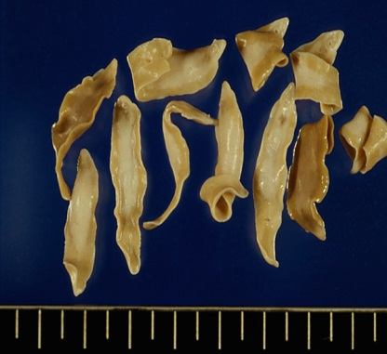
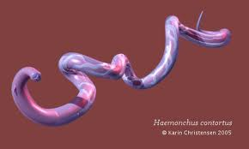
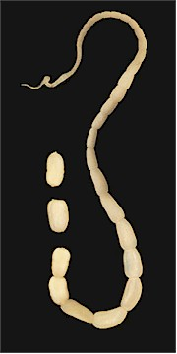
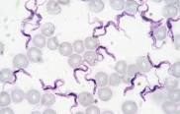
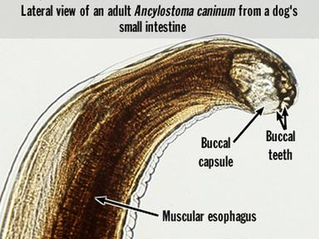
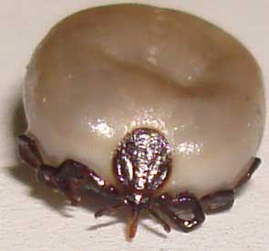
General Veterinary Parasitology
Types of Parasites
Dr. AJIT KUMAR
HEAD
Department of Veterinary Parasitology
Bihar Veterinary College
Bihar Animal Sciences University
Patna-800014
Image source: Google image

Slide 2
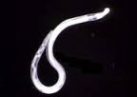
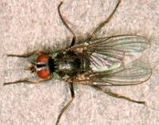
Types of Parasites
Endoparasite: the parasites live within or inside the body of the host.
Examples: Round worm, tape worm and flukes.
Ectoparasite : the parasite lives on the body of host particularly on the skin.
Examples: Fly, tick, mite, louse, flea, bug etc.
Trematode ( Flukes)
Cestode ( Tapeworm)
Nematode (Round worm)
Fly
Tick
Mite

Slide 3
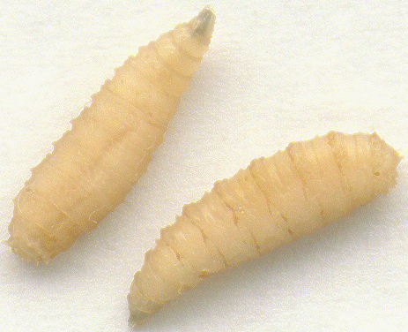
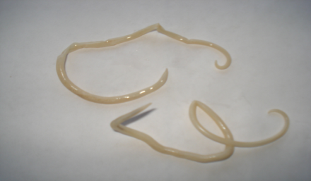
Types of Parasites
Facultative parasite: These are those parasites which can live in host body and also can live freely on the environment i.e. they can have both parasitic and free life.
e.g. Maggots of flies, Blow fly, Strongyloides etc.
Obligatory parasite: It is a parasite which completely adopted a parasitic mode of life and it can not live without the host.
e.g. Toxocara vitulorum, Ancylostoma caninum etc.
Maggots
Ancylostoma caninum (Hookworm)
Toxocara vitulorum

Slide 4
Types of Parasites
Hyperparasite: It is a parasite which parasitise on other parasites.
e.g. Hunterellus hookeri on ticks, Plasmodium species in mosquito etc.
Permanent parasite: It is a parasite which lives its entire life within or on its host.
e.g. Mites, lice & Trichinella spiralis.
Temporary parasite or periodic parasite: It lives in the host in some of the part of life-cycle.
e.g. Ticks, Ox warble fly, Leeches etc.
Mite
Tick

Slide 5
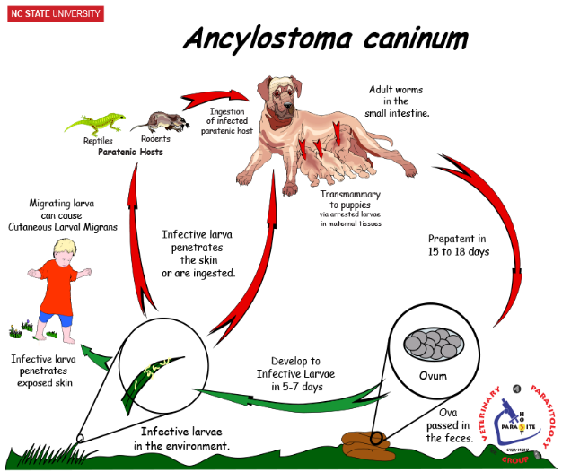
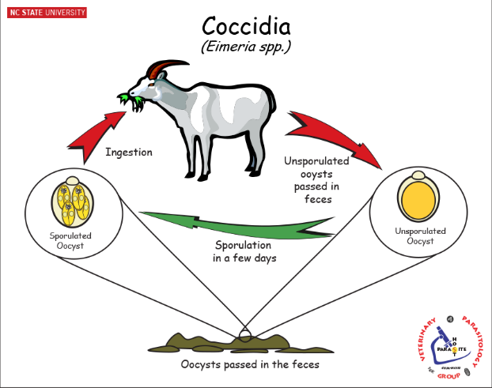
Types of Parasites
Monoxenous parasite: It require only one type of host during the course of their normal life- cycle.
e.g. Eimeria spp., Hook worms, Hymenolepsis nana etc.
Final host - Dog
Ancylostoma caninum (Hookworm)

Slide 6
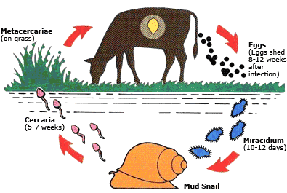
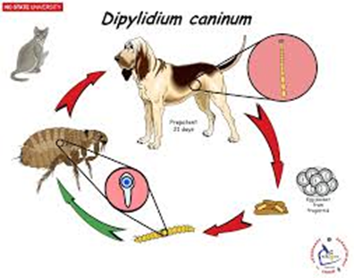
Types of Parasites
Heteroxenous parasite: It require two or more type of hosts during the course of their normal life-cycle.
e.g. All digenetic trematodes, tapeworms etc.
Trematode
Fasciola
( Liver fluke)
Final host- Cattle
Intermediate host- Snail
Tapeworm
Final host- Dog
Intermediate host- Fleas and louse)
Dipylidium caninum

Slide 7
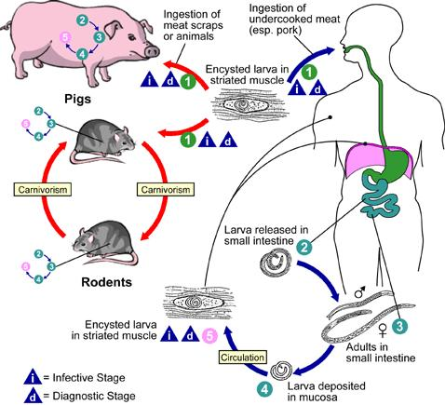
Types of Parasites
Autoheterogenous parasite: Same vertebrate animal acts as definitive and intermediate host of a parasite.
e.g. Trichinella spiralis.

Slide 8
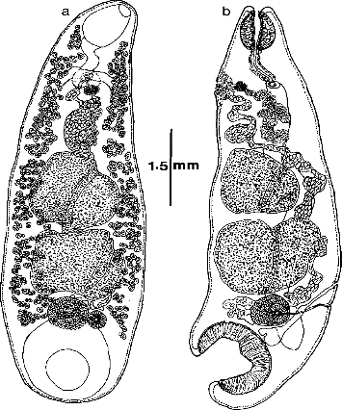
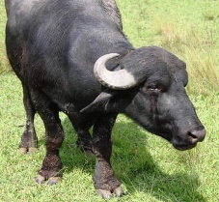
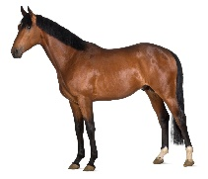
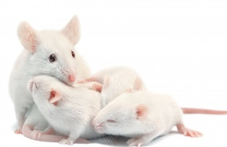
Types of Parasites
Stenoxenous parasite: A parasites which has a narrow host range.
e.g. Gigantocotyle explanatum which is found only in buffaloes.
Euryxenous parasite: A parasite which has a broad host range.
e.g. Trypanosoma evansi which found in a wide range of hosts like cattle, buffaloes, sheep, goat, horse, dog, pig, tiger etc.
Gigantocotyle explanatum
Trypanosoma evansi
Notes:
Vansi

Slide 9
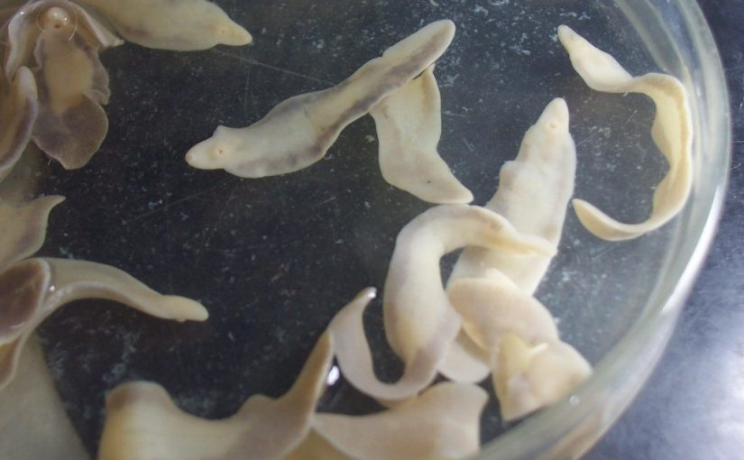
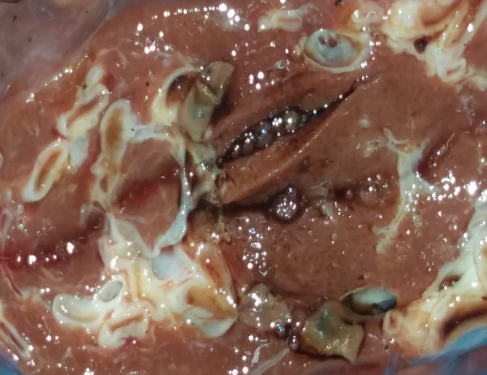
Types of Parasites
Erratic or aberrant parasite: Parasites occur in other organs than the normal habitat in the host.
e.g. Fasciola hepatica when found in the lung and kidney instead of the normal site of predilection i.e. bile duct and liver.
Predication sit inside host- Bile duct and liver
Fasciola hepatica

Slide 10
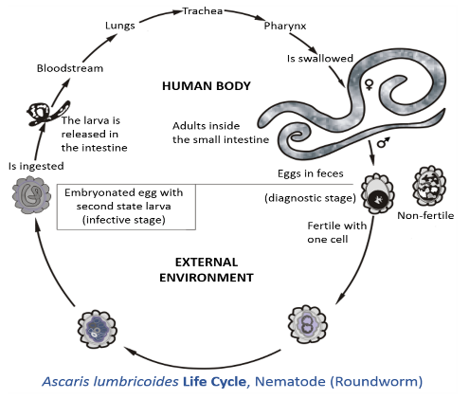
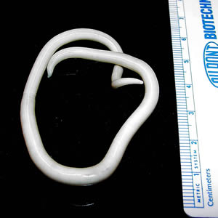
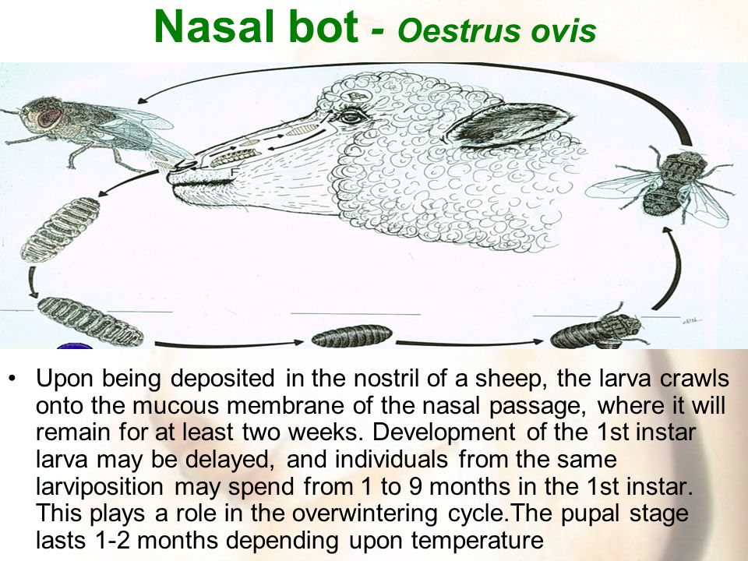
Types of Parasite
Accidental or incidental parasite: when parasites found in a host in which it usually does not occur or live normally.
e.g. Ascaris lumbricoides in sheep.
Protelean parasite- An insect species in which only their immature stages are parasitic.
e.g.- Oestrus ovis

Slide 11
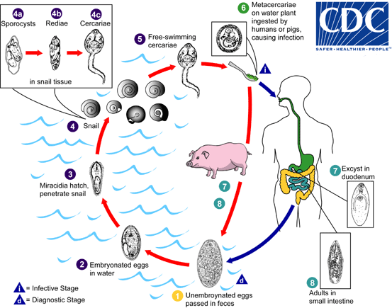
Types of Parasites
Zoonotic parasites: Parasites which are transmissible from man to animal and vice-versa.
e.g. Trichinella spiralis, Fasciolopsis buski, Paragonimus westermani (lung fluke), Entamoeba histolytica etc.
Life-cycle of Fasciolopsis buski

Slide 12
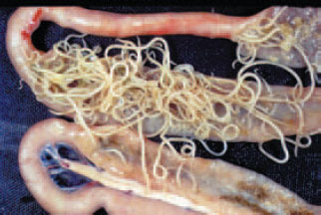
Types of Parasites
Histozoic parasites: Parasites which live in the tissues of the muscles or organs of their host.
e.g. Toxoplasma gondii, Sarcocystis spp. etc.
Coelozoic Parasites: Parasites which live in the lumen of the intestine or in the hollow organs or body cavity of their host.
e.g. Ascaridia galli found in the small intestine of poultry.

Slide 13
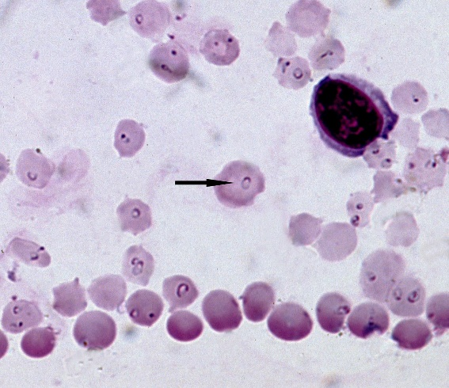
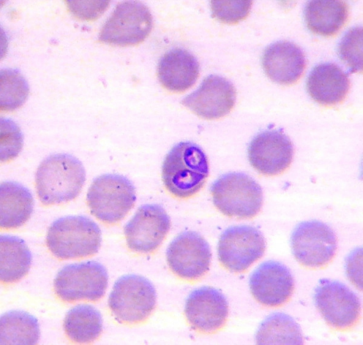
Types of Parasites
Protozoan parasites: Unicellular eukaryotic parasites are known as protozoan parasites.
e.g. Trypanosoma, Theileria, Babesia, Plasmodium, Entamoeba, Giardia etc.
Trypanosoma
Theileria
Babesia

Slide 14
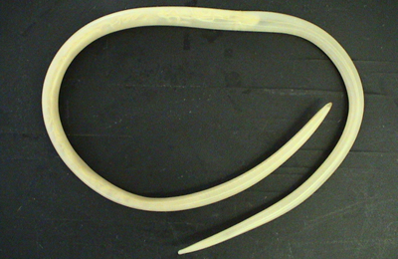
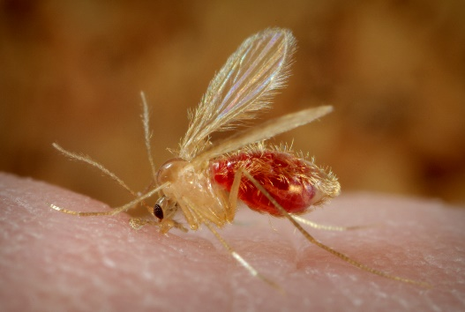
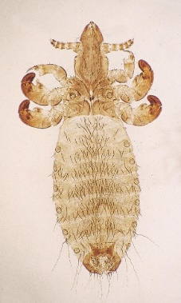
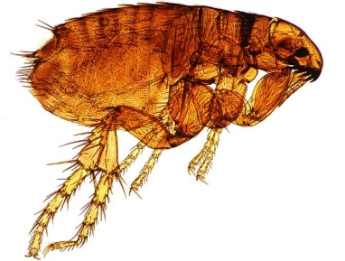
Types of Parasites
Metazoan Parasites: Multicellular eukaryotic parasites are known as metazoan parasites.
e.g. Helminths and Arthropods.
Helminths:
Arthropods:
Nematode ( Round worm)
Trematode ( fluke)
Cestode
( Tapeworm)
Flea
Tick
Mite
Fly
Louse

Slide 15
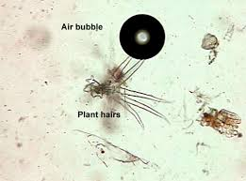
Types of Parasites
Pseudoparasites: Objects or organisms that appear to be parasites but are not.
e.g.- Pollen grain, plant cells, air bubble Psocid insects, grain mites etc.

Slide 16
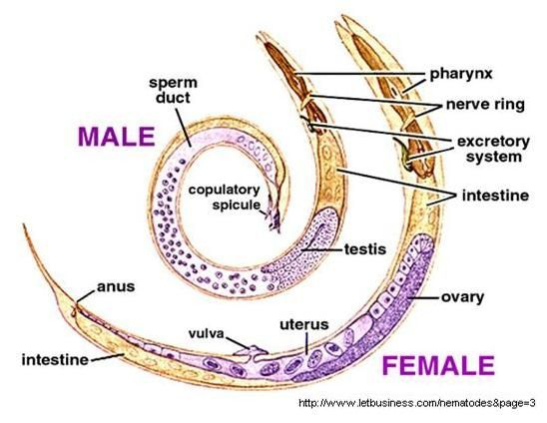
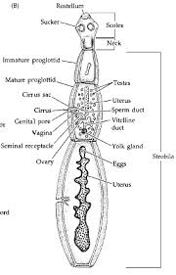
Types of Parasites
Unisexual parasite: Male and female parasites are different or separate.
e.g Nematodes ( Hook worms, Ascarid worms, Haemonchus etc.)
Hermaphrodite or bisexual parasite: Parasites having both male and female sexes.
e.g. Trematodes ( except Schistosoma spp.) and Cestodes .
Cestode
Trematode

Slide 17
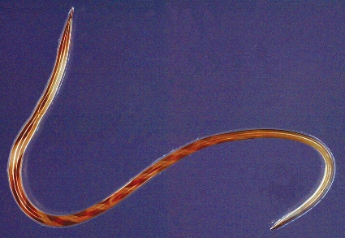
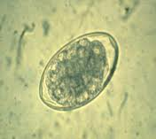
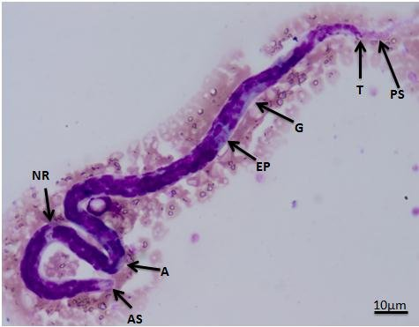
Types of Parasites
Oviparous parasite: Female parasite lay eggs.
e.g. Hook worms, Ascaridia galli, Haemonchus spp.
Viviparopus parasite: Eggs are hatched in the uterus of the female parasite and larvae passed out.
e.g. Filarid worms ( Setaria digitata, Stephanofilaria assamensis etc.)
Egg of Haemonchus contortus
Haemonchus contortus
Adult Setaria sp.
Microfilaria of Setaria sp.

Slide 18
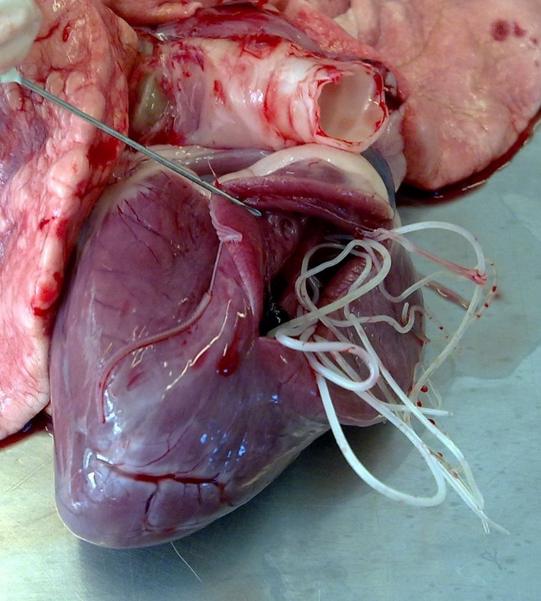
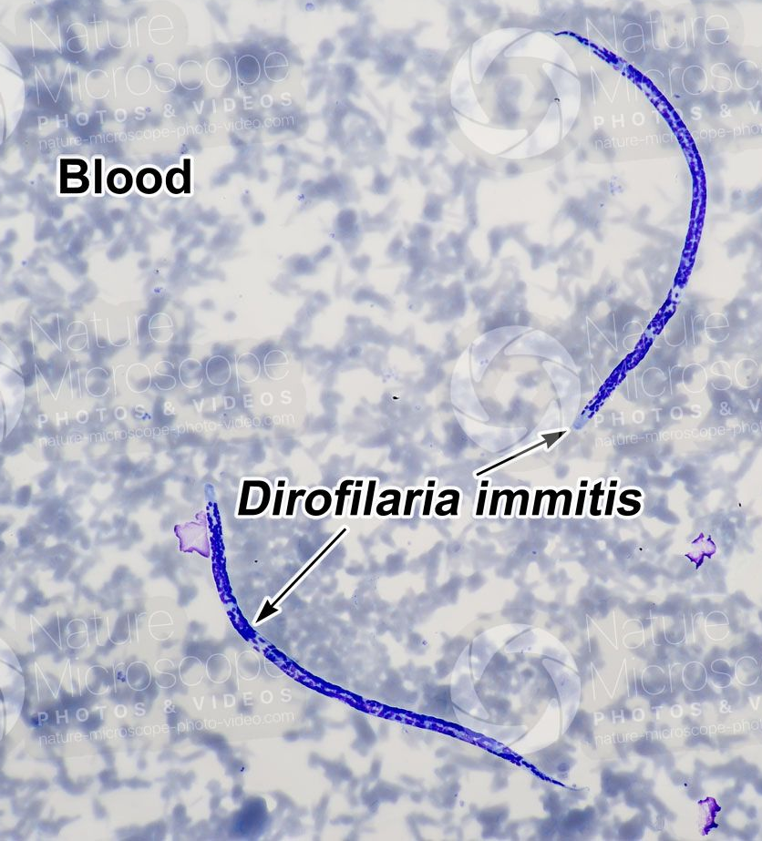
Types of Parasites
Ovo-viviparous parasite: Female parasite lays egg which are containing fully developed larvae to hatch.
e.g. Dirofilaria immitis ( Heart worm of dog)
Dirofilaria immitis (Adult)
Microfilariae of Dirofilaria immitis

Slide 19
THANK YOU

