Slide 1
VCP-511, TOPIC: Treatment and management of wounds and abscess
Dr Gyan Dev Singh, Assistant professor, VCC, BVC, Patna-14

Slide 2
Abscess
Abscesses are circumscribed collections of purulent material (pus) in a cavity
Corynebacterium, Pseudomonas, Streptococcus and Staphylococcus
Abscess consists of a wall, pyogenic membrane and pus (Liquor puris).
Pyogenic membrane controls spread of infection, and helps in phagocytosis and granulation tissue formation

Slide 3
Pus contains necrosed tissue, dead bacteria, leukocytes and proteins of blood and tissues.
Pus cells mainly consist of polymorphonuclear leukocytes along with a few mononuclear cells.
Pus is alkaline in nature and yellow in colour.
Pus serum will not clot, since the fibrin of exudates is digested by the proteolytic enzymes of the leukocytes

Slide 4
Classification of abscess
Abscess may be classified as:
Acute Abscess (Hot abscess): Inflammatory symptoms are more active.
Chronic Abscess (Cold abscess): Inflammatory symptoms are less active.
Chronic abscess may be:
Hard with inspissated pus,or
Soft with liquid pus and thin abscess wall.
Superficial or deep abscess: based on location

Slide 5
Etiology of abscess
Pyogenic organisms like Staphylococci, Streptococci, Escherichia coli and Pseudomonas aeruginosa.
Specific organisms like Corynebacterium pyogenes, Actinomyces bovis etc.
Chemicals like mercuric chloride and Zinc chloride.

Slide 6
Common seats of abscess formation
Cattle: Yoke, udder and prominences
Horses: Shoulders, sub-maxillary and post pharyngeal lymph nodes.
Dogs: Anal region, and mammary glands.

Slide 7
ACUTE ABSCESS
Acute abscess forms in 3 to 5 days following infection.
In long duration abscess, the liquid part is absorbed and the solid part is left. This is called Inspissated Pus.
Symptoms
Acute superficial abscess appears as a local painful swelling.
The dead tissues and dead inflammatory cells are continuously thrown into the cavity which leads to a gradual increase in the amount of pus.
Thus the abscess enlarges till it reaches the surface of skin or mucous membrane.
The center of abscess becomes soft (pointing) and later ruptures, discharging pus.
Local acute inflammatory symptoms without fever are observed in superficial abscess.
Deep abscess has no local symptoms, but fever and pain on manipulation of the part are evident.

Slide 8
CHRONIC ABSCESS (Cold abscess)
A chronic abscess develops slowly without any inflammatory symptoms.
It may be painless or slightly painful.
Primary chronic abscess usually occurs from repeated injuries and observed on the prominences of limbs and ribs due to bed sores.
Secondary chronic abscess develops in the course of various local affections.
Chronic abscess may be hard in consistency surrounded by fibrous tissue and containing small amount of pus or it may be soft and thin walled with comparatively larger amount of pus.

Slide 9
TREATMENT
maturation of abscess by using liniments, fomentations and mild blisters.
Drainage of pus
Tincture of Iodine soaked gauge packing (Gauze soaked with 0.5% silver nitrate is best against most of the micro-organisms)

Slide 10
WOUND-CLASSIFICATION, SYMPTOMS, DIAGNOSIS AND TREATMENT

Slide 11
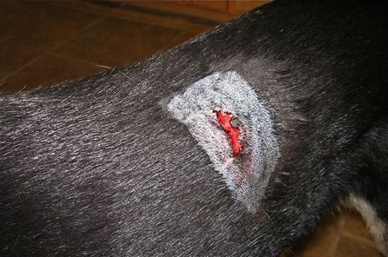
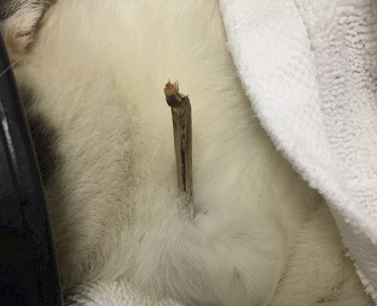
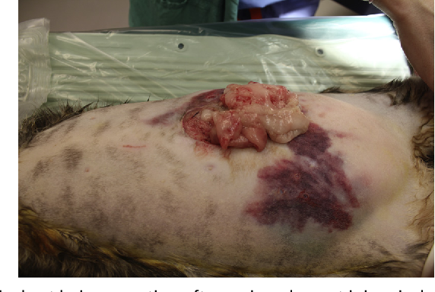
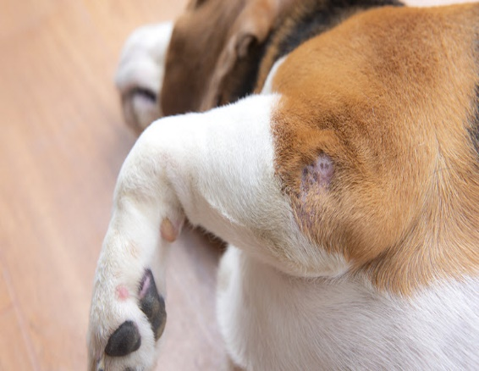
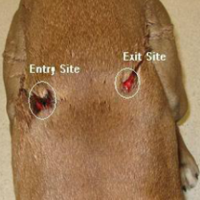
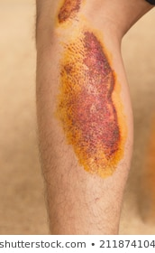
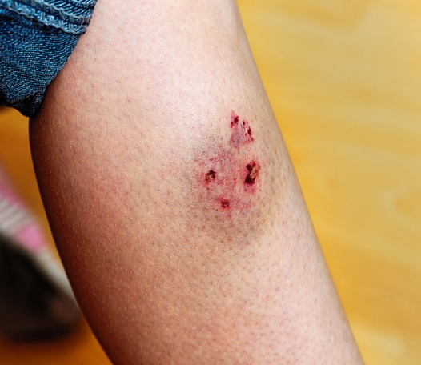
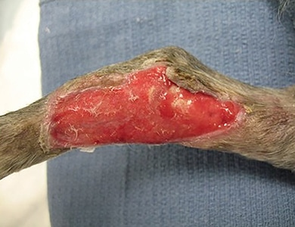
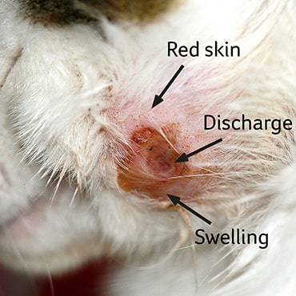
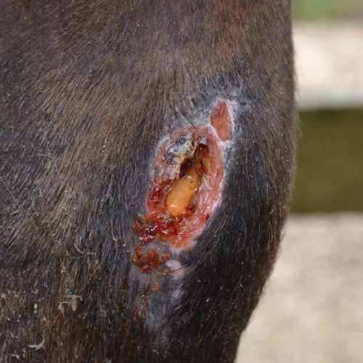
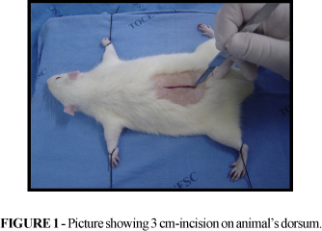
Open wounds
Incised wound
Penetrating
Lacerated wound
perforating
Bite wound
granulating
Punctured wound
Gunshot wound
abrasion
Asceptic wound
Contaminated wound
Septic wound

Slide 12
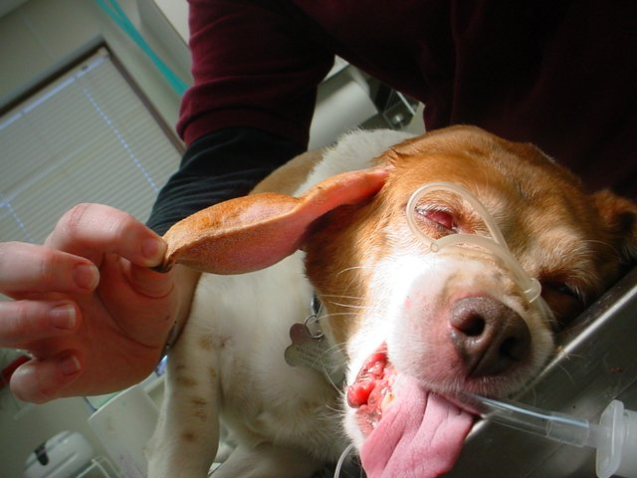
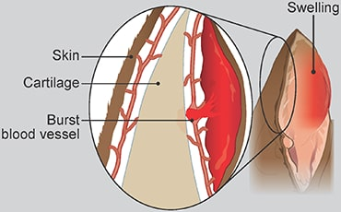
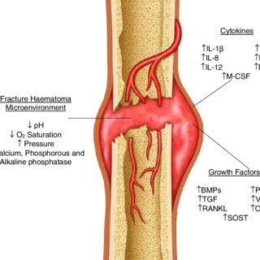
Close wound

Slide 13
SYMPTOMS OF WOUND
Localized pain and bleeding.
Gaping of the lips of wound.
Weakness, paralysis or a loss of function in a dependent portion.
Febrile disturbances in severe septic wound.
Neuritis extending along the course of the nerve involved in the wound.

Slide 14
FACTORS AFFECTING WOUND HEALING
LOCAL FACTORS:
Tissue vascularity
Infection
Topical medications
Lavage and dressings
Presence of foreign bodies
Obliteration of dead space
Ionizing radiation
Movement
Mutilation

Slide 15
Systemic factors
Advanced age
Nutrition
Protein
Glucose
Iron
Minerals like zinc, copper
Vitamins A and B complex
Vitamin C
Carbohydrates and fats

Slide 16
MEDICATION
Anti-inflammatory drugs
Chemotherapeutic agents
Anticoagulant drugs
Most NSAIDs lower resistance to infection and ultimately delay healing

Slide 17
SYSTEMIC DISEASES
malignancy, uncontrolled diabetes, renal and hepatic disturbances delay healing process.
Malignancy (by altering metabolism, producing chachexia, and minimizing inflammatory cell division.)
Uremia
diabetes

Slide 18
MANAGEMENT OF WOUNDS
Contusions: are treated with cold and astringent applications to minimize extravasation.
Haematomas: when small get absorbed other wise they may have to be opened and treated.
Open wounds: surgical or aseptic wound, contaminated and septic wound or infected wounds.

Slide 19
Surgical or aseptic wounds
Surgeon should avoid drying of the tissue, excessive trauma and haemorrhage
Prophylaxis against tetanus.
Dependent drainage should be provided if haemotoma or seroma formation is expected.
Suture should be supported upto healing time 8 -14 days
Antibiotics as a therapeutic or prophylactic measure.
Local application of Fly repellents – hot summer months.
The patient and the affected injured part should be kept at rest.

Slide 20
Contaminated wound
A fresh wound gets contaminated when it is more than 4 -5 days old.
The principal therapeutic strategies of the open and contaminated wound are to convert it into a clean closed wound.

Slide 21
SEPTIC WOUND OR INFECTED WOUND
Debridement
Lavage
Wound drainage
Antimicrobial therapy
Sterile protective bandaging

Slide 22
Thank you

