Slide 1

Veterinary Laboratory Diagnosis
VLD-411
Sample Collection
Dr. Anil Gattani
Veterinary Biochemistry

Slide 2
Patient Preparation
Fasting requirements
Provocation tests : e.g. Glucose Tolerance Tests

Slide 3
General Specimen Collection and Handling Guidelines
Specimen Quality

Slide 4
Hemolysis
Autoimmune hemolytic anemia
Transfusion reaction
Improper specimen collection
Specimen processing, or specimen transport
Centrifuge speed or time
Needle gauge size
Exposure to excessive heat or cold

Slide 5
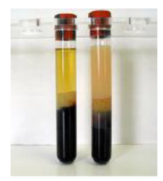
Inadequate Draw/Quantity Not Sufficient (QNS)
Clotted Specimens
Lipemia
Poor Preservation/Old specimens

Slide 6
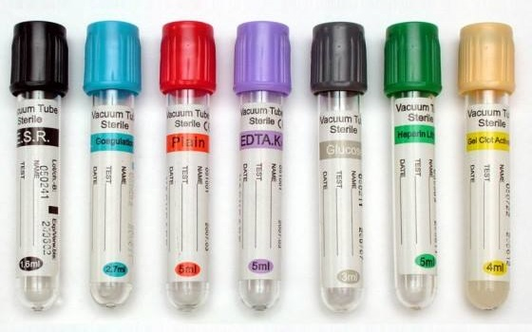
Order of Blood Draw
Clear (Discard) Tube
Blood Cultures
Light Blue (Sodium Citrate)
Red/ Dark Blue (Clot Activator)
Green (Heparin/Lithium)
Lavender (Purple/EDTA)
Pink (K2EDTA)
Grey (Potassium oxalate/sodium fluoride)

Slide 7
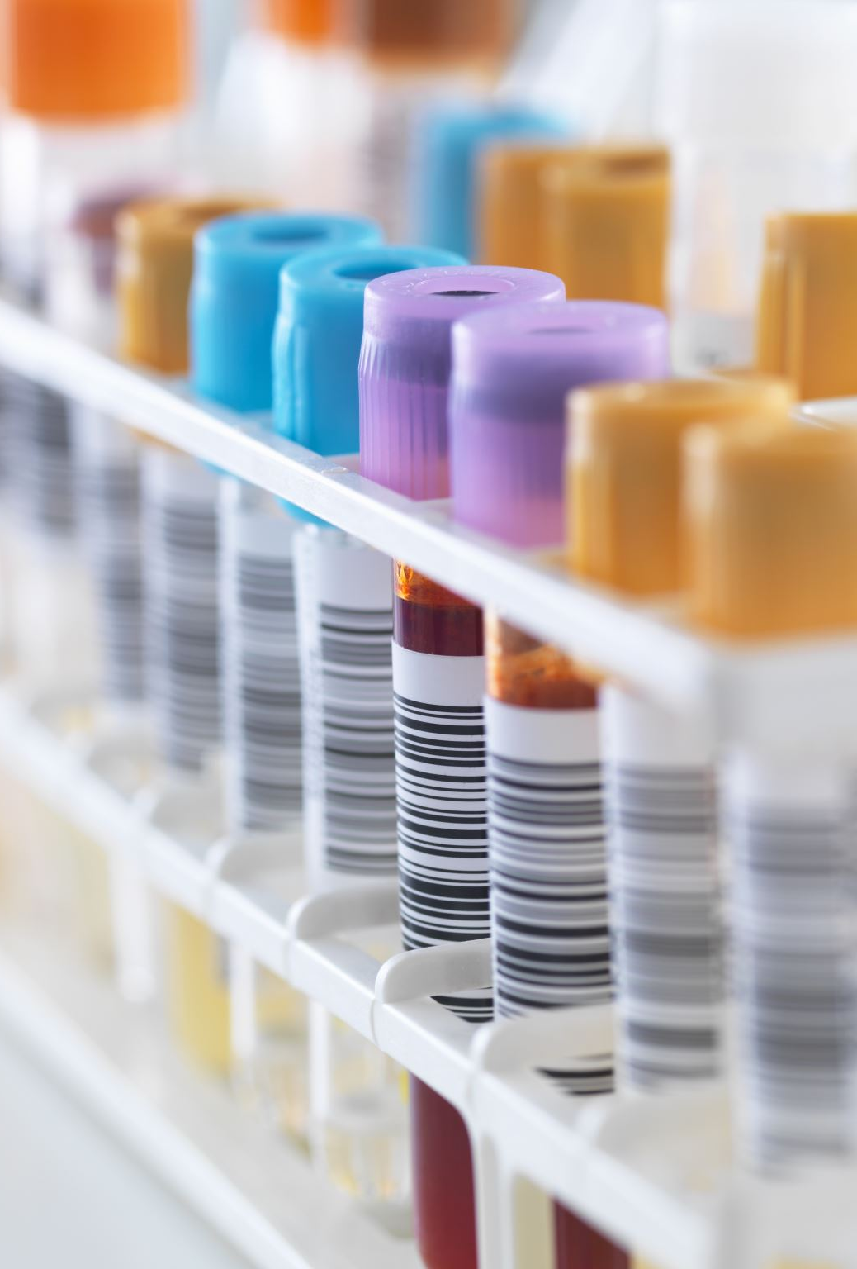
Specimen Rejection
Specimen is not accurately and properly identified.
Specimens that are received in an incorrect container, collected improperly.
Specimens collected in expired collection media, tube or kit.
Insufficient specimen volume received to perform testing.
They are not accompanied by a requisition/order.
The quality/integrity of the sample is suboptimal or too old to yield accurate results.

