Slide 1
General Surgery
.

Slide 2
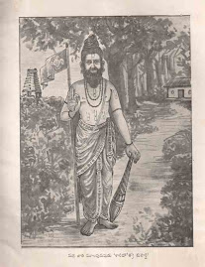
Historical perspective
Salihotra and palakapya were the greatest of ancient India veterinarians
Salihotra treated horses & Palapya treated Elephants
According to Vedas, medical science arose from veterinary science.
The earliest work on medicine is known as ‘Atharvaveda’ which existed in 1,000 B.C.
Salihotra

Slide 3
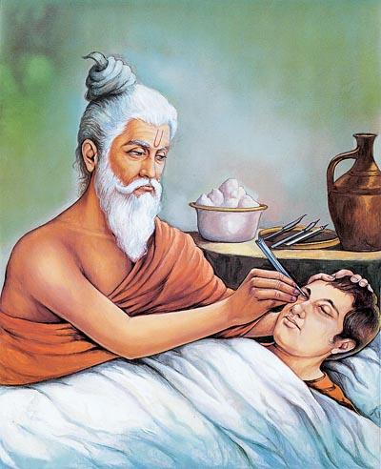
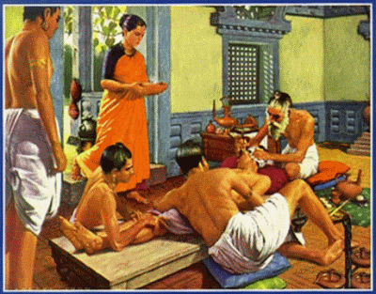
Cont.
Susruta Samhita is the earliest known work dealing with medical science (especially surgery )
Susruta Samhita contains details of discourses by the holy sage Dhanvantri to his disciples Susruta and his colleagues
Surgery was given a place of honour in Susruta Samhita .
Susruta Samhita is written in Sanskrit and divided into 120 chapters, distributed in 5 divisions.

Slide 4
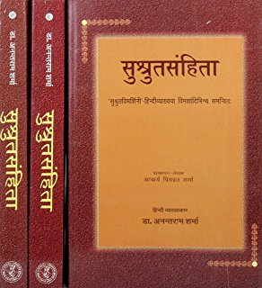
Cont.
A large part of Susruta Samhita is devoted to surgery and it includes :-
Preliminary preparations for surgery,
Various types of instruments and their care
Teaching of surgical methods
Dressing and bandaging of wounds
Symptoms to predict prognosis of the surgical case

Slide 5
Special Surgical methods include
Application of cautery,
Removal of foreign bodies and obstructions,
Surgical grafting (specially of ears lobes),
Dislocations,
Piles and fistula.
Methods of suturing and nurse have been dealt with in detail.
A special emphasis on the dissection of a dead body of the human body is given

Slide 6
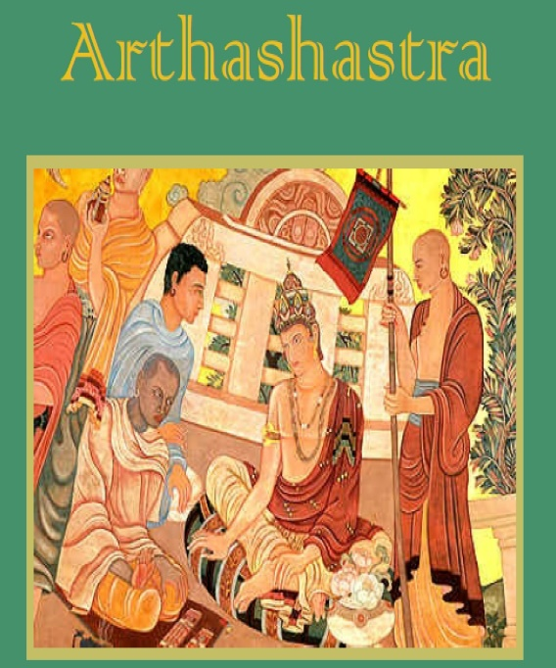
Cont.
The first highly organized department of livestock in indian history has been given by kautalya in his ‘Arthashastra’ under king Chandragupt maurya (322-298 B.C.)
The Great Emperor Ashoka developed organized veterinary hospitals throughout his kingdom (273-232 B.C.)
Most ancient texts on medical & veterinary sciences were lost or destroyed in the war
One of the reasons for non –availability of ancient knowledge was the known secretive nature of the Indian scholars.

Slide 7
Cont.
Oral discourse were the common ways of knowledge propagation
In the 16th century, veterinary schools were established in spain to grant licences for veterinary practice but schools did not last long
Major achievements which made modern surgery possible include
The development of anaesthesia,
Microbiology,
Discovery of antibiotics and
Methods of blood transfusion.
These achievement were made in about 100 years beginning from 1846.

Slide 8
Cont.
The first public demonstration of Ether anaesthsia was made in 1846 by W.T.G. Morten
C.P. Jackson, a Boston physician, appears to be the first to apply ether anaesthesia extensively in animals in 1853
Joseph Lister introduced the theory and practice of asepsis.
In 1875, One reported intravenous anaesthesia using chloral hydrate and three years later Humbert used in a horse.
Pean in 1867 popularized a forceps for controlling haemorrhage.
W. S. Halsted in 1894 propagated maintaining a dry operative field and introduced the use of rubber gloves.

Slide 9
Cont.
Sterilisation by boiling was introduced by Von Bergmann in 1886.
Discovery of X-rays was done by Roentgen in 1895
In 1898, August Bier of Germany produced true spinal anaesthesia in animals
In 1901,Cuille and Sendrail of Franc induced subarachnoid anaesthesia in horse, cattle and dogs.
R Eberlein of Germay, is considered as the father of veterinary radiology, elaborated the use of X-rays in veterinary practice during the period of 1897-1916.

Slide 10
Cont.
The concept of splints to correct over-riding fracture in dogs was adopted by Schroeder in 1933
Paralumabar anaesthesia was introduced in medical science by selheim in 1909, the technique was applied to cattle by Farquharson and Formston in 1940.
The Indian Society for Veterinary Surgery was formed in 1977 at Hisar.

Slide 11
INTRODUCTION
Surgery is an art and practice of treating injuries, deformities and other disorders by manual operations or instrumental appliances
In Latin, surgery is referred to as ‘chirurgia’
Greek synonym is ‘cheirourgia’ and the word cheir means “hand” and ergon “to work”

Slide 12
CLASSIFICATION OF SURGERY
Surgery can be classified according to:
Nature of surgery,
Region/system involved, and
Instruments/appliances used.

Slide 13
Nature Of Surgery
General surgery : carried out to restore the normal function of the body or a part without substituting or discarding any part of the body .It is also called Restorative surgery e.g. Rumenotomy
Extirpative surgery : involves the removal of a part e.g. Hysterectomy.
Plastic surgery : to restore disturbed function and includes reconstructive and cosmetic surgery

Slide 14
Cont.
Replacement surgery means replacement of a diseases part by either a living tissue (vascular graft), non-living material (heart valve) or dead tissue tissue (corneal or bone graft).
Physiological surgery involves alterations in the normal physiological mechanisms for the benefit of the whole body e.g. vascular shunts.
Surgery done to arrive at a diagnosis is called Diagnostic surgery (exploratory laparotomy, biopsy, paracentesis).
Experimental surgery is done solely for the purpose of experiments e.g. making carotid loops.

Slide 15
Region/ System involved :
Specialize on a particular region or system e.g.
Thoracic surgery
Cardiovascular surgery,
Orthpaedic surgery,
Ophthalmic surgery neurosurgery,
Urogenital surgery.

Slide 16
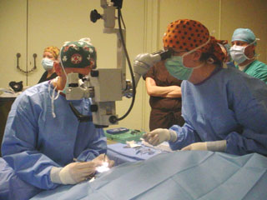
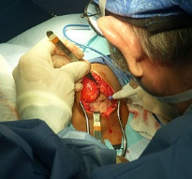
Instruments/Appliances used:
In Microsurgery, magnification facilities are used for specialized surgical procedures.
Cryosurgery involves controlled use of substances like liquid nitrogen which produces freezing temperatures to destroy abnormal tissues.
In Electrosurgery, electricity is converted to heat to incise a tissue.
In laser surgery laser beams are used to cut or destroy the diseased tissue.
Surgery in which high frequency waves are used to destroy a particular tissue or a substance is called as Ultrasonic surgery e.g. lithotripsy.
Microsurgery
Electrosurgery

Slide 17
Reasons for Surgery
To save the life of an animal
To prolong the life of an animal
To hasten recovery from an injury (wound suturing)
For elimination of disease process (extraction of tumour)
For cosmetic reasons (ear cropping)
For correcting deformities or malformations
To aid in diagnosis of a suspected pathological process (exploratory laparotomy)
For investigation in research work (Experimental surgery)

Slide 18
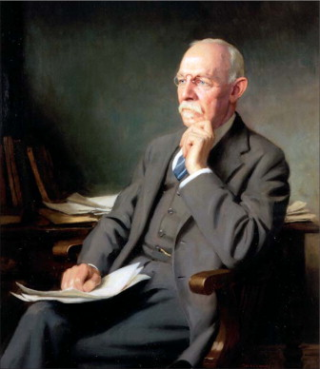
.
TENETS OF HALSTEAD
GENTLE HANDLING OF TISSUE
METICULOUS HAEMOSTASIS
PRESERVATION OF BLOOD SUPPLY
STRICT ASEPTIC TECHNIQUE
MINIMUM TENSION ON TISSUES
ACCURATE TISSUE APPOSITION
OBLITERATION OF DEADSPACE

