Slide 1
Practical No.3 : Special examination of Respiratory system
Unit 2
Dr. Pallav Shekhar
Assitant Professor

Slide 2
Objectives: To study the method of recording of respiration rate in animals
Procedure:
Examination of respiration is important in
diagnosing respiratory system diseases as well as
other systemic disorders. Rate, rhythm, type and depth
of respiration should be noted when assessing the
animal’s respiratory movements.
Rate is the number of respiratory cycles (inhalation, exhalation and rest) in a minute.
The rate is counted by noting either the inhalations or exhalations.

Slide 3
RESPIRATORY CYCLE

Slide 4
Caudal Boundary of Pulmonary Percussion Area (Intercostal Space).
Sl. No. | Animal | No. of ribs | At level of external angle of ileum | Middle Thorax | Ventral Border
1. | Horse | 18 | 16 | 11 | 6
2. | Cow | 13 | 11 | 9 | 5
3. | Sheep & goats | 13 | 11 | 7 | 6
4. | Pig | 14-15 | 11-12 | 8-9 | 4-5
5. | Dog & Cat | 13 | 11 | 9 | 6
6. | Rabbit | 12 | 10 | - | 7

Slide 5
Manifestation of Respiratory Insufficiency (Terminology for normal and abnormal lung and thoracic sounds).
 | Sound Heard | Term Replaced | Example | Present finding in patients (To be filled by the students)
i. Normal Lung Sound | Normal breath sound | Alveolar vesicular bronchial sound/tone
ii.Abnormal lung sound | i.Increased breath sound | - | Fever, exercise, high environmental temperature
 | ii.Decreased/absence of breath sound | - | Pneumothorax,
 | iii. Crackels | Moist rales | Interstitial pneumonia
 | Wheezes | Dry rales, Ronchi | CODP, Chronic stages of pneumonia
 | Pleuritic friction | - | Pleurisy
 | Stridors | - | DRT disease

Slide 6
ANATOMY OF NORMAL LUNGS

Slide 7
CHEST X-RAY

Slide 8
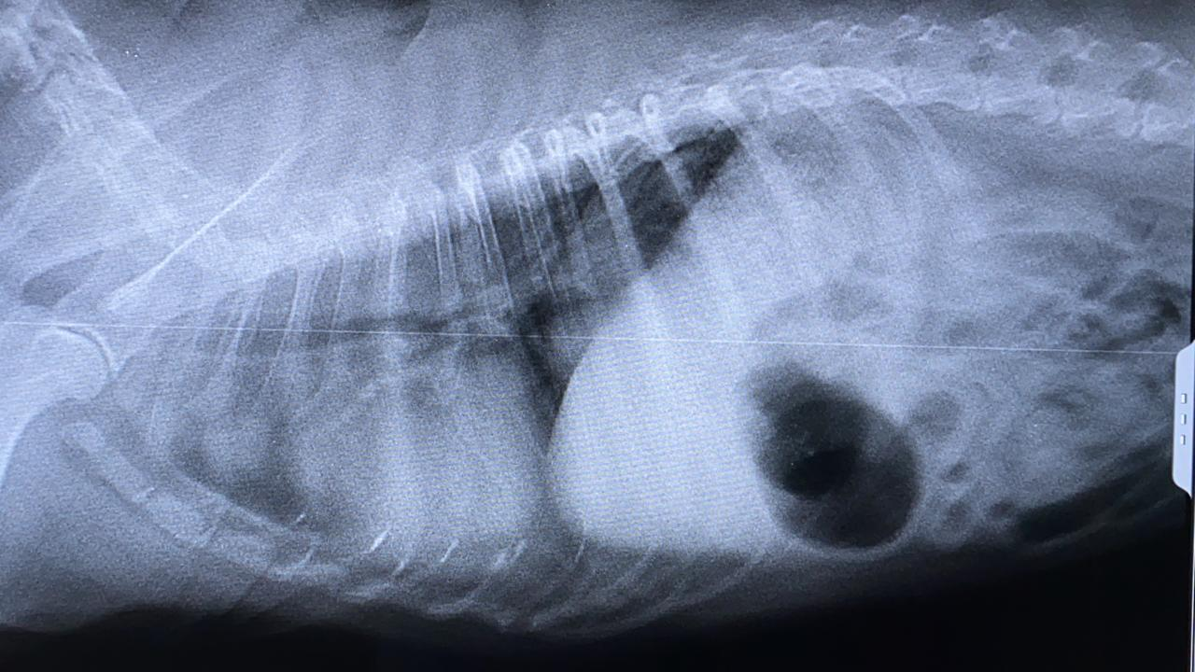
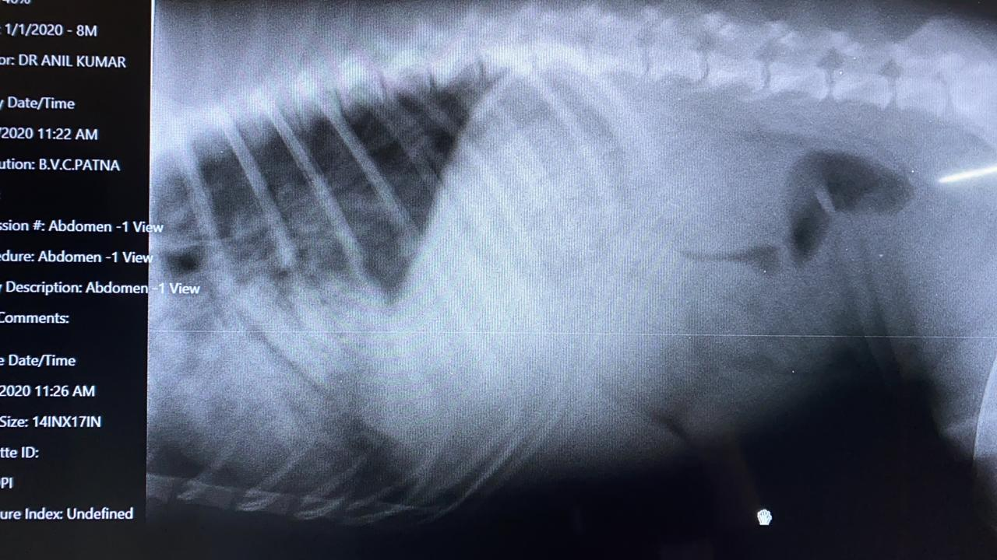
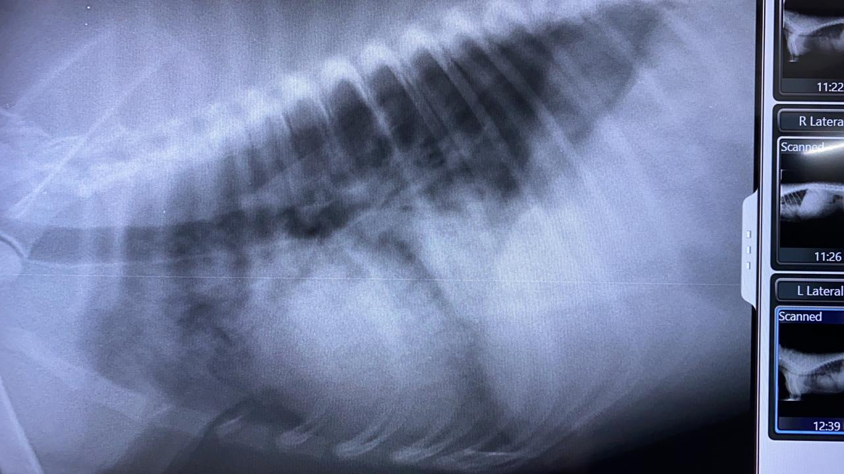

Slide 9
Respiratory rates in different animals (Respiration/ Min.):
Animal | Normal Respiration Rate/Min. | Present Respiration Rate/Min. (To be filled by the student) | Animal | Normal Respiration Rate/Min. | Present Respiration Rate/Min.(To be filled by the student).
Horse | 10-14 |  | Dogs | 15-30
Ox | 10-30 |  | Cats | 20-30
Yearling | 15-40 |  | Rabbit | 30-45
Sheep & Goat | 20-30 |  | Camel | 5-12
Pigs | 8-18

Slide 10
Note: Exercise and exposure to high atmospheric temperatures increase the respiratory rate as the animal’s body is trying to get rid of excessive heat. Pathological conditions that increase the respiratory rates are Fever, Various pulmonary diseases, Upper respiratory tract diseases, Cardiac diseases, Pleurisy or peritonitis, Anaemia etc.

Slide 11
Types of Respiration: On the basis of involvement of muscle in respiration
The muscles involved in respiration are abdominal muscles, intercostal muscles and the diaphragm.
1. Abdominal Respiration-
In abdominal respiration, the abdominal muscles predominate in creating the respiratory movement. This type of respiration is evident in cattle.

Slide 12
2. Costo-abdominal Respiration-
When both abdominal and costal muscles are similarly sharing in respiratory movements the type of respiration is termed costo-abdominal. This type of respiration is seen in horses.

Slide 13
3. Costal respirations-
The costal muscles are predominant in movement in costal respirations. This type of respiration is evident in dogs and cats.

Slide 14
The rhythm of respiration is altered in some diseased conditions (advanced renal and cardiac disease, severe toxaemia, menengitis).
The respiratory depth is also altered in some respiratory disorders (hydrothorax, pneumothorax).
On the basis of rhythm and depth it can be classified in following steps:-

Slide 15
1. Hyperpnoea
Hyperpnoea is the increased pulmonary ventilation (increased respiratory rate with or without increase in the amplitude or width of the movement.

Slide 16
2. Polypnoea
-Polypnoea is increased respiratory rate with reduction in the depth of movements.

Slide 17
3. Oligopnoea
Oligopnoea is reduced respiratory rate. This occasionally occurs in animals suffering from space-occupying lesions of the brain and uraemia.
The above mentioned condition comes under dyspnoea
Dyspnoea:
Difficulty in breathing due to diseased conditions is termed dyspnoea.
Acceleration of the rate of respiration without change in type or depth defines the simple dyspnoea.
It is often seen in fever, pneumonia, and pulmonary tuberculosis and in some cardiac affections.

Slide 18
OLIGOPNOEA/HYPOPNEA

Slide 19
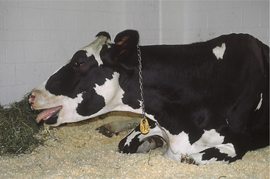
Laboured breathing is called aggravated dyspnoea.
Animals suffering from this type of dyspnoea show the following signs;
Widely distended nostrils,
Open mouth,
Extension of the head and neck
Adduction of the forelimbs.
Laboured breathing or aggravated dyspnoea- categorized into inspiratory, expiratory and mixed dyspnoea

Slide 20
Inspiratory dyspnoea- Observed in severe unilateral paralysis of the pharynx, paralysis or rupture of the diaphragm, advanced cases of pneumonia and bronchitis, stenosis or obstruction of the nasal passages.

Slide 21
Expiratory dyspnoea- seen when exhalation is made difficult.
Exaggerated movement of the abdominal muscles- Evident in this type of dyspnoea, as animals need more force to expel air from the lungs. This occurs in vesicular and interstitial emphysema and chronic bronchitis.

Slide 22
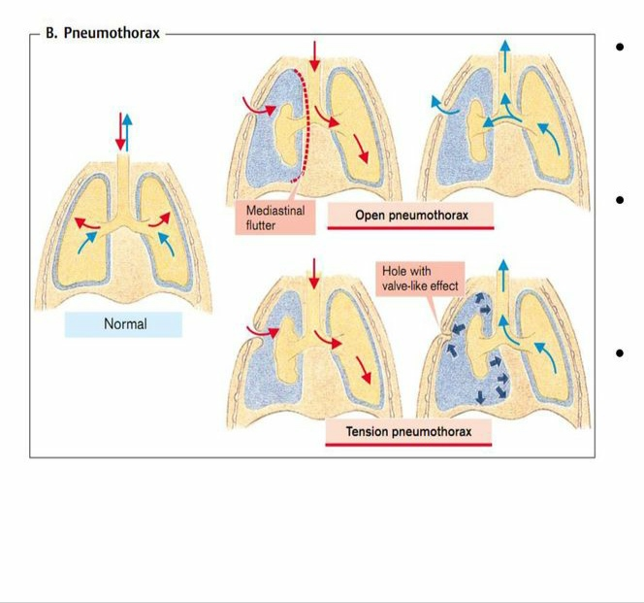
Mixed dyspnoea- Apparent when the respiratory rate is accelerated as well as difficulty encountered during inspiration and expiration. This occurs in all severe diseases of the respiratory tract (Pneumothorax and hydrothorax) as well as some infectious diseases.
PNEUMOTHORAX

Slide 23
PNEUMOTHORAX

Slide 24
PULSE OXIMETRY POSITION

Slide 25
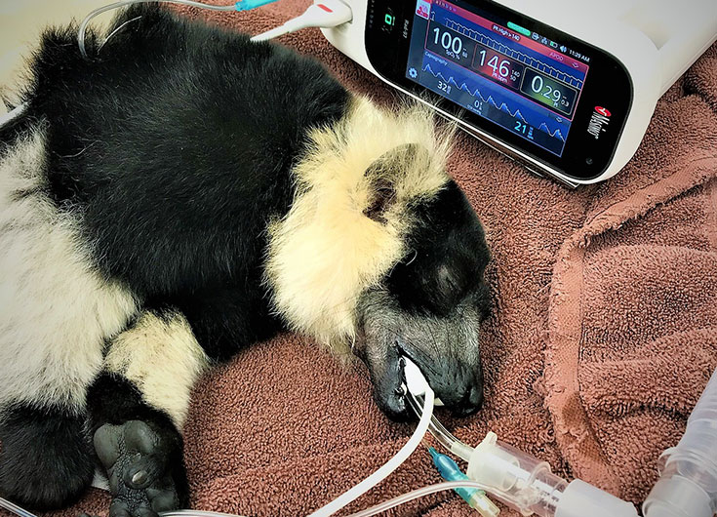
Pulse Oximeter

