Slide 1
Unit-I Hepatic evaluation of body functions
Clinical Physiology
Course No. – VPY- 607
Credit Hrs. – 2+1=3
Dr. Pramod Kumar
Asstt. Professor
Deptt. of Veterinary Physiology
BVC, Patna

Slide 2
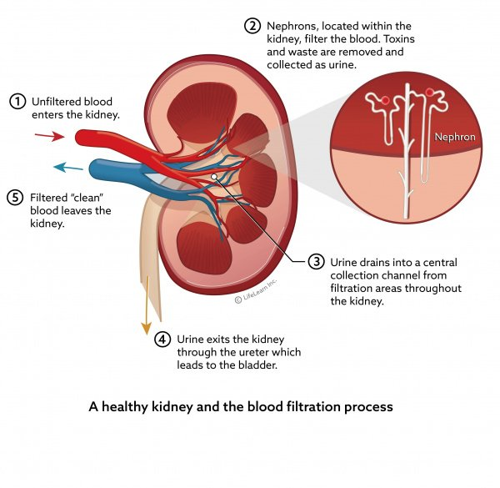
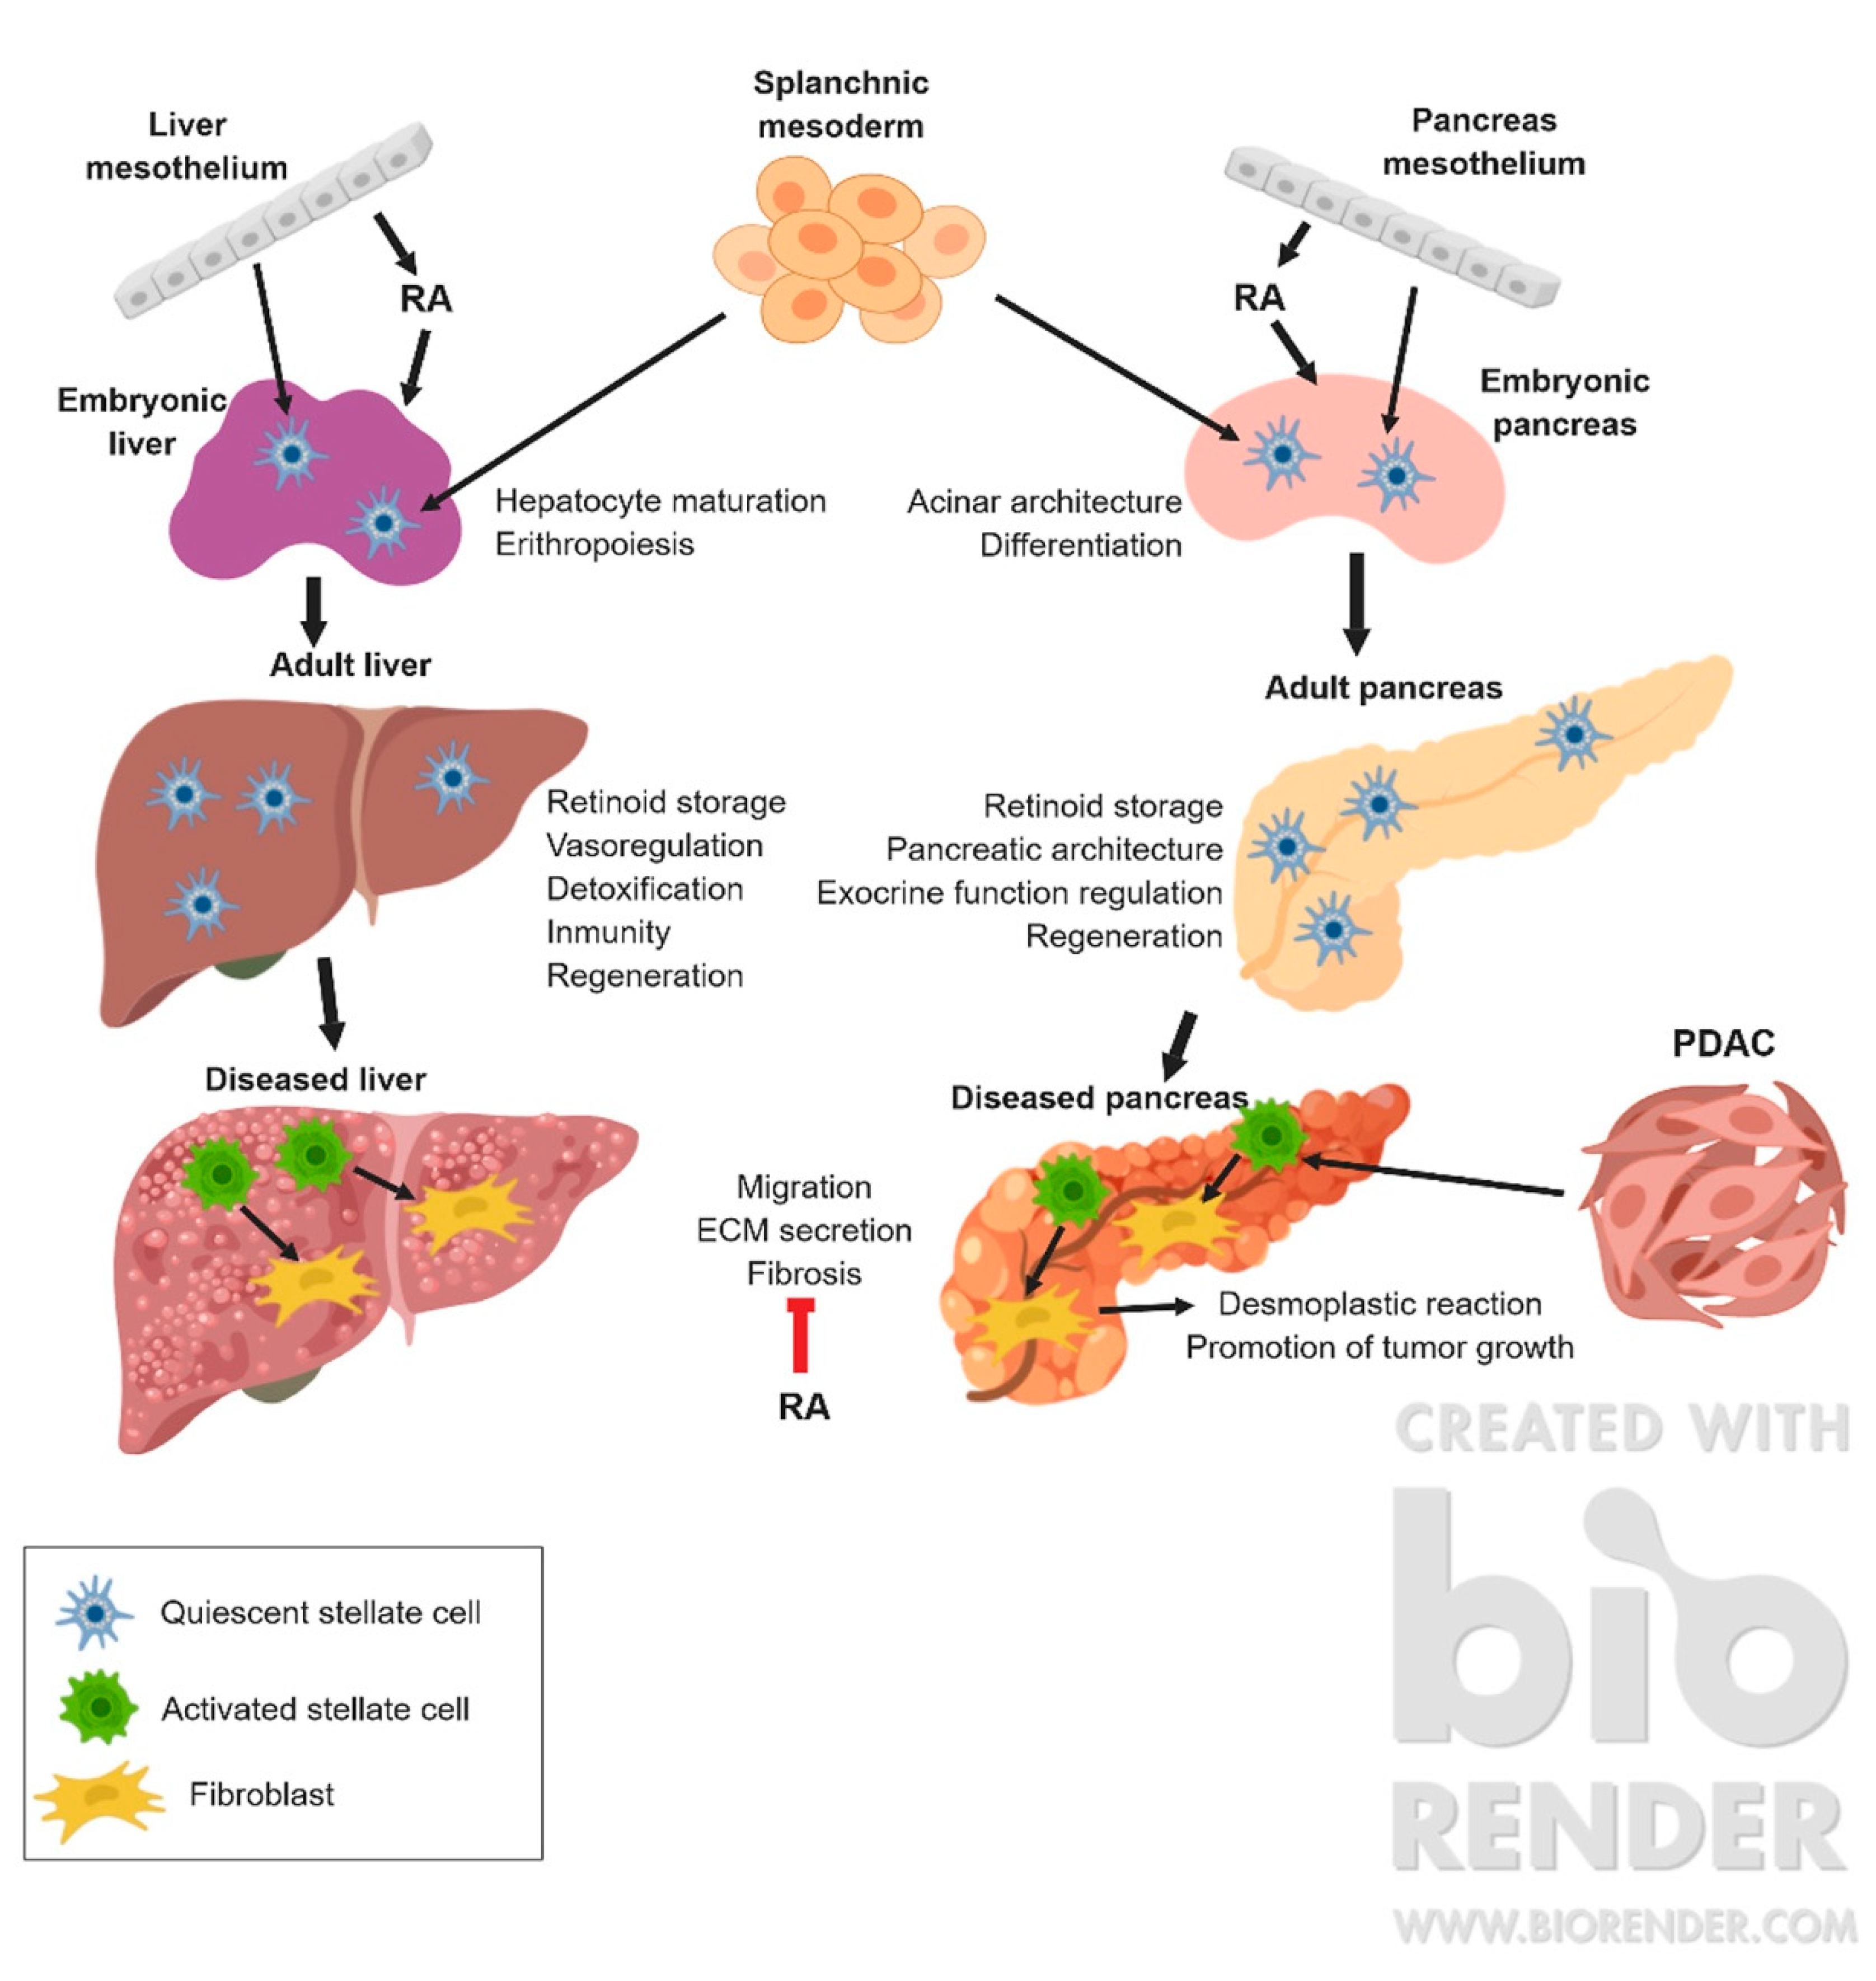

Slide 3
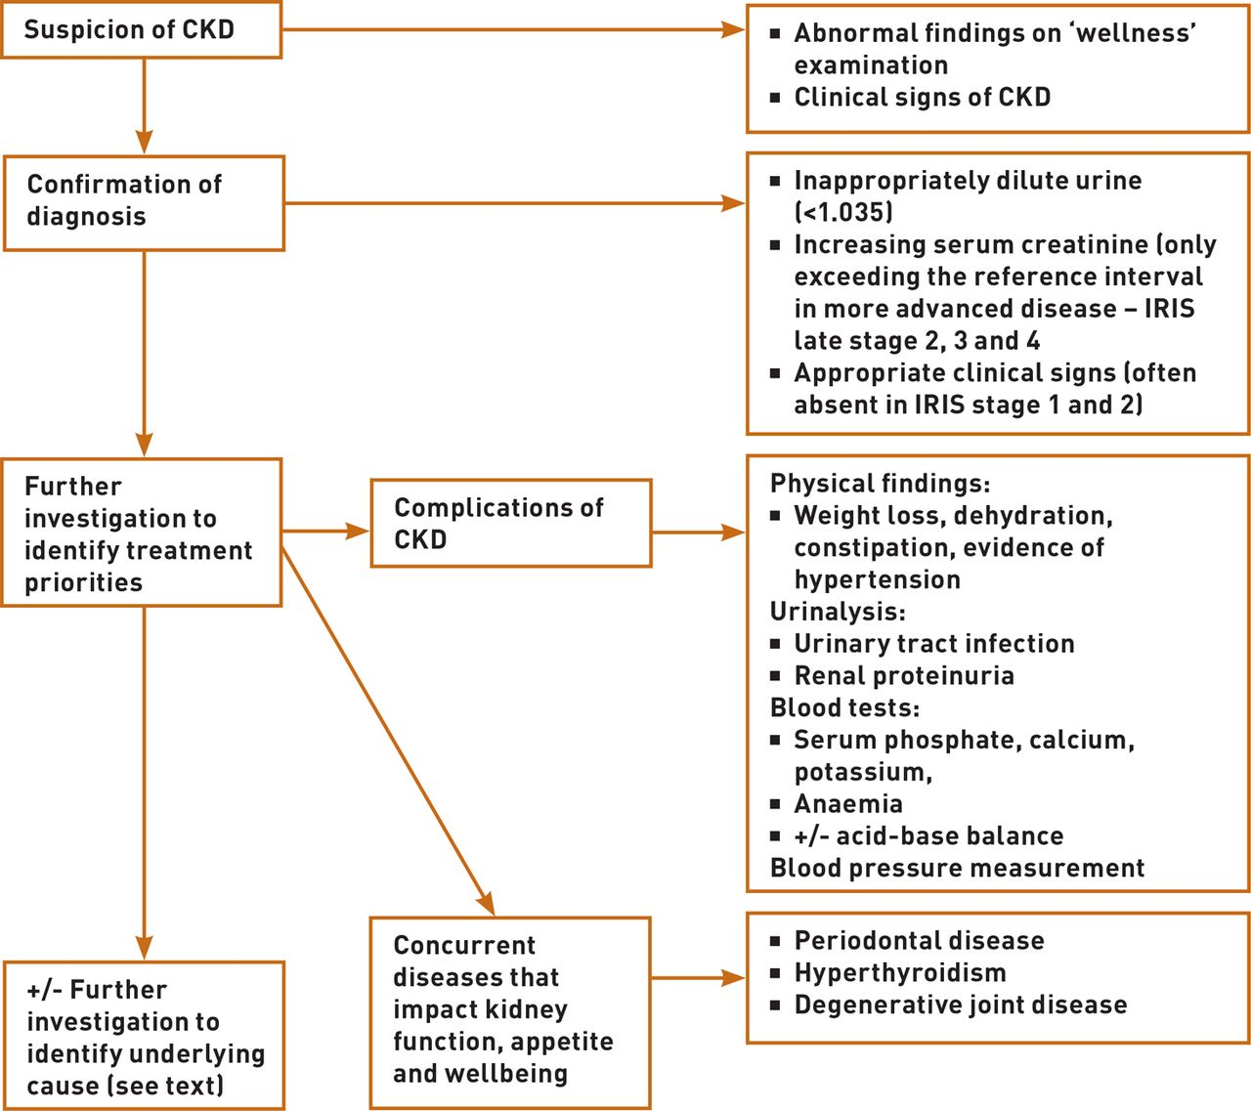

Slide 4
Hepatic disease is common in large animals. Increases in serum hepatic enzymes and total bile acid concentration may indicate hepatic dysfunction, insult, disease or failure. Although liver disease is especially common in horses and foals.
Diseases that frequently result in hepatic failure in horses include pyrrolizidine alkaloid toxicosis, hepatic lipidosis, suppurative cholangitis, cholelithiasis, and chronic active hepatitis. Obstructive disorders (biliary stones, right dorsal colon displacement, neoplasia, duodenal ulceration and stricture, hepatic torsion, portal vein thrombosis), aflatoxicosis, leukoencephalomalacia, pancreatic disease, clover poisoning, portal caval shunts, hepatic abscess, and perinatal herpesvirus 1 infections sporadically result in hepatic failure. Less frequently, hepatic failure is associated with endotoxemia, steroid administration, inhalant anesthesia, systemic granulomatous disease, drug-induced amyloidosis, parasite damage, iron toxicity or after neonatal isoerythrolysis.

Slide 5
In ruminants, hepatobiliary disease is associated with hepatic lipidosis, hepatic abscesses, endotoxemia, pyrrolizidine alkaloid and other plant toxicoses, certain clostridial diseases, liver flukes, mycotoxicosis, and mineral toxicosis (copper, iron, zinc) or deficiency (cobalt). Vitamin E or selenium deficiency (hepatosis dietetica), aflatoxicosis, ascarid migration, bacterial hepatitis, and ingestion of toxic substances (eg, coal tar, cyanamide, blue-green algae, plants, gossypol) are associated with hepatic injury in swine.
Although the exact incidence of hepatic disease in camelids is Hepatic lipidosis (secondary more often than primary) and reportedly the most common liver disease in llamas and alpacas, occurring in both crias and adults. Bacterial cholangiohepatitis, adenoviral hepatitis and pneumonia, fungal hepatitis (coccidioidomycosis), toxic hepatopathy (copper), halothane-induced hepatic necrosis, hepatic neoplasia (lymphosarcoma, hemangiosarcoma, adenoma) and liver fluke infestation have also been reported in camelids.

Slide 6
The liver can respond to insult in only a limited number of ways. Fat droplets in the liver may be an early and often reversible change. Biliary hyperplasia is also reversible if the insult is removed early. Necrosis of hepatocytes indicates more recent damage. The dead cells are removed by an inflammatory process and replaced with either new hepatocytes or fibrosis. Unless the dysfunction is acute and hepatocellular regeneration is evident, prognosis for animals with liver failure is usually un-favorable. Early hepatic fibrosis may be reversible with prompt recognition and intervention. Chronic disease with extensive loss of hepatic parenchyma and fibrosis, especially with portal bridging, warrants a poor prognosis.

Slide 7
Clinical signs of hepatic disease may not be evident until >60%–80% of the liver parenchyma is non-functional or when hepatic dysfunction is secondary to disease in another organ system. Clinical signs may vary with the course of the disease, primary site of injury and specific cause. Onset of signs of hepatic encephalopathy and liver failure is often acute regardless of whether the hepatic disease process is acute or chronic. Clinical signs and severity of hepatic pathology reflect the degree of compromise of one or more of the liver’s vital functions, including blood glucose regulation; fat metabolism; production of clotting factors, albumin, fibrinogen, nonessential amino acids, and plasma proteins; bile formation and excretion; bilirubin and cholesterol metabolism; conversion of ammonia to urea; polypeptide and steroid hormone metabolism; synthesis of 25-hydroxycholecalciferol and metabolism and/or detoxification of many drugs and toxins.

Slide 8
Icterus, weight loss or abnormal behaviour are common in horses with liver disease and hepatic failure. CNS signs are often the initial and predominant sign in horses with acute hepatic failure, whereas weight loss is a prominent sign in most horses with chronic liver disease and failure. Photosensitization and less commonly, bilateral pharyngeal paralysis, causing inspiratory stridor, diarrhoea or constipation may be present. Affected cattle usually show in-appetence, decreased milk production and weight loss. Tenesmus and ascites are seen in cattle but are not common in affected horses. Weight loss may be the only sign associated with liver abscesses. Icterus, which is most pronounced when the biliary system is diseased is also common in horses with acute liver failure. It is more variably present in horses with chronic liver failure or in ruminants. Fasting hyperbilirubinemia is a more common cause of icterus in horses and is not associated with hepatic disease. Occasionally, persistent hyperbilirubinemia may be seen in healthy horses without evidence of hemolysis or hepatic disease. In ruminants, icterus is more commonly due to hemolysis and primarily involves increases in indirect bilirubin. Hyperbilirubinemia caused by obstructive biliary conditions is rare in goats and sheep.

Slide 9
Hepatic encephalopathy is associated with behavioral changes in horses, ruminants and swine. The severity of hepatic encephalopathy often reflects the degree of hepatic failure but does not differentiate between acute or chronic liver failure. Signs of hepatic encephalopathy range from nonspecific depression and lethargy to head pressing, circling, aimless walking, dysphagia, ataxia, dysmetria, persistent yawning, pica, increased friendliness, aggressiveness, stupor, seizures, or coma. Pharyngeal or laryngeal collapse with loud, stertorous inspiratory noises and dyspnea occurs in some cases of hepatic failure, especially in ponies. The pathogenesis of hepatic encephalopathy is unknown, but proposed theories include ammonia as a neurotoxin, alterations in monoamine neurotransmission (serotonin, tryptophan) or catecholamine neurotransmitters, imbalance between aromatic and short branch chain amino acids resulting in increased inhibitory neurotransmitters (γ-aminobutyric acid, l-glutamate), neuro-inhibition due to increased cerebral levels of endogenous benzodiazepine-like substances, increased permeability of the blood-brain barrier, and impaired CNS energy metabolism. Although the signs can be dramatic, hepatic encephalopathy is potentially reversible if the underlying hepatic disease can be resolved.

Slide 10
Photosensitization, which may be seen secondary to acute or chronic liver failure, must be differentiated from primary photosensitization. Hepatogenous photosensitization develops when compromised hepatic function results in phylloerythrin, a photodynamic metabolite of chlorophyll, entering the skin. Phylloerythrin in the skin reacts with ultraviolet light and releases energy, causing inflammation and skin damage.
Signs of photosensitization are varied but include uneasiness, pain, pruritus, mild to severe dermatitis with erythema, extensive subcutaneous edema, skin ulceration, sloughing of skin and ophthalmia with lacrimation, photophobia, and corneal cloudiness. Dermatitis and edema are particularly evident on non-pigmented, light-colored or hairless areas of the body and areas exposed to sun. Muco-cutaneous junctions and patches of white hair are the most common sites of photosensitization in cattle. Occasionally, the underside of the tongue may be affected. Blindness, pyoderma, loss of condition and occasionally death are possible sequelae. Pruritus may result from photosensitization or from deposition of bile salts in the skin secondary to alterations in hepatic excretion.

Slide 11
Diarrhea or constipation may be seen in animals with hepatic disease. Diarrhea is more commonly seen in cattle than in horses with chronic liver disease or in animals with chronic fascioliasis and hepatotoxic plant poisonings. Ponies and horses with hyperlipemia and hepatic failure may develop diarrhea, laminitis, and ventral edema. Some animals with liver disease have alternating diarrhea and constipation. Horses with liver failure and hepatic encephalopathy frequently develop colonic impaction due to decreased water intake. Constipation is characteristic of Lantana poisoning in goats and other ruminants.

Slide 12
Recurrent colic, intermittent fever, icterus, weight loss, and hepatic encephalopathy may be seen in horses with choleliths that obstruct the common bile duct. Infectious or inflammatory hepatic disease or failure of the liver to prevent endotoxin from gaining access to the systemic circulation may also result in intermittent fever and colic. Abdominal pain, due to pressure on the liver capsule from parenchymal swelling, often is seen in animals with acute diffuse hepatitis or trauma to the capsule itself. Affected animals stand with an arched back, are reluctant to move, or show signs of colic. In ruminants, pain may be localized to the liver by palpation over the anterior ventrolateral aspect of the abdomen or the last few ribs on the right side. Tenesmus followed by rectal prolapse is seen in some ruminants with liver disease. It may be associated with diarrhea, hepatic encephalopathy, or edema of the bowel from portal hypertension.

Slide 13
Hypoalbuminemia is not as frequently associated with liver disease in horses as previously thought. Due to the long half-life (19–20 days in horses, 16 days in cows) and liver reserve for albumin production, hypoalbuminemia is usually a very late event in the disease process. Serum total protein concentrations may be normal or increased because of an increase in β-globulins in horses with liver disease. Hypoalbuminemia and hypoproteinemia most commonly develop in chronic liver disease and they are common findings in llamas with liver disease. Generalized ascites or dependent edema may result. Ascites is related to portal hypertension caused by venous blockage and increased hydrostatic pressure and to protein leakage into the peritoneal cavity. The abdominal fluid present with liver disease usually is a modified transudate. Hypoalbuminemia can aggravate the ascites, but if it is seen alone, it more likely will cause inter-mandibular, brisket or ventral edema. Ascites is difficult to appreciate in horses and adult cattle unless it is extensive. Ascites is a common finding in calves with liver cirrhosis.

Slide 14
Anemia may be seen in animals with liver dysfunction due to parasitic diseases, chronic copper toxicity, some plant poisonings or chronic inflammatory disease. Anemia in acute fasciolosis results from severe hemorrhage into the peritoneal cavity as the larvae penetrate the liver capsule. Trauma and feeding activity of adult flukes within the bile ducts cause anemia and hypoproteinemia in animals with chronic fasciolosis. Chronic inflammatory disease may cause anemia without accompanying hypoproteinemia.
Clinical signs of severe or terminal hepatic failure include coagulopathies and hemorrhage due to decreased production of clotting factors by the liver and possibly increased utilization in septic or inflammatory processes. A prolonged prothrombin time is usually seen first because factor VII has the shortest plasma half-life. Horses may develop a terminal hemolytic crisis caused by increased RBC fragility. This has not been reported in ruminants.

Slide 15
Fecal color rarely changes in adult herbivores with liver disease. In young ruminants and monogastric animals, cholestasis may result in lighter color feces being passed because of loss of stercobilin, a metabolite of bilirubin.
Liver disease should always be considered when nonspecific clinical signs such as depression, weight loss, intermittent fever and recurrent colic are present without an apparent cause. Differentiation between acute and chronic hepatitis or failure based on the duration of clinical signs before presentation may be misleading because the disease process is often advanced before clinical signs are evident. Early vague signs of depression and decreased appetite may be overlooked. Liver biopsy to determine the type of pathology, degree of hepatic fibrosis present and the regenerative capabilities of the liver parenchyma is necessary to develop a treatment plan and give an accurate prognosis.

