Slide 1
Averages or measures of central tendency
The inherent inability of the human mind to grasp in its entirety a large body of data which compel us to seek relatively few constants that will adequately describe the data.
The large number of big figures are not only confusing to mind but also difficult to analyse.
In order to reduce the complexity of data and to make them comparable, it is essential that the various phenomena which are compared should reduced to one figure each.
Example marks of 200 students of two university are compared based two series of data (marks).
It would be imposable to arrive at any conclusion. It would be easy to compare both series of marks if they are represented by one figure.

Slide 2
Contd…
It is obvious that one figure of each series will fall in middle of lowest and maximum value of series.
Around which most of figures are cluster. Such figures are called as measures of central tendency or averages.
The average represents a whole series and as such its value always lies between the minimum and maximum value, generally.
It is located in the centre or middle of the distribution.
This measure of central tendency is a single value which represents a whole series and is supposed to contain major characterise.

Slide 3
Requites for central tendency
It should be rigidly defined.
It should be easy to understand and calculate.
It should be based on all observation.
It should be suitable for further mathematical treatment.
It should be affected as little as possible by random of sampling.
It should not be affected by extreme observation.

Slide 4
Various measures of central tendency
Arithmetic mean
Median
Mode
Geometric mean
Harmonic mean

Slide 5
Arithmetic Mean
It is the sum of all the observations of data under study divided by their total number of observation.
$\overline{X} =$ $\frac{X_{1} + X_{2}+…+X_{n}}{n}= \frac{\sum{X}}{n}$
For frequency distribution
$\overline{X}=\frac{\sum{f}X}{N}$
In case of frequency distributions
$\frac{X = X1 X2 X3……. Xn}{f = f1 f2 f3……..fn}$
X = $\frac{\sum{fX}}{\sum{f}}= \frac{EfX}{N}$

Slide 6
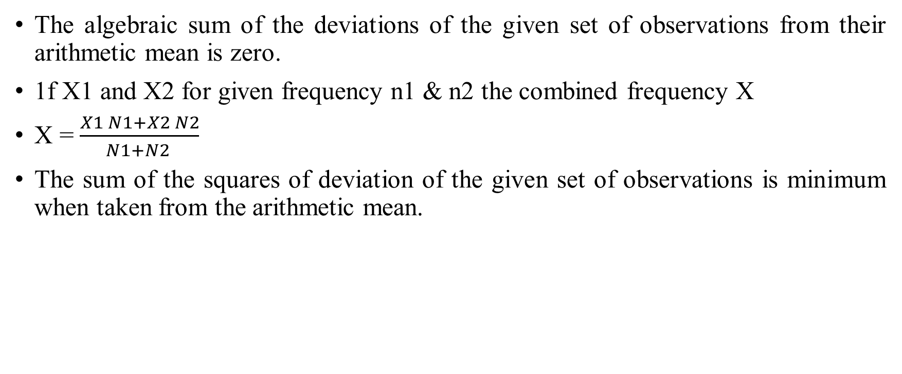
Properties of AM –
The algebraic sum of the deviations of the given set of observations from their arithmetic mean is zero.
1f X1 and X2 for given frequency n1 & n2 the combined frequency X
X = $\frac{X1 N1+X2 N2}{N1+N2 }$
The sum of the squares of deviation of the given set of observations is minimum when taken from the arithmetic mean.

Slide 7
Merits of AM
It is rigidly defined
It is easy to calculate and understand
It is based on all the observations
It is suitable for mathematical treatment
Among all averages it is least of affected by fluctuating / random sampling.

Slide 8
Demerits
It is much affected by extreme values
It cannot be used for open end classes
It cannot be determined by inspection nor can it be located graphically.
It cannot be used for qualitative types of data, for which median is used.
Am cannot be obtained for missing values.
Am is not measure of location for extreme skewed distribution.

Slide 9

Weighted mean
X_{w} = $\frac{W1X1+W2X2……….. +WnXn}{W1+W2+…………………..+Wn }$ = $\frac{\sum{WX}}{\sum{W} }$

Slide 10
Thank You

