Slide 1
ANIMAL GENETICS & BREEDING UNIT – I Biostatistics & Computer Application Lecture – 7
Chi-square Test of Significance
Dr K G Mandal Department of Animal Genetics & Breeding Bihar Veterinary College, Patna Bihar Animal Sciences University, Patna

Slide 2
Chi-square (χ²) test of significance
Chi-square (χ²) test of significance was designed by Karl Pearson (1899).
This test is applied to test the hypothesis when observations are expressed only in frequency.
Chi-square is the sum of the ratio of square deviation or differences between observed and expected frequencies to the expected frequency.
χ² = ∑$\frac{\left(Oi −Ei\right)2}{Ei}$
= $\frac{\left(O1 −E1\right)2}{E1}$ + $\frac{\left(O2 −E2\right)2}{E2}$ + $\frac{\left(O3 −E3\right)2}{E3}$ + ………+ $\frac{\left(On −En\right)2}{En}$
Where, Oi = observed frequency in the ith cell
Ei = Expected frequency in the corresponding cell
i = 1,2,3,…….n

Slide 3
It measures the departure of the observed frequencies from the expected frequencies.
Level of significance: Generally 5% and 1% level of significance are used where there are risk of 5% and 1%.
Level of significance is the level of possible error that we may commit in our conclusion or inferences in the testing of hypothesis.
Use of X² test: Chi-square test is used :-
i.) to test the Goodness of fit
ii) to test the Independency in contingency table
iii) to test the Homogeneity of variances
iv) Detection of linkage in genetics

Slide 4
Test procedure or steps involved :
i) Formation of hypothesis i.e., H_{O} & H_{A}
ii) Calculation of X²
iii)Deciding the degrees of freedom (df)
iv)Tabulated value of X² to be obtained from X² distribution table for the corresponding degrees of freedom and level of significance.

Slide 5
v) Comparisons and conclusions :
(a) If calculated value of X² is greater than the tabulated value, the difference between observed and expected frequencies are significant.
Therefore, null hypothesis may be rejected and alternate hypothesis may not be rejected.
(b) If calculated value of X² is not greater than the tabulated value of X² for the corresponding degrees of freedom and level of significance, the difference between observed and expected frequencies are not significant.
Therefore, null hypothesis may not be rejected and alternate hypothesis may be rejected.

Slide 6
Types of chi-square test:
Following two chi-square tests are most commonly used.
1. Chi-square test of goodness of fit
2. Chi-square test of independency in contingency table
(i) in 2x2 contingency table
(ii) in rxc contingency table

Slide 7
Chi-square test of goodness of fit:
This test is conducted when experimental observations fall under the influence of one factor or effect. E.g. sex ratio, blood groups, Mendelian classical phenotypic or genotypic ratios etc.
Degrees of freedom (df) : In chi-square test of goodness of fit the df is N-1. Where N is the total number of class and 1 is the number of restriction imposed.
Problem 1. Out of 250 calves born in a cattle farm of Sahiwal breed, 165 were females. Test whether these observations do agree with the concept of sex ratio to be 1:1.

Slide 8
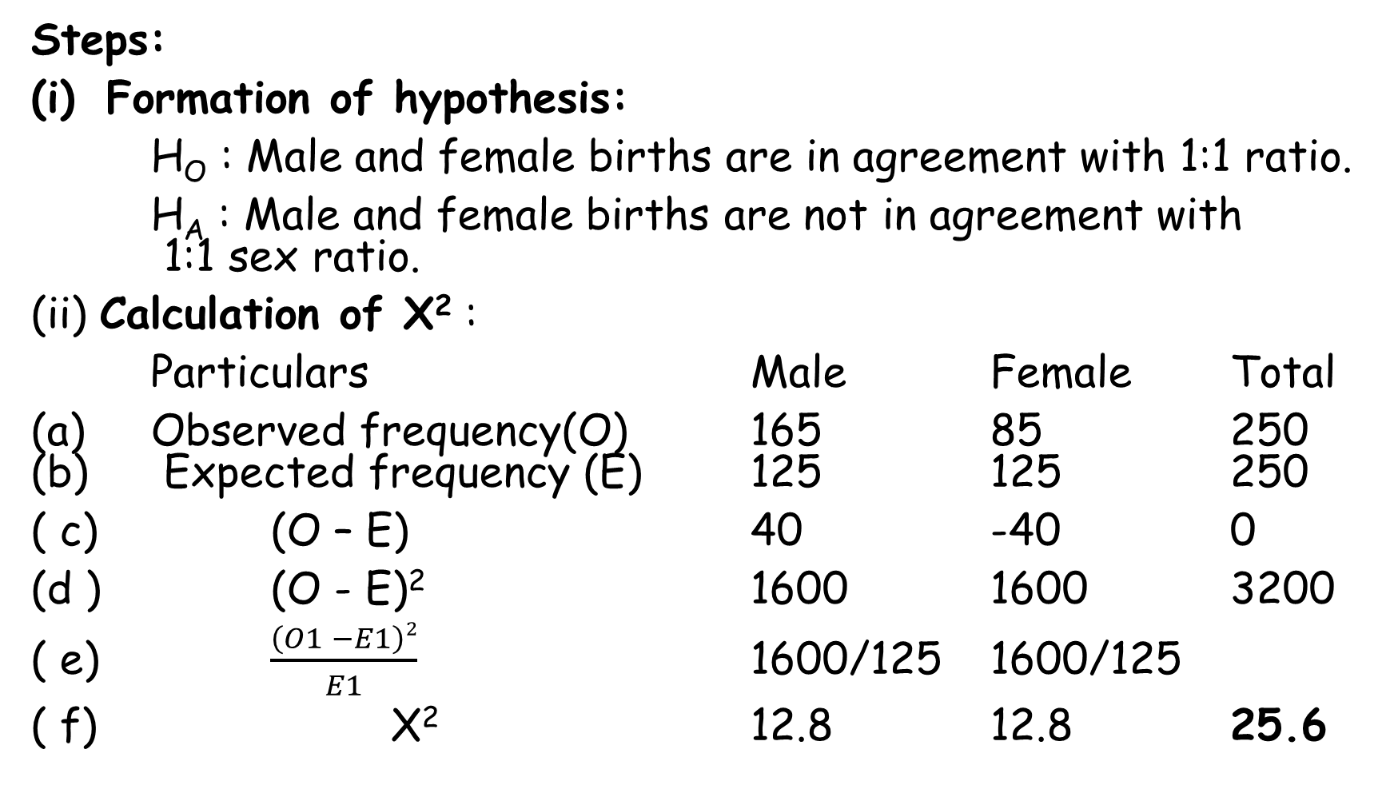
Steps:
Formation of hypothesis:
H_{O} : Male and female births are in agreement with 1:1 ratio.
H_{A} : Male and female births are not in agreement with 1:1 sex ratio.
(ii) Calculation of X² :
Particulars Male Female Total
(a) Observed frequency(O) 165 85 250 (b) Expected frequency (E) 125 125 250
( c) (O – E) 40 -40 0
(d ) (O - E)² 1600 1600 3200
( e) $\frac{\left(O1 −E1\right)2}{E1}$ 1600/125 1600/125
( f) X² 12.8 12.8 25.6

Slide 9
(iii) Decision of d.f. and tabulated value of X² :
(a) As there are only 2 classes or levels of the effect of observations i.e., Male & Female, so there is only one independent class. Therefore, d.f. for X² test will be 2-1 = 1.
(b) Tabulated value of X² distribution given for 1d.f. at 0.05 and 0.01 level of significance :
At 0.05 level of significance = 3.84
At 0.01 level of significance = 6.63

Slide 10
(iv) Comparison and conclusion :
(a)Since calculated value of X² (25.6) for 1 d.f. is greater than the tabulated value both at 0.05 and 0.01 level of significance , so the differences between observed and expected frequencies are significant.
(b)Therefore, H_{O} may be rejected and H_{A} may not be rejected.
( c)Hence, male and female births are not in the agreement of 1:1 sex ratio.

Slide 11
Exercise no. 1. Six hundred students were examined for their blood groups. Following results were observed. Test whether they fall under the ratio of 1:2:1.
( Given tabulated value of X² for 2df at 0.05 = 4.74 and at 0.01 = 6.63).
Particulars | Blood Groups |  |  | Total
 | M | MN | N
Observed Freq. | 160 | 300 | 140 | 600

Slide 12
Exercise No. 2. In a breeding experiment following F₂ populations were observed in four phenotypic classes. Determine how closely each of the following populations fits in the ratio of 9:3:3:1.
(Given tabulated value of X² for 2df at 0.05 = 4.74 and at 0.01 = 6.63).
Sl.No. | AB | Ab | aB | ab
1. | 315 | 108 | 101 | 32
2. | 75 | 35 | 41 | 9

Slide 13
2. Chi-square test of independency in contingency table:
This test is applied when the observations are made in the form of frequencies and not the sample estimates or population parameter like mean, variance or standard deviation.
This test is applied when the observations fall under the effect of two major factors.
This test gives the value of X² with the assumption that the factors are independent.
(a) Formation of hypothesis:
H_{O} : Factors are independent
H_{A} : They are not independent

Slide 14
(b) Presentation of data and calculation of expected frequency:
Contingency tables are popularly known as rxc contingency table where ‘r’ denotes the number of rows and ‘c’ denotes the number of columns depending upon the number of levels under each factor. Following are the different types of contingency table:
(i) 2 x 2 contingency table: with two major factors each having two levels or types. Presentation of data in 2 x 2 contingency table:
R1 + R2 = C1 + C2 = N
Expected frequency of a,b,c & d cells is to be calculated.
 |  | Factor A |  | Total
 | Levels | A1 | A2
Factor B | B1 | a | b | a + b =R1
 | B2 | c | d | c + d =R2
 | Total | a + c =C1 | b + d =C2 | a+b+c+d = N

Slide 15
Expected frequency will be calculated in the following way:
Expected freq. in cell A₁B₁ = $\frac{(a+b)(a+c)}{N}$ , in cell A₂B₁ = $\frac{(a+b)(b+d)}{N}$
in cell A₁B₂ = $\frac{(c+d)(a+c)}{N}$ , in cell A₂B₂ = $\frac{(c+d)(b+d)}{N}$ = $\frac{R2C2}{N}$
( c) Calculation of X² = ∑$\frac{\left(O −E\right)2}{E}$
(d) Degrees of freedom for rxc contingency table = (r-1)(c-1)
Where, r = number of rows & c = number of columns
In 2 x 2 contingency table, the df = (2-1)(2-1) = 1x1 =1
(e) Comparison and conclusion : If calculated value of X² is > tabulated value for the corresponding degrees of freedom and level of significance there is significant difference between observed and expected frequency. Hence, null hypothesis may be rejected and alternate hypothesis may not be rejected.

Slide 16
If calculated value of X² is > tabulated value for the corresponding degrees of freedom and level of significance there is significant difference between observed and expected frequency. Hence, null hypothesis may be rejected and alternate hypothesis may not be rejected.
If calculated value of X² is < tabulated value for the corresponding degrees of freedom and level of significance there is no significant difference between observed and expected frequency. Hence, null hypothesis may be accepted and alternate hypothesis may be rejected.

Slide 17
Problem 1. Out of two groups each with 15 animals, one group was vaccinated against a particular disease. 13 animals of vaccinated group and 7 animals of non-vaccinated group could survive after the vaccination. Test whether the vaccine was effective or not.
Answer:
Formation of hypothesis:
H_{O}: Vaccination is independent of the incidence of disease or vaccine has no effect on the disease or vaccine is not effective.
H_{A}: Vaccination is not independent of the incidence of the disease or vaccine may be effective against the disease.

Slide 18
(ii) Presentation of data in 2x2 contingency table:
(iii) Calculation of expected frequency in each cell:
Expected frequency in A1B1 = 20x15/30 = 10
A2B1 = 20x15/30 = 10
A1B2 = 15x10/30 = 5
A2B2 = 15x10/30 = 5
 |  | Factor 1: vaccination
 |  | Vaccinated group (A1) | Non-vaccinated group (A2) | Total
Factor 2 | Survived (B1) | 13 | 7 | 20
 | Died (B2) | 2 | 8 | 10
Total |  | 15 | 15 | 30

Slide 19
(iv) Calculation of X²for1df = $\frac{\left(13−10\right)2}{10}$ + $\frac{\left(7−10\right)2}{10}$ + $\frac{\left(2−5\right)2}{5}$ + $\frac{\left(8−5\right)2}{5}$
= $\frac{9}{10}$ + $\frac{9}{10}$ + $\frac{9}{5}$ + $\frac{9}{5}$ = $\frac{9+9+18+18}{10}$ = $\frac{54}{10}$ = 5.4
(b) Without calculating expected frequencies:
X²for 1df = $\frac{30\left[13x8 −7x2\right]2}{20x10x15x15}$ = $\frac{30\left[104 −14\right]2}{300x150}$ = $\frac{30x8100}{45000}$
= $\frac{27}{5}$ = 5.4
(c) Yate’s correction, X² for 1df = $\frac{30\left[13 x 8−7x2 −\frac{30}{2}\right]2}{20x10x15x15}$
= $\frac{30\left[90 −15\right]2}{45000}$ = $\frac{30\left[75\right]2}{45000}$ = $\frac{30x75x75}{45000}$ = 3.75
(v) Degrees of freedom is (r-1)(c- 1) = (2-1)(2-1) = 1x1 = 1

Slide 20
(vi) Conclusion based on uncorrected X² :
(a) Since the calculated value of X² is greater than tabulated value both at 0.05 and 0.01 level of significance, so the differences between observed and expected frequencies are significant.
(b) So, Ho is rejected.
(c) H_{A} may not be true
(d) Vaccine is highly effective
(vii) Conclusion based on corrected X²:
(a) Since the calculated value of X² is not greater than the tabulated value at 0.05 level of significance, so differences between observed and expected frequencies are not significant.
(b) Hence H_{O} may not be rejected, H_{A} may be true.
(C) Vaccine is not significantly effective.

Slide 21
(ii) In 2x2 contingency table, chi-square may also be calculated without estimating the expected frequencies as follows:
X² = $\frac{N\left(ad −bc\right)2}{(a+b)(c+d)(a+c)(b+d)}$
(d) Yates correction: Yates correction is required for 2x2 contingency table if frequency in any cell is 5 or less than 5. Under this situation the corrected chi-square,
X² = $\frac{N\left[ ad−bc − \frac{N}{2}\right]2}{(a+b)(c+d)(a+c)(b+d)}$
(e) Comparison and conclusions are made in the same way as done for Chi-square test of Goodness of Fit.

Slide 22
(iii) Presentation of data in 3 x 3 contingency table when number of levels under each factor is three :
R1 + R2 + R3 = C1 + C2 + C3 = N
Where, a, b, c, d, e, f, g, h & i are observed frequency in the respective cell.
Expected freq. in cell A₁B₁ = $\frac{R1xC1}{N}$ , in cell A₂B₁ = $\frac{R1xC2}{N}$
In cell A₃B₁ = $\frac{R1xC3}{N}$ ………. In cell A₃B₃ = $\frac{R3xC3}{N}$
 |  | Factor A |  |  | Total
 | Levels | A1 | A2 | A3
Factor B | B1 | A | b | c | a +b + c = R1
 | B2 | d | e | f | d +e + f = R2
 | B3 | g | h | i | g + h + I = R3
 | Total | a + d + g = C1 | b + e + h = C2 | c + f + i = C3 | N

Slide 23
Calculation of X² = ∑$\frac{\left(Oi −Ei\right)2}{Ei}$
DF in 3x3 contingency table =(3-1)(3-1) = 2x2 = 4
Tabulated value of X²
at 4df & 5% LS =
at4df & 1% LS =
Comparison and conclusion:
i) If calculated value of X² is > tabulated value for the corresponding degrees of freedom and level of significance there is significant difference between observed and expected frequency. Hence, null hypothesis may be rejected and alternate hypothesis may not be rejected.
ii) If calculated value of X² is < tabulated value ……..

Slide 24
Problem 2. Three different breeds of goats were observed for their body colours. Following results were obtained:
Test whether breeds differ significantly in colours.
Given tabulated value of X² for 4df at 5% LS = 9.48
1% LS = 13.27
 |  | Breeds |  |  | Total
 |  | B1 | B2 | B3
Body colour | White | 80 | 150 | 70 | 300
 | Black | 100 | 240 | 160 | 500
 | Grey | 70 | 60 | 70 | 200
 | Total | 250 | 450 | 300 | 1000

Slide 25
THANK YOU

