Slide 1
Department of Veterinary Medicine Bihar Veterinary College, Patna – 800 014 (BASU, Patna)
Diseases of Respiratory System(Class-4)
(Kennel cough/Canine Infectious Tracheobronchitis (ITB) )
Dr. Ranveer Kumar Sinha Assistant Professor cum Junior Scientist
E-mail: ranveervet@rediffmail.com

Slide 2
INTRODUCTION
Def:
• It is a collection of highly contagious infectious diseases of the canine respiratory tract that cause acute tracheobronchitis and sudden onset of a paroxysmal cough lasting several days.
Etiology:
Two most important causes of canine ITB are
Canine parainfluenza virus (CPIV) and Bordetella bronchiseptica
Other infectious agents occasionally isolated from coughing dogs include
Canine adenoviruses (especially CAV-2), canine herpesvirus, reoviruses (types 1, 2, and 3), and mycoplasmas

Slide 3
Transmission
Fomites (e.g., personnel, cages, food and water bowls)
Dogs infected with CPIV or CAV-2 shed the virus for only 1 week following recovery
However, dogs infected with B. bronchiseptica or mycoplasmas can become chronic carriers with persistent shedding.
Pathogenesis:
• Incubation period is 5 to 7 days.
• The primary target of these agents is the upper airway epithelium, which result in epithelial injury, acute inflammation and dysfunction of the airway cilia.

Slide 4
CLINICAL SIGNS
• Dry, harsh, hacking cough is due to tracheobronchitis
Increased production of mucus.
• Cough may be high-pitched because of laryngitis and swollen vocal folds.
• Cough may be more frequent during exercise, excitement, or changes in temperature and humidity of inspired air.
• Cough may be elicited by tracheal palpation or pressure from the collar.
CLINICAL SIGNS:
• Mild, serous, or mucopurulent naso-ocular discharge can be seen.
• Typically, affected dogs continue to eat, remain active and alert, and are non febrile.
In severe cases, anorexia, depression, and fever may be present.

Slide 5
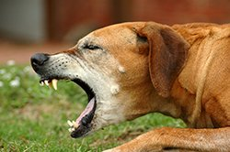

Slide 6
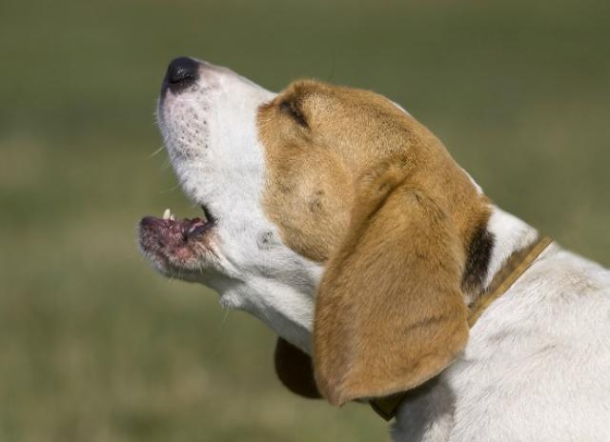

Slide 7
DIAGNOSIS
• Based on exposure history and clinical signs, especially the sudden onset of a severe cough in a previously healthy dog.
Haemogram:
• Mild ITB: CBC is usually normal or shows a stress response (mature neutrophilia, lymphopenia).
• Severe ITB: Neutrophilic leukocytosis with a left shift is seen with complicating pneumonia.
Thoracic Radiography:
• Mild ITB: Usually normal; a mild increase in interstitial lung density is seen occasionally.
• Severe ITB: Interstitial and alveolar pattern with lobar consolidation is seen with complicating bronchopneumonia.

Slide 8
DIAGNOSIS
Airway Cytology :
• Evaluation of airway cytology is only indicated in severe, febrile, or complicated ITB.
Obtain specimens by transtracheal aspiration, endotracheal tube lavage, or bronchoscopic lavage or swab.
• Findings include increased mucus, mucopurulent exudate
Cultures :
• Nasal swabs or tracheobronchial specimens can be cultured for Bordetella and mycoplasma.
Virology and Serology :
• Virus isolation can identify CPIV and CAV-2 from nasopharyngeal or tracheal swabs.

Slide 9
TREATMENT
Antibiotics :
Doxycycline (10 mg/kg PO ) for 2 to 4 weeks; effective for both Bordetella and mycoplasma
Amoxicillin/K clavulanate (12.5–25 mg/kg POq12h) for 2 to 4 weeks
Azithromycin (5 mg/kg PO, once daily) for 5 to 7 days.
Others: enrofloxacin, trimethoprim/sulfamethoxazole
Antitussives :
Hydrocodone (0.22 mg/kg PO q6–12h)
Butorphanol (0.55–1.1 mg/kg PO q6–12h).
Corticosteroids :
Prednisolone 0.25–0.5 mg/kg PO q12h

Slide 10
TREATMENT
Bronchodilators :
Theophylline: Dog: 10 mg/kg PO q12 h
Albuterol: Dog: 50 mg/kg PO q12 h
Terbutalin: Dog: 1.25–5.0 mg/dog PO q12 h
Supportive Care :
Provide adequate fluid intake, airway humidification, nutritional support, and rest.

Slide 11
PREVENTION
vaccination and kennel management practices
Vaccination :
routine canine vaccination (CAV-2 and CPIV).
Kennel Prevention :
Avoid overcrowded, high-density confinement
Isolate infected (coughing) animals.
Caretaker hygiene to prevent fomite spread.
Proper kennel ventilation.
Use disinfectants such as sodium hypochlorite, chlorhexidine, and benzalkonium Cl.

Slide 12
THANKS YOU !

