Slide 1
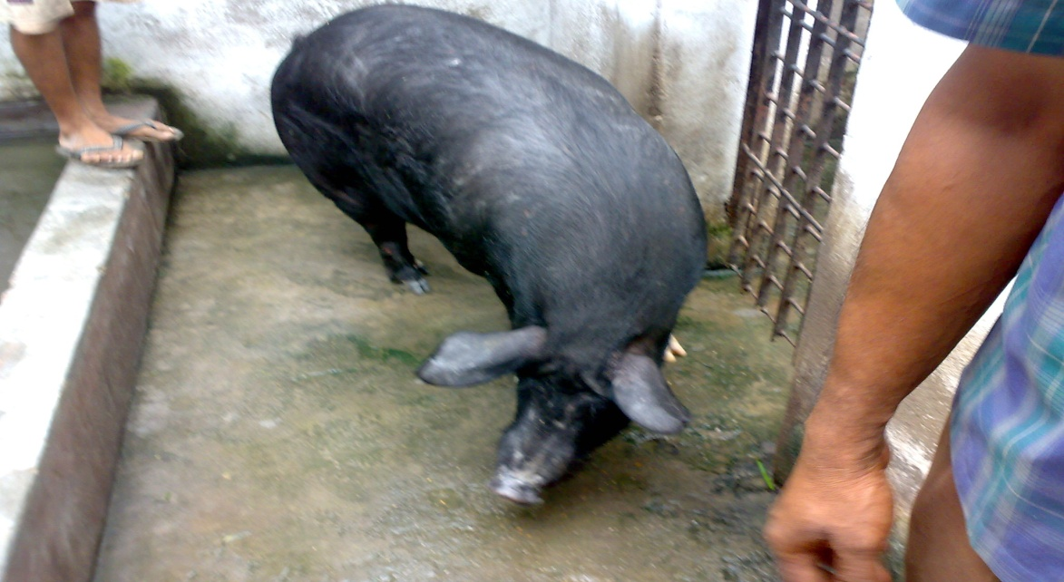
Classical Swine Fever
Unit 6
Dr. Arvind Kumar Das
Assistant professor
Department of Veterinary Medicine
Bihar Veterinary College, Patna-800014.

Slide 2
Introduction
Also called Hog Cholera / Swine fever
Highly contagious and febrile viral disease of swine
Disease may occur from per-acute and acute to sub-acute and chronic, and can last for several weeks or even months.
Notifiable to OIE
Naturally susceptible: Only the domestic pig and wild boar
No infection to human
Morbidity and mortality : Zero to 100 %
Mortality high in young ones

Slide 3
Epidemiology
World wide
Endemic in parts of Latin America, Caribbean islands & pig producing countries of Asia
First notice as an animal disease in early 19th century in USA
Epidemic: In Minnesota in 1913
South Africa in 1918
Netherland in1997-98: 429 herds infected, 700,000 pigs culled

Slide 4
Policies adopted to Control
Controlled by: Early detection and control to spread
High Risk Period: Shortest time between introduction of virus and detection of outbreak with clinical symptoms
Restricted movements
Culling of infected and suspected pigs
Total 12 million pigs slaughtered
Australia, New Zealand, Canada and USA are free from CSF
Many country banned the pig meat feeding

Slide 5
Etiology
Small enveloped RNA virus
Genus: Pestivirus
Family: Flaviviridae
Antibody discrimination tests must to differentiate
Only one serotypes with minor antigenic variability, divided into three major genotypes, including numerous sub-genotypes

Slide 6
Close Relationship
Antigenically related to BVDV of cattle and Border disease virus of sheep
CSF
BVD
Border disease

Slide 7
Characters of virus
Moderately fragile
No persistent in environment- No spread from long route by airborne infection
Survive prolonged in moist protein rich medium, meat, tissues, body fluids if frozen or chilled
Survive several years in frozen pig meat and months in chilled meat
Inactivated by cooking

Slide 8
Source of Infection
Main source: wild boar population or domestic Pigs (live or uncooked pig product)
Wild boar populations may harbour virus; domestic pigs in the affected area are at a high risk
Spread by: Movement of infected pigs
Contaminated garbage
Accidental introduction of virus through illegally imported pig meat.

Slide 9
Transmission
Routes : Oral and oronasal via direct or indirect contact
Direct: Secretions, excretions, semen, blood
Indirect : Contact through premises, implements, vehicles, clothes, instruments, needles and
insects
“Neighbourhood effect” during outbreaks in areas of high pig farm density: airborne transmission
over short distances
Spread by mechanical transmission: Vehicles, equipments and personnel travelling between pig farm and infected area

Slide 10
Tran-placental Transmission
The virus can pass from the sows to their offspring
Tran-placental infection: Offspring's of pregnant ewes infected with low or moderately virulence strain and recovered at high risk and may be carriers. Not showing symptoms but permanently shed the virus.
Important to investigate herds having high level of unexplained reproductive failure and congenital tremor or other abnormalities

Slide 11
Clinical Findings
Acute & Chronic Forms
Virulence: Severe - High mortality
Mild or subclinical
Low – Poor reproductive performance, congenital
neurologic defect in newborn piglet

Slide 12
Severe Acute Form: Clinical Signs
Fever (>41°C) until terminal stage when temperature subnormal
Inappetence
Depression
Incubation period – 3 to 5 days
Death – 10 to 20 days after infection
Anorexia
Constipation followed by diarrhoea

Slide 13
Severe Acute Form….Continued
Multifocal hyperaemia and/or haemorrhagic lesions of the skin
Conjunctivitis
Enlarged, swollen lymph nodes
Cyanosis of the skin especially of extremities (ears, limbs, tail, snout)
Transient constipation followed by diarrhoea
Vomiting (occasional)

Slide 14
Severe Acute Form….Continued
Lethargy
Dyspnoea, coughing
Ataxia, paresis and convulsion
Pigs huddle together
Mortality in young pigs can approach 100%

Slide 15
Chronic form
Dullness, capricious appetite, pyrexia, diarrhoea for up to 1 month
Ruffled appearance of pigs
Growth retardation
Poor reproductive performance may be the only sign in some breeding herds infected with less virulent strains
Apparent recovery with eventual relapse with anorexia, depression, fever, and progressive loss of condition and death within 3 months

Slide 16
Lesions
Enlarged hemorrhagic lymph nodes are common
Generalized vasculitis
Vasculitis in CNS lead to incordination or convulsions
Hemorrhages and cyanosis in skin especially in extremities
Generalized erythema
Severe tonsillitis with necrotic foci sometimes occurs

Slide 17
Lesions
Necropsy: Widespread petechial or echymotic hemorrhages in skin, lymph nodes, epiglottis larynx kidneys, spleen, bladder and rectum, specially in spleen
Multifocal infarction of the margin of the spleen is characteristic: nearly pathognomonic but occurs infrequently with currently circulating strains
Nonsuppurative encephalitis with vascular cuffing
Histologically: Atrophy of thymus, lymphoid depletion
Button shaped ulcers in intestine particularly near ileocecal junction.

Slide 18
Tests Samples
Tissues of tonsil
Maxillary or submandibular lymph node
Mesenteric lymph node
Spleen
Ilium and
Kidney
Whole blood with EDTA for virus isolation
Clotted blood for serologic test

Slide 19
Diagnosis
Virus isolation o Isolation in PK-15 cell line culture o Demonstration by an immunostaining method (FAT or immunoperoxidase)
RT-PCR
Detects infected animals early during the incubation period and for a longer period of reverse transcriptase polymerase chain reaction (RT-PCR) techniques time in cases where the pigs recover. In this test virus nucleic acid detection is done.
Fluorescent antibody test (FAT) It is a rapid test that can be used to detect CSFV antigen
ELISA: Also detect antigen but low sensitivity only screened herd level
Serological tests
Due to the immunosuppressive effect of CSFV, antibodies cannot be detected with certainty until at least 21 days post-infection.

Slide 20
Differential Diagnosis
With other febrile hemorrhagic diseases of pigs
African swine fever
Bacterial septicemias (eg. Salmonellosis, Erysipelas etc)
Anticoagulant poisoning (coumarin type)
Hemolytic disease of newborn
Low reproductive performance and congenital tremors differentiated with pseudorabies, parvovirus and BVDV

Slide 21
Prevention and Treatment
No specific treatment available.
Infected or in contact animal slaughtered and carcasses buried or incinerated
Modified live vaccines (MLVs) based on several attenuated virus strains are most widely used, and many of them have proven to be both safe and efficacious.
New generations of marker vaccines are also being developed, including a new chimeric Pestivirus vaccine that has been licensed by the European Medicines Agency (EMA).
DIVA??

Slide 22
Thank you

