Slide 1
Clinical significance and interpretation of Blood Urea Nitrogen
VLD-411

Slide 2
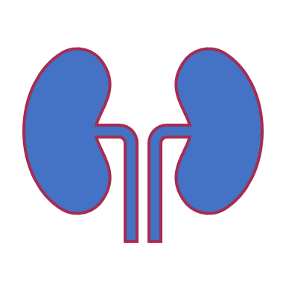
Urea or Blood Urea Nitrogen

Slide 3
Urea is the major excretory product of protein metabolism
formed in the liver from amino groups (−NH2) and free ammonia generated during protein catabolism
Enzymatically catalyzed process is termed the urea cycle

Slide 4
Clinical Application
to evaluate renal function
to assess hydration status
to determine nitrogen balance
to aid in the diagnosis of renal disease
to verify adequacy of dialysis

Slide 5
Measurements of urea were originally performed on a protein-free filtrate of whole blood and based on measuring the amount of nitrogen
urea is often reported in terms of nitrogen concentration rather than urea concentration (BUN)
Urea N concentration can be converted to urea concentration by multiplying by 2.14

Slide 6
Analytic Methods

Slide 7
Enzymatic method
urease catalyzes hydrolysis of urea in the sample, and the ammonium ion produced in the reaction is quantified
It couples with glutamate dehydrogenase (GLDH) and the rate of disappearance of NADH at 340 nm is measured
Clinical chemistry (Bishop)

Slide 8
Clinical chemistry (Bishop)

Slide 9
Specimen Requirements
in plasma, serum, or urine
If plasma is collected,
ammonium ions and high concentrations of sodium citrate and sodium fluoride must be avoided
citrate and fluoride inhibit urease
fasting sample is not required usually
Urea is susceptible to bacterial decomposition, so specimens (particularly urine) that cannot be analyzed within a few hours should be refrigerated

Slide 10
Pathophysiology
An elevated concentration of urea in the blood is called AZOTEMIA
Very high plasma urea concentration accompanied by renal failure is called UREMIA or the UREMIC SYNDROME
condition is eventually fatal if not treated by dialysis or transplantation
Three main categories: prerenal, renal, and postrenal

Slide 11
Prerenal azotemia
1. Result of reduced renal blood perfusion
Less blood is delivered to the kidney; consequently, less urea is filtered
Might be due to: congestive heart failure, shock, hemorrhage, dehydration, and other factors resulting in a significant decrease in blood volume
2. Amount of protein metabolism
A high-protein diet
increased protein catabolism, such as occurs in stress, fever, major illness, corticosteroid therapy, and GI hemorrhage, may increase the urea

Slide 12
Renal Azotemia
Decreased renal function causes an increase in plasma urea concentration
acute and chronic renal failure
glomerular nephritis
tubular necrosis
Other intrinsic renal disease

Slide 13
Postrenal azotemia
due to
obstruction of urine flow anywhere in the urinary tract by renal calculi
Tumors of the bladder or prostate
severe infection

Slide 14
Decreased plasma urea
Low protein intake
Severe liver disease
Severe vomiting and diarrhoea
during late pregnancy and in infancy as a result of increased protein synthesis

