Slide 1
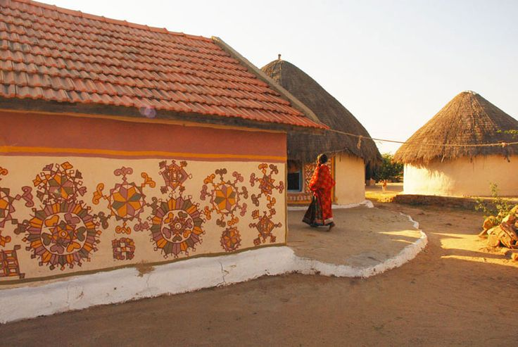
UNIT-01 (LIVESTOCK BASED LIVELIHOODS AND THEIR EVOLUTION)
Dr. Puspendra Kumar Singh
Department of Veterinary & Animal Husbandry Extension Education, BVC

Slide 2
Cooperative farming

Slide 3
Co-operative Farming
In cooperative farming, all the farming units are working under the direction acted management committee and its a form of farm business organization in which persons unite voluntarily pool their land, resources and cultivate the lands jointly.

Slide 4
The all India Cooperative Planning Committee (1955) classified cooperative farming as :
Type | Ownership of Farming | Operationship of Farming
Cooperative better | Individual | Individual
Cooperative joint | Individual | Collective
Cooperative tenant | Collective | Individual
Cooperative collective | Collective | Collective

Slide 5
Cooperative farming refers to an organisation in which:
Each member-farmer remains the owner of his land individually. But farming is done jointly.
Profit is distributed among the member-farmers in the ratio of land owned by them.
Wages distributed among the member-farmers according to number of days they worked.

Slide 6
Benefits/Advantages/Potential of Co-operative Farming:
Economies of scale:
As the size of farm increases, the per hectare cost of using tube-well, tractor comes down.
Small farms=some land is wasted in forming the ‘boundaries’ among them. When they’re combined into a big cooperative farm, we can also cultivate on that boundary land.
Large farms are economically more beneficial than small farms.
Solves the problem of sub-division and fragmentation of holdings.
Cooperative farm has more men-material-money resources to increase irrigation potential and land productivity. Members would not have been able to do it individually on their small farm.

