Slide 1
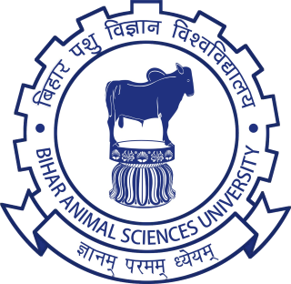
DATA RECORDING
Prepared By--
Dr. Suchit Kumar
Asstt. Prof. cum Jr. Scientist
Department of Livestock Farm Complex
Bihar Veterinary College, BASU, Patna-14

Slide 2
Data Recording
“Animal farm is dynamic and complicated enterprise having objective for milk production and profitability increase”.
It is dynamic because every moment will change the data such as-
Number of Milking and Dry Animal
Number of days open and Pregnant Animal
Age Structure
Input Cost
For achievement of goal -efficient manager is required to tackle all the data in systemic manner and that record all the information regarding farm activity.
Data Recording with purposefully -help in proactive management

Slide 3
Record Keeping
Data is being maintained for the past many decades on sheets and registers etc. As herds continued to increase in size and as milking three times daily became more prevalent, gathering data through historical methods became more costly for that ,
Latter on----
Use of PC
Data recoding Software's
Online Software's
Real time recording software’s
Analysis of Data----
Online and Software's
Statistical methods-manually

Slide 4
Types of Data Recording
Livestock register
Pedigree and history Sheet
Birth Register
Daily Milking Register
Growth Register
Daily Sick Animal & Treatment Register
Milk feeding register
Feed and Fodder register
Sale/Auction/mortality Register
Case book Register
Stock Book etc.

Slide 5
Livestock Register
It contains information about number of animals, animal number, breeds, sex, age etc.
Serial No. | Animal No. | Breed | Sex(M/F) | Age

Slide 6
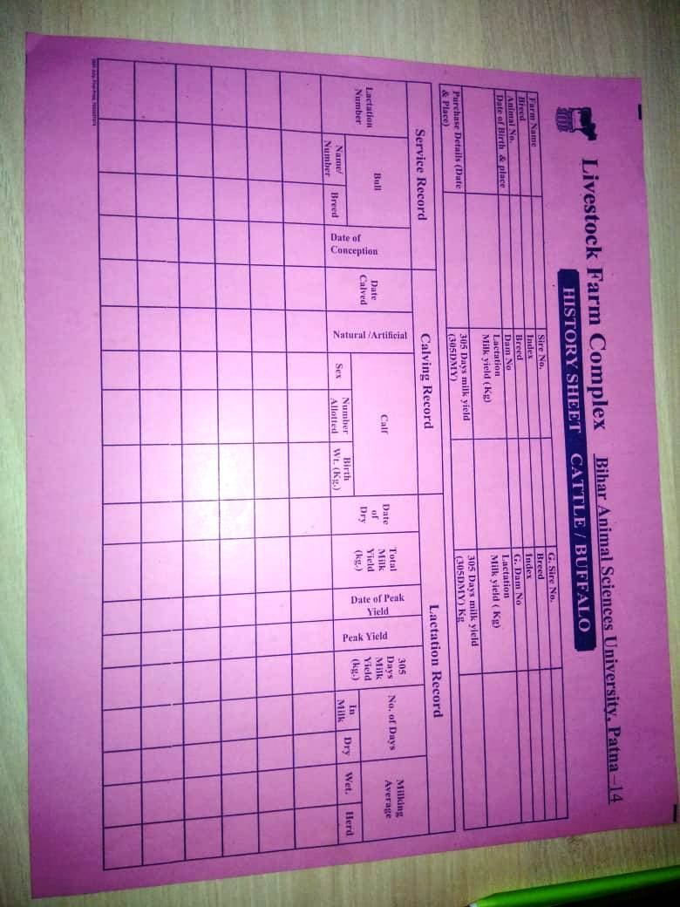
Pedigree and History Sheet

Slide 7
Daily Milk Yield Register

Slide 8
Reproductive Traits Register

Slide 9
Post Mortem Register

Slide 10
Birth Register
It contains information about date of birth(DOB), sire and dam number
birth weight, calf number, sex, date of death/disposal etc.
Sire No | Dam No. | DOB | Calf No | Sex(M/F) | Birth Weight | Date of Death/Disposal

Slide 11
Growth Register- Recording of body weight at different age group from calf hood age
Treatment Register- It records the animal number of sick animals, name of the
disease/disorder, treatment given
Milk feeding register- It records about the amount of milk fed to the calves in case of
weaning and also to orphan calves
Feed and Fodder register- To record expenditures on feed and fodder
Sale/Auction/mortality Register
Case book Register etc.

Slide 12
Purpose of Data Recording-------------
To Know the pedigree and history of each animal
It helps to compare between herd performance within breed as well as to make
Breed comparison
It helps in culling and selection of animal for breeding purpose which in turn bring
the genetic improvement of future generations
It may helps in feeding management for different group of animal
It also helps in research and proactive development planning
Growth record of young stock may helps in culling of poor performing calf
To know financial status of farm
To Know the health status of animal
Proactive management and plan

Slide 13
Record-keeping systems have provided an essential link that significantly increase milk
Production.
The data of one farm may be utilized as reference for other Farm
In-milk-parlor milk recording meters became available, milking machine manufacturing
companies developed procedure to capture cow side data and to develop on-farm data
Bases and to develop on-farm data-bases

Slide 14
Thank
You

