Slide 1
Diseases of amino acid metabolism- II
P.G.
VBC-607
Unit-1
6.11.2020

Slide 2
MAPLE SYRUP URINE DISEASE
Also known as Branched chain ketonuria
Partial or complete deficiency of branched-chain α keto acid dehydrogenase (a multienzyme complex associated with inner membrane of mitochondrion)
The enzyme complex that decarboxylate Leucine, Isoleucine and Valine
Accumulation of-keto acids and hydroxy acids (especially leucine ) in blood and urine
Physical and mental retardation of newborn
Distinct maple syrup or burnt sugar odour in urine, breath and skin

Slide 3
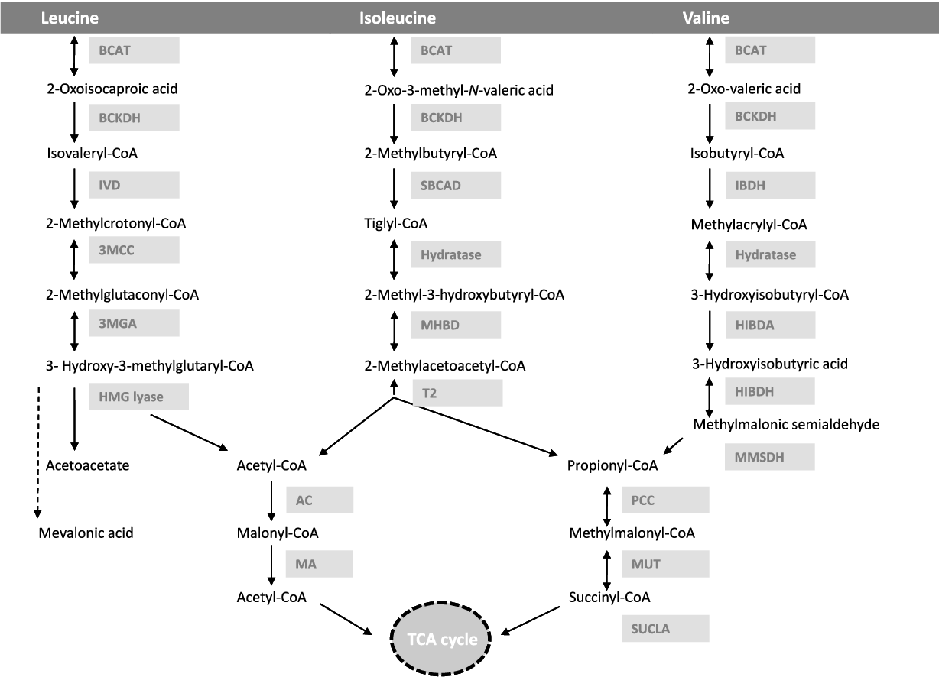
BCAT: Branched chain aminotransferase
BCKDH: branched chain keto acid dehydrogenase
IVD: iso valeric acid dehydrogenase
SBCAD: Short/branched chain acyl-CoA dehydrogenase
IBDH: Isobutyric acid dehydrogenase

Slide 4
Branched chain AA and their metabolic products (α- keto acids) accumulate in the blood, CSF
Leads to toxic effect that interferes with neurologic changes and brain functions, including seizures and mental retardation

Slide 5
Symptoms
Loss of appetite
Fussiness
Sweet-smelling urine
Feeding problems
Vomiting
Dehydration
Severe metabolic acidocis
Physical disabilities and even death

Slide 6
Treatment
Treatment involved dietary restriction of the amino acids leucine, isoleucine, and valine
Supplementation of high doses of thiamine pyrophosphate
Patients can be treated with I/v infusion that helps the body use up excess leucine, isoleucine, and valine for protein synthesis.
Gene therapy is also a potential future treatment for patients with MSUD. This treatment would involve replacing the mutated gene with a good copy, allowing the patient's cells to make a functional BCKD protein complex and break down the excess amino acids

Slide 7
ALBINISM
A group of inherited disorders that results in little or no production of the pigment melanin
Lack of tyrosinase
A marked lack of pigmentation
Sensitive to damage from sunlight and must take added precaution against UV radiation
Normal eyesight
No neurologic deficits

Slide 8
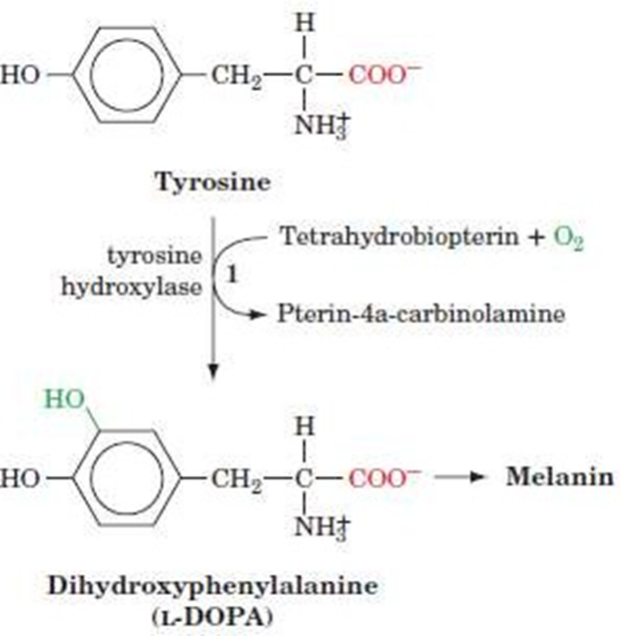
Tyrosine hydroxylase and aromatic amino acid decarboxylase deficiencies: Inherited causes of impaired biogenic amine metabolism

Slide 9
Two main types of albinism - characterized by the areas affected by the abnormality:
1. Oculotaneous albinism and 2. Ocular albinism.
1. Oculotaneous albinism describes a phenotype that lacks pigment in the skin, hair, and eyes.
2. Ocular albinism occurs when the phenotype only lacks pigment from the eyes, the hair and skin appear normal in these individuals.
Among the two types, oculotaneous albinism is typically more prominent

Slide 10
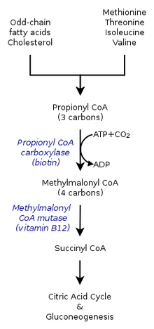
Methyl Malonic Aciduria
A classical type of organic acidemia
Condition is the inability to properly digest specific fats and proteins
Leads to a buildup of a toxic level of methylmalonic acid in the blood
An autosomal recessive disorder of amino acid metabolism, involving a defect in the conversion of methylmalonyl-coenzyme A (CoA) to succinyl-CoA

Slide 11
Symptoms
Treatment
Neurologic manifestations, such as seizure, encephalopathy, and stroke
Several cases have involved stroke
Protein-restricted diet- decreases the key amino acids (eg, isoleucine, valine, threonine, methionine)
Cobalamin supplementation- a cofactor in the enzymatic conversion of methylmalonyl-coenzyme A (CoA) to succinyl-CoA.
L-carnitine- involved in the metabolism of long-chain fatty acids, buffers the acyl-CoA metabolites
Liver transplantation alone or in conjunction with kidney transplantation has been attempted

Slide 12
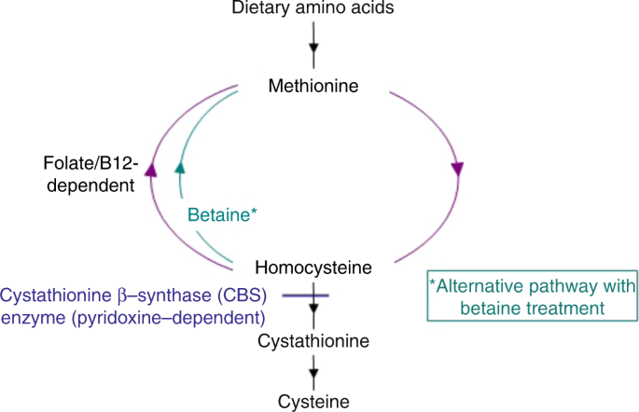
Homocystinuria
disorder of the metabolism of the amino acid methionine
Due to the defect in the enzyme Cystathionine β–synthase which converts Homocysteine to Cystathionine
Leads to accumulation of homocysteine and other toxins that damage the nervous system, which includes the brain, and the vascular system

Slide 13
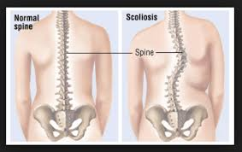
Symptoms
dislocation of the lenses in the eyes
nearsightedness
abnormal blood clots
osteoporosis, or weakening of the bones
learning disabilities
chest deformities, such as a protrusion or a caved-in appearance of the breastbone
long, spindly arms and legs
scoliosis

Slide 14
Treatment
High doses of vitamin pyridoxine
A diet low in the amino acid methionine (sulphur containing amino acid)
Betaine is a nutrient that works to remove homocysteine from the blood. Taking a folic acid supplement and adding the amino acid cysteine to the diet are helpful

Slide 15
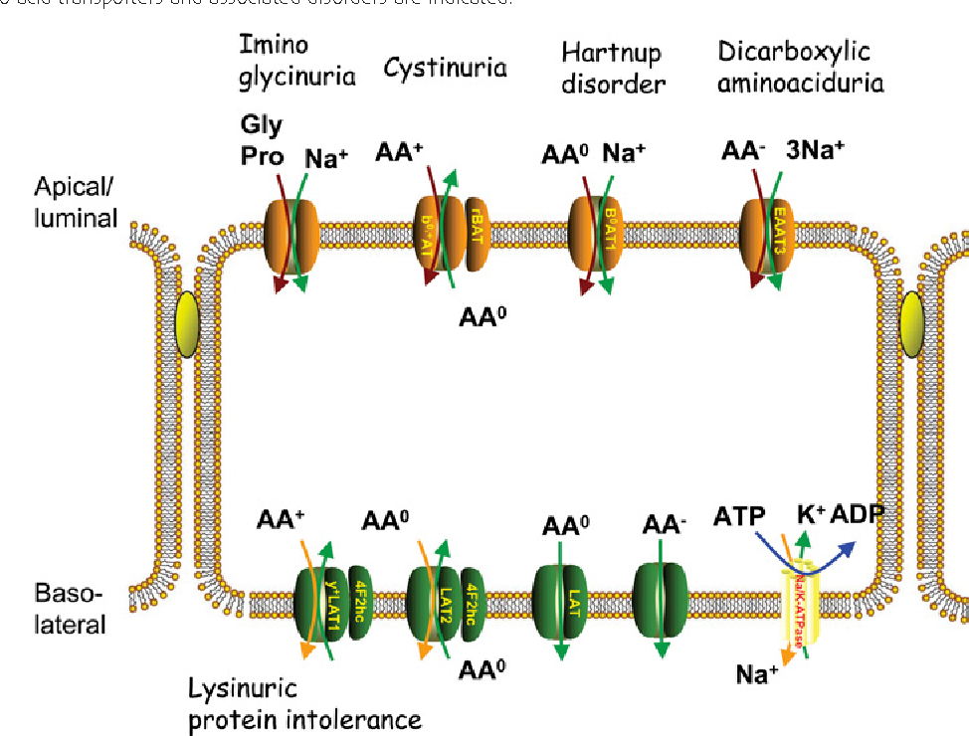
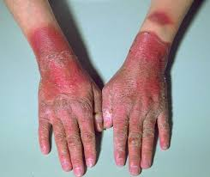
Hartnup’s disease
Also known as Pellagra-like dermatosis
Absorption of nonpolar amino acids (particularly tryptophan) intestine& kidney is impaired

Slide 16
Symptoms
Treatment
sensitivity to light
anxiety
hallucinations
delusions
tremor
abnormalities in muscle tone: either muscles can become more tight
consists of a change in diet, avoidance of sunlight, and prescribing sulfonamide drugs
B-complex vitamin Niacin can significantly reduce symptoms.
Good sources of niacin include: Meat, poultry, fish, fortified and whole grains
B-complex or niacin vitamin supplements (such as nicatonic acid)

