Slide 1
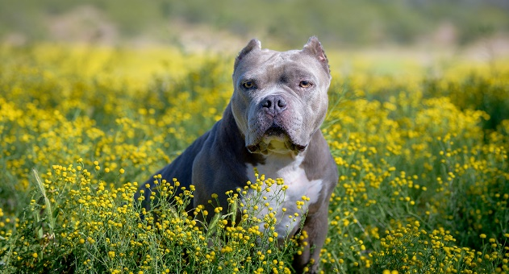
EAR CROPPING
DR GYANDEV SINGH, Assistant professor, VCC, BVC, Patna-14

Slide 2
CONTENTS-
INTRODUCTION
ANATOMY
LEGAL STATUS
SURGICAL PROCESS
POST OPRATIVE CARE

Slide 3
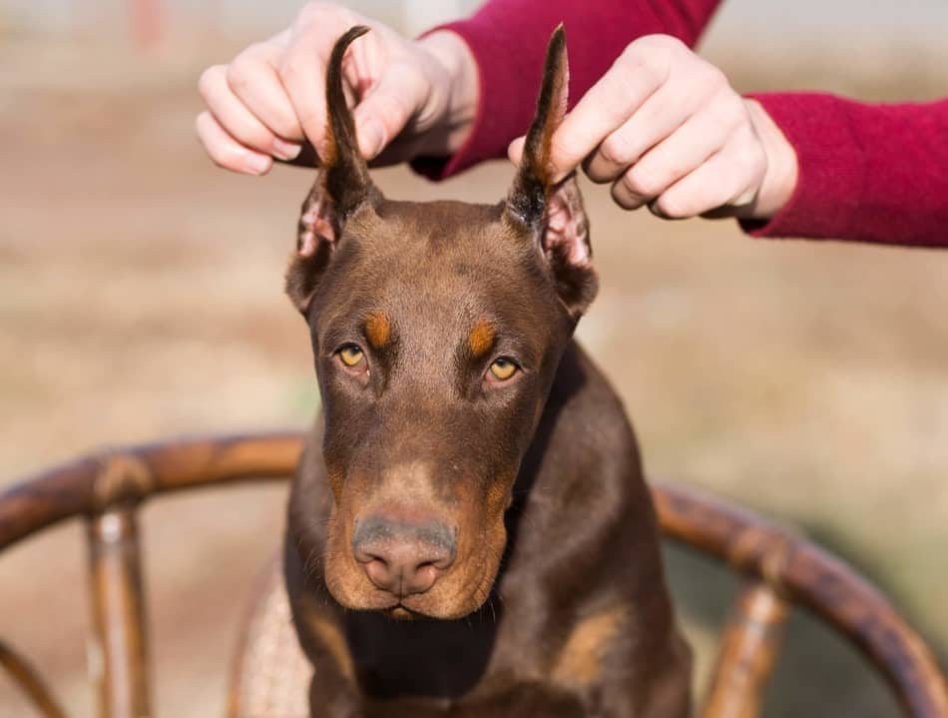
INTRODUCTION-
Cropping is the removal of part or all of the pinnae or auricle ,the external visible flap of the ear and earhole.
It is banned in many nation but is still legal permitted in limited no of countries
It is seen only in pit bulls ,Doberman pinscher,schnauzer,great dane,boxer,and cane corso.

Slide 4
INDICATION-
Owner fancy
Correction of irreparable injury
Drooping ears
Reduce the possibility of aggressor dog getting a hold on them.
Reduce the ear nfection.

Slide 5
AGE FOR CROPPING -
The real age for ear cropping in dog is 2- 3 month .
CONTROL AND ANAESTHESIA-
The animal is controlled in sternal recumbency after proper medication.
SITE OF OPRATION-
Lteral boarder of ear flap.

Slide 6
Types of ear crop-

Slide 7
LEGAL STATUS-
The cruel procedure were originally banned by the veterinary council of India in 2011.
PETA India fired off letters to numerous Indian veterinary regulatory bodies including the veterinary council of India, state veterinary council, central and state animal husbandry department, veterinary college and universities and veterinarian association as well as the animal welfare board of India urging then to implement enforce the ban on cosmetic tail docking under the prevention of cruelty to animal rules 2017

Slide 8
SURGICAL ANATOMY-

Slide 10
INSTRUMENT-

Slide 11
SURGICAL PROCESS-
The ear clamp is applied from the upper to lower points of flattened ear flap so as to adjust the flap to the desired shape.
A concave curve made by pulling earflap laterally through the clamp and convex curve the pulling ear flap medially .

Slide 12
Lateral portion of ear flap is excised by cutting along the clamp and bleeding is controlled by using electro cautery or with sponge.
The auricle ear cartilage is trimmed with scissors at the base of ear flap.
The upper 2/3 of ear flap is closed skin to skin with simple continuous suture 3-0 to 4-0 silk and the lower portion of incision is suture with simple interrupted suture.
Care should be taken to avoid folding and second ear is cropped in same manner.

Slide 13
Post operative care
The ear flap should be bandaged over the head for first 48 hrs and analgesic is given to the animal .
Scratiching should be prevented to avoid disruption line.
Antibiotc should be given for 4-5 days.

Slide 14
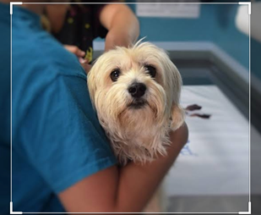
THANKU

