Slide 1
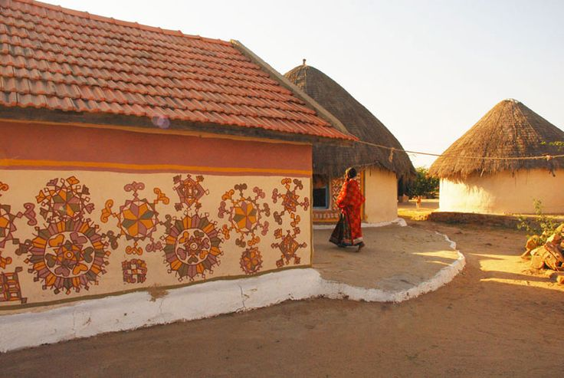
UNIT-01 (LIVESTOCK BASED LIVELIHOODS AND THEIR EVOLUTION)
Dr. Puspendra Kumar Singh
Department of Veterinary & Animal Husbandry Extension Education, BVC

Slide 2
Estate Farming

Slide 3
Estate Farming
A form of industrialized agriculture.
Involve large monoculture of cash crop.
A tree or bush farming which had been introduced by the British around the 19th century.
It mostly refers to single crop orchards or crops such as tea, rubber, spice crops, coconut, coffee, oranges, apples etc.

Slide 4
It requires investment and cultivation facilities like good irrigation, modern farming methods, irrigation facilities, technical farming skills, required machinery, fertilizers, and quality high yielding seeds.
It is very useful for export business.
Most of the orchards produce crops for many years. Some crops take many years to get into the harvesting stage, but these crops are worth growing, as there are huge profits afterward.
This is mostly confined to the tropical climate.

Slide 5
It is a capital centred system, it is important to be technically advanced and have efficient methods of cultivation and tools including fertilizers and irrigation.

Slide 6
Main features of estate farming include:
Agriculture are done on a very large land.
Single crop production.
Heavy labour intensive agricultural production.
High investment requirement.
Highly sophisticated and advance technology oriented farming.
This farming is mainly for commercial export purpose.

Slide 7
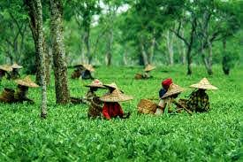
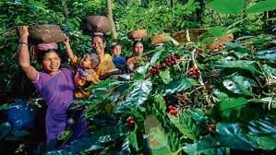
Tea Farming
Coffee Farming

Slide 8
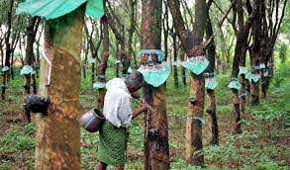
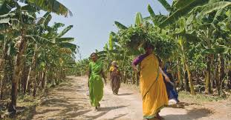
Rubber Farming
Banana Farming

