Slide 1
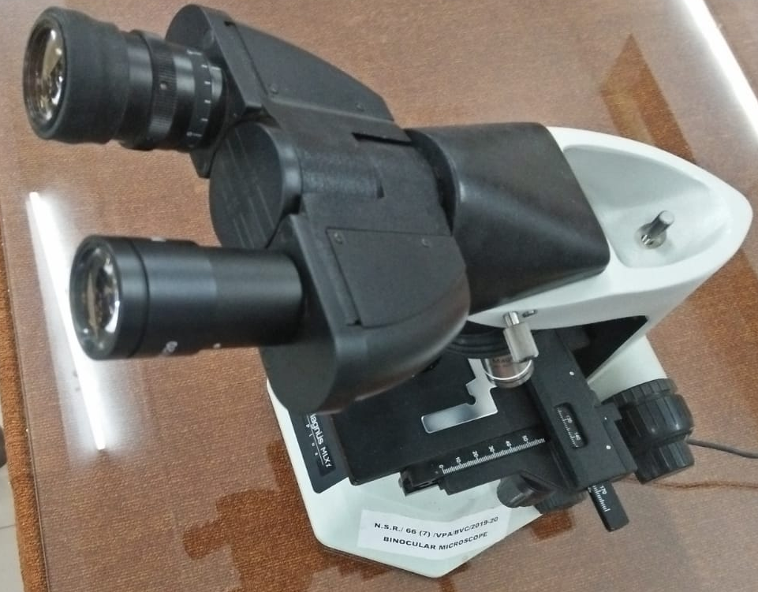
Faecal Examination Techniques –II (Practical)
Dr. AJIT KUMAR
Department of Veterinary Parasitology
Bihar Veterinary College
Bihar Animal Sciences University
Patna-800014
Image source: Google image

Slide 2
Faecal Examination Techniques
Faecal Examination
Qualitative method
Quantitative Method
Stoll’s Dilution Method
Mc Master Method
Unconcentration method
Direct method
Concentration method
Floatation method
Simple sedimentation
Centrifugal sedimentation
Formalin-ether concentration technique

Slide 3
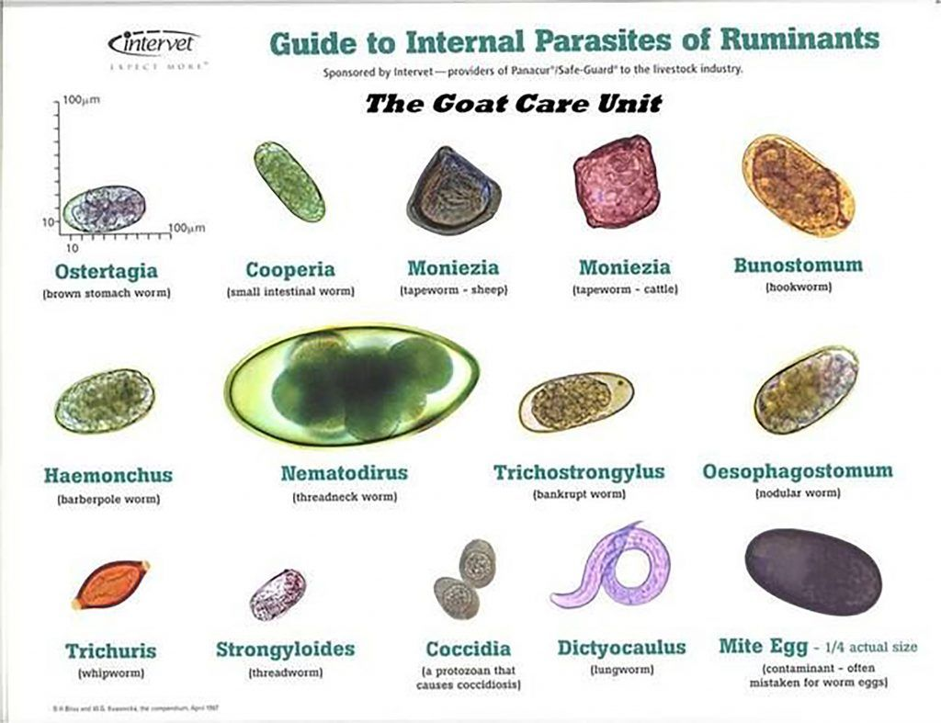
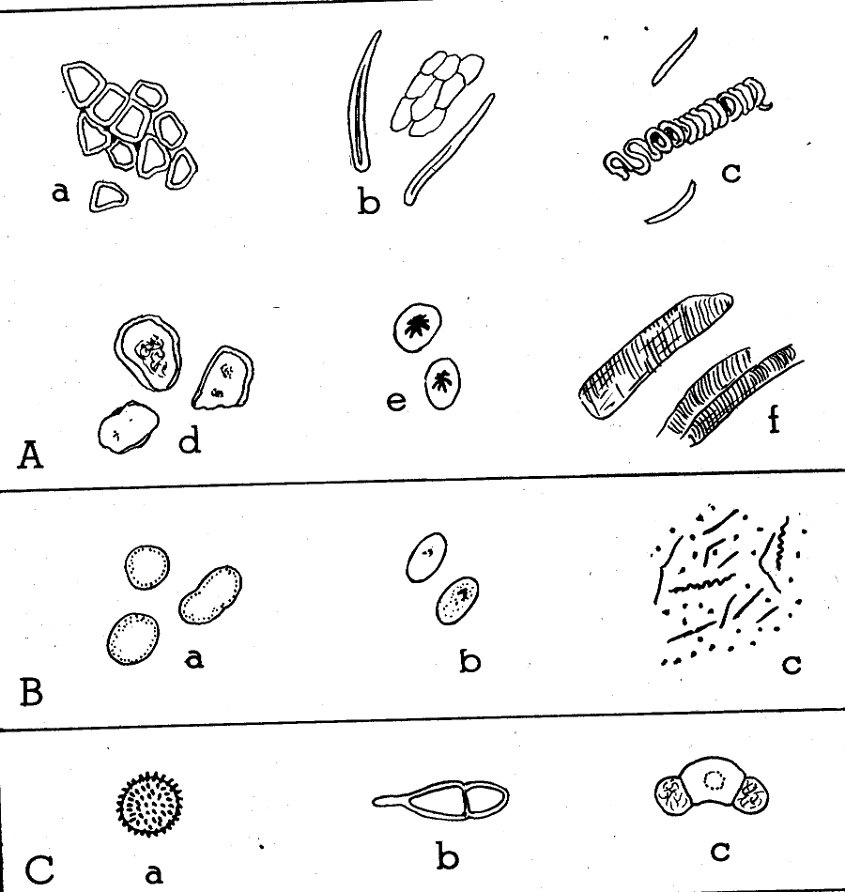
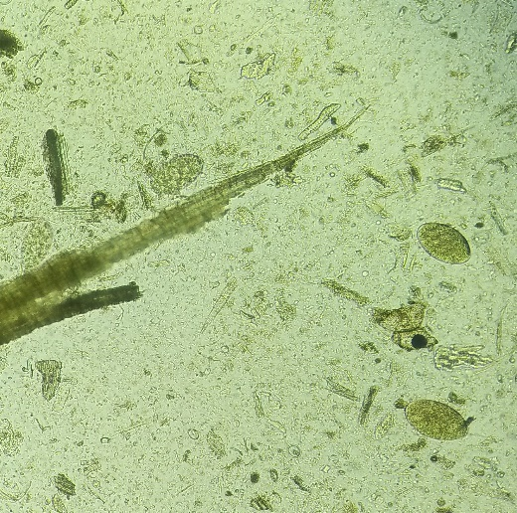
Faecal Examination Techniques
Eggs of Parasites
EGG
Artifacts generally confused as parasite eggs and larvae
Image source: Google image

Slide 4
Faecal Examination Techniques
Eggs of Parasites
EGG
Artifacts generally confused as parasite eggs and larvae
Image source: Google image

Slide 5
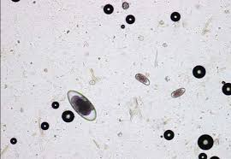
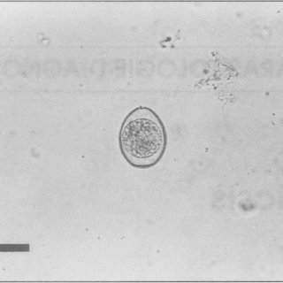
Faecal Examination Techniques
Air bubble
Egg of Parasite
Oocyst of Protozoa
Cyst of Balantidium coli
Image source: Google image

Slide 6
Faecal Examination Techniques
Floatation Method:-
Principle- When worms eggs are suspended in a liquid with a specific gravity higher than that of eggs, the latter will float up to the surface.

Slide 7
Faecal Examination Techniques
Floatation Method:-
Common saturated solution used in floatation technique: Sodium chloride (specific gravity- 1.20), Sugar (specific gravity- 1.12-1.30), Zinc sulphate, Magnesium sulphate etc.

Slide 8
Faecal Examination Techniques
Floatation Method:-
Procedure:-
About 2.0 g of faces are mixed with 10 – 20 ml of saturated common salt solution ( brine) in a small floatation tube.
Fill the floatation tube up to the tip with solution.
A clean coverslip or slide is slid sideways over the top of the tube.

Slide 9
Faecal Examination Techniques
Floatation Method:-
Procedure:-
Left about 30 minutes by which time all the eggs would have floated up and touches the coverslip.
Then coverslip or slide is gently lifted, inverted and examined the fluid film under low power of the microscope.
This method is not suitable for eggs of trematodes or most cestodes but is useful for the majority of nematode eggs.

Slide 10
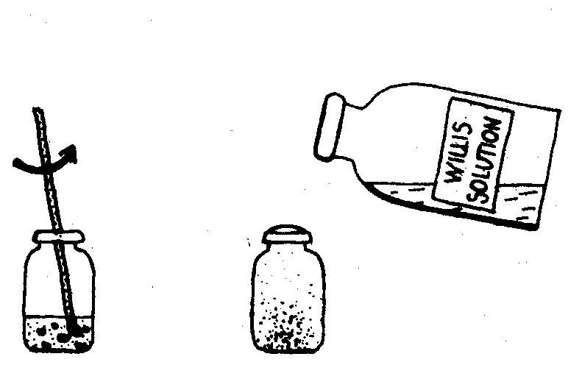
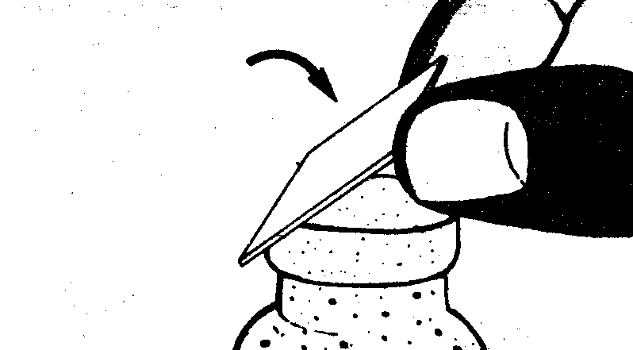
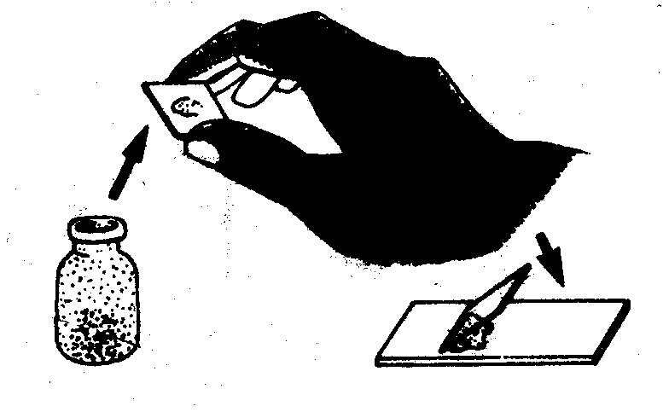
Faecal Examination Techniques
Floatation Method:-

Slide 11
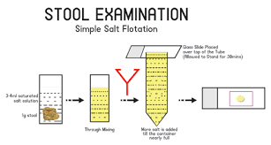
Faecal Examination Techniques
Floatation Method:-
Image source: Google image

Slide 12
Faecal Examination Techniques
Sedimentation Method:-
Light infections as well as heavy infection can be diagnosed.
Low specific gravity of most helminthes eggs are separated from the faecal samples.

Slide 13
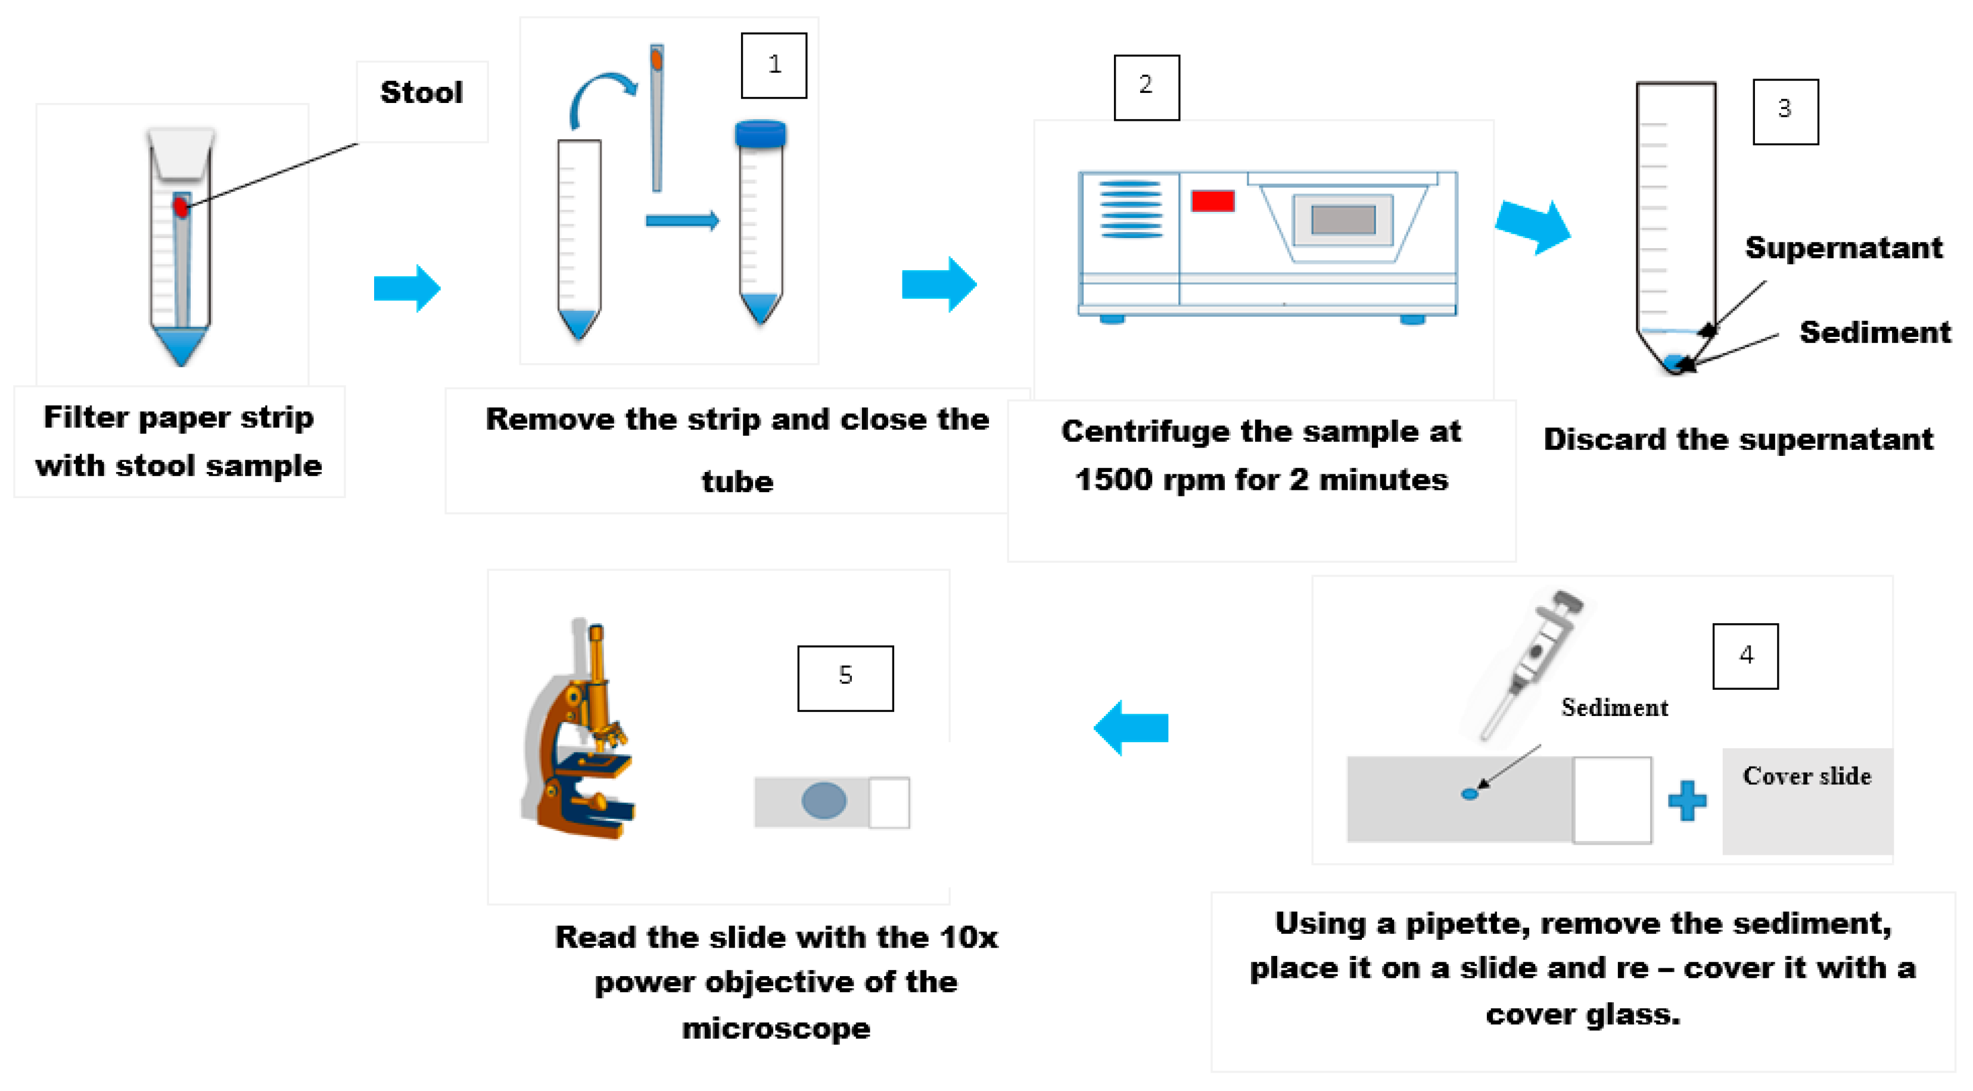
Faecal Examination Techniques
Sedimentation Method:-
Image source: Google image

Slide 14
Faecal Examination Techniques
Quantitative Examination of Faeces
Egg Counting Methods:
For accurate information regarding to severity of infection egg count methods are very useful by estimating eggs per gram (EPG) of faeces.
It is quantitative method.

Slide 15
Faecal Examination Techniques
Sedimentation Method:-
About 02 g of faeces are mixed with 15 ml of water in a pestle and mortar.
Emulsifies strained faeces is poured into a centrifuge tube water and centrifuged for 1-2 minute at 1500-2000 RPM.
Discard the supernatant fluid and a few drop of sediment is taken on a slide covered with cover slip and examine under low power objective of microscope.

Slide 16
Faecal Examination Techniques
Quantitative Examination of Faeces
Egg Counting Methods:
Stoll’s Dilution Method:-
Procedure -
3 gram faeces are taken in a test tube graduated to 45 ml.
b. Fill the test tube up to the 45 ml mark with N/10 NaOH (4 g NaOH in 1 liter water) and add sever small glass beads and homogenize the faecal samples.

Slide 17
Faecal Examination Techniques
Quantitative Examination of Faeces
Egg Counting Methods:
Stoll’s Dilution Method:-
Procedure -
0.15 ml mixed suspension is drawn with a graduated pipette and placed on a slide and a cover slip applied on it.
Count the total number of eggs and multiply by 100, which indicate the number of egg per gram of faces.
For counting trematode as well as nematode eggs.

Slide 18
Faecal Examination Techniques
Quantitative Examination of Faeces
Egg Counting Methods:
Mc Master Method:-
Procedure -
In this method a special counting is used for the estimation of no. of egg or larvae per gram of faces.
Counting slide having two counting chamber is made of two glass slides separated by three or four narrow transversely placed strips of glass 1.5 mm thick, so that two or three spaces of 1.5 mm depth are obtained between the two slides. On the under surface of the upper slide an area of 1 cm² is ruled over each space.
The volume underneath this ruled area will therefore be 0.15 ml.

Slide 19
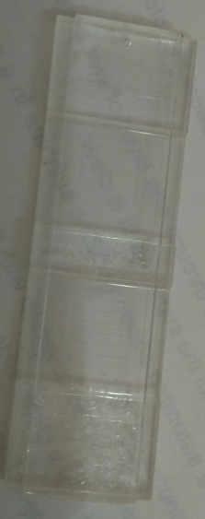
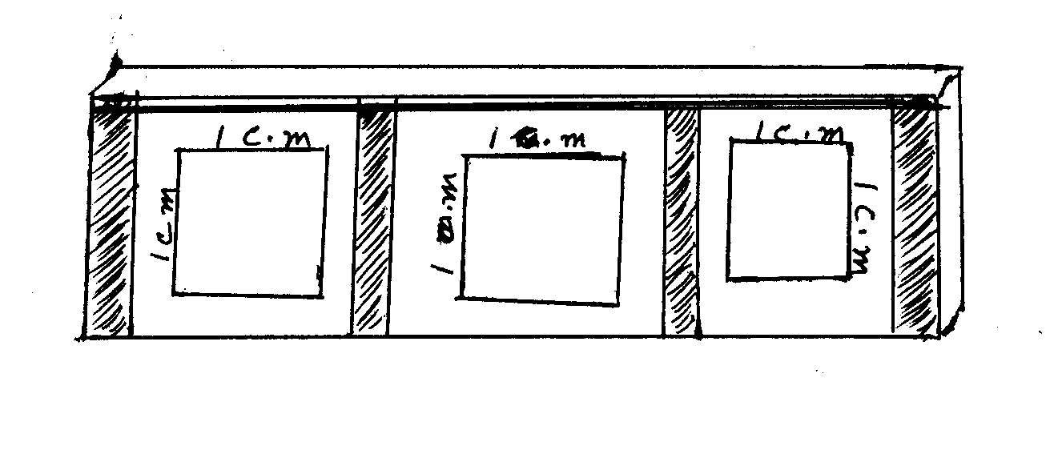
Faecal Examination Techniques
Quantitative Examination of Faeces
Egg Counting Methods:
Mc Master Method:-
Mc Master Slide

Slide 20
Faecal Examination Techniques
Quantitative Examination of Faeces
Egg Counting Methods:
Mc Master Method:-
Procedure -
Weigh 3 g of faces and add 42 ml water in a container.
Homogenize and pour the suspension through a tea strainer.
Take 15 ml of the filtrate in to a centrifuge tube and centrifuge at 2000 rpm for 2 minutes.

Slide 21
Faecal Examination Techniques
Quantitative Examination of Faeces
Egg Counting Methods:
Mc Master Method:-
Procedure -
Pour off the supernatant, agitate sediment and add saturated sodium chloride solution to 15 ml mark of centrifuge tube.
Mix the solution thoroughly and fill the chambers of Mc Master slide.
Examine one chamber under microscope and multiply number of eggs or larvae under one etched area by 100 or two chambers and multiply by 50 to arrive at the number of eggs per gram (EPG) of faeces.

Slide 22
Faecal Examination Techniques
Eggs per gram (EPG) counts in different animals Vs levels of infection: -
Parasite | Animal | level of infection
 |  | Mild | Moderate | Severe
Nematodes | Cattle | 50-300 | 300-600 | >600
 | Sheep | 100-500 | 500-2000 | 2000-6000
 | Horse | 500 | 800-1000 | 1500-2000
Fasciola spp. | cattle | 10-100 | 100-200 | >200
 | Sheep | 50-300 | 300-600 | >600

Slide 23
THANK U

