Slide 1
Fluid therapy in animals
Dr. Bipin Kumar, Assistant Professor
Department of Veterinary Medicine
Bihar Veterinary College, Patna
(Bihar Animal Sciences University, Patna)

Slide 2
Body Fluid overview;
Basics of body fluids and its composition.
Water balance in body.
Regulation of body fluids.
Fluid therapy &its indication.
Types of fluids.
Routes of administration.
Fluid over load signs.

Slide 3
Basics of Body Fluid:
An adult animal contains about 60% fluid of its body weight.
Intracellular fluid (ICF) consists of about two-thirds of total body fluids.
The extracellular fluid (ECF) which constitutes about one-third of the total body fluids. It is divided into three sub compartments— interstitial, intravascular, and trans cellular.
The interstitial contains three-quarters of all the fluid in the extracellular space.
The intravascular contains the fluid, mostly plasma, that is within the blood vessels. Total blood volume is roughly 8% of bodyweight and plasma roughly 5% of bodyweight

Slide 4
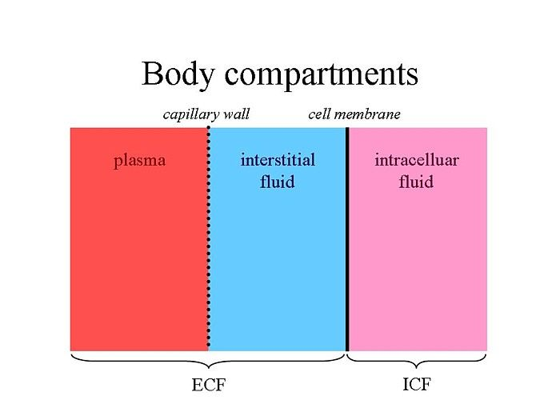

Slide 6
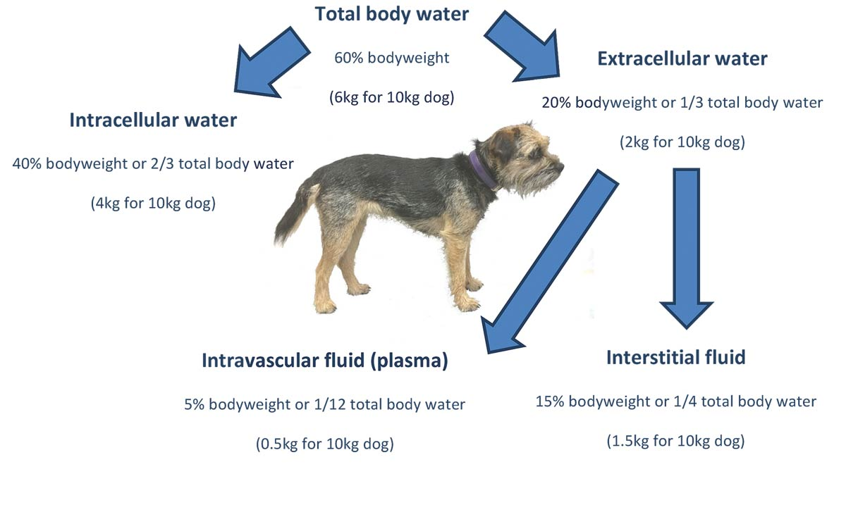

Slide 7
The fluid in the transcellular compartment is produced by specialized cells responsible for cerebrospinal fluid, gastrointestinal fluid, bile, glandular secretions, respiratory sections, and synovial fluids.
Daily water intake is about 10% of the body weight (can vary from animal to animal with respect of their age, environment, feed intake etc. ).
Daily water loss equals daily intake and this loss occurs through the skin, lung, kidney and gastrointestinal tract.

Slide 8
Body water contains solutes (substances that dissolve in solvent; particles).
Electrolytes are substances that split into ions when placed in water.
Primary ions in the body are sodium, potassium, chloride, phosphate, and bicarbonate.
Cations are positively charged ions.
Anions are negatively charged ions.
Body water is the solvent in biological systems
To establish equilibrium, body water moves along its concentration gradient

Slide 9
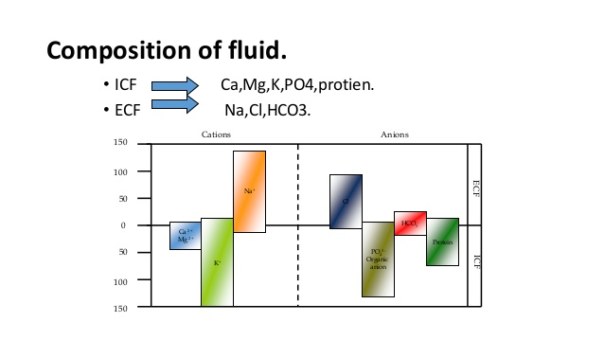

Slide 10
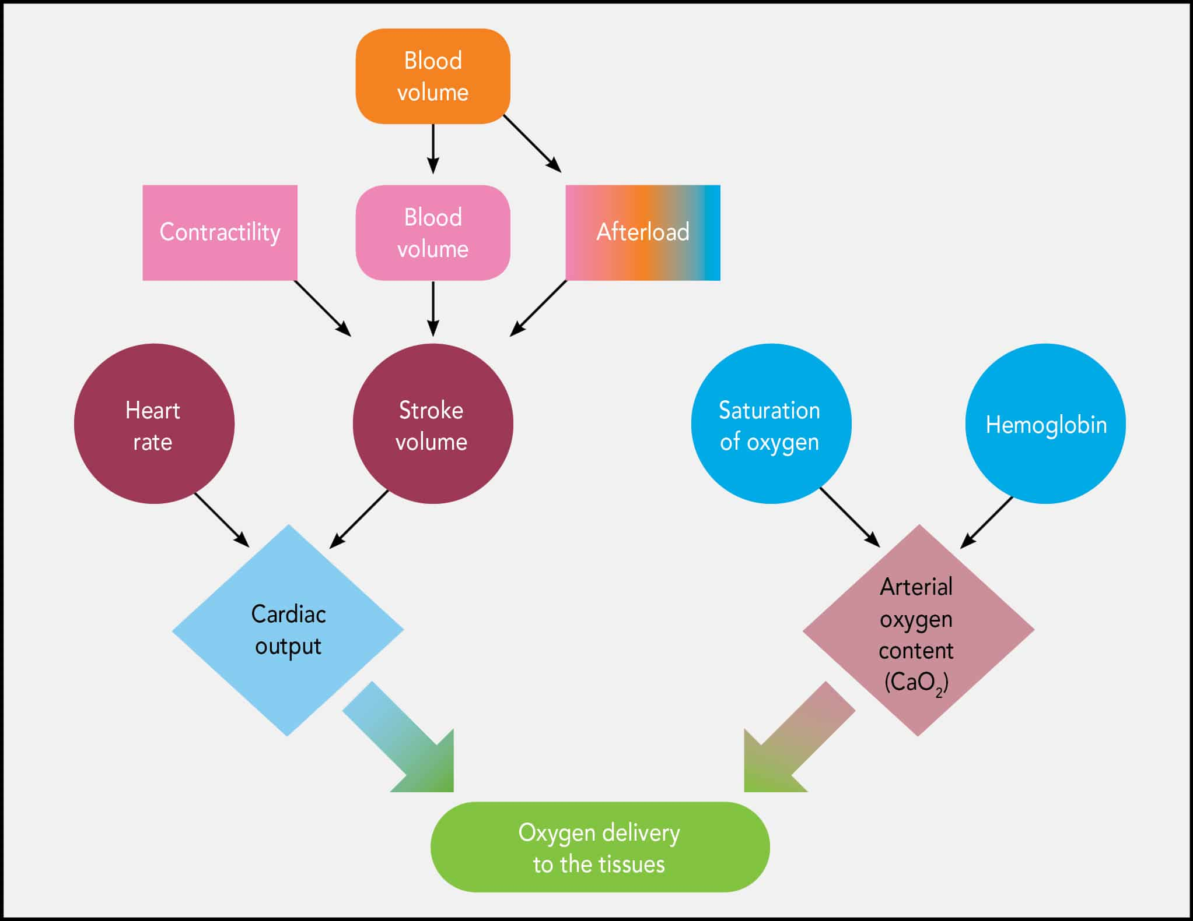

Slide 11
Fluid therapy Types:
• Replacement therapy: Therapy in which we infuse same type of fluid which is lost from body
• Adjunctive Therapy: One type of fluid is given to remove other type of fluid e.g. mannitol 25% is given in case of ascites and edema.
• Supportive Therapy: Fluid is given to animal just to support him to cure quickly i.e. amino acids, minerals, multivitamins and carbohydrates etc.

Slide 12
Indications:
Fluids are administered to patients not only to replace fluid loss but also to correct electrolyte abnormalities, promote kidney diuresis, and maintain the tissue or organ perfusion.
During shock.
Dehydration.
Diuresis (Toxicities , renal diseases).
After surgical procedure i.e. to prevent hypotension as hypotension may be due to vasodilation, decreased cardiovascular function etc.
Acid base abnormalities.
Electrolyte abnormalities.

Slide 13
Dehydration:
• Dehydration or the loss of fluid from the interstitial space in the form of increased fluid loss from vomiting, diarrhea, or polyuria is one of the main cause of water reduction in body.
• Signs include decreased skin tenting, sunken eyes, depressed mentation, and tacky/dry mucous membranes, CRT 2-3 sec in mild cases and >3 sec in severe cases, Slight depression of eyes into sockets.

Slide 14
Diagnosis of Dehydration:
• Physical exam
• Weight loss
• PCV (HCT) increased
• Albumin or total protein increased
• BUN, creatinine
• Prerenal azotemia

Slide 15
Degree of dehydration(%) | Clinical signs
<5 | Not clinically detectable.
5-6 | Subtle-loss of skin elasticity
6-8 | Obvious delay in return of tented skin. Slightly ↑ CRT Possible sunken & dry mucous membrane of eye
10-12 | Skin remain tented. Very prolonged CRT. Sunken eyes & dry mucous membranes. Possibly signs of shock (tachycardia, cool extremities, rapid & weak pulse)
12-15 | Obvious signs of shock. Death imminent

Slide 16
Clinical signs | Hypovolaemic and cardiogenic shock | Vasodilatory shock
Heart rate | Tachycardia and end stage bradycardia | Tachycardia
Pulse rate | Weak becoming absent | Bounding
Mucus membrane | Pale | Bright red (hyperemic)
Capillary refill timeCRT | Prolonged | Rapid
Blood pressure | May initially be normal due to sympathetic response then decline | Low
Temperature of extremities | Cool | Warm

Slide 17
Types of fluid:
(a) Crystalloids.
• Contain sodium as the main osmotically active particle.
• Useful for volume expansion (mainly interstitial space).
• For maintenance infusion.
• Correction of electrolyte abnormality.
• Types of crystalloids
• Isotonic crystalloids Lactated Ringer’s, 0.9%NaCl(Normosol)
• Only 25% remain intravascularly

Slide 18
Hypertonic saline solutions 3% NaCl, 0.9% normal saline with 5% dextrose &10% dextrose in water
Hypotonic solutions D5W(dextrose 5 % in water) 0.45% NaCl 0.25% NaCl
Less than 10% remain intravascularly, inadequate for fluid resuscitation.

Slide 19
Lactated Ringer’s Solution:
• Composition closely resembles ECF
• Contains physiological concentrations of: sodium, chloride, potassium, and calcium
• Also contains lactate, which is metabolized by the liver alkaline- forming
• Because small animals that are sick or under anesthesia tend towards acidosis

Slide 20
Ringer’s Solution:
Same as LRS except no lactate added
Commonly used in Large animals
Large animals who are sick tend towards alkalosis instead of acidosis
Normal Saline:
0.9% Sodium chloride = ISOTONIC
Lacking in K+, Ca2+
Used for hyperkalemia, hypercalcemia
Used as a carrier for some drugs
Used if don’t want lactate

Slide 21
(b) Colloids
Contain high molecular weight substances which do not readily migrate across capillary walls
Preparations - Albumin: 5%, 25% - Dextran - Gelifundol - Haes-steril 10%
Natural Colloids
• Blood products:
• Whole blood
• Plasma
• Platelet-rich plasma
• Packed RBC’s

Slide 22
Synthetic Colloids;
• Dextrans, Hetastarch
• Used when quantity of a crystalloid is too great to be able to infuse quickly
• Stays within the vasculature maintain blood pressure
• Duration of effect is determined by molecular size:
• bigger = longer
• Small volumes produce immediate increases in blood pressure

Slide 23
Routes of administration | Advantage | Disadvantage
Oral | Safe &Easy | •Less rapid absorption •Possible aspiration •Cannot use for vomiting animals
Subcutaneous | •Relatively easy to administer •Absorption distributed over time | •Possible infection •Must use isotonic fluids •Slower absorption
Intravenous | •Precise amount given is available rapidly •Various tonicities of fluid can be used | •Possible fluid overload and vessel damage •Requires close monitoring •Must be sterile
Intraperitoneal | •Relatively rapid absorption •Can be used when IV access is not available | •Possible infection •Cannot use hypertonic solutions
Routes of administration:

Slide 24
Intraosseous | •Useful for small animals, birds, and pocket pets •Can be used when vein inaccessible •Rapid absorption | •Lack of confidence in administering fluid via this route •Possible infection
Rectally | •Good absorption | Not frequently used

Slide 25
Fluids:
How Much to Give?
• Correct dehydration
• Weight in kg times percent dehydration equals the amount in litres that the animal is dehydrated
• Example: 100 kg animal who is 8% dehydrated
• 100kg X 0.08 = 8 liters
• Patient is lacking 8 liters, or 8000 ml fluids

Slide 26
So How Is It Delivered?
• Infusion pump (easy)
• IV drip set: drops per ml written on package
• Regular Drip sets have 10, 15, or 20 drops per ml -- Med & large dogs
• Micro drip sets have 60 drops per ml --Small dogs & cats

Slide 27
Calculate Drops Per Hour
• Calculate ml/hr.
• Calculate drops/hr by: ml/hr X drops/ml (from the package)
• Gives you drops needed in an hour
• Example: 100 ml X 10 drops per ml = 1000 drops in the first hour

Slide 28
Calculate Drops Per Minute
• Divide drops per hour by 60 min/hr to get drops per minute
• Ex: 1000 drops/ hr divided by 60 minutes per hour = 16.7 drops per minute
• 16.7 drops/min divided by 60 sec per min = 0.28 drops/sec

Slide 29
Principles of Rehydration:
• Correct dehydration, electrolyte, and acid-base abnormalities prior to surgery
• Do not attempt to replace chronic fluid losses all at once
• Severe dilution of plasma proteins, blood cells and electrolytes may result
• Aim for 80% rehydration within 24 hours
• Monitor pulmonary, renal and cardiac function closely

Slide 30
For example.
• An adult 18kg cat with 6% dehydration comes into the clinic. It is estimated that the cat vomited 150 ml of fluid overnight
• Maintenance fluids can be dosed at 50 ml/kg/day in adults and 110 ml/kg/day in young animals
• Calculate maintenance volume 18kg x 50 ml/kg/day = 900ml per day
• Rehydration fluid is based on the estimated percent of dehydration % dehydration x weight in kg = deficit in liters

Slide 31
Calculate replacement for dehydration 6% = 0.06
0.06 x 18 kg = 1.08 l
1.08 l x 1,000 ml/l = 1080 ml
1080ml x 0.8 (80% of dehydration value replaced in 24 hours) =840 ml to replace on first day
• Take estimated volume lost in fluid and add to the other volumes
• Final step: Take all values and add together 900ml + 840 ml + 150 ml = 1890ml

Slide 32
Fluid overload:
• Serous nasal discharge
• Increased respiratory rate (Dyspnea)
• Crackles or muffled lung sounds on pulmonary auscultation
• Late stage consequence = pulmonary edema (or pleural effusion in cats)
• Decreased PCV
• Increased BP

Slide 33
Thank you

