Slide 1
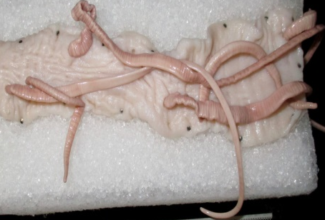
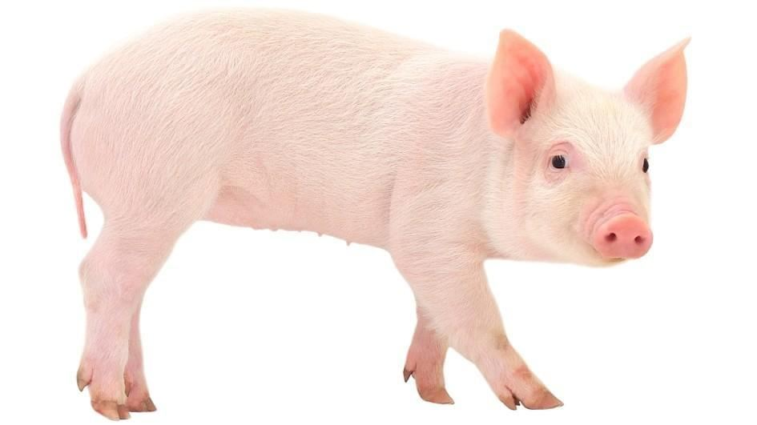
Salient Characters
of
Phylum: Acanthocephala
Dr. AJIT KUMAR
Department of Veterinary Parasitology
Bihar Veterinary College
Bihar Animal Sciences University
Patna-800014
Image source: Google image

Slide 2
Salient Characters of
Phylum: Nemathelminthes
&
Acanthocephala
Parasites are eukaryotic organisms.
Parasites
Helminths
(Metazoa- Multicellular)
Phylum:- Platyhelminthes
Phylum:-Nemathelminthes
Phylum:-Acanthocephala
Arthropods
(Metazoa- Multicellular)
Protozoa
(Unicellular)

Slide 3
Salient Characters of
Phylum: Nemathelminthes & Acanthocephala
Helminth word has been derived from a Greek word helmins or helminthos which means a worm.
Helminths (worms) are mainly endoparasites.
Helminths
Platyhelminthes
Nemathelminthes
Acanthocephala

Slide 4
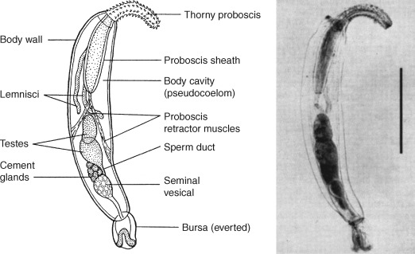
Characters of Phylum- Acanthocephala
General Characters:
Body is cylindrical with thick cuticle like nematodes
A retractable proboscis at the anterior end and it is armed with hooks, hence they are called as thorny –headed worms.
Image source: Google image
Notes:
ic

Slide 5
Characters of Phylum- Acanthocephala
General Characters:
Body cavity present (Pseudocoelomate)
Body segmentation absent
Sucker absent
Alimentary canal absent.
Notes:
ic

Slide 6
Characters of Phylum- Acanthocephala
General Characters:
Unisexual
Excretory system absent or a pair of nephridia present.
Image source: Google image
Notes:
ic

Slide 7
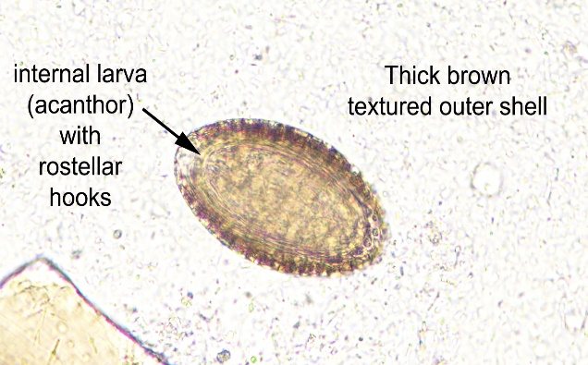
Salient Characters of
Phylum: Acanthocephala
Life-cycle: Indirect
Females are ovo-viviparpous.
Females are longer than male.
Eggs are spindle shaped with thickened shell containing a larva called acanthor which has an anterior circlet of hooks.
Larvated eggs are ingested by the arthropod intermediate hosts and develop into cystacanth.
Final hosts get infection by the ingestion of cystacanth infected arthropods.
Egg
Image source: Google image

Slide 8
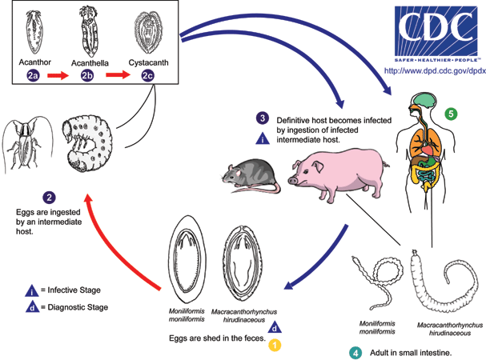
Salient Characters of
Phylum: Acanthocephala
Life-cycle: Indirect
Image source: Google image

Slide 9
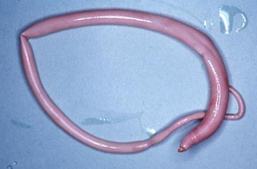
Phylum: Acanthocephala
Family: Oligacanthorhynchidae
Genus: Macrocanthorhynchus
Species: Macrocanthorhynchus hirudinaceus
Image source: Google image

Slide 10
THANK U

