Slide 1
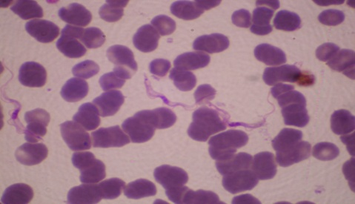
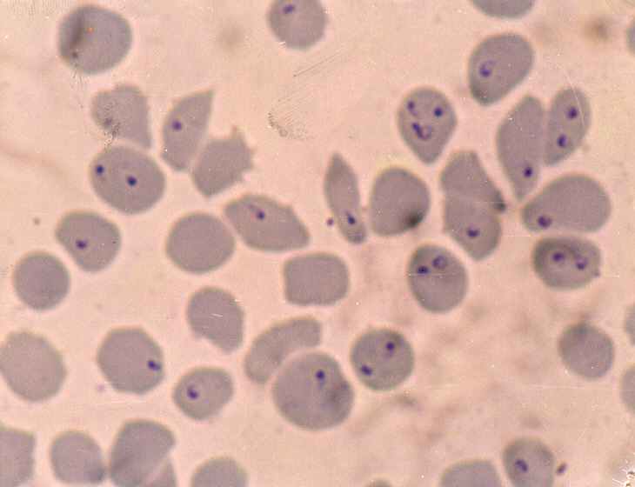
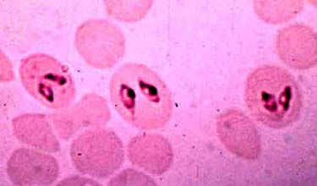
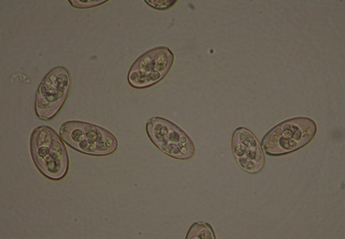
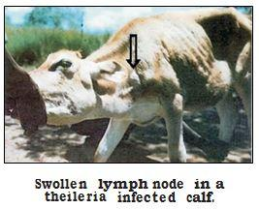
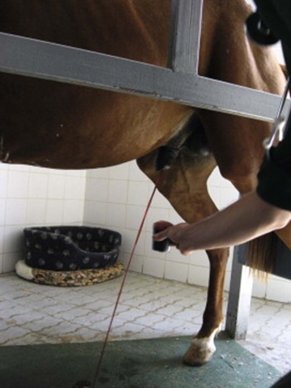
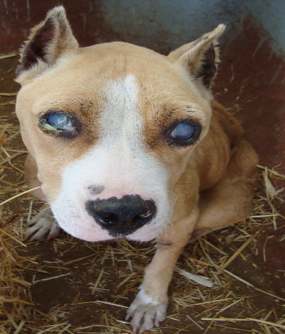
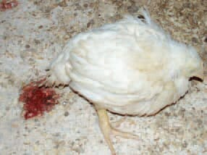
Salient Characters
of
Protozoa
Dr. AJIT KUMAR
Department of Veterinary Parasitology
Bihar Veterinary College
Bihar Animal Sciences University
Patna-800014
Image source: Google image

Slide 2
Salient Characters of
Protozoa
Parasites
Helminths
(Metazoa- Multicellular)
Arthropods
(Metazoa- Multicellular)
Protozoa
(Unicellular)

Slide 3
Salient Characters of
Protozoa
Kingdom- Protista
Sub-kingdom- Protozoa
Phylum-- Sarcomastigophora
Phylum-- Apicomplexa
Phylum: Microspora
Phylum: Ciliophora
Family:Haemogregarinidae
Eimeriidae
Cryptosporidiidae
Sarcocystidae Toxoplasmatinae
Plasmodiidae
Babesiidae
Theileriidae
Family: Balantidiidae
Family:Trypanosomatidae
Monocercomonadidae
Trichomonadidae
Endamoebidae

Slide 4
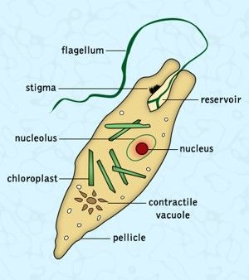
Salient Characters of
Protozoa
Protozoa were discovered by Antoni Van Leeuwenhoek (Dutch scientist) and also known as Father of Protozoology.
First animal life which appeared on this earth belonged to this category.
Protozoa is an unicellular, microscopic and eukaryotic organism having a distinct nucleus enclosed in a membrane.

Slide 5
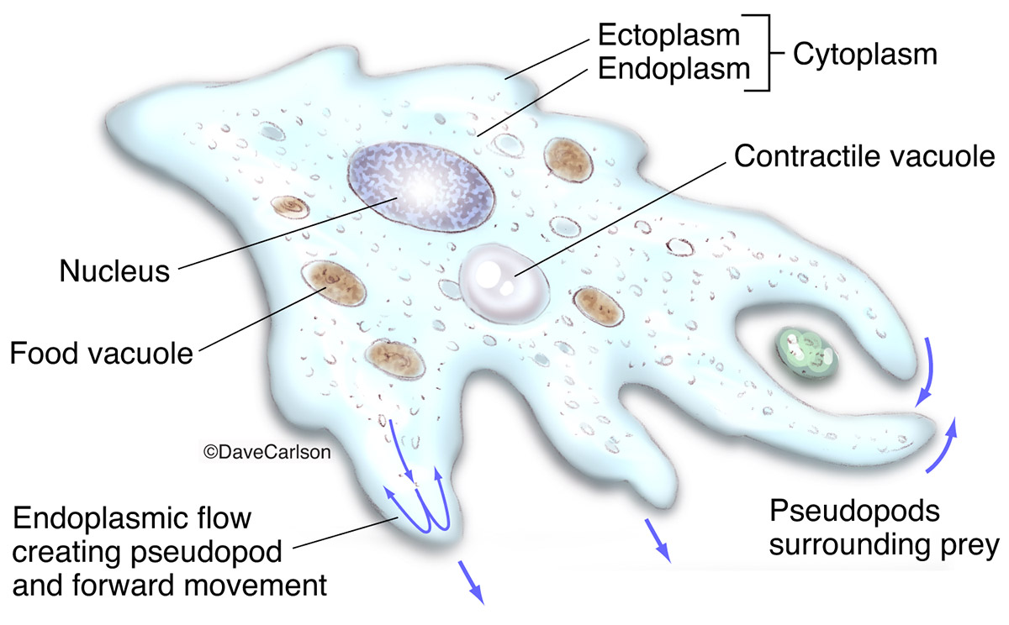
Salient Characters of
Protozoa
Body divided into two parts i.e. cytoplasm and nucleus.
Nucleus is either vesicular or compact type.

Slide 6
Salient Characters of
Protozoa
Movement of Protozoa:
Protozoa move by means of pseudopodia or flagella or Cilia or by gliding.

Slide 7
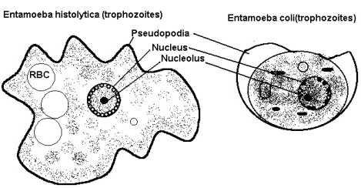
Salient Characters of
Phylum: Protozoa
Movement of Protozoa:
Protozoa move by means of pseudopodia

Slide 8
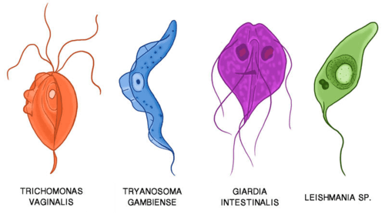
Salient Characters of
Protozoa
Movement of Protozoa:
Protozoa move by means of flagella

Slide 9
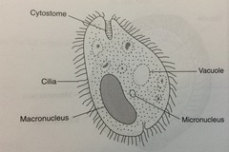
Salient Characters of
Phylum: Protozoa
Movement of Protozoa:
Protozoa move by means of Cilia
e.g. Balantidium coli.

Slide 10
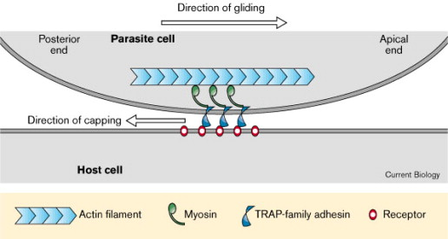
Salient Characters of
Protozoa
Movement of Protozoa:
Gliding movement: due to absent of locomotary organ (Members of Phylum Apicomplexa and class sporozoea i.e. Toxoplasma, Sarcocystis, Eimeria, Isospora, Cryptosporidium, Hepatozoon,Theileria, Babesia, Besnoitia, Hammondia, Plasmodium, Haemoproteus and Leucocytozoon species)

Slide 11
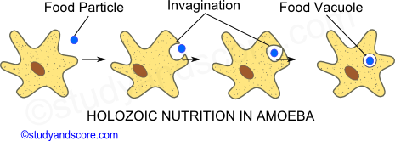
Salient Characters of
Protozoa
Nutrition of Protozoa:
Nutrition of protozoa is either holophytic (example-free living protozoa)or holozoic or saprozoic.

Slide 12
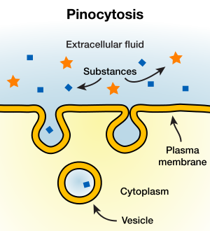
Salient Characters of
Protozoa
Saprozoic Nutrition of Protozoa: soluble nutrients cross the plasma membrane by pinocytosis, diffusion, or carrier mediated transport.

Slide 13
Salient Characters of
Protozoa
Excretion:
Metabolic waste product excreted out either through the body surface membrane or by means of contractile vacuole which plays an osmoregulatory function.

Slide 14
Salient Characters of
Protozoa
Reproduction in Protozoa :-
Asexual or both asexual and sexual method.
Asexual :
Binary fission,
Schizogony (multiple fission),
Budding
Sporogony
Sexual :
Syngamy
conjugation

Slide 15
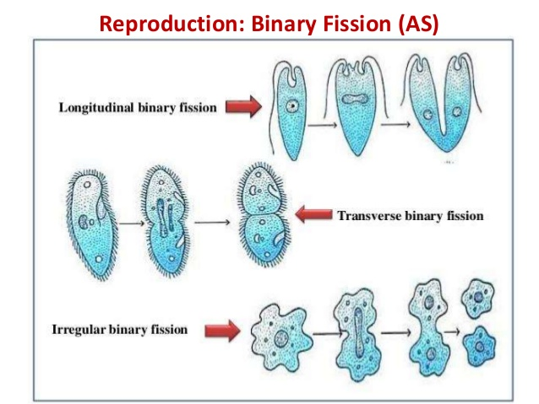
Salient Characters of
Protozoa
Asexual Reproduction in Protozoa :-
Binary fission : Binary fission is commonest mode of asexual reproduction, in the space of nucleus divides first, and then cytoplasmic division occurs.

Slide 16
Salient Characters of
Protozoa
Asexual Reproduction in Protozoa :-
Schizogony ( Multiple fission) : First nucleus divides several times, then cytoplasm. The dividing forms with a multinucleated mass and surrounded by a distinct wall known as Schizont and daughter forms called merozoites.

Slide 17
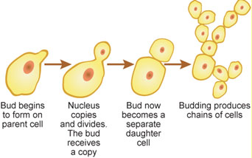
Salient Characters of
Protozoa
Asexual Reproduction in Protozoa :-
Budding : Two or more daughter forms are produced from the parent cell and grow to full size.
Edodyogeny(Internal budding): Two daughter cells are formed within the parent cells.
Endopolygeny- Many daughter cells are formed within the parent cells. e.g. Toxoplasma and Sarcocystis spp.

Slide 18
Salient Characters of
Protozoa
Sexual Reproduction in Protozoa :-
Conjugation: Exchange of nuclear materials from the micronucleus takes place . e.g. Ciliates

Slide 19
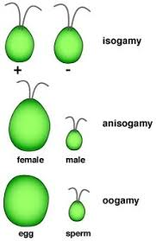
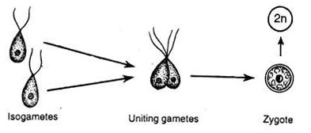
Salient Characters of
Protozoa
Sexual Reproduction in Protozoa :-
Syngamy:
Two gamete fuse to form a zygote .
Two similar size gametes i.e. isogametes and process of fusion called isogamy.
Two dissimilar size gametes i.e. anisogametes and it fusion called anisogamy.
In anisogamy, the smaller gamete is a male gamete known as microgamete and the larger one is a female gamete known as macrogamete which is produced from microgametocyte and macrogametocyte, respectively.

Slide 20
Salient Characters of
Protozoa
Asexual Reproduction in Protozoa :-
Sporogony is an asexual process of multiple fission and sporogony normally follows syngamy.
In sporogony, zygote forms a number of sporozoites within the wall of a cyst.

Slide 21
Salient Characters of
Protozoa
Life-cycle of Protozoa:
Life-cycle is usually indirect except. Balantidium, Giardia, Entamoeba, Tritrichomonas spp.
Indirect life-cycle:-

Slide 22
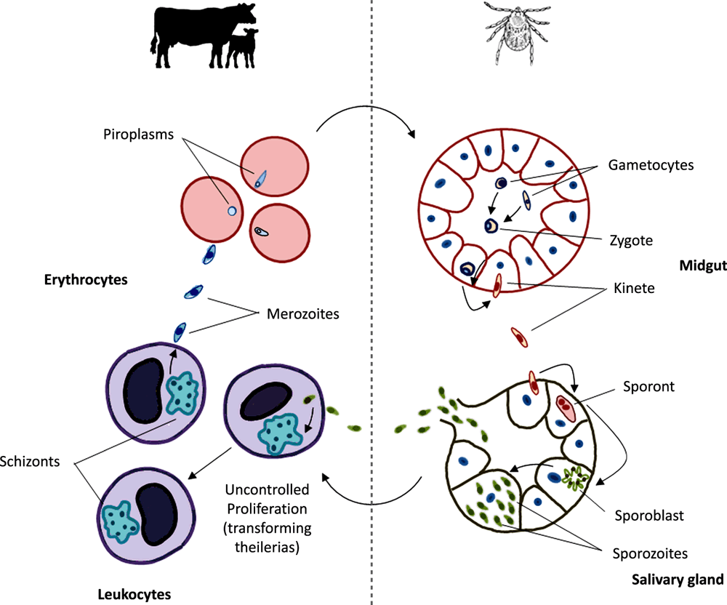
Salient Characters of
Protozoa
Life-cycle of Protozoa:
Indirect life-cycle:-
Theileria sp. Life-cycle

Slide 23
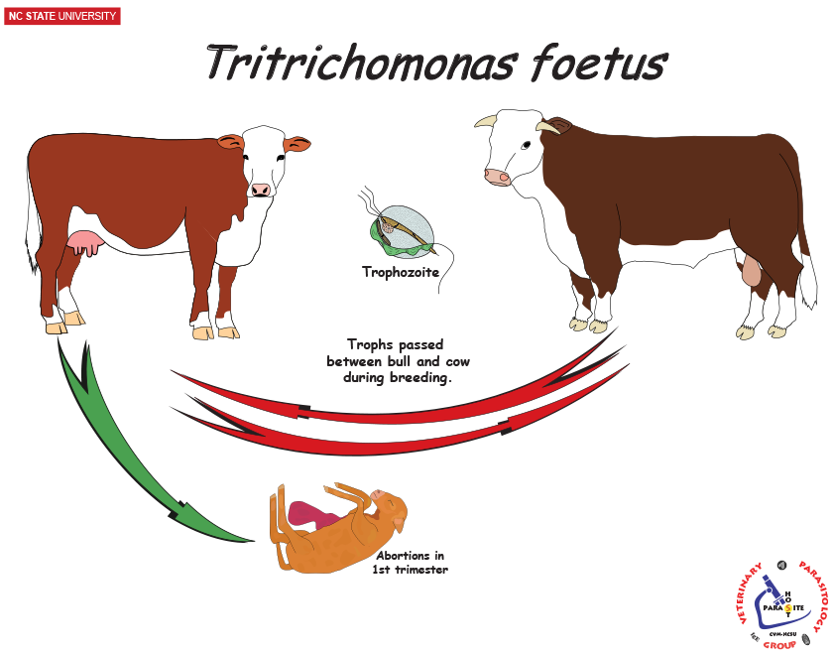
Salient Characters of
Protozoa
Life-cycle of Protozoa:
Direct life-cycle:-

Slide 24
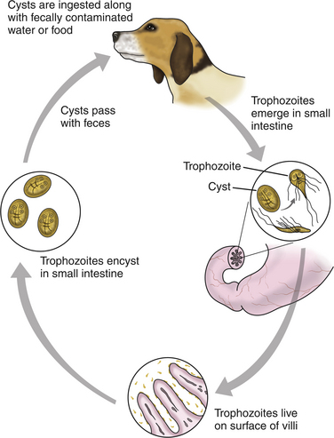
Salient Characters of
Protozoa
Life-cycle of Protozoa:
Direct life-cycle:-
Giardia sp. Life-cycle

Slide 25
Salient Characters of Protozoa
Protozoan Parasites
Haemoprotozoa | Caused disease
Trypanosoma evansi | Trypanosomosis or Surra
Babesia bigemina | Babesiosis or red water disease
Theileria annulata | Bovine tropical theilerioisis
Hepatozoon canis | Hepatozoonosis
Leishmania donovani | Kala azar
Trypanosoma sp.
Babesia sp.
Theileria sp.
Gametocyte of Hepatozoon canis inside neutrophil

Slide 26
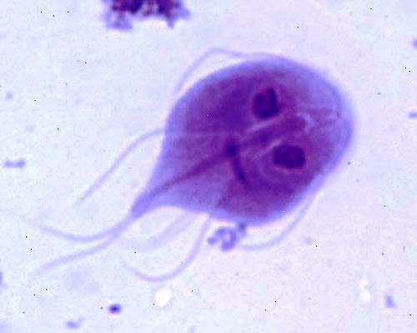
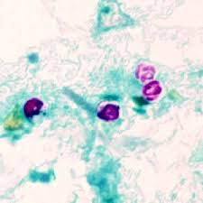
Salient Characters of Protozoa
Protozoan Parasites
Gastrointestinal Protozoa | Caused disease
Eimeria spp. | Coccidiosis
Entamoeba histolytica | Amoebic dysentery
Giardia spp. | Giardiosis
Toxoplasma gondii | Toxoplasmosis
Cryptosporidium spp. | Cryptosporidiosis
Oocysts of Eimeria
Giardia sp.
Oocyst of Cryptosporidium sp.

Slide 27
THANK U

