Slide 1
Class Lecture
HISTORY AND DEVELOPMENT OF CONDENSED MILK
Dr. Sanjeev Kumar
Associate Professor
Department of Dairy Technology
SGIDT, Patna-14

Slide 2
Condensed milk ..???
Partial removal of water from milk, skim milk, whey and other milk products i.e Concentrated
Purpose : to diminish the volume
to enhance the shelf life quality.
Water can be removed from milk by evaporation and in addition to water, volatile substances (especially dissolved gases) removed.
Evaporation is usually done under reduced pressure — hence, decreased temperature — to prevent damage caused by heating.
Water can also be removed by a membrane process called as reverse osmosis, i.e., high pressure is applied to a solution to pass its water through a suitable membrane.
Water as well as part of some low-molar-mass substances passes through the membrane.
A different method of concentrating is by freezing.

Slide 3
History...
Marco Polo (1200) described the production of a paste like milk concentrate in Mongolia which was used by mixing with water.
Then 600 years passed before we again find concentrated milk in the literature, but thereafter the development progressed rapidly.
The advent of condensed milk belongs to 19th century.
The condensed milk industry was introduced at about the same time as the factory system of butter and cheese making.
Its rapid development stands in sharp contrast to the production of butter and cheese.

Slide 4
Nicolas Appert condensed milk in France in 1820 and was developed afterwards in the United States in 1856 by Gail Borden.
Before this development, milk could only be kept fresh for a short while and so was only available in the immediate vicinity of its production.
After several attempts, Borden was able to produce a usable milk derivative that was long-lasting and needed no refrigeration.
By 1858 Borden's milk, sold as Eagle Brand, had gained a reputation for purity, durability and economy.
In 1864, Gail Borden's New York Condensed Milk Company constructed the New York Milk Condensery in Brewster, New York.
This condensery was the largest and most advanced milk factory and was Borden's first commercially successful plant.

Slide 5
The basic principle of the process of sterilization by heat was introduced by Mr. John B. Meyenbarg - a native of Switzerland in the year 1884-‘87.
He conceived the idea of making condensed milk without the addition of cane sugar or other preservatives and without the necessity of keeping it cold.
Mr. Meyenbarg experimented with the sterilization of condensed milk by steam under pressure and as the result of these experiments; he decided to preserve milk without the aid of sugar by the use of revolving sterilizer which he designed.
Originally the unsweetened sterilized condensed milk was sold under the trade name of Evaporated Cream.
The Federal Food & Drug act of 1906 changed the name “Evaporated Cream” to “Evaporated Milk”.

Slide 6
The vacuum pan that was developed in 1883 has undergone marked improvement as a result of scientific knowledge and at present modern types of evaporators are available in different designs and shapes, which have much more advantages than the original one in terms of evaporating capacity, fuel efficiency and product quality.
In 1911, Nestlé constructed the world's largest condensed milk plant in Dennington, Victoria, Australia.
In 1914, Professor Otto F. Hunziker, head of Purdue University's dairy department, published a book titled “Condensed milk and milk powder”.
This text, along with additional work of Professor Hunziker and others involved with the American Dairy Science Association, standardized and improved condensery operations in the U.S. and other countries.

Slide 7
The simplest evaporator is an ordinary open pan heated with steam or direct gas.
The evaporation takes place from the surface while the liquid to be evaporated is heated up to the boiling point corresponding to the ambient pressure, which at sea level will be 100°C.
As the evaporation has to take place from the surface, which is limited in relation to the content of the pan, the evaporation will naturally take long time.
The milk will be exposed to the high temperature with deterioration of the proteins and chemical reactions such as the Maillard reaction or even coagulation results.
As the development went on, the concentration was carried out in forced recirculation evaporators and multi stage evaporators. For the separation of liquid and vapours, centrifugal separators are preferred.

Slide 8
There are principally two kinds of condensed milk :
Sweetened Condensed
Unsweetened Condensed milks
Both reach the market in hermetically sealed tin cans.
Sweetened Condensed Milk as the name suggests is sweetened with addition of sugar which acts to enhance its shelf life.

Slide 9
Unsweetened condensed milk is known by trade name “Evaporated Milk”.
It is made by removal or evaporation of water from milk without the addition of any preserving material.
The canned product is heat sterilized to extend shelf life.
Fortification with vitamins of either or both A or D₃ is common.
Because of its concentrated form, evaporated milk is a multipurpose, convenient dairy product ready for every milk use.
Evaporated skim milk is obtained by a simple concentration of skim milk by vacuum evaporation or reverse osmosis.
Evaporated filled milk is a prepared blend of skim milk, vegetable oil, stabilizers and vitamins.

Slide 10
The improvements in modern equipment are:
Change of metal from copper to stainless steel.
b. Double and triple effect or combination of single effect evaporator with thermo- temperature control.
c. Plate type evaporators were developed in 1958.

Slide 11
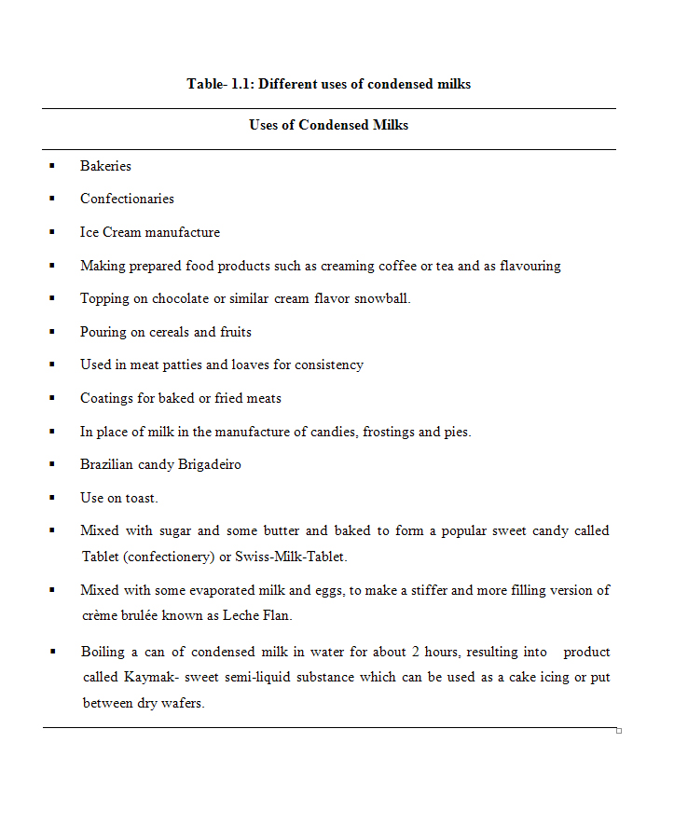
USES OF CONDENSED MILKS

