Slide 1
Immune Evasion by Parasites
Dr. AJIT KUMAR
Department of Veterinary Parasitology
Bihar Veterinary College
Bihar Animal Sciences University
Patna-800014
Image source: Google image

Slide 2
Immune Evasion by Parasites
Parasites have various mechanism of immune evasion, so that they can survive and proliferate in the host . The following evasion mechanism uses by the parasites:-
Antigenic variation
Antigenic disguise
Antigenic shedding
Immune suppression
Immune complex formation
Inert cuticular surface
Location in protective site
Modified leucocytic function

Slide 3
Immune Evasion by Parasites
Antigenic variation:
It is a phenomenon in which parasites shed the outer Variant Surface Glycoprotein (VSG) coat and replace it with another one on every 7-10 days. Therefore, immune response developed against preceding VSG, can not work with subsequent antigenically different VSG and the parasites thus evade the host immune response. Example- Trypanosoma spp.

Slide 4
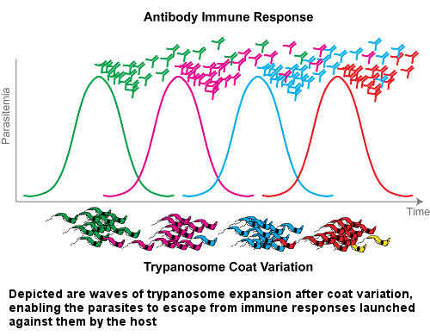
Immune Evasion by Parasites
Antigenic variation:

Slide 5
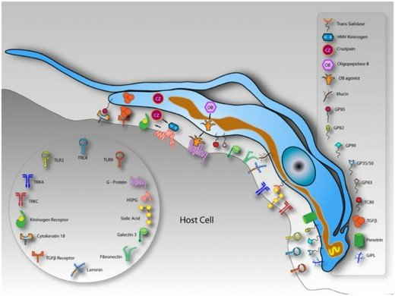
Immune Evasion by Parasites
Antigenic Variation :
Trypanosomes have antigenic variation character due to variant surface glycoproteins (VSG).
Image source: Google image

Slide 6
Immune Evasion by Parasites
Antigenic Variation:
The surface coat of trypanosomes is a 12-15 mm thick layer made up of about 10⁷ identical molecules of approximately 60 kDa which are closely packed to cover the entire surface. These molecules are variant surface glycoproteins (VSGs).
Image source: Google image

Slide 7
Immune Evasion by Parasites
Antigenic Variation:
Changing antigenic characters of trypanosomes in vertebrate’s hosts, the development of an effective vaccine against trypanosomes is difficult.
Image source: Google image

Slide 8
Immune Evasion by Parasites
2. Antigenic disguise :-
It is mechanism where the parasites mask their antigens by incorporating host molecules like RBCs, immunoglobulin etc.
e.g. Schistosoma spp.
Schistosoma

Slide 9
Immune Evasion by Parasites
3. Antigenic mimicry :-
It is mechanism where the parasites mask their antigens by incorporating host molecules like RBCs, immunoglobulin etc.
e.g. Schistosoma spp.
Schistosoma

Slide 10
Immune Evasion by Parasites
4. Antigenic shedding:-
Nematodes and some other parasites shed their whole cuticular sheath and also antigenic molecules during molting.
e.g. Schistosoma mansoni, Plasmodium falcifarum , Entamoeba, Ancylostoma, etc.

Slide 11
Immune Evasion by Parasites
Antigenic shedding:-
molecules during molting.
Parasites shed their antigens in abundance can neutralize antibody response at a distance away from the parasites. This help the parasites to evaded the host’s protective response.
Schistosoma

Slide 12
Immune Evasion by Parasites
5. Immune suppression:-
Many parasites stimulate the production of specific immune suppressor cells, induce lymphotoxicity, produces blocking antibodies and leads to inhibition of immune system of hosts.
e.g. Schistosoma, Trypanosoma , Plasmodium etc.

Slide 13
Immune Evasion by Parasites
6. Immune Complex formation:-
Parasite like Toxoplasma gondii and Plasmodium spp. evade the hosts immune system by immune complex formation.
e.g. Toxoplasma gondii, Plasmodium etc.

Slide 14
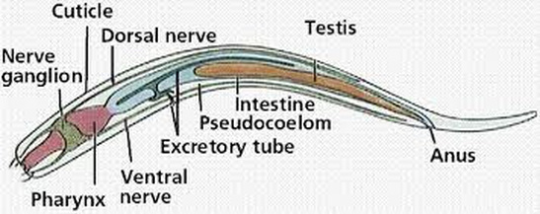
Immune Evasion by Parasites
7. Inert cuticular surface:-
Helminthes especially nematodes have immunologically inert cuticular surface. This helps in evasion of host’s immune response.

Slide 15
Immune Evasion by Parasites
8. Sequestration of parasites ( Location of parasites in a protective site)

Slide 16
Immune Evasion by Parasites
10. Survive in macrophage by Preventing phago-lysosome fusion:-
e.g. Leishmania, Trypanosoma, Toxoplasma etc.
Amastigote stage of Leishmania spp.
Macrophage

Slide 17
Immune Evasion by Parasites
11. Modified leucocytic function:-
Parasites like Schistosoma mansoni and Fasciola hepatica release some inhibitory factors which can alter the leucocytic functions and evade the host’s immune system.

Slide 18
Immune Evasion by Parasites
12. Neonatal immunological responsiveness:-
Young animals are unable to develop a proper immune response to some parasitic infections.

Slide 19
Effects of Immune Response on Parasites
Usually expel the adults and larvae of parasites after development of immunity.
e.g. Self-cure Phenomenon
Concomitant Immunity
Preventimg the migration and establishment of larvae or sometimes, by arresting the development of larvae in re-infection.
Stunting of growth and reduction of fecundity of parasites.

Slide 20
Effects of Immune Response on Parasites

Slide 21
Effects of Immune Response on Parasites

Slide 22
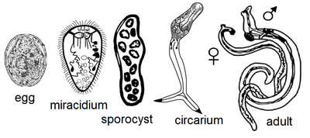
Effects of Immune Response on Parasites
Concomitant immunity: An immunity which acts against invading larval stages, but not against an existing infection. Thus, a host may be infected with adult parasites or established larval of cestodes but has a measure of immunity to further infection. e.g. Schistosoma infection.

Slide 23
THANK U

