Slide 1
BIHAR ANIMAL SCIENCES UNIVERSITY, PATNA, BIHAR Bihar Veterinary College, Patna
UNIT-I
Introduction to Presentation of Data
Speaker: Ramesh Kumar Singh
Assistant Professor cum Jr. Scientist
Division of Animal Genetics and Breeding
Bihar Veterinary College, Patna

Slide 2
Introduction
Since most data are available to researchers in a raw format, they must be summarized, organized, and analysed to usefully derive information from them.
Furthermore, each data set needs to be presented in a certain way depending on what it is used for.
Planning how the data will be presented is essential before appropriately processing raw data.
First, a question for which an answer is desired must be clearly defined.
A well-defined question is crucial for the data to be well-understood later. Once a detailed question is ready, the raw data must be prepared before processing.

Slide 3
Data Presentation
Data can be presented in one of the three ways:
– as text
– in tabular form
– in graphical form
Methods of presentation must be determined according to the data format, the method of analysis to be used, and the information to be emphasized.

Slide 4
Text presentation
Text is the main method of conveying information as it is used to explain results and trends, and provide contextual information.
Data are fundamentally presented in paragraphs or sentences.
Text can be used to provide interpretation or emphasize certain data.
If quantitative information to be conveyed consists of one or two numbers, it is more appropriate to use written language than tables or graphs.

Slide 5
Contd…
If more data are to be presented, or other information such as that regarding data trends are to be conveyed, a table or a graph would be more appropriate.
By nature, data take longer to read when presented as texts.
when the main text includes a long list of information, readers and reviewers may have difficulties in understanding the information.

Slide 6
Diagrammatic and Graphic Representation
The classification and tabulation are the devices of presenting the statistical data in neat, concise, systematic and readily comprehensible and intelligible form thus highlighting the salient features.
Diagrammatic and graphic representation is an another important, convincing, appealing and easily understandable form of data presentation which have a number of advantages.

Slide 7
Advantages
Diagrams and graphs are visual aid which present the data in simple and readily comprehensible form. If properly constructed, if highlight hidden fact of data otherwise if might have been lost.
Diagrams are very attractive as they delight the eyes and appeal to mind and leave long lasting impression to mind of people in general.
They are early intelligible
They are highly impressive
They are easily comparable
They consume less time and energy
They are very much helpful in various types of studies.

Slide 8
Different between diagrams and graph
Diagram | Graph
It is constructed on plain paper and used for comprehension only, not for relationship study It furnishes only approximate information Useful in depicting categorical and geographical data | Graph paper is used which helps to study the relationship between two variables. It is more precise and accurate and help to study slope, rates of change and estimation. Useful in study of time series and frequency distribution data.

Slide 9
General rules for constructing the diagrams
It should have neatness in clarity.
It should have title & foot note.
Selection of scale should be appropriate.
Proportion between width and height should be maintained
Diagram should be selected with almost care.
It should have source note and number
It should have index also.
It should be simple.

Slide 10
Types of diagram – it is of following types
One dimensional Eq. Line diagram & Bar diagram
Two dimensional Eq. Rectangles, Squares, Pie-chart
Three dimensional Eq. Cubes, Spheres, Cylinder etc.
Pictograms
Cartograms

Slide 11
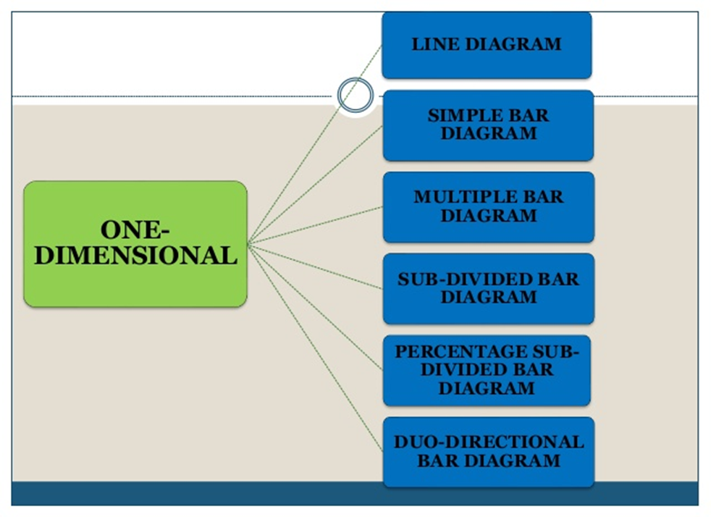
Types of One-dimensional diagrams

Slide 12
Thanking You

