Slide 1
LPT
Milk Products (Part-6)
By-
Dr. SUSHMA KUMARI
ASST.PROF., DEPT. OF LPT
BVC, PATNA

Slide 2
Ghee
Ghee may be defined as clarified fat prepared from cream of cow or buffalo milk.
The largest ghee producing states are U.P., A.P., Punjab, Rajasthan, M.P., Bihar, Haryana etc.
Buffalo milk is preferred for ghee preparation because being richer in fat content than other types of milk. It gives a larger yield of ghee.
The production of ghee is higher in winter and lower in summer corresponding to months of higher and lower milk production.

Slide 3


Slide 4
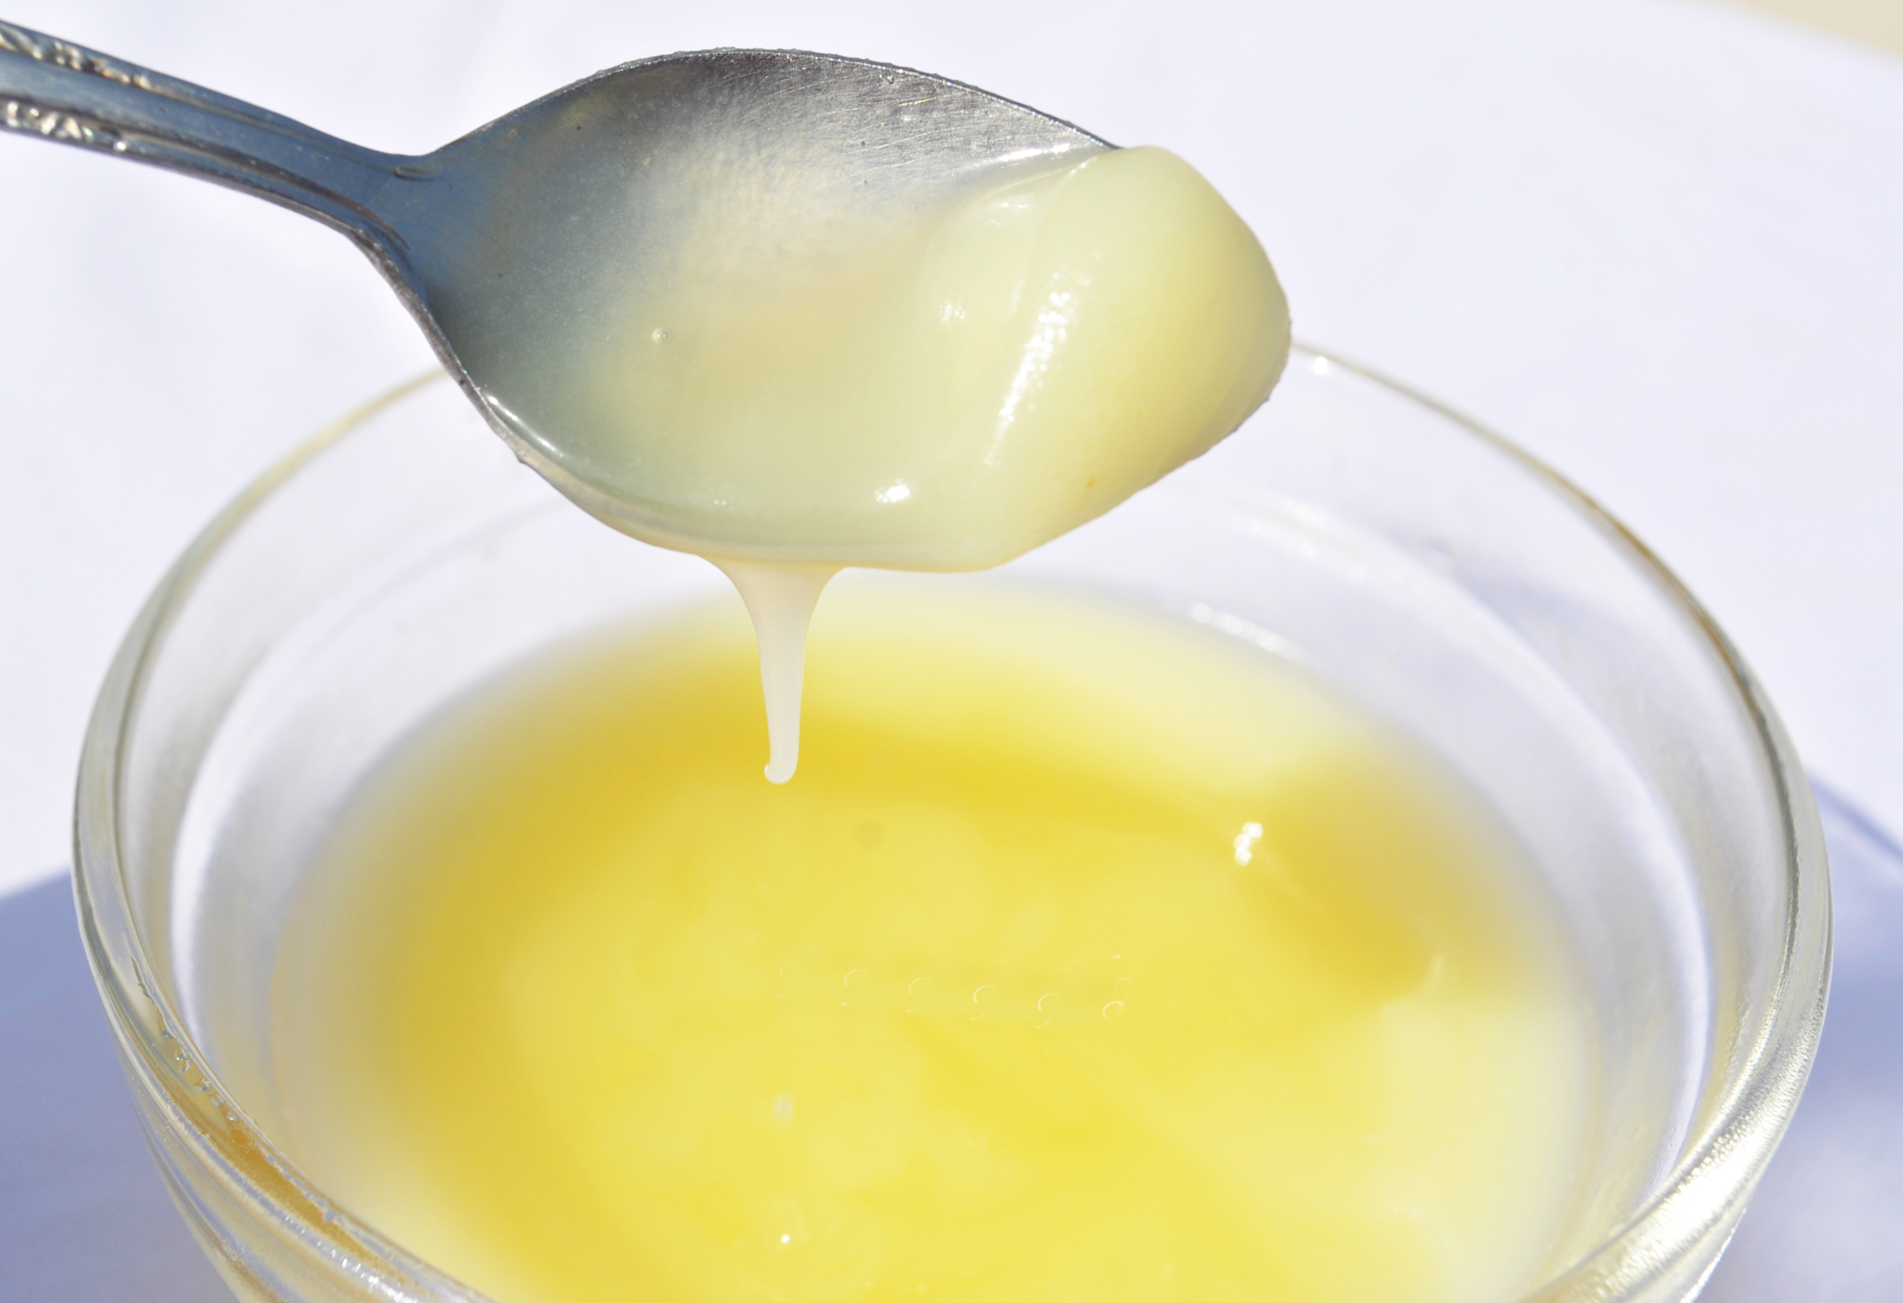
Ghee

Slide 5
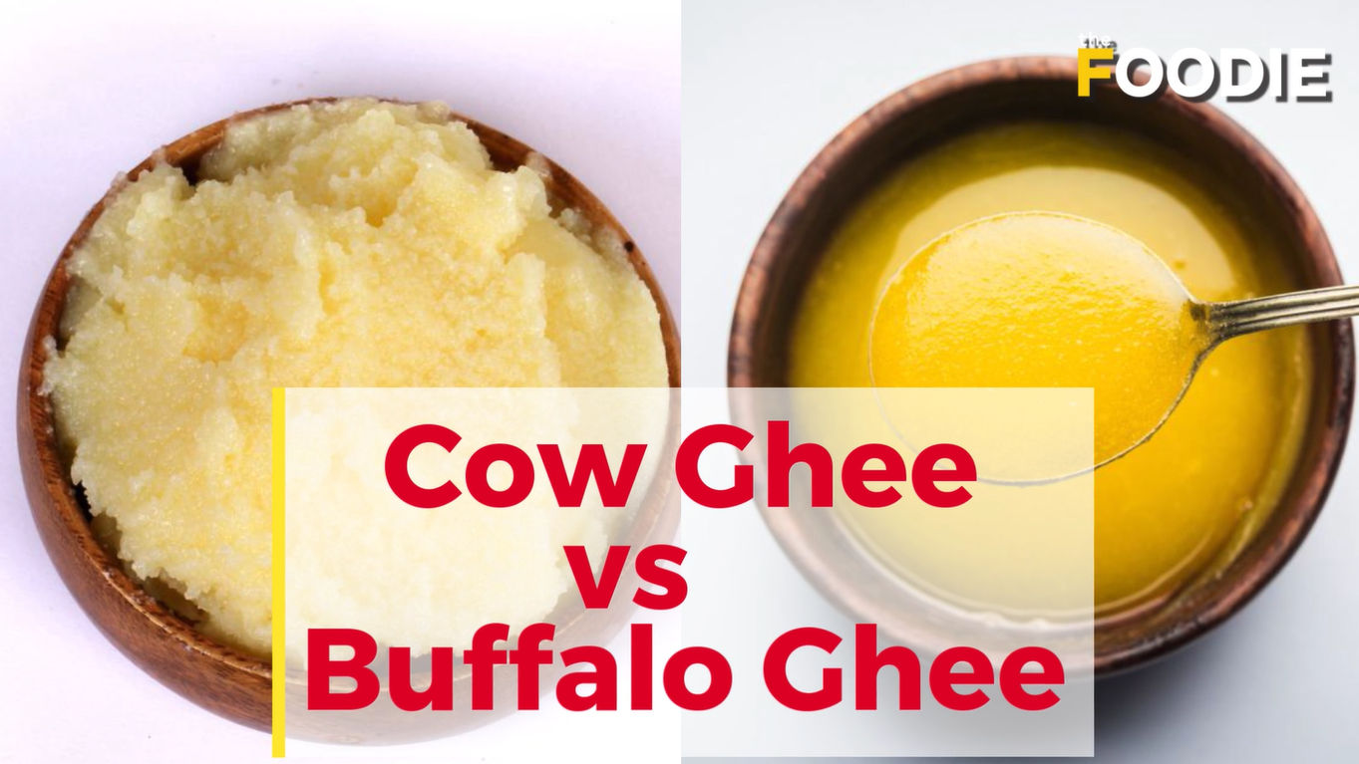

Slide 6
Chemical composition of ghee
Milk fat = 99.55%
Moisture= 0.5%
Shelf life of ghee- 6-12 months at 21C.
Method of preparation-
Milk
Separation of cream (ripened/unripened)
Churning at 110 C.
Ghee
Defects of ghee-
Smoky, rancid, metallic, burnt etc.

Slide 7

Ghee Obtained From Cream

Slide 8
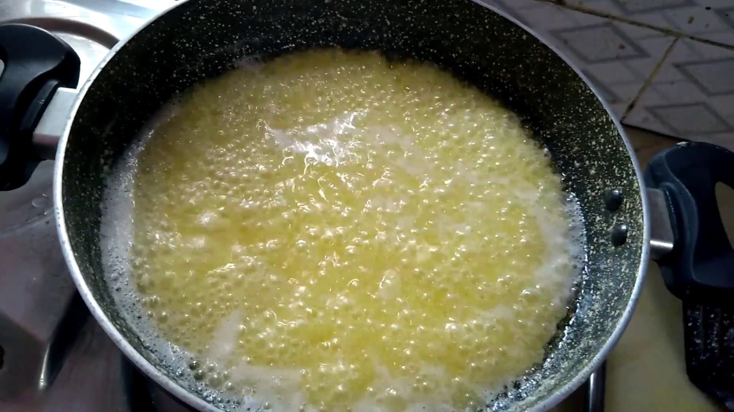
GHEE

Slide 9
THANKS

