Slide 1
LAMENESS PART -III
Fourth Professional(OLD)
Dr. RAMESH TIWARY
ASSSITANT PROFESSOR
Department of Veterinary Surgery & Radiology
BVC, PATNA-14

Slide 2
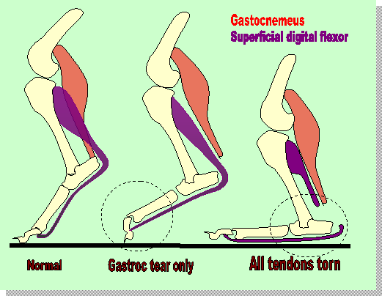
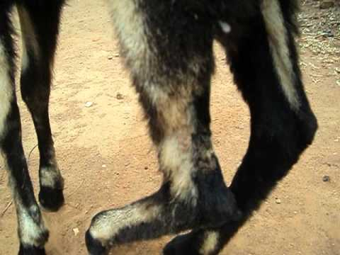
Rupture of Tendoachilles
Rupture of the gastrocnemius muscle

Slide 3
Excessive strain on the tendon during jumping
Malicious cutting of the tendon-Hamstringing
Keep the hock extended by putting plaster of Paris bandage 6-8 wks.

Slide 4
Rupture of Peroneus Tertius
Due to overextension of the hock joint
Rupture of the peroneus tertius hock can be extended without extending the stifle.
Complete rest is the best treatment 4-6 wks.

Slide 5
Fibrotic Myopathy/Ossifying Myopathy
The limb jerks backward and downward during the last 3 to 5 inches of the stride, resulting in slapping of the foot on the ground.

