Slide 1
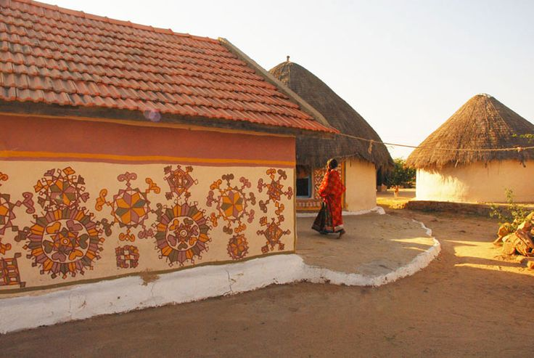
UNIT-01 (LIVESTOCK BASED LIVELIHOODS AND THEIR EVOLUTION)
Dr. Puspendra Kumar Singh
Department of Veterinary & Animal Husbandry Extension Education, BVC

Slide 2
Large Scale farming

Slide 3
Different means of describing scale of livestock enterprise:
Quantity of produce & marketed unit within a time period
Number of animals/ birds maintained
Area of holding over which the livestock enterprise is based
The advantages of large scale production over small scale production are called Economies of scale (Economies of scale are cost advantages reaped by enterprises when production becomes efficient.)

Slide 4
Advantages of Large-scale farming
Increased efficiency & full utilization of labor
Lower machine cost as a result of greater annual use
Building economics
Buying and selling
Management
Economics in financing
Economics in the use of by-products

Slide 5
Disadvantages of Large-scale farming
Greater losses during depression period
Difficulty in supervision
Under utilization of resources, equipments, labors
Apart from this, extended limit of farm then leads to inefficiencies

Slide 6
Advantages of small scale farming
Close attention & supervision
Efficient use of family labour
Higher productivity
Low market dependence for inputs
Intensive cultivation is possible
Social justice through distribution of landed property
Higher family labour employment

Slide 7
Disadvantages of small scale farming
Inadequacy of productive resources
Unremunerated farming
Limited scope for development
Shortage of farm implements
Under employment
Market diseconomies
Shortage of finance

Slide 8
Comparison between Large & Small scale farming
Aspects | Large scale | Small scale
Division of labour | Possible | Limited
Mechanization | Possible | Not possible
Quantity of output | More | Less
Cost of production | Low | High
Cost of management | Low | High
Risk | More | Less
Marketing facilities | Better | Poor
Economy of buying & selling | More | Less
Possibility of using improved technology | More | Less
Danger of over production | More | Less
Supervision | Poor | Better
Flexibility | Inflexible | Flexible
Chances of unhealthy competition | More | Less

