Slide 1
MILK PRODUCTS (Part-1)
BY-
Dr. SUSHMA KUMARI
HOD,
DEPT. OF LPT,BVC,
Bihar Animal Sciences University, Patna

Slide 2
Milk Products
Primary milk products- Khoa, Channa, Curd, Paneer etc.
Secondary milk products-
Matha ,Lassi- curd
Rasogulla- channa
Gulabjamun- Khoa
Milk by-products-
whey- channa, paneer, cheese
Ghee residue- ghee

Slide 3
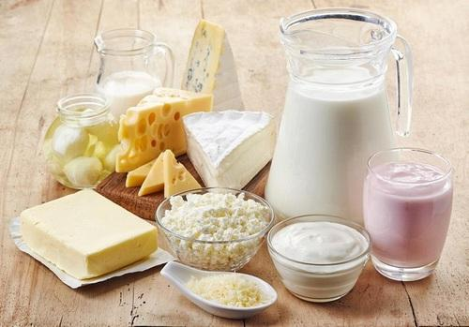
MILK PRODUCTS

Slide 4
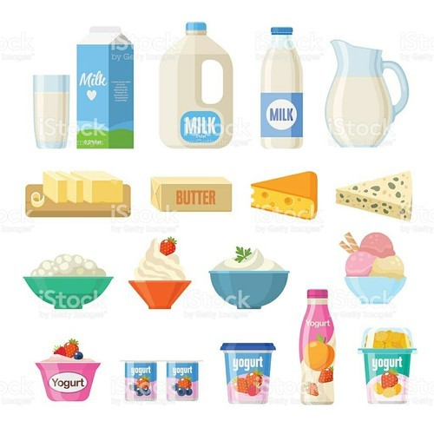
MILK PRODUCTS

Slide 5
Classification of milk products
1. Fermented milk products-
curd, lassi, matha
2. Acid coagulated milk products-
channa, paneer
3. Acid and Rennet coagulated milk products-
cheese
4.Concentrated milk products-
evaporated milk, condensed milk

Slide 6
5. Dehydrated milk products-
khoa
6. Dried milk products-
milk powder
7. Frozen milk products-
ice-cream, kulfi. Softy etc.

Slide 7
THANKS

