Slide 1
MILK PRODUCTS (Part-3)
BY-
Dr. SUSHMA KUMARI
Asst.Prof,
DEPT. OF LPT,BVC,
Bihar Animal Sciences University, Patna

Slide 2
Fermented Milk Products
Lassi
Method of preparation-
Curd
churning
breaking of curd
addition of sugar (6%)
and flavour
Lassi (chilling)

Slide 3
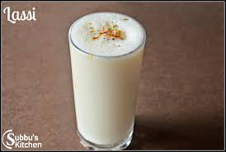
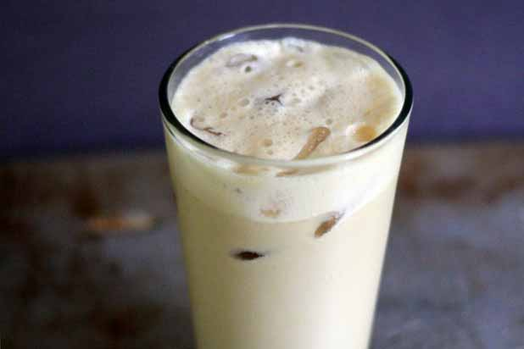

Slide 4
Srikhand
Curd
strained to remove whey
Chakka ( intermediate product)
add sugar, dry fruits, flavour etc.
Srikhand

Slide 5
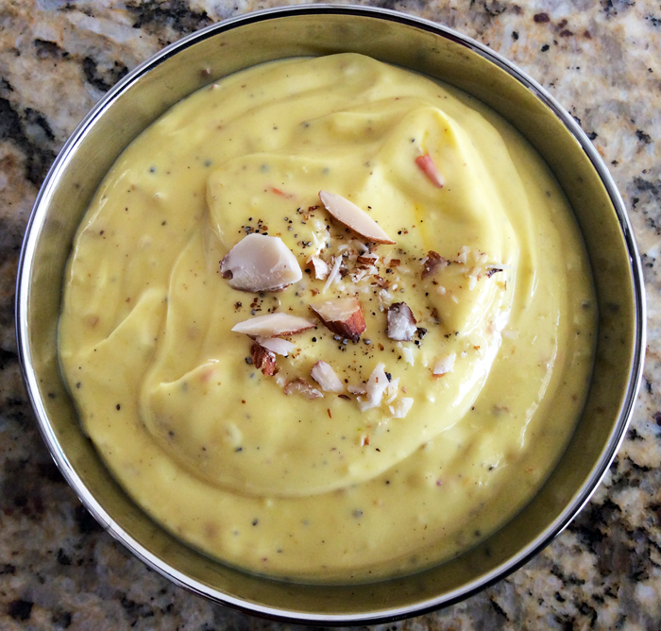
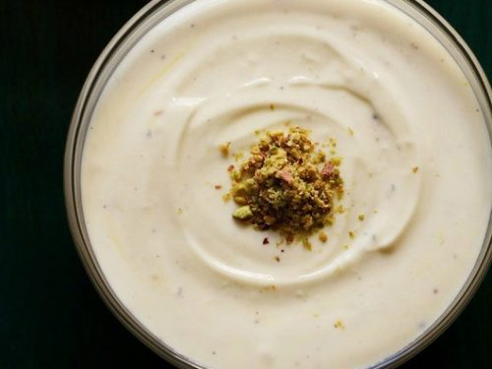
Shrikhand

Slide 6
Acid coagulated milk products
Chana-
It refers to milk solids obtained by the acid coagulation of boiled hot milk and subsequent drainage of whey.
Milk
boiled
Addition of 1-2% lactic acid, citric acid or acetic acid
coagulation of milk solid
drainage of greenish yellow colour whey
channa

Slide 7
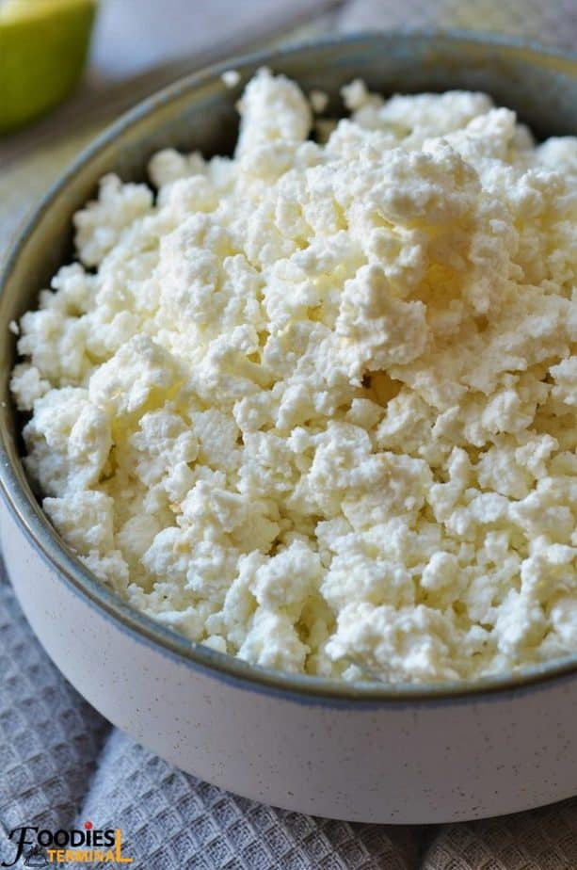
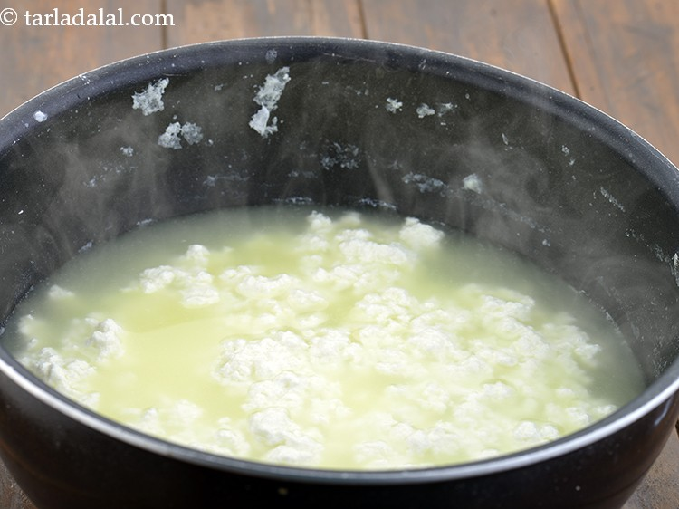
Chenna

Slide 8
Cow milk is preferred for channa preparation, because it has open texture due to which it is easy to mix up other ingredient during product preparation.
Channa is used for rasogulla making and other sweets making.
Channa contain high protein and fat but lower than Paneer.
Channa- (chemical composition)
Moisture-53.5% Lactose-2%
Fat- 25% Ash-.2%
Protein-17.5%

Slide 9
Quality of good channa
Colour- light yellow
Appearance- moist surface
Body- soft
Texture- smooth
Flavour- mild acidic
Highly suitable for sweets preparation.
Yield of channa-
Cow milk- 18-20%
Buffalo milk- 22-24%

Slide 10
THANKS

