Slide 1
Plasmids and Antibiotic resistance
Veterinary Microbiology (Unit-1)
Dr. Savita Kumari
Assistant Professor-cum-Jr. Scientist
Department of Veterinary Microbiology
Bihar Veterinary College, BASU, Patna

Slide 2
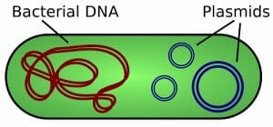
Plasmids
Usually circular, double stranded extrachromosomal DNA molecules, can exist independently of host chromosomes
Have their own replication origins
Autonomously replicating and stably inherited
Present in many bacteria (also in some yeasts and other fungi)
Encode traits that are not essential for bacterial viability
The term plasmid first introduced by American molecular biologist Joshua Lederberg in 1952

Slide 3
..
Plasmids and bacterial chromosomes separate replicons
Replicon- DNA molecule or sequence, has replication origin, capable of being replicated
Usually much smaller than bacterial chromosome (< 5 to > several 100 kbp)
As large as 2 million base pairs in some bacteria
Present in both Gram-positive and Gram-negative bacteria
Relatively few genes, generally less than 30
Genetic information not essential to host, bacteria lacking them usually function normally

Slide 4
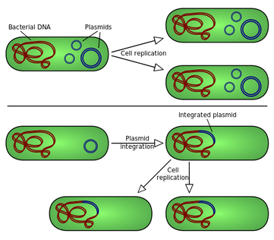
..
Also be present as integrated with bacterial chromosomes
Episome- plasmid can exist either with or without being integrated into host’s chromosome

Slide 5
..
Single-copy plasmids produce only one copy per host cell
Multicopy plasmids- 40 or more per cell
Curing-plasmids can be eliminated from host Cells
Spontaneous
or induced by treatments that inhibit plasmid replication while not affecting host cell reproduction
Some commonly used curing treatments:
Acridine mutagens
UV and ionizing radiation
Thymine starvation
Growth above optimal temperatures

Slide 6
Types of plasmids
Transmissibility of plasmids:
Transmissible/ conjugative plasmids:
Transferred from cell to cell by conjugation
Large plasmids
Contain genes responsible for synthesis of sex pilus and enzymes required for processing transfer of genetic material
Usually, one to three copies present in a cell
Non-transmissible/ non-conjugative plasmids:
Cannot be transferred from cell to cell
Small
Have high copy numbers (typically 10–60 per chromosome)

Slide 7
Fertility plasmids/F-plasmids/ F factor
Contain transfer (tra) genes- genetic materials through conjugation
Conjugative plasmids
Genes for production of sex pilus, enzymes required for conjugation
Also contains genes involved in their own transfer
Episomes
Bacteria having F-plasmid: F positive (F⁺), function as donors
Bacteria without it : F negative (F–), behave as recipients

Slide 8
F factor
plays a major role in conjugation in E. coli , first described
About 100 kilobases long
Most information for plasmid transfer in tra operon, at least 28 genes
Several segments- insertion sequences
assist plasmid integration into the host cell chromosome

Slide 9
R factor/Resistance factors/ Resistance plasmids
Conjugative plasmids
Two components of R factor : resistance transfer factor (RTF) and resistant determinant (r)
RTF - conjugational transfer, required for transfer of the plasmid between bacteria
r-determinant carries genes conferring antibiotic resistance

Slide 10
Functions of R factor:
Spread of multiple-drug resistance among bacteria
Carry genes for a variety of enzymes that can destroy antibiotics and modify membrane transport system
May carry one or more antibiotic resistance gene
Resistance to more than one type of antibiotics
May also carry genes for resistance to metal ions
Carry resistance to certain bacteriophages by coding for the enzymes, e.g., restriction endonucleases that degrade the DNA of the infecting bacteriophages

Slide 11
Colicinogenic (Col) factor /Col Plasmids
Competitive advantage
Bacteriocins-
Bacterial proteins that destroy other bacteria
Usually act only against closely related strains
host unaffected by the bacteriocin it produces
kill cells by forming channels in plasma membrane
Degrade DNA and RNA
Attack peptidoglycan and weaken the cell wall

Slide 12
..
Col plasmids- genes for synthesis of bacteriocins
large self-transmissible plasmids, or small nonconjugative, but mobilizable
Colicin directed against E. coli
Similar plasmids carry genes for bacteriocins against other species
Diphthericin- by Corynebacterium diphtheria
Pyocins- by Pseudomonas aeruginosa
Some Col plasmids are conjugative and also can carry resistance genes

Slide 13
Virulence Plasmids
make their hosts more pathogenic
bacterium better able to resist host defense or to produce toxins
help bacteria infect humans, animals
Adhesive fimbriae in E. coli
carry genes for virulence on plasmids
e.g. Bacillus anthracis- Toxin, capsule
Clostridium tetani- Tetanus toxin
usually large, low copy elements
usually transmitted between hosts by conjugation

Slide 14
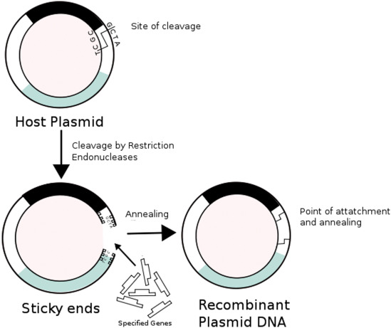
Metabolic plasmids/Degradative plasmids
carry genes for enzymes that degrade substances such as
aromatic compounds (toluene)
pesticides (2,4 dichlorophenoxyacetic acid)
sugars (lactose)
Cryptic plasmids - No known functions
Recombinant plasmids-
Plasmids altered in the laboratory, DNA fragments or genes into a plasmid vector, introduced into the bacteria
Recombinant plasmid containing foreign DNA - chimera

Slide 15
Functions of plasmids:
Survival of the organism
Many plasmids control medically important properties of pathogenic bacteria
resistance to one or several antibiotics
production of toxins
synthesis of cell surface structures required for adherence or colonization
Plasmids used in genetic engineering - vectors
Used to amplify, or produce many copies of certain genes
To make large amounts of proteins
Gene therapy

Slide 16
Antibiotic Resistance
..
Antibiotic
chemical substances, produced by various microorganisms
Antimicrobial substance active against bacteria
used to prevent and treat bacterial infections
Antibiotic resistance
occurs when bacteria change in response to use of antibiotics
survive and reproduce in the presence of antibiotic doses that were previously thought effective against them

Slide 17
Mechanisms of Antibiotic Resistance
Production of enzymes
Inactivate antibiotics
Enzyme Beta-lactamase destroys penicillins and cephalosporins by splitting the Beta-lactam ring of drug
Enzymatic alteration of the target site
Synthesis of modified targets
against which the antibiotic has no effect
Alteration of permeability of cell wall
by changing their permeability to the drug- effective intracellular concentration of antibiotic not achieved inside bacterial cell
Alteration of metabolic pathways
that bypasses the reaction inhibited by the drug
Efflux pumps
resistance to many groups of antibiotics including aminoglycosides, quinolones etc.

Slide 18
Basis of Resistance
Resistance by bacteria against antibiotic may be classified as:
1. Non-genetic basis
lose their cell wall, non-susceptible to action of cell wall acting drug such as penicillins
Presence of foreign bodies
bacteria in their resting stage
2. Genetic basis
03 types
(a) chromosome-mediated resistance- by mutation in the gene
(b) plasmid-mediated resistance- mediated by resistance plasmid
(c) transposons-mediated resistance
Transposons- small pieces of DNA, move from one site of bacterial chromosome to another and from bacterial chromosome to plasmid DNA
Many R factors carry one or more transposons (antibiotic resistance transposons Tn3 and Tn4 on R factor plasmid)

Slide 19
Plasmid-mediated resistance
Plays very important role in antibiotics usage in clinical practice
A high rate of transfer of plasmids from one bacterium to another bacterium takes place by conjugation
■ Plasmids mediate resistance to multiple antibiotics
■ Mostly in Gram negative bacteria

Slide 20



