Slide 1
PROCESSING OF MILK (Part-3)
BY-
Dr. SUSHMA KUMARI
HOD,
DEPT. OF LPT,BVC,
Bihar Animal Sciences University, Patna

Slide 2
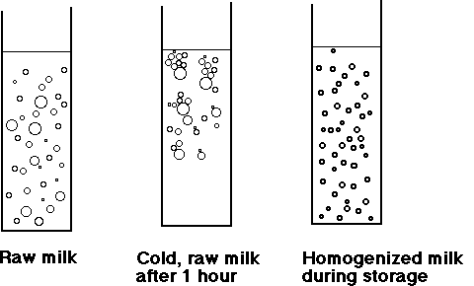
8. Homogenization of milk
8. Homogenization-

Slide 3
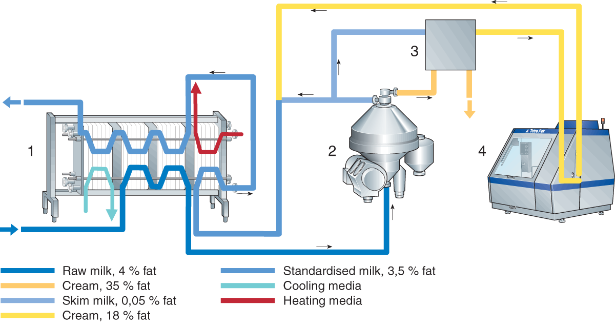
Homogenizer

Slide 4
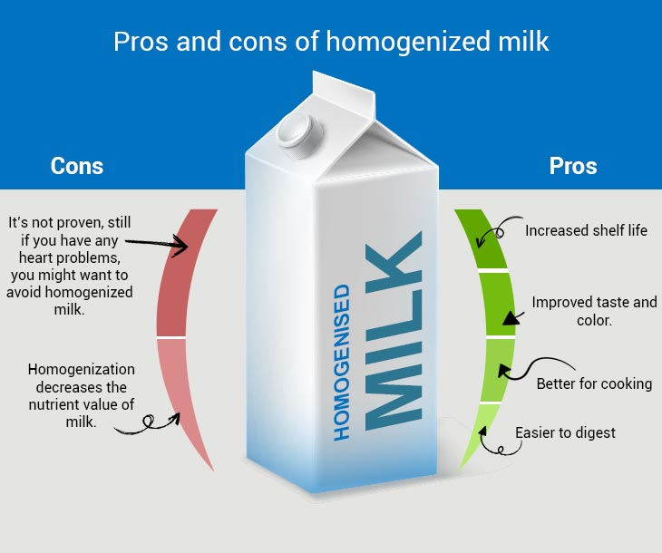

Slide 5
Bactofugation

Slide 6
Objectives of Bactofugation

Slide 7
Equipment for Bactofugation

Slide 8
Advantages of Bactofugation

Slide 9
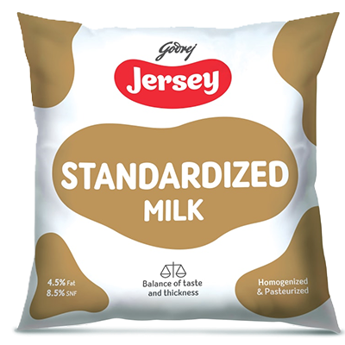
Standardized Milk

Slide 10
Types of Milk
Cow Milk 3.5% Fat and 8.5% SNF
Buffalo Milk 6% Fat and 9% SNF
Standardized Milk 4.5% Fat and 8.5% SNF
Toned Milk (Single) 3% Fat and 8.5% SNF
Double Toned Milk 1.5% Fat and 9% SNF
Skim Milk 0.5% Fat and 8.7% SNF
Recombined Milk (prepared from butter oil and milk powder)
Humanized Milk ( fat and SNF similar as human milk)
Filled Milk ( Fat is derived from vegetable source)
Imitation Milk (Resemble milk but non-dairy origin)

Slide 11
THANKS

