Slide 1
RADIOLOGY-3 Fourth Professional UNIT 3
Dr. Ramesh Tiwary
Assistant Professor
Deptt. of Vet. Surgery and Radiology

Slide 2
“PRODUCTION OF X-RAYS”

Slide 3
Ionising Radiation
Particulate or corpuscular – alpha, beta particle, protons, electrons, neutrons, nuclear fragments.
Electromagnetic radiation – Heat waves, light waves, infra-red rays, U/V-rays, x-rays, gamma rays.

Slide 4
Wave length to x-ray – 0.1 to 0.5 A⁰ (1A⁰ = 10⁻¹⁰ cm)
Energy - 25 to 125 Kev.
Diagnostic x-ray: 30 – 150 kVp.
Coherent scattering: A photon interacts with an object and changes its direction.
Subject does not absorb the photon and photon energy does not changed.
Degrade image quality, strike radiographer, increased personal exposure.

Slide 5
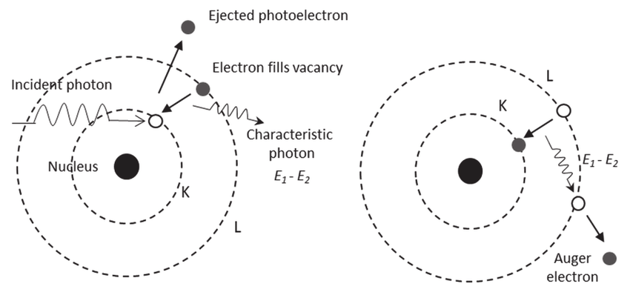
Interaction of Photons with Matters

Slide 6
Photoelectric effect
When x-ray photons interact with inner shell (K, L, M shell) electron of atom, free electron fly off as photoelectric and get absorbed in the body. Outer electrons shift to the inner shell gives off energy in the form of radiation called characteristic radiation or line radiation.
Photoelectric effect α z³ and inversely proportional to 1/E³.
By using high kVp photoelectric effect decrease thus patient dose decreased.
Photoelectric effect is responsible for formation of image on radiographs of object.

Slide 7
Bremstrahlung or breaking or General or white radiation – when electron passing through positive nucleus of target get deflected or slow lose in kinetic energy
Compton effect: - Moderate or high energy photon encounters free electron of the outer shell of the atom.
Compton effect produces almost all the scatter radiation encountered in diagnostic radiology.
Compton effect of x-ray independent of atomic number of absorbing material.

Slide 8
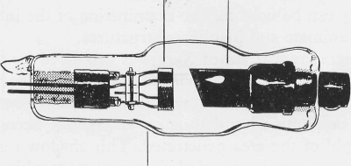
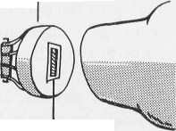
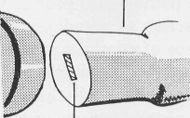
X-RAY TUBE
It consists of a glass tube (12-18cm L, 9cm D) which has been evacuated to produce a high vacuum and into which are sealed two electrodes, the cathode (-) and the anode (+) placed 1-3cm apart.
Cathode
Anode
Glass Envelope
CATHODE
Spiral filament in focusing cup.
Tungsten target set in
anode face.

Slide 9
CATHODE .
Cathode:- Negative side of the x-ray tube, its filament consists of tungsten atomic no. 74 and melting point 3370⁰C.
Tungsten has little tendency to vaporise, thus it prolongs the life of the x-ray tube.
Focusing cup: - Filament is embedded in a concave metal shroud called focusing cup made of nickel or molybdenum.

Slide 10
ANODE
Positive side of the x-ray tube.
It is termed the target, because it is the origin of the X-ray beam it is also spoken of as the focus or focal spot.
99% of kinetic energy in the collision converted into thermal energy and 1% irradiated as x-rays.
Cathode filament and its focusing cup are so constructed that the beam of electrons focused on this relatively small area.

Slide 11
Types of Anod
Stationary type – used in dental x-ray machine as portable x-ray units where high current power not required.
Consists of copper block embedded with tungsten rhenium alloy metal.

Slide 12
Rotating type
Rotating type –Consists of a molybdenum disc coated with a strip of tungsten –rhenium alloy.
Advantage over stationary type is better heat dissipation, provides larger target area for electron beam to interact.
Size of focal spot in x-ray machines varies from 0.3 to 3 mm and angle should not less than 15⁰.

Slide 13
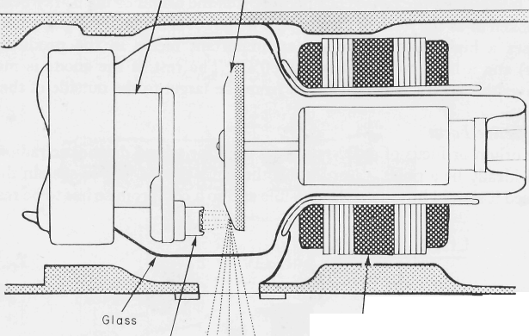
Diagram Of A Rotating Anode Tube
Rotating disc target of anode
Glass Tube
Emitted Rad
Cathode

Slide 14
Heel effect
Heel effect: - Radiation intensity as high as 40% on the cathode side of the x-ray beam than on the anode side is called heel effect.
while taking radiograph of unequal thickness, thicker or denser side should be positioned towards the cathode.
Smaller angle of anode more pronounced heel effect.
When film size larger and focal film distance are less heel effect more noticeable.

Slide 15
Quantity of x-ray production
Tube current (Milliamperage or mA) – Increasing mA increases the x-ray output.
Tube potential (KVP):- If KVP is doubled the x-ray quantity increase by a factor of four.
Increase in KVP by 15% would require a reduction in mAs by one half.
Focal film distance: - X-ray intensity varies inversely to the squire of the distance between the target and focal spot.

Slide 16
Type of x-ray machines
Portable x-ray machine – 70 to 110 kv and 15 to 35 mA.
Mobile x-ray machine - 90 to 150 KV and 40 to 300 mA.
Fixed x-ray machine – 120 to 150 KV and 300 to 1000 mA.

Slide 17
THANKS

