Slide 1
LIVE STOCK FARM COMPLEX
Topic – Round The Year Fodder Production
Date – 07/ 11/ 2020
Prepared by-
Dr Pramod Kumar
Assistant Professor cum Jr. Scientist
Department of Livestock Farm Complex (ANN)
Bihar Veterinary College, BASU, Patna-800014

Slide 2
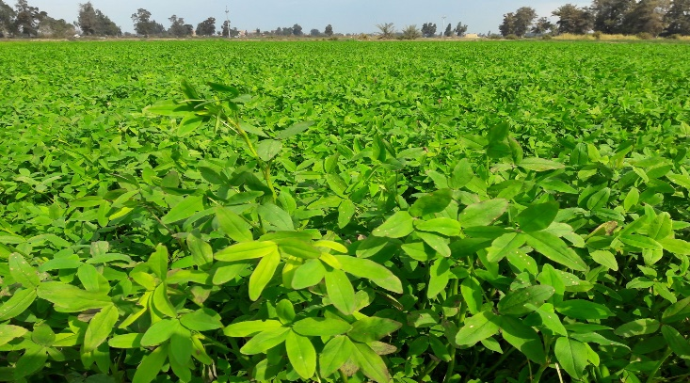
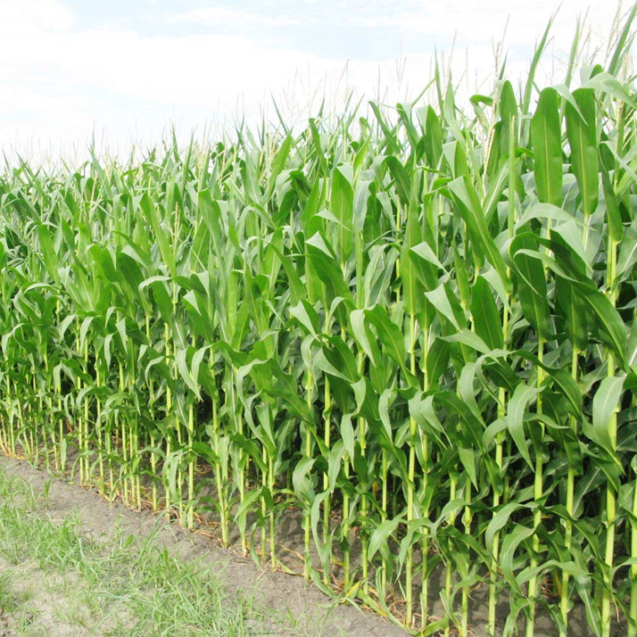
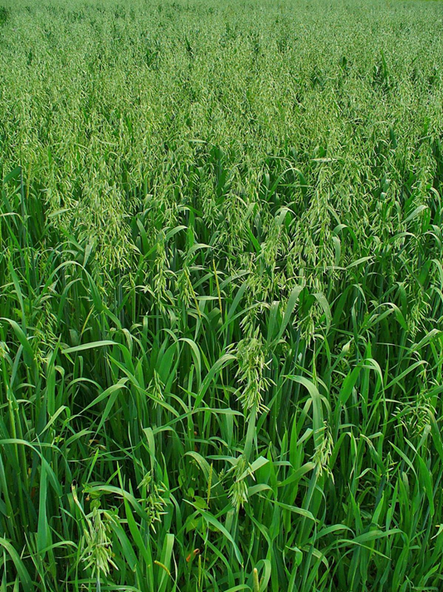
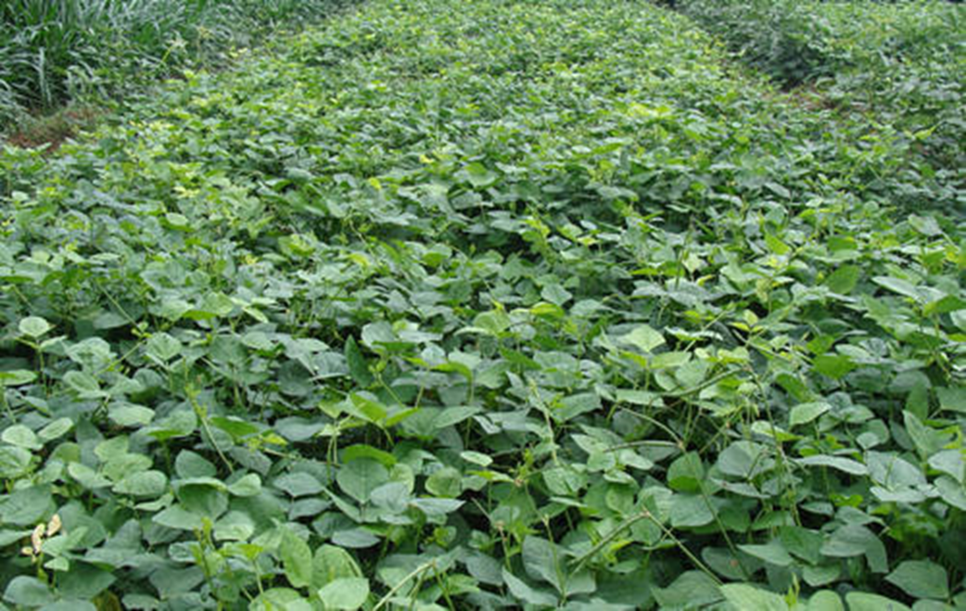
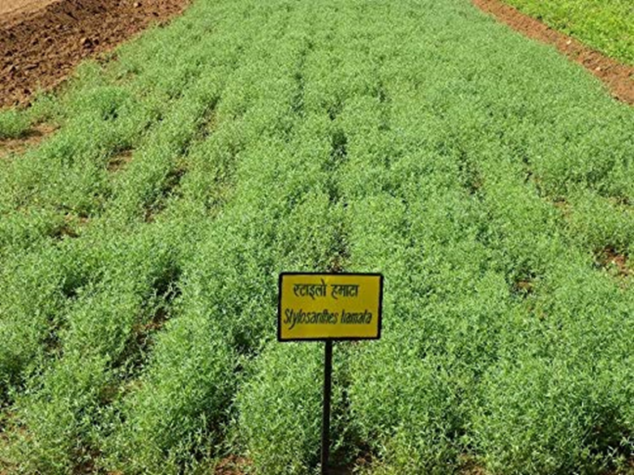
ROUND THE YEAR FODDER PRODUCTION

Slide 3
Importance of Fodder Production
The importance of green fodder round the year for sustained and economical milk production.
The dairy farmers have been looking forwards the improved technology for continuous flow of green fodder though out the year.
In greater part of India there are two lean period
April to June
November to December
Silage is an alternative for green fodder, but is still a dream for indian dairy farmers.
Under these circumstances cropping plans have been formulated to ensure year round supply of green fodder.

Slide 4
Milk production and profit in dairy farming depends upon the feeding and management practices.
Long term economical milk production along with the maintenance of better health and fertility of the dairy animals can only be achieved through feeding of quality green fodder in balanced ratio.
Productivity of cultivated fodder crops is also very low, as these are getting least attention in allocation of production resources and lack of information on recent development in production techniques.
This needs to be tackled by educating the forage growers about the recent development in production technique of the fodder crops.
Thus, the need of the hour is not only to enhance the fodder production, but also to make the fodder accessible round the year to all types of dairy animals adequately.

Slide 5
Although we are largest producer of milk, but productivity is very low.
Reasons of Low productivity are---
Inadequate availability of quality fodder :-
The total area under cultivated fodder is only 8.4 m ha (5.23%) which is static since last two decades.
Total green fodder and dry fodder availability in India is 732.2 mt and 326.4 mt against requirement of 827.19 mt and 426.1 mt respectively.
Poor genetic constitution and pest and disease
The fodder production in the country is not sufficient to meet the requirements of the growing livestock population and also the forages offered to animal are mostly of poor quality.
This gap in demand and supply is rising due to consistent growth of livestock population at the rate of 1.23% in the coming years.

Slide 6
Quality Feed and Fodder for Enhanced Productivity of Livestock
The genetic potential of high yielding animals can be realized only if they are Fed well with quality fodder.
For full exploitation of milk production of dairy animals, it is imperative that nutritious lush green fodder is made available at the rate of about 40-50 kg per adult animal per day throughout the year.
So to feed this livestock population, we have to design some innovative strategies so that the produce from agriculture could effectively be utilized for livestock feeding.
Under such situation, various fodder crops can be effectively used as feed, green fodder, dry fodder and conserved as silage during ROUND OF THE YEAR.

Slide 7
Scenario of green fodder availability and future requirement
Year Deficit as % of demand (actual demand) | Supply (in million tones) | Demand (in million tones) | Deficit as % of demand (actual demand)
1995 | 379.3 | 947 | 59.95(568)
2000 | 384.5 | 988 | 61.10(604)
2005 | 389.9 | 1025 | 61.96(635)
2010 | 395.2 | 1061 | 62.76(666)
2015 | 400.6 | 1097 | 63.50(696)
2020 | 405.9 | 1134 | 64.21(728)
2025 | 411.3 | 1170 | 64.87(759)
Sorce : Draft Report of Working Group on Animal Husbandry and Dairying for Five
Year plan(2002-2007, Govt. of India, Planning Commission, August -2001)

Slide 8
GREEN FODDER
Any feed that is made from green crops like legume crops, cereal crops or tree based crops is called green fodder.

Slide 9
Types/ Classification of Green Fodder
There are different types of Classification available. However, the following two classifications are more easy to understand and adopt.
Classification on the basis of season of cultivation :
1. Kharif Fodder (June – September)- cowpea, field bean, bajra, shorghum, maize, etc.
2. Rabi fodder (October – Dec/Jan) – berseem, lucerne, oats, barley, etc.
3. Summer fodder (April – June)- cowpea, maize, field bean, shorghum, bajra, etc.
Classification on the basis of plant family and duration of Crop
1. Legumes (Annual and perennial)
Annual- Berseem, cowpea, stylo, guar, etc.
Perennial- Lucerne, Stylo, Subabaul, Dashrath etc.
2. Non-legumes (Annual and perennial)
Annual- maize, jowar, bajara, oat, etc.
Perennial- Hybrid napier, Gunea grass, Para grass, Rhodes grass, Anjan Grass etc.

Slide 10
Production Technology for Green Fodder Availability Throughout the year
Sl. No | Particulars | Hybride napier/ Bajra | Cowpea/ Guar |  | Berseem/Lucern |  | Cowpea
1 | Sowing/ planting Time | February-july | July(kharif) |  | October(Rabi) |  | March(zaid)
2 | Harvesting/Cutting | 1st cutting-75-80 DAP Successive 40-45 DI (Summer) 30-35 DI (Other) | 60-75 DAS at 50% flowering | 60-75 DAS (Flowering or podding) | 1 st- 50-55 DAS Successive25-30 DI | 1st- 55-60 DAS Successive25-30 DI | 50% Flowering
3 | Yield green fodder (q/ha) | 1000 | 200 | 250 | 650 | 700 | 150
4 | Yield of the system (q/ha) | 2000-2100
COWPEA | GUAR
Berseem | Lucern

Slide 11
Crop Rotation
Sorghum/Bajra/ Maize
Chari+cow Pea
Berseem/lucern/Oat
Bajara+ cow pea

Slide 12
Quantity Requirement of green fodder for adult animal ( cattle and Buffalo)
An adult animal requires minimum 10% of green fodder of its body weight.
Eg.-Animal weighing 400 kg requires 40 kg green fodder (10% of body weight).
Balancing of green fodder is very important:
As a thumb rule - 2/3 rd should be non-legume fodder & 1/3 rd legume fodder
Sole feeding of only non-legume fodder or legume fodder causes imbalance. So, feeding of fodder through above thumb rule is very necessary.
Non-legume fodder is rich in energy than protein and it is used for supplying energy and feeling of stomach, whereas, legume fodder is rich in protein than energy and it is used for supplying body building proteins and increases milk production.
Hence, both kind of fodder crops (legume and non-legume) either annual or perennial are very essential.

Slide 13
Production Method
The entire area divided into 8 plots each of 0.5 hectare and a blend of these rotation adopted.
The sowing regime is rotated with different crop sequences in clock or anti- clock wise pattern so as not only to maintain soil productivity but also to check incidence of pest and disease.
In order to maintain continuous flow of green fodder supply for the animals from within the allocated area, each of the crops may be split sown twice or thrice with fortnightly intervals depending upon the needs.
In case of Surplus production, during lush period may be be conserved as silage or hay to cater to the feeding requirements during lean periods.

Slide 14
Berseem

Slide 15
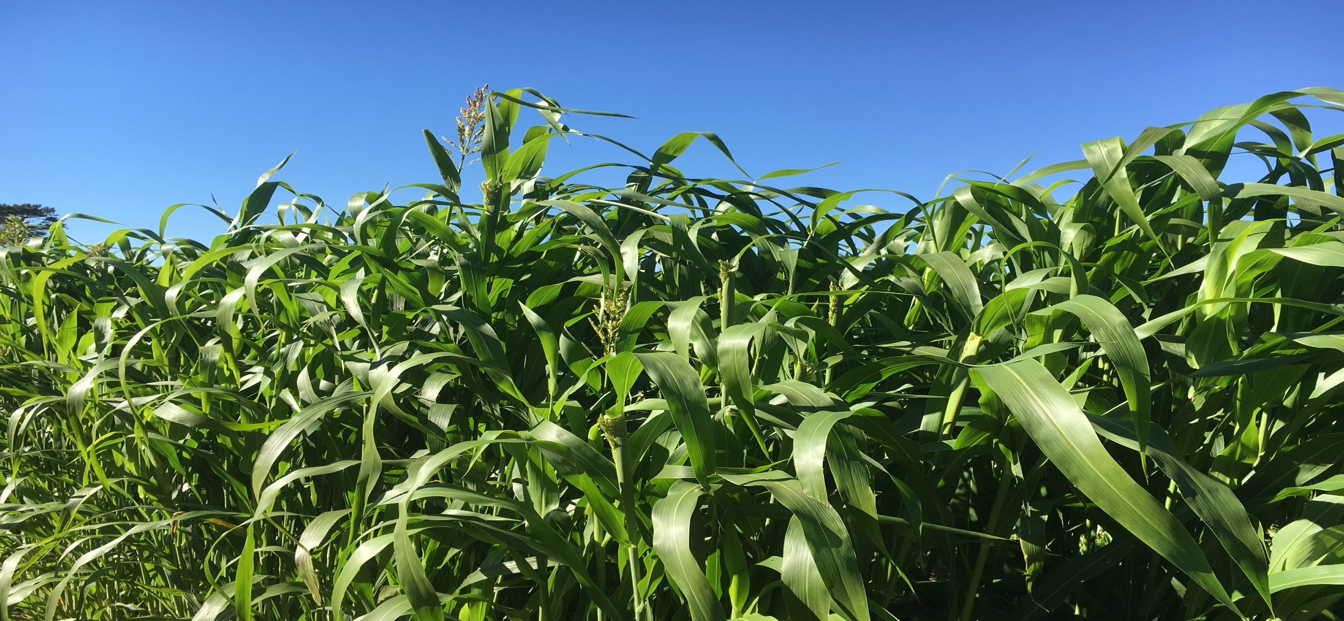
Sorghum

Slide 16
Maize

Slide 17
Oats

Slide 18
Cow pea

Slide 19
Lucerne

Slide 20
Stylo

