Slide 1
Small Molecule Hormone Receptor (Nuclear Receptor)
P.G.
VBC-612
Unit-1
16.10.2020
28.10.2020

Slide 2
Nuclear receptors are intracellular proteins expressed in the nucleus of a cell that have a binding site for a particular steroid molecule
Nuclear receptors are a family of ligand-regulated transcription factors that are activated by steroid hormones, such as estrogen and progesterone, and various other lipid-soluble signals, including retinoic acid, and thyroid hormone.
Nuclear receptors (NRs) are proteins that share considerable amino acid sequence similarity in two highly conserved domains
DNA binding (DBD) and the ligand binding domains (LBD)
Freedman, Cell 97 (1999)

Slide 3
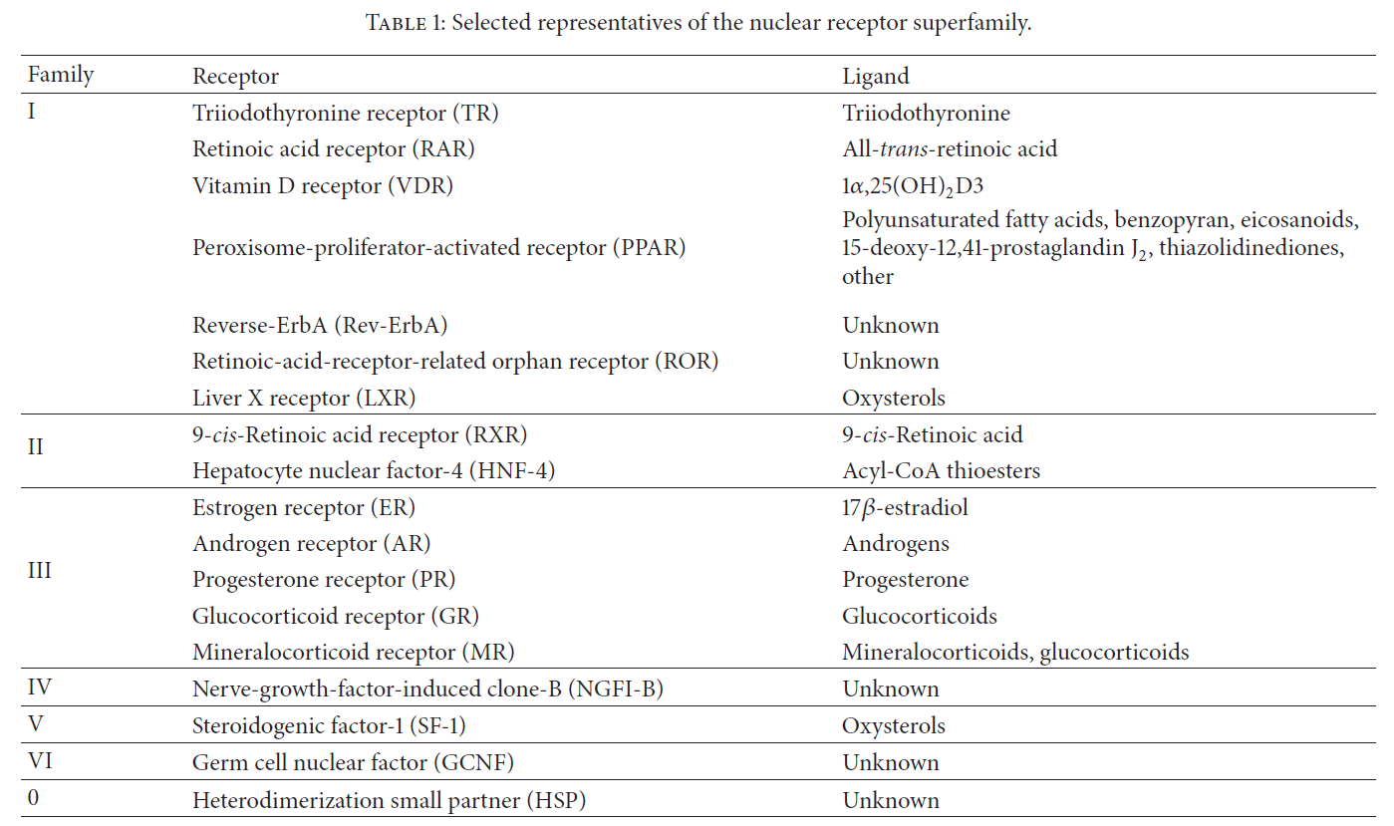
Nuclear Receptors

Slide 4
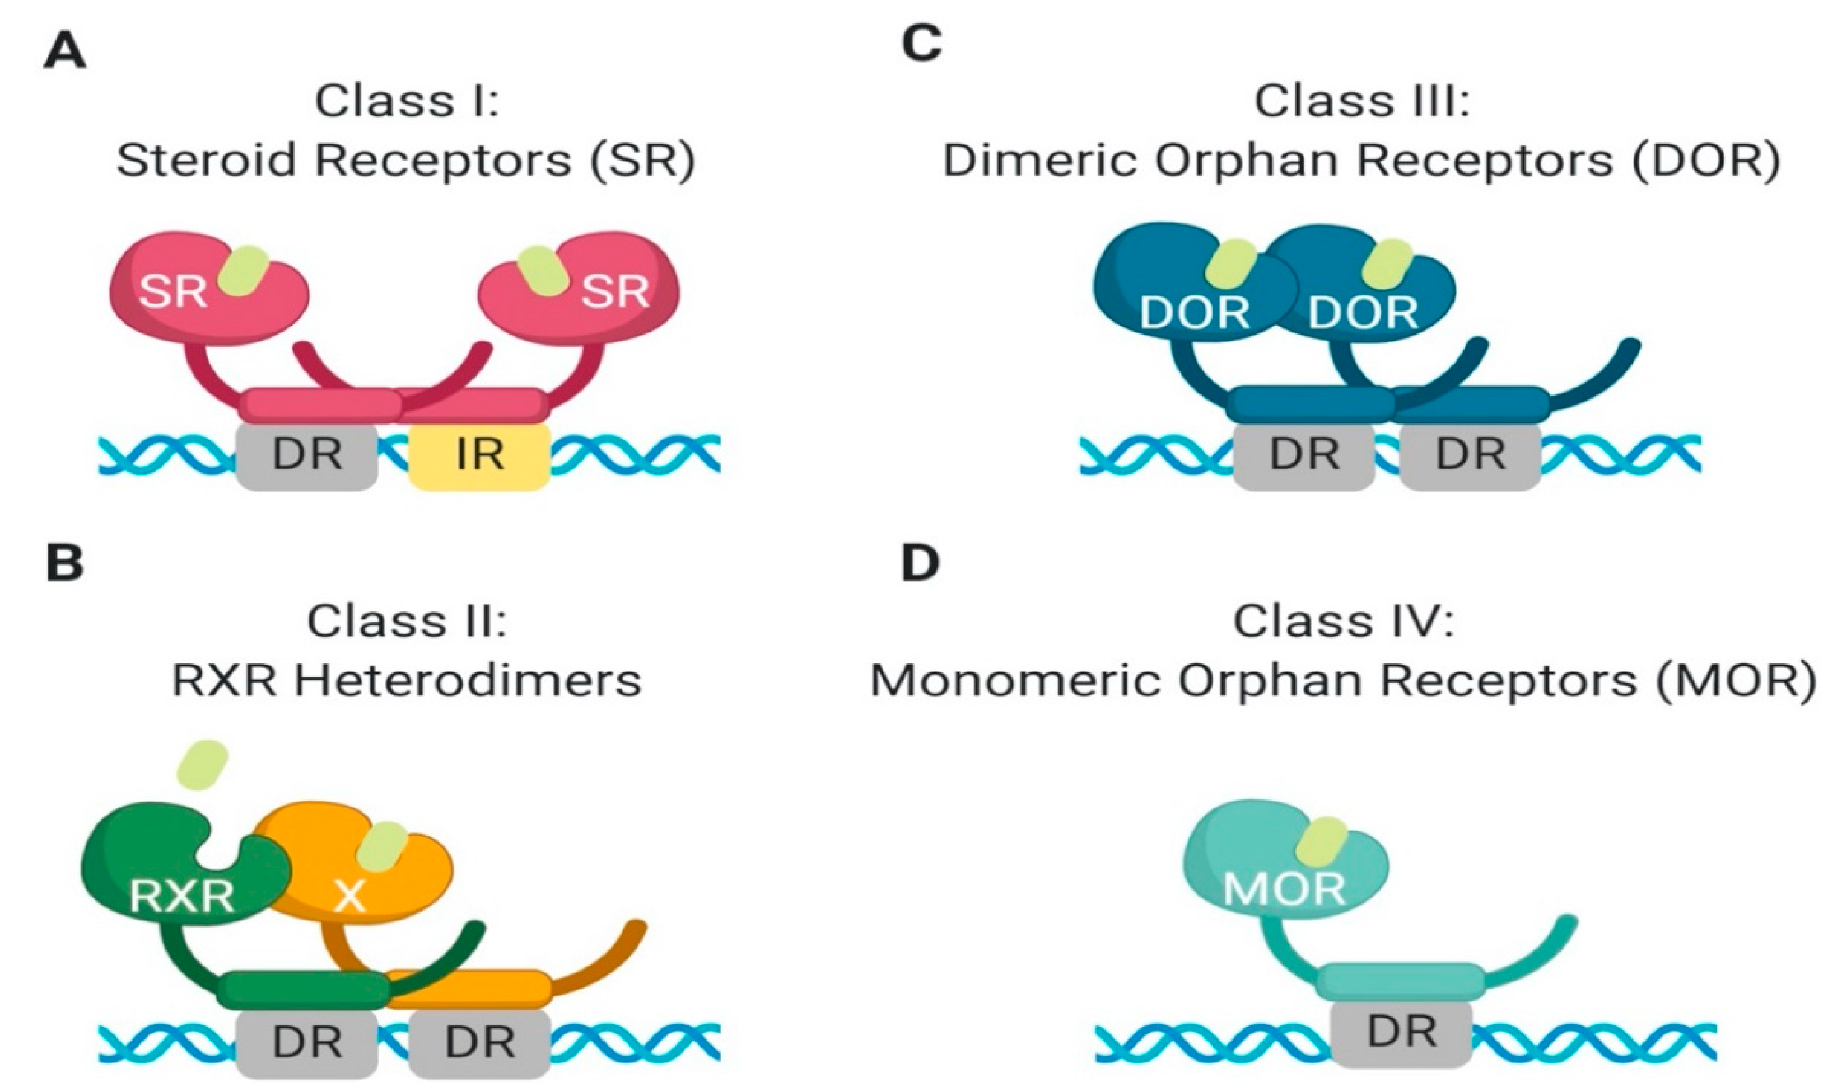
Hormone Receptor- DNA Interaction
Porter et al. (2019) DOI: 10.3390/cancers11121852

Slide 5
Basic components related to nuclear receptor
Zinc fingers
Zinc fingers have one or more zinc atoms gripped by a combination of four amino acids, either cysteine or histidine. a protein can grab a zinc ion and fold tightly around it. a short chain of 20 -30 amino acids is enough to create a solid, stable structure.
Many zinc fingers play essential roles in DNA recognition and essential role in the development of blood cells.
Nolte (1998), PNAS 95

Slide 6
Heat shock proteins (HSP)
Are a family of proteins that are produced by cells in response to exposure to stressful conditions such as infection, inflammation, exercise, exposure of the cell to toxins ( ethanol arsenic, trace metals and ultraviolet light), starvation, hypoxia.
Heat-shock proteins are named according to their molecular weight. For example, Hsp60, Hsp70 and Hsp90 (Chaperones).
Heat Shock Proteins bind to denatured proteins to prevent aggregation

Slide 7
Coactivator and Corepressor
Transcription coregulators that activate gene transcription are referred to as coactivators while those that repress are known as corepressors. The mechanism of action of transcription coregulators is to modify chromatin structure and thereby make the associated DNA more or less accessible to transcription
Petkovic et al (1987). Nature 330

Slide 8
Hormone response element (HRE)
A short sequence of DNA within the promoter of a gene that binds to a Specific hormone receptor complex and therefore regulate transcription.
HRE responds to steroid hormones, as the activated steroid receptor is the transcription factor binding HRE
Umesono et al (1991). Cell 65

Slide 9
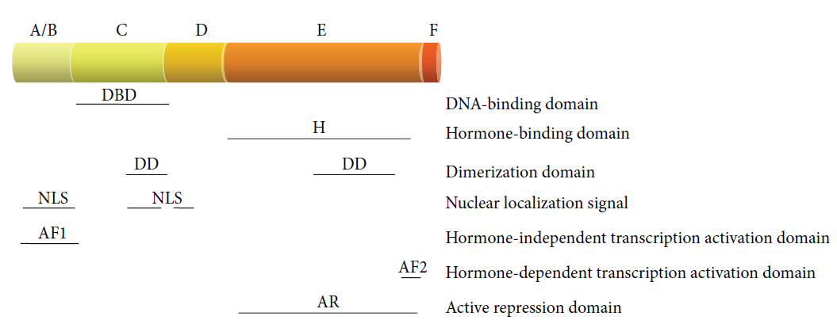
Structure of Nuclear Receptor
Five distinct regions :
Two end terminals – N terminal & C terminal.
A hinge region
Two domains – DNA binding domain & Ligand binding domain
N- terminal
C- terminal
Puzianowska-Kuznicka et al (2013). DOI: 10.1155/2013/601246

Slide 10
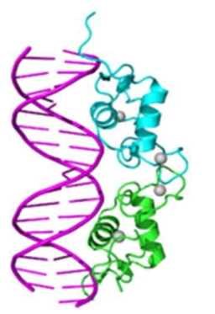
Structure of Nuclear Receptor
N TERMINAL (A/B Region)
It is also called as VARIABLE terminal as the length of this terminal is variable for every hormone.
Its length ranges between 100 to 500 amino acids.
It contains several autonomous transactivation domain.
DNA BINDING DOMAIN (C Region)
Highly conserved domain
It consists of two zinc fingers and forms a highly conserved residue core.
Usually present in the centre of receptor molecule.
binds to specific sequences of DNA called hormone response elements (HRE)
HINGE REGION (D Region)
It is a poorly conserved region, serves as a connection between the DBD and LBD.
It allows the DBD and LBD to adopt different conformations without creating a steric hindrance.
Domain also harbors a nuclear localization signal

Slide 11
LIGAND BINDING DOMAIN (E Region)
Largest domain and forms 30% of the receptor
Referred to as an alpha helical sandwich fold in which three anti parallel alpha helices are flanked by two alpha helices on one side and three on the other
It is moderately conserved
Ligand binding cavity is within the interior of the LBD and just below three anti parallel alpha helical sandwich "filling
This domain with the heat shock proteins (chaperone proteins) in cytoplasm.
C Terminal (F Region)
the C-terminal is present at the end of LBD.
It is a highly variable terminal with amino acids ranging from 530 to 984.
The terminal connects the molecule to its pair in the homodimer or heterodimer. It may affect the magnitude of the response.

Slide 12
INTERACTION WITH DNA
There two models about how the hormone interacts with the DNA
Ist Model
The DNA is wrapped tightly in nucleosome which is composed of histone fold domains.
The nucleosome also consists an amino terminal tail rich in lysine .
Acetylation of tail lysines reduces the affinity of histone to DNA, thus making it accessible to transcription factors.
The architecture of the nucleosome is also maintained.
IInd Model
According to the 2nd model NURF induces an ATP dependent remodeling of chromatin resulting in an unstable or transient opening of promoter nucleosome.
In this case,NF1 acts as a wedge to stabilize the open conformation of chromatin

Slide 13
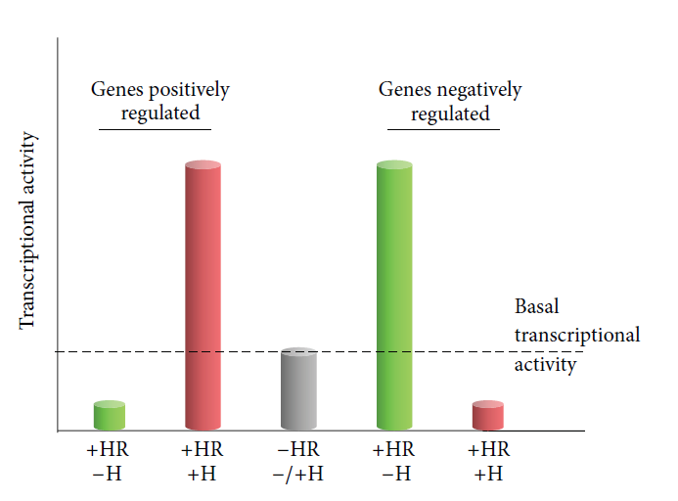
Transcription regulation by small-molecule hormones
Puzianowska-Kuznicka et al (2013). DOI: 10.1155/2013/601246

Slide 14
Regulation
The action of small molecule hormone ligand is regulated by the presence of two components- Coactivators and Corepressors.
The activation or inhibition of transcription of genes by ligand depend on the presence of these components.
They are a class of protein whose mechanism & function is synonymous to that of coenzymes & inhibitors in case of enzyme action .
Corepressors
Not much known about them.
Antagonizes the effect of hormone to stimulate transcription from reporter genes

Slide 15
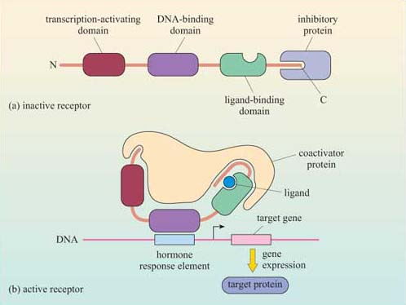
COACTIVATORS
Made up of amino acid motif.
It is distinguished into two classes
Interacts with sequence specific transcription factors.
Interacts with general machinery on core promoter elements. Eg. TATA box binding protein
https://www.open.edu/openlearn/science-maths-technology/cell-signalling/content-section-2.5

Slide 16
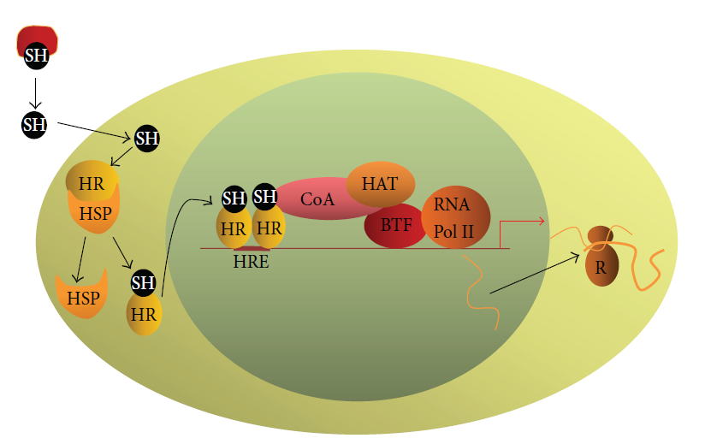
Type I receptor genomic mode of action
The hormone enters the cell by diffusion
hormone-free receptors form an inactive complex with heat shock chaperone
Upon hormone binding, translocates into the nucleus
Recruitment of a coactivator complex possessing a histone acetyltransferase activity results in local chromatin decondensation
Puzianowska-Kuznicka et al (2013). DOI: 10.1155/2013/601246

Slide 17
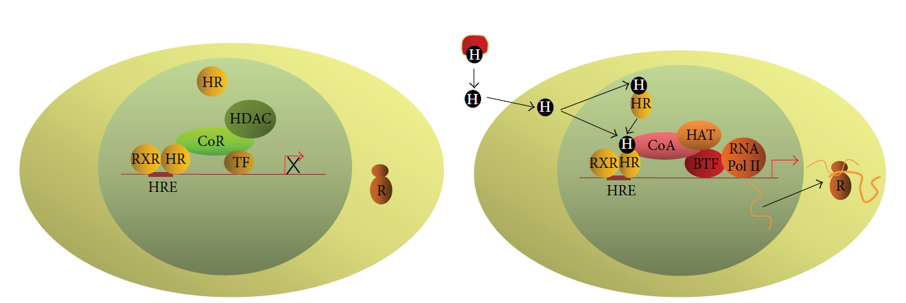
Type II receptor genomic mode of action
Upon hormone binding, the receptor changes its conformation, which results in the dissociation of the corepressor complex and in the binding of the coactivator complex
Histone acetylation results in chromatin decondensation
In the absence of the hormone, the receptor binds to HRE as heterodimer with 9-cis-retinoic acid receptor
a corepressor complex possessing a histone deacetylase activity
Puzianowska-Kuznicka et al (2013). DOI: 10.1155/2013/601246

Slide 18
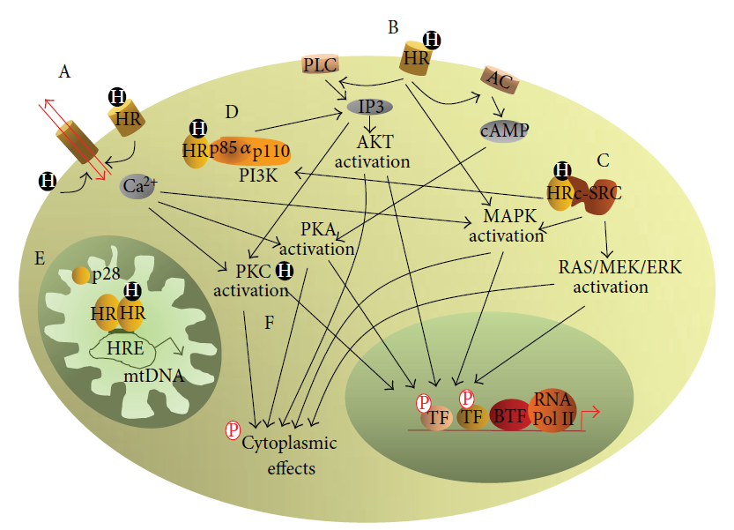
Nongenomic mechanisms of action of small-molecule hormones
(A) Interaction of the hormone with cell membrane receptor- modifies the function of ion channels
(B) Activation of phospholipase (C)
(C) Activation of c-SRC by the hormone-activated nuclear receptor
(D) The binding of the hormone-activated nuclear receptor to the phosphatidylinositol 3 kinase p85𝛼 subunit results in an increased synthesis of inositol triphosphate
(E) In mitochondria, acting via their shorter (mitochondrial) isoforms of HR regulate transcription of mitochondrial DNA
(F) The binding of the hormone activates protein kinase (C)
Puzianowska-Kuznicka et al (2013). DOI: 10.1155/2013/601246

Slide 19
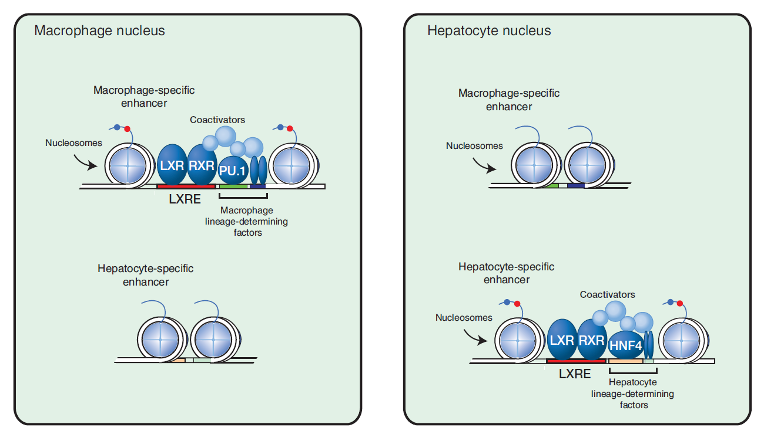
Tissue-specific nuclear receptor signaling
Cold Spring Harb Perspect Biol 2013;5:a016709

