Slide 1
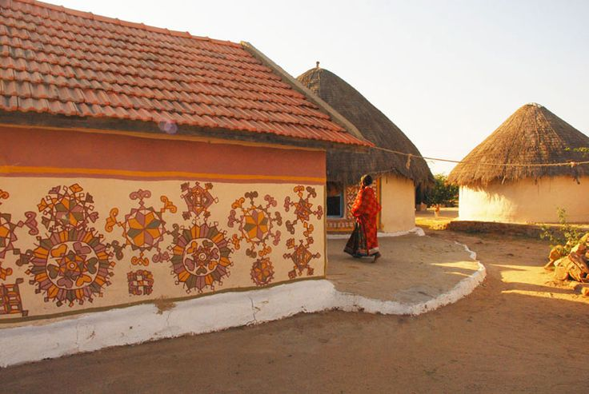
UNIT-01 (LIVESTOCK BASED LIVELIHOODS AND THEIR EVOLUTION)
Dr. Puspendra Kumar Singh
Department of Veterinary & Animal Husbandry Extension Education, BVC

Slide 2
Small Scale farming

Slide 3
Farm: Farm is an area of land and its buildings which is used for growing crops and rearing animals. It is devoted primarily to agricultural processes with the primary objective of producing food and other crops.
System: A system is a set of inter-related, interacting and interdependent elements acting together for a common purpose and capable of reacting as a whole to external stimuli.

Slide 4
Farming System:
Farming system is an approach for developing farm household systems, built on the principles of productivity, profitability, stability and sustainability.
The farming system approach emphasizes understanding of farm household, community inter linkages, reviews, constraints and assesses potentials and it combines improvements desired from better technology.

Slide 5
Definition of Farming System:
• Farming system is a decision making unit comprising the farm household, cropping and livestock system that transform land, capital and labour into useful products that can be consumed or sold (fresco and westphal, 1988)
• Farming system is a resource management strategy to achieve economic and sustained agricultural production to meet diverse requirements of farm livelihood while preserving resource base and maintaining a high level of environment quality (Lal and Miller 1990).

Slide 6
Types of Farming
Types of farming can be defined as the farms in a group are a similar in the kind and proportions of the crops and livestock that produced and the methods followed in production. Specialized Farming

Slide 7
DIFFERENCE between types of farming and system of farming
Types of Farming | System of Farming
When farms in a group are quite similar in the kind and proportions of the crops and livestock that are produced and the methods, followed in production | Refers to the combination of products on a given farm and the methods or practices that are used in production of the product.
It is not related to ownership and operationship of farming | It is related to ownership and operationship of farming
Examples : specialized farming, diversified farming, mixed farming, dry farming and ranching etc. | Examples : Peasant farming, cooperative farming, capitalistic farming, collective farming and state farming etc.

Slide 8
Types of farming

Slide 9
Factors determining type of farming
Physical factors:
Climate
Soil
Topography
Social factors:
Type of community
Cooperative spirit
Economic factors
Relative Profitability
Availability of funds
Availability of labour & capital
Availability of input
Land values
Marketing costs
Marketing facilities
Cycles of over & under production
Competition between enterprises
Personal choices
Miscellaneous – seasonal availability of raw material, diseases etc.

Slide 10
Classification of farming
Based on how income is derived from a farming enterprise
Specialized farming
Diversified farming
Mixed farming
Based on mode of ownership and organization of farms
Individually owned
Co-operative farming
Collective farming
Based on scale of operations
Small scale farming
Large scale farming

Slide 11
Specialized farming
When a farm business unit derives more than of its 50 per cent income forms a single enterprise, known as specialized farming.
Examples : paddy farming, sugarcane farming, tobacco farming, poultry farmers sheep farming etc.
Why specialized farming ?
assured income from the enterprise.
its suitability to the area
its relative

Slide 12
Advantages of specialized farming
Best suited to particular soil, climate, topography & other physical conditions like market type
Better utilization of land,
Better marketing
Better management
Less equipments and labour needed
Efficiency & skill of personnel increased
Costly & efficient machinery can be kept
Farmer can secure complete mastery over the conditions, problems of production, processing & sale
Under favourable & specific conditions extremely profitable

Slide 13
Disadvantages
Failure of crop,
Non-utilization of productive resources
Effect on soil health etc.

Slide 14
Large & Small scale farming
Different means of describing scale of livestock enterprise:
Quantity of produce & marketed unit within a time period
Number of animals/ birds maintained
Area of holding over which the livestock enterprise is based
The advantages of large scale production over small scale production are called Economies of scale

Slide 15
Advantages of Large-scale farming
Increased efficiency & full utilization of labour
Lower machine cost as a result of greater annual use
Building economics
Buying and selling
Management
Economics in financing
Economics in the use of by-products

Slide 16
Disadvantages of Large-scale farming
Greater losses during depression period
Difficulty in supervision
Under utilization of resources, equipments, labors
Apart from this, extended limit of farm then leads to inefficiencies

Slide 17
Advantages of small scale farming
Close attention & supervision
Efficient use of family labour
Higher productivity
Low market dependence for inputs
Intensive cultivation is possible
Social justice through distribution of landed property
Higher family labour employment

Slide 18
Disadvantages of small scale farming
Inadequacy of productive resources
Unremunerative farming
Limited scope for development
Shortage of farm implements
Under employment
Market diseconomies
Shortage of finance
Relatively more overheads

Slide 19
Comparison between Large & Small scale farming
Aspects | Large scale | Small scale
Division of labour | Possible | Limited
Mechanization | Possible | Not possible
Quantity of output | More | Less
Cost of production | Low | High
Cost of management | Low | High
Risk | More | Less
Marketing facilities | Better | Poor
Economy of buying & selling | More | Less
Possibility of using improved technology | More | Less
Danger of over production | More | Less
Supervision | Poor | Better
Flexibility | Inflexible | Flexible
Chances of unhealthy competition | More | Less

