Slide 1
SOLAR ULCERATION
DR MITHILESH KUMAR
ASSISTANT PROFESSOR
DEPARTMENT SURGERY AND RADIOLOGY
BVC, PATNA-800014

Slide 2
Definition: circumscribed limited reaction of the pododerm (deep sensitive
tissues) often characterised by an erosive defect.
Incidence:- Calved heifer to mature animal
Aetiology: disputed, possibly excessive weight-bearing by lateral claw following horn overgrowth.
abnormal claw (poor trimming), and frequently with laminitis.

Slide 3
Signs :
• moderate degree of lameness typically up to three months postpartum, masking the frequently
bilateral nature of the lesions, i.e. lateral claw of both hind legs, one more painful than the other
• severe lameness when granulation tissue protrudes and in presence of deeper purulent infection
(osteomyelitis, septic arthritis)
• under-run heel horn exposes sensitive laminae

Slide 4
• at typical site granulation tissue may protrude through undermined horn
• under-running commonly extends cranially and peripherally to abaxial white line.

Slide 5
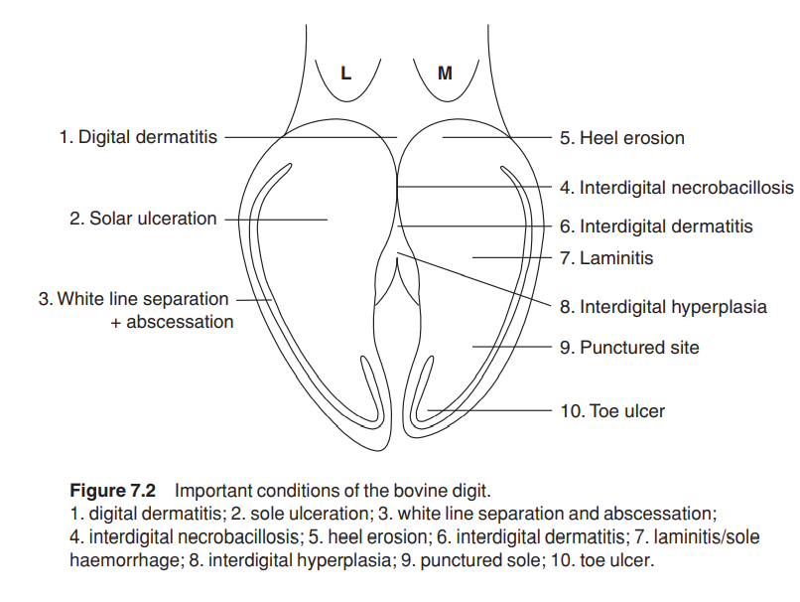

Slide 6
Treatment •
trim all feet initially or at end
IVRA
remove under-run horn, trim horn of wall and heel so that weight-bearing by affected claw is minimal
possibly apply block (hoof resin) to sound claw which should be minimally trimmed.

Slide 7
remove protruding granulation tissue, leaving healthy pododerm and apply tetracycline spray,
and bandage (waterproof) for five days
put on sulphadimidine powder, bandage and spray oxytetracycline over
bandage to prevent wicking by mud into bandage
broad spectrum antibiotics in septic cases
confine to box and straw bedding for five days

Slide 8
Prophylaxis :
avoid overgrown claws by emphasising need for routine trimming
avoid factors predisposing to laminitis.
do not breed from affected young cows

