Slide 1

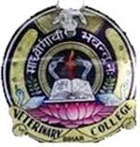
Sources and characteristics of water

Slide 2
Water
Water supply and sanitation scheme:
  Improved health
  One of the most effective and permanent way to improve human health
Without safe community water supply there can not be a status of positive health
With the supply of safe water, there is drastic decline in disease burden of community
Provision of safe community water supply is one of the MOST effective & permanent health technologies to improve and maintain public health

Slide 3
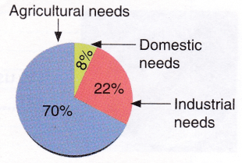
Water is required for a number of daily activities
Use:
  Domestic: Drinking, cooking
  Public: Garden, swimming pool, Fire fighting
  Industrial: Iron, paper, food
  Agricultural: Irrigation
  Power generation
  Waste management
Therefore, essential for
  Economic
  Social
  Cultural development

Slide 4
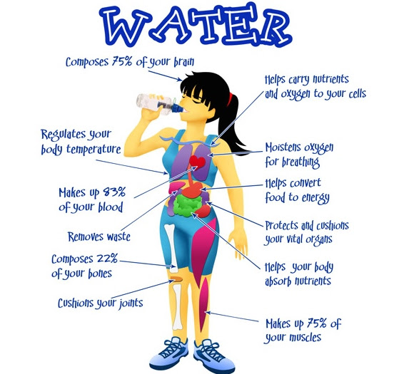
Water Requirement:
  2 liter/person/day: mere survival
  Adequate H₂O must be supplied
  150-200 liters (35-40 gallons) /person/day
Consumption depends on:
  Climate
  Standard of living
  Personal habits

Slide 5
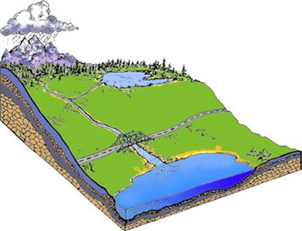
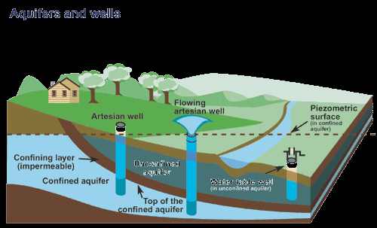
Sources of water
Rain H₂O
Surface H₂O
  Impounding reservoir
  Rivers, Streams
  Tanks, Ponds, Lakes
Ground H₂O
  Shallow well
  Deep well
  Springs

Slide 6
Criteria
Quality : Acceptable
Quantity : Must meet 95% of annual need
        Present
        Future

Slide 7
Unsafe Water, Inadequate Sanitation and Hygiene
1.1 billion lack access to "improved" drinking water supply
4 billion cases of diarrhoea annually, 88% attributable to unsafe water
1.8 million die each year from diarrhoeal diseases, vast majority being children under5
Lack of safe water perpetuates poverty
WHO says 94% of diarrhoeal cases preventable through environmental modifications

Slide 8
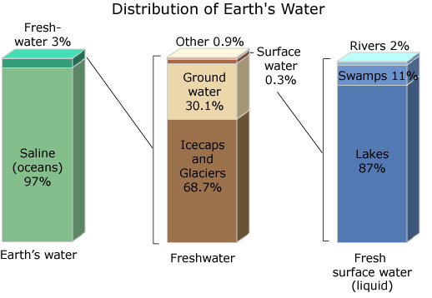

Slide 9
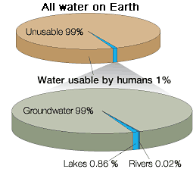
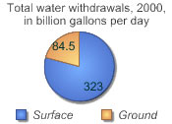

Slide 10
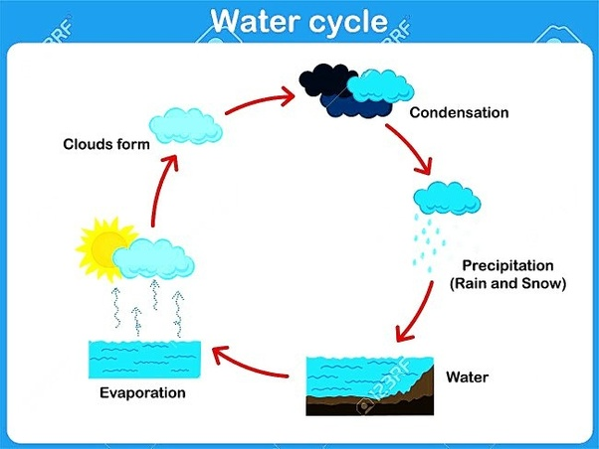
Rain
“Prime” source but not important in our country
Water cycle:
  Ground water
  Evaporation
  Run off Streams, rivers Sea
  Uptake by vegetation

Slide 11
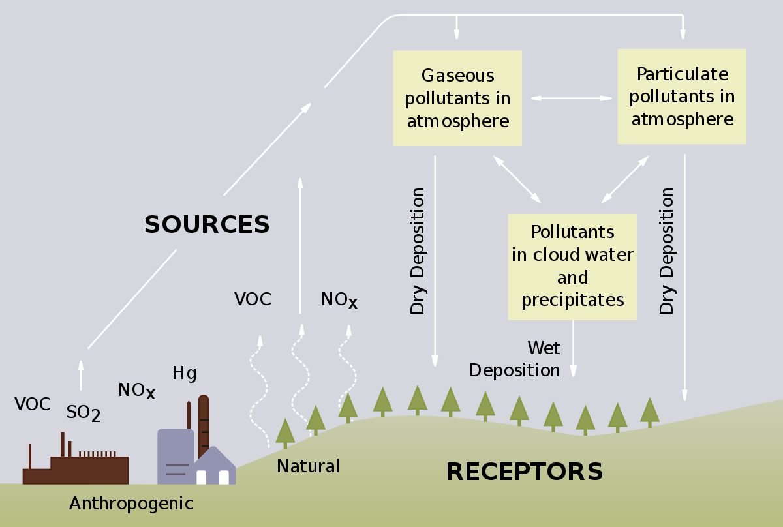
Characteristics of Rain Water
Purest H₂O in nature
Physically: clear, bright, sparkling
Chemically: Very soft with traces of
  dissolved solid (0.0005%)
  Bacteriologically: Free from pathogens
Impurities:
  Suspended particles: Dust, shoot, microbes
  Gases: CO₂, N, O₂ NH₃

Slide 12
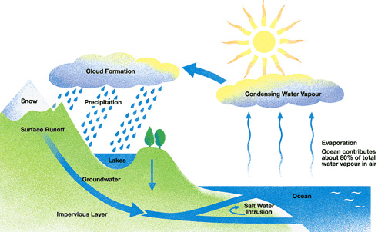
  Impounding reservoir
  Rivers, Streams
  Tanks, Ponds, Lakes
Surface water
  Mostly rain water
  Majority of Indian cities use it
  High probability of contamination
    Inorganic
    Organic
    Bacterial
    Viral

Slide 13
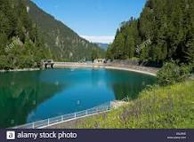
Impounding reservoir
  Artificial lakes generally Earth work or massonary work for storage of large quantity of surface water
  Dams across
    Rivers
    Mountain streams
Disadvantages:
Longer storage
Growth of algae and other microscopic organisms
Bad taste odour

Slide 14
Characteristics:
  Usually fairly good quality H₂O
  H₂O clear and palatable
  Next to rain H₂O in purity
  Usually soft H₂O
  Usually free of pathogens
Impurities:
From Catchment areas
      Human habitation
      Animal husbandry grazing
      Wild animals
The belief that H₂O from mountain streams are pure,
is not always true

Slide 15
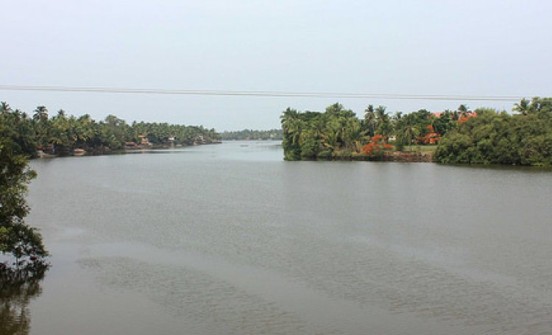
Rivers
Dependable H₂O supply of source
  Grossly polluted
  Unfit for drinking without treatment
Characteristics:
  Turbid during rainy season
  Contains dissolved and suspended impurities
  Bacterial counts may be very high

Slide 16
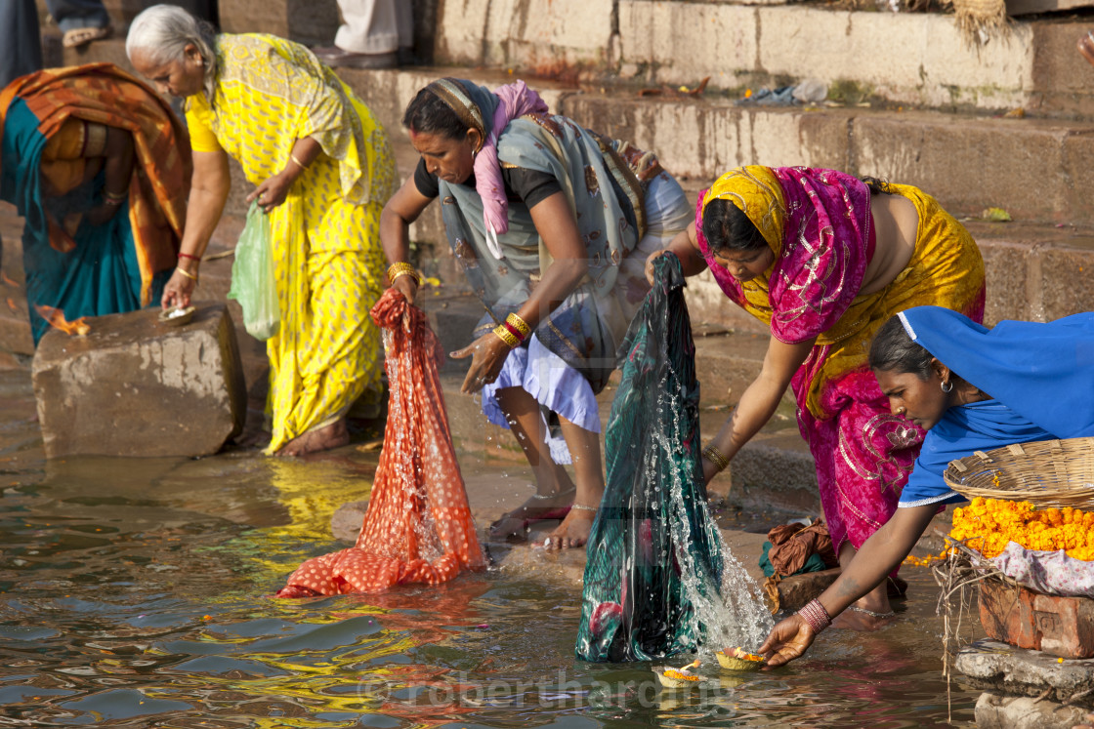
Impurities
Direct connection between
Customs/Habits:
    Bathing
    Washing  Cloths
    ⬧ Animals
    Disposal of dead
Alimentary canal and mouth
of people
living up and downstream

Slide 17
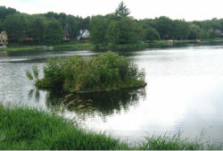
Natural purification
Dilution
Sedimentation
Aeration
Oxidation
Plant life
Animal life
Sunlight

Slide 18
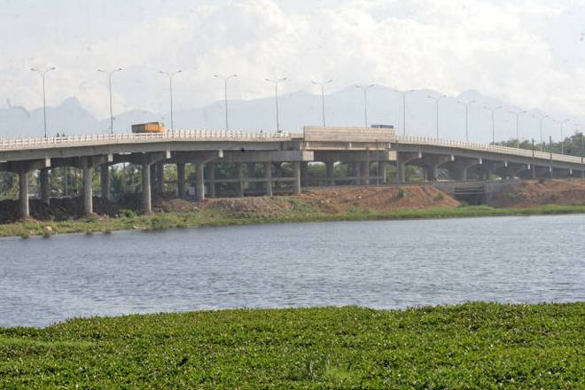
Tanks
Important source of water in many villages
Large excavations to store ground H₂O
Receives contaminants of all types
Increase amount of silt and colloidal matter
Older tanks may have vegetation (aquatic plants)
Liable to unlimited possibility of contamination
Highly Dangerous

Slide 19
Improvements
Natural purification not adequate
Elevated edges
Fencing: to check animal access
Platform: to take out H₂O
Restricted entry
Weed removal
Cleaning: Specially at the end of dry season
Even then, pollution prevention remains a practical problem

Slide 20
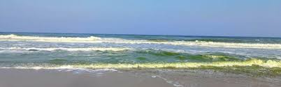
Sea Water
Plentiful source
Limitations: 3.5% salts in solution
Off shore water of Ocean & sea have salt conc.
  30000 to 36000mg/lit of dissolved solid
    19000 mg/lit of chloride
    10600mg/lit of Na
    1270 mg/lit of Mg
Desalting and Demineralization--- Heavy expenditure

Slide 21
Ground water
  Shallow well
  Deep well
  Springs
Cheapest and most practical
Superior to surface H₂O
Advantages
Disadvantages
Likely to be free of pathogenic agents
Usually requires no treatment
Assured supply
Less amenable to contamination
High in mineral content:
Hardness Mg/Ca
Requires pumping

Slide 22
Wells
Primary
source of H₂O in
Indian villages
Shallow well
Deep well
Definition:
Definition:
Taps H₂O From
Taps H₂O From
Above first impervious layer
Below first impervious layer
Quality
Quality
Chem:
Moderately hard
Much hard
Bact: Grossly polluted
Purer
Yield: Dries during summer
Continuous supply

Slide 23
Indian wells are Mostly shallow
Potential health hazards since liable to pollution
Latrines
Urinals
Drains
Cesspools
Soakage pits
Manure collection

Slide 24
Shallow
Well
Deep
Well
…………………………………………………………………………………………………………
…………………………………………………………………………………………………………
…………………………………………………………………………………………………………
…………………………
………………………………………………………………………………………………
…………………………………………………………………………………………………………
…………………………
………………………………………………………………………………
Porous Strata
…………………………………………………………………………………………………………
Porous Strata
Non-Porous Strata
Porous Strata
……………………………………………………………………………………………………………………………………………………………………………….
………………………………………………………………………………………
Non-Porous Strata

Slide 25
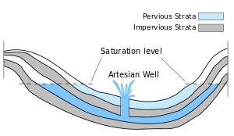
Artesian wells
Not common in India
Water comes to surface on to its own
held under pressure
Saline Intrusion

Slide 26
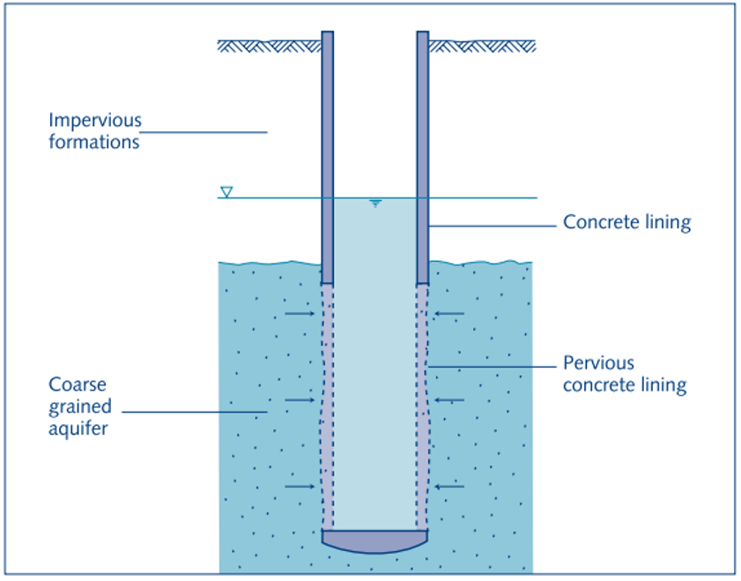
Dug wells
Most common
Katcha
Pacca
/ Masonary
Step wells: Now obsolete
Improvements
Katcha wells
  Deepening of bottom
  Hand pump
  Fill with sand upto water
  level and clay above that
  Platform for drainage
Pucca wells
  Upper 10 feet or > pucca
  Hand pump
  Raise lining above ground
  at least one feet
  Concrete slab as cover

Slide 27
Sanitary wells
Properly located
Well constructed
Protected against pollution
Provides again safe water

Slide 28
i. Location:
  15 mts (50ft)} sources of pollution
  Elevation
  ≥100 mts from house
ii. Lining:
  6 mts (20ft) →
  2’-3’ above ground

Slide 29
iii. Parapet:
  At least 70-75 cms above ground
  Concrete
iv. Platform:
  Atleast ‘1 mt’ around well with outward slope
v. Drain
  Outside cone of filtration (Drainage area)
vi. Covering:
  To cover top of well ‘↑’ Bacteriological quality
  Open well is not a sanitary well

Slide 30
vii. Hand pump:
  Robust to withstand rough handling
  ↑ H₂O Quality : Bacteriological
viii. Consumer responsibility
ix. Quality: Improved
  Physical
  Chemical and
  Bacteriological

Slide 31
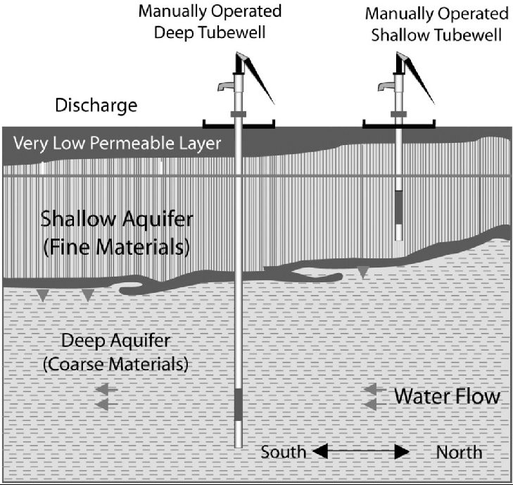
Tube wells
SUCCESSFUL
  Bacteriological safe
  Cheap
Shallow
Largest source of H₂O in rural areas
Area within 15 mts must be pollution free
Water bearing stratum
Deep
Costly but good
with ↑ yield
No dependence
on rain fall
Successive layers of rocks

Slide 32
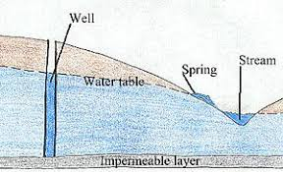
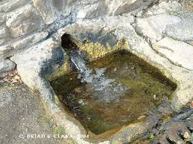
Springs
Topography
Not important source
Shallow, Deep, Mineral, Thermal
Liable to gross pollution
Yield is too low for use as a source of
community H₂O supply

Slide 33
Reference book
1. Park’s Textbook of Preventive and Social Medicine, 24th Edition
By: K. Park, Banarsidas Bhanot Publishers.

