Slide 1
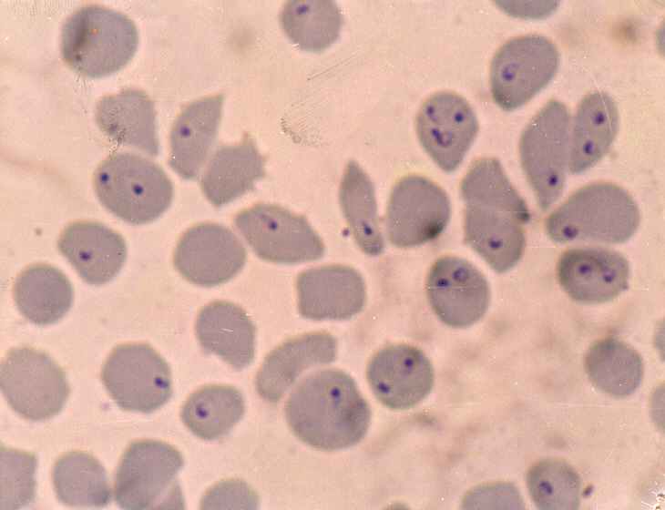
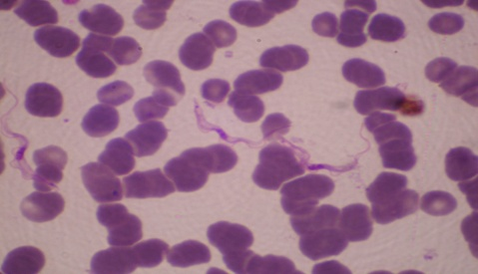
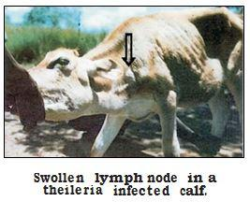
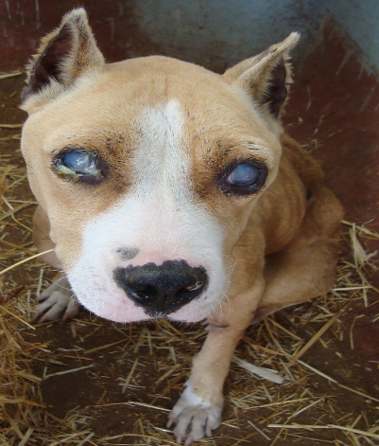
Specific Tissues lesions Caused by the Parasites
( Practical)
Dr. AJIT KUMAR
Department of Veterinary Parasitology
Bihar Veterinary College
Bihar Animal Sciences University
Patna-800014
Image source: Google image

Slide 2
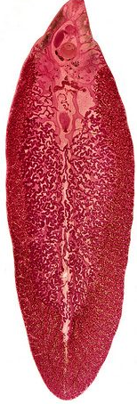
Specific Tissues lesions Caused by the Parasites
Submandibular Oedema ( Bottle jaw): Fasciola, Amphistomes, Haemonchus contortus, Hook worms etc. infection.

Slide 3
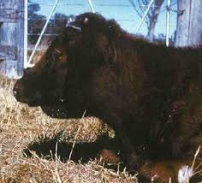
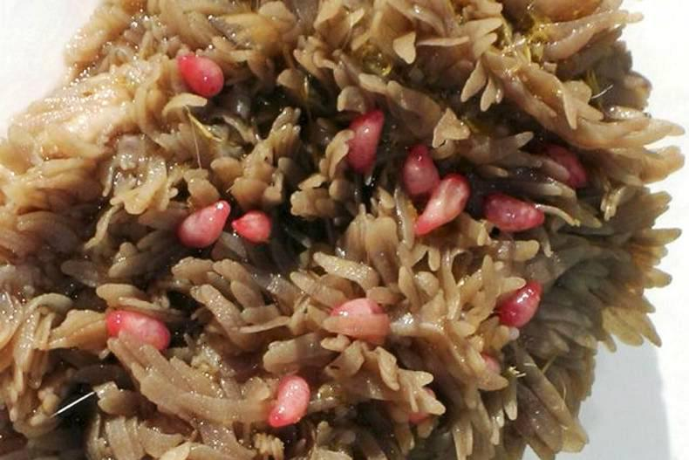
Specific Tissues lesions Caused by the Parasites
Submandibular Oedema ( Bottle jaw): Amphistomes ( Paramphistomum cervi etc.) infection.

Slide 4
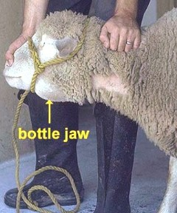
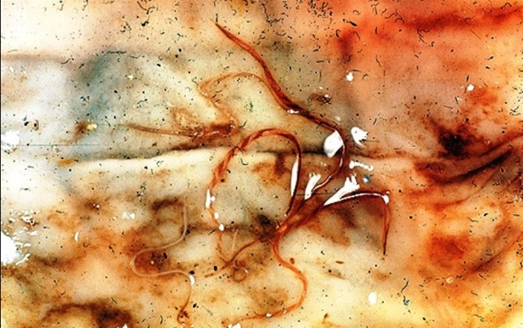
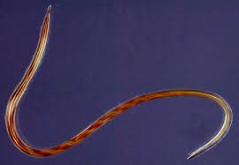
Specific Tissues lesions Caused by the Parasites
Submandibular Oedema ( Bottle jaw): Haemonchus contortus infection.

Slide 5
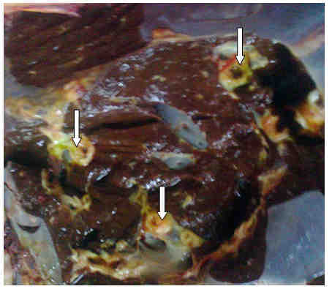
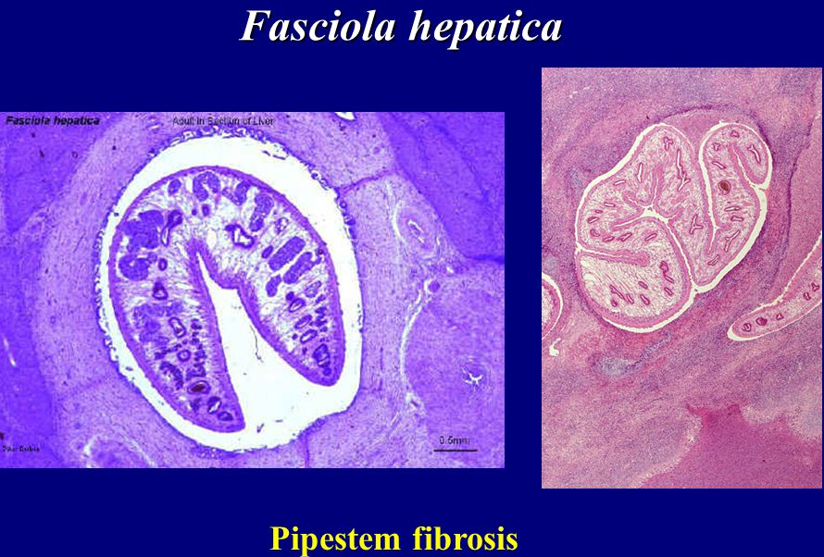
Specific Tissues lesions Caused by the Parasites
Pipe stem liver: In cattle during fasciolosis, the walls of the bile ducts are generally calcified and protrude markedly from the surface and are difficult to cut with a knife. They resemble the stem of a clay pipe, giving the common name of Pipe stem liver to the infection.

Slide 6
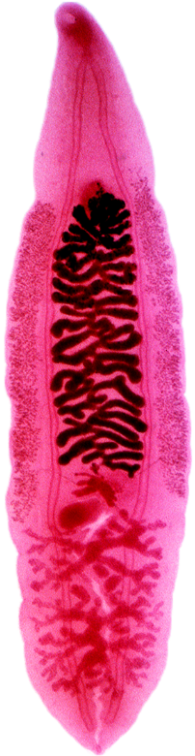
Specific Tissues lesions caused by the Parasites
Cholangiocarnima: due to Clonorchis sinensis infection.
Clonorchis sinensis ( Chinese liver fluke)

Slide 7
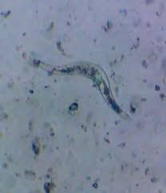
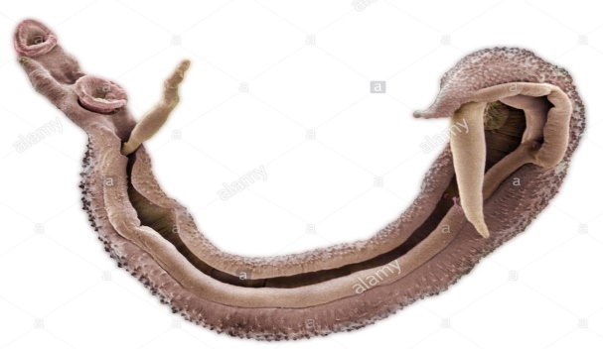
Specific Tissues lesions caused by the Parasites
Cauliflower like Granulomatous lesions:
e.g. Schistosoma nasale caused cauliflower like growth in nasal mucosa of infected host.
Egg
(Napolean hat shaped)
Adult flukes

Slide 8
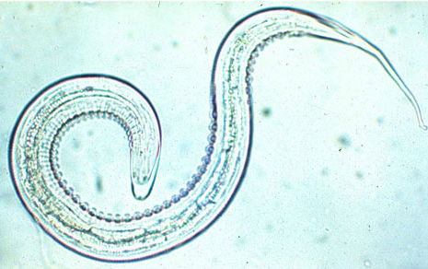
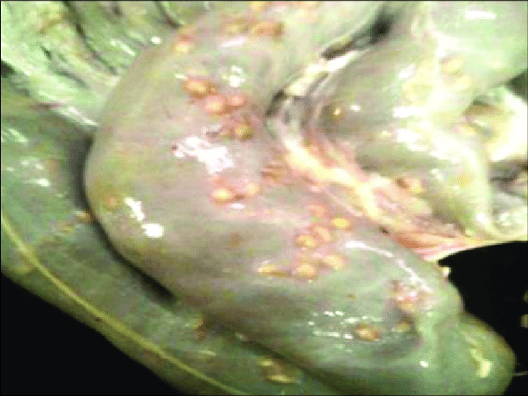
Specific Tissues lesions caused by the Parasites
Pimply gut: due to Oesophagostomum spp. ( Nodular worm) infection.
Parasitic larvae cause the formation of nodules on the intestinal walls.
Nodulated gut is called pimply gut or knotty gut.
Oesophagostomum sp.

Slide 9
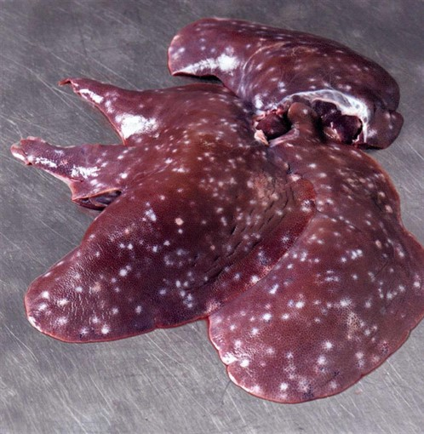
Specific Tissues lesions caused by the Parasites
Milk spot lesions in liver: due to Ascaris suum infection in pig.
Ascaris suum (Male & Female)
Milk spots in liver

Slide 10
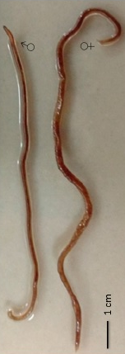
Specific Tissues lesions Caused by the Parasites
Stenosis of the aorta or formation of aneurysms, malignant tumour in the oesophagus, osteosarcoma (golf ball size lesion) : due to Spirocerca lupi infection in dog.

Slide 11
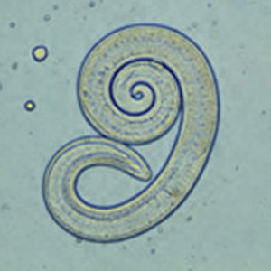
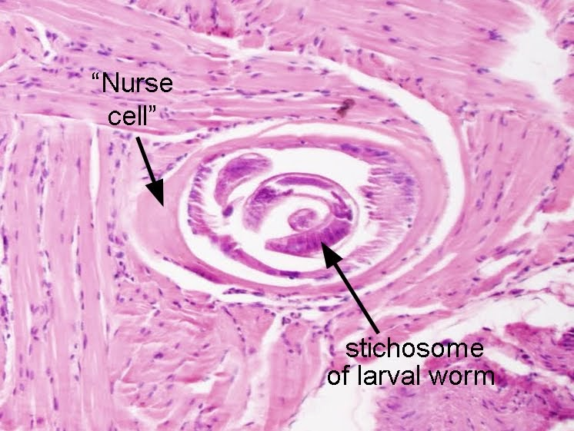
Specific Tissues lesions Caused by the Parasites
Nurse cell: First stage larvae of Trichinella spiralis via blood reach to the striated (Skeletal) muscles where they are encapsulated by the host, grow and assume characteristic coiled position. Parasitised cells are called nurse cell.
Trichinella spiralis

Slide 12
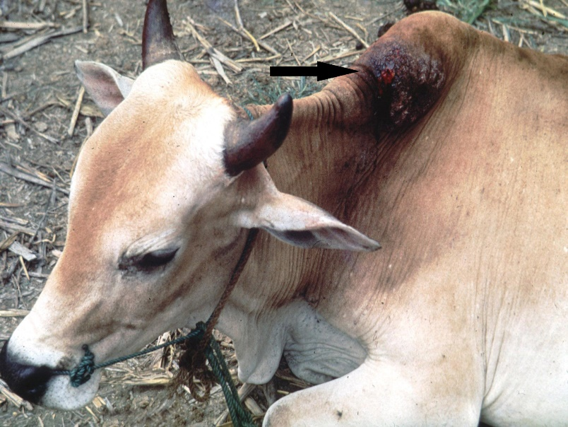
Specific Tissues lesions Caused by the Parasites
Chronic dermatitis (hump sore) in cattle : due to Stephanofilaria assamensis infection.

Slide 13
Specific Tissues lesions Caused by the Parasites
Enlargement of superficial lymph nodes (Prescapular lymph nodes) : due to Theileria spp. infection.

Slide 14
Specific Tissues lesions Caused by the Parasites
Punched necrotic ulcers in abamasum: due to Theileria annulata infection.
Necrotic punched ulcers in abomasum

Slide 15
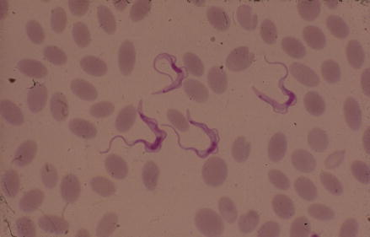
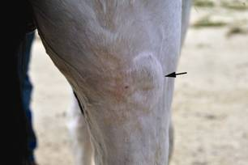
Specific Tissues lesions Caused by the Parasites
Doller spot: due to Trypanosoma equiperdum infection in horse.
Typical 'silver dollar' oedematous skin plaque (arrowed) on the hind leg of a horse infected with Dourine.
Trypanosoma equiperdum

Slide 16
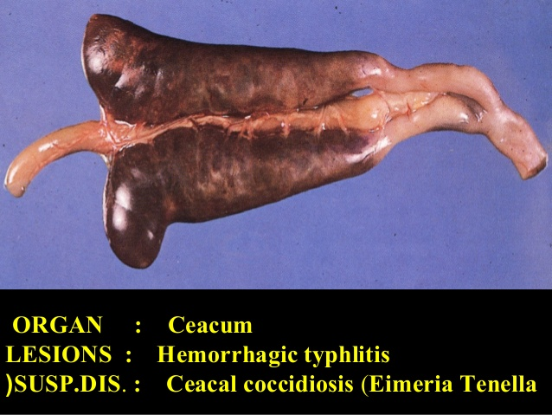
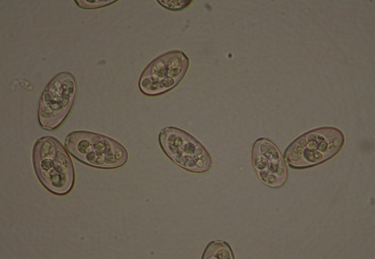
Specific Tissues lesions caused by the Parasites
Haemorrhagic typhlitis: due to Eimeria tenella infection in poultry.
Oocysts of Eimeria

Slide 17
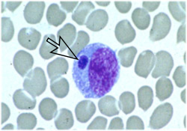
Specific Tissues lesions caused by the Parasites
Corneal opacity: due to Trypanosoma evansi and Ehrlichila canis infection in dog..
Ehrlichia canis
Trypanosoma evansi

Slide 18
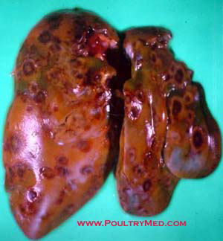
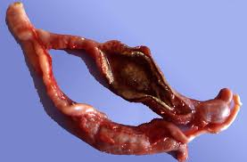
Specific Tissues lesions caused by the Parasites
Histomonas meleagridis (Histomonosis) produces foul smelling yellowish exudates forming a hard caseous plug in caecum and formed circular necrotic foci with yellow depressed center (bulls eye appearance) in liver.
Caecum
Circular necrotic lesions in liver

Slide 19
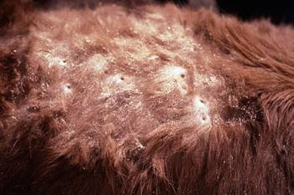
Specific Tissues lesions caused by the Parasites
Warbles : L3 larvae of Hypoderma spp. (warble fly) which can be palpated as distinct swellings (warbles).
Licked beef : Hypoderma larvae caused discolouration of meat (beef) and infested meat may also be gelatinous which called “licked beef”.
Larvae of Hypoderma fly
Warbles lesion

Slide 20
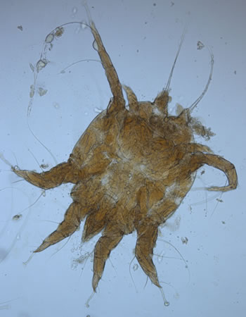
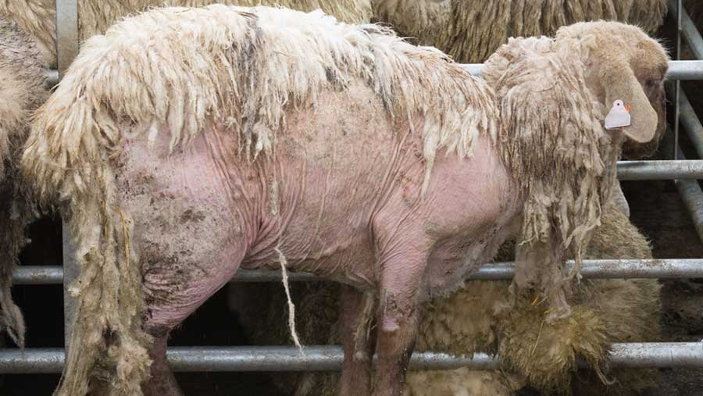
Specific Tissues lesions caused by the Parasites
Sheep scab: due to Psoroptes ovis mites infestation.
Psoroptes ovis (mite)
Sheep scab due to Psoroptes ovis (mite) infestation

Slide 21
THANK U

