Slide 1
Viral diseases of wild and zoo animals
By: Sonam Bhatt
Assistant Professor
VMD BVC Patna

Slide 2
Common diseases
FMD
Rabies
Canine Distemper
Avian influenza
Measles (Rubeola)
Viral hepatitis
Kyasanur forest disease (KFD)
Herpesvirus & pox virus

Slide 3
FMD
This disease occurs in case of wild ruminants and other artiodactylids, in general.
Affected wild animal species may have lesions in the foot and mouth.
• This disease may lead to severe morbidity among the hooved stock.
• This disease has been documented in herbivores like gaurs, cervids, suids etc. and is common among wild fauna but needs documentation in most of the cases.
• Elephants are also affected.

Slide 4
All Deers, Serow, Elephant, Himalayan Black Bear, Rhinoceros, Hippopotamus, Bison, Wild Pig, Nilgai. Source of infection: Aerosol. Contaminated feed and water, nasal secretion, nasal discharge, lacrimal secretion, infected bedding. Diagnosis: Clinical diagnosis:- Salivation, ulcerative stomatitis, painful lesion on cleft and coronet region. High rise of temperature with anorexia. Laboratory diagnosis: Isolation of organism from infected lesion. Prevention and management: Half yearly vaccination in case captive animals susceptible to this disease. Segregation of infected animals in hygienic condition. Disinfection of enclosure with Glutaraldehyde solution and other disinfectant material like Lime powder etc. Ring vaccination of domesticated animals in protected areas. Treatment: It is not possible to treat free ranging wild animal inside protected areas. Captive animals to be treated with fluid therapy with antibiotic and topical application of antiseptic spray/lotion/ointment. Daily dressing with P.P. lotion.

Slide 5
CANINE DISTEMPER
This is a viral disease affecting the canids as well as the felids.
Causative agent : Morbilliviruses belong to the family Paramyxoviridae and include a number of highly pathogenic viruses such as measles virus, rinderpest virus, canine distemper virus (CDV), and peste-des-petits-ruminants virus. In the last decades, morbilliviruses emerged also as causative agents of several mass-mortalities in marine mammals
The occurrence of canine distemper in case of felids as an outbreak has been
documented among the free ranging lions in Africa.
Affected ones reveal dullness, ataxia or deranged gait, anorexia, thick muco-purulent discharge etc. in general.

Slide 6
Wild canids :Affected members of the genus Canis include Australian dingos (Canis dingo), coyotes (Canis latrans), black-backed jackals (Canis mesomelas), golden jackals (Canis aureus), Canadian wolves (Canis lupus), American gray wolves (Canis lupus), Mexican wolves (Canis lupus baileyi), Iberian wolves (Canis lupus), and Apennine wolves (Canis lupus)
Procyonids
Ailurids (red panda), Ursids (bear), Mustelids (black footed ferrets, mink, and skunks)
Felids (tiger, leopard, lions )
Viverrids (Binturong, Asian palm civet)
Hyaenids
Distemper in non-carnivore species: rhesus monkeys (Macaca mulatta); marine mammal (seal- phocine distemper virus)

Slide 7
Clinical signs: discharge from the eyes and nose, dyspnea (difficulty breathing), coughing, and pneumonia. Fever, anorexia and respiratory tract issues are most common.; gastrointestinal manifestations, neurological signs and cutaneous involvement
Diagnosis: Virus isolation ; RT-PCR
Treatment : symptomatic & supportive
Prevention & control: vaccination

Slide 8
Rabies
Rabies is a neurological disease of mammals that is almost invariably fatal once the clinical signs develop
Rabies has been documented in chital, rhino, elephants etc. Even oral infection has been documented in foxes and skunks by experimental means, following the ingestion of mouse carcasses infected by rabies virus.
Etiology: Rabies results from infection by the rabies virus, a neurotropic virus in the genus Lyssavirus, family Rhabdoviridae; Lagos bat virus (genotype 2, serotype 2) is found in bats in parts of Africa, and has caused fatal cases of neurological disease in cats, dogs and a water mongoose, Mokola virus (genotype 3, serotype 3) is the only rabies-related lyssavirus that has not been found in bats
Animals affected: All species of mammals Source of infection: Rabies virus shed in the saliva of infected mammals (Canids) and introduced by bite wound inoculation.

Slide 9
Diagnosis:
Clinical diagnosis:- Neurological disorder
Laboratory diagnosis: Detection of Negri bodies in cerebellar Purkinje’s cells.
Prevention and management: Zoo animals should be protected from contact with potentially rabid animals at the Zoo. Vaccination of domestic animals recommended in the area where there is past record of exposure of the disease. Captive animals with good management and care are less likely to be exposed to Rabies.
Treatment: No treatment once the disease is exposed.

Slide 10
Measles
Measles is a highly contagious viral disease in nonhuman primates. The infection can range from asymptomatic to rapidly fatal, resulting in significant morbidity and mortality in captive populations.
This is a highly infectious exanthematous viral disease of children. This has been
documented in marmosets, tamarins, owl monkeys etc. and is fatal to them.
Vaccination of infant rhesus monkeys and other macaques with human measles vaccine is recommended.
• Several outbreaks of viral hepatitis have been documented in primate handlers
and primate practitioners.
• The virus causing human infectious hepatitis (hepatitis A) can infect
chimpanzees, patas, wooley monkey, gorilla, tamarins, cebus etc.
• KFD has been reported in non human primates and is of zoonotic importance.

Slide 11
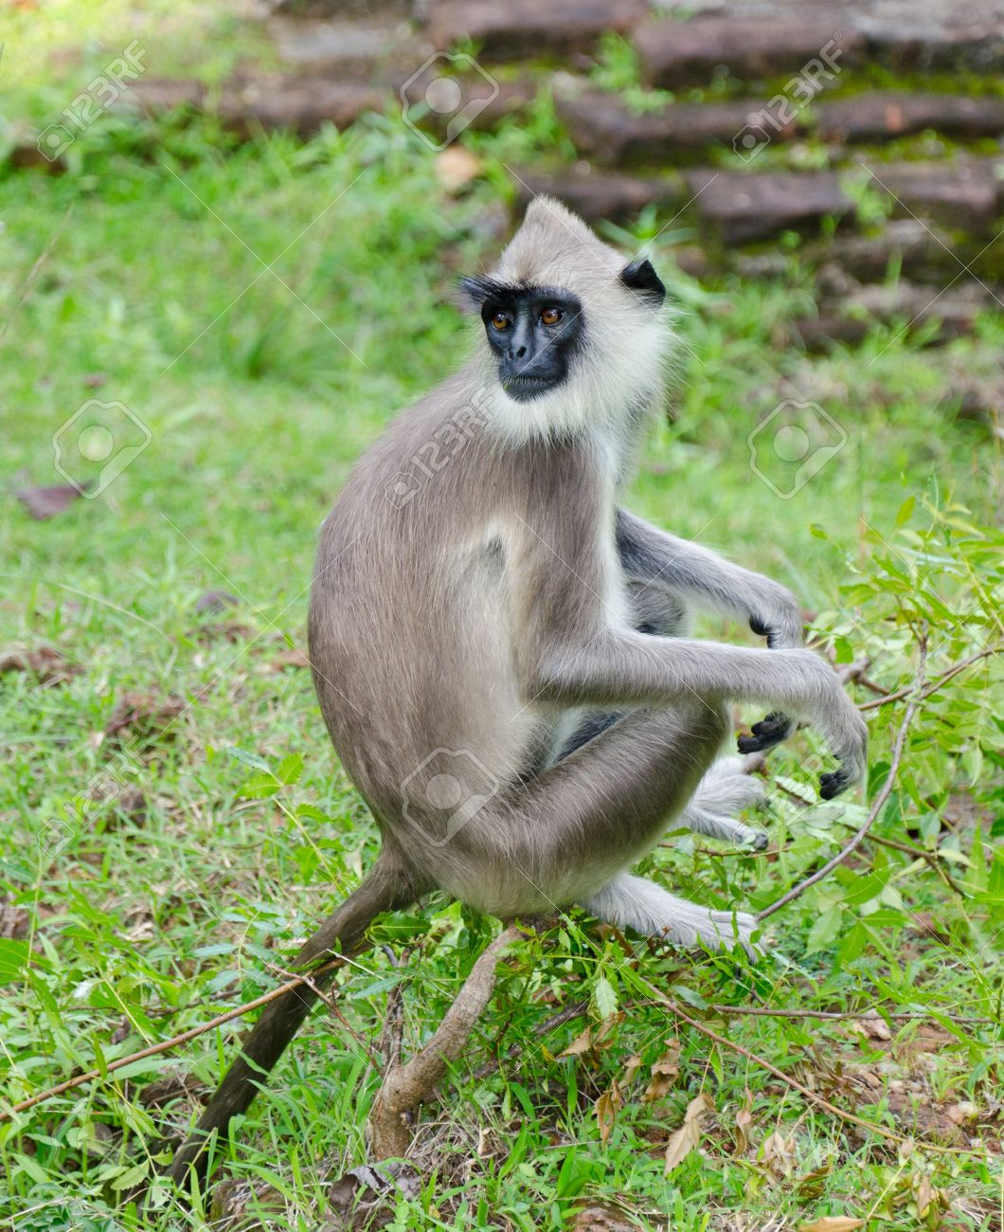
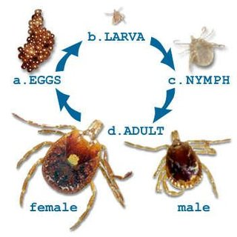
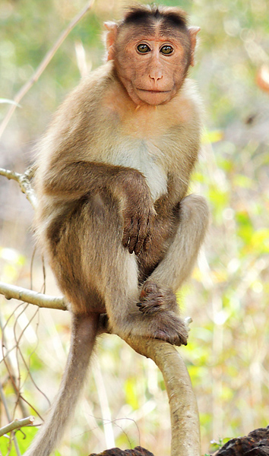
KFD
Caused by Kyasanur Forest disease virus (KFDV), a member of the virus family Flaviviridae
Hard ticks (Hemaphysalis spinigera) are the reservoir of KFD virus and once infected, remain so for life. Rodents, shrews, and monkeys are common hosts for KFDV after being bitten by an infected tick.
Monkeys, predominantly, the black-faced langur (Presbytis entellus) and the redfaced bonnet monkey (Macaca radiata) are susceptible to KFDV
Zoonotic importance
Gastrointestinal, bleeding complication

Slide 12
HERPES VIRUS AND POX VIRUS INFECTIONS
Herpes virus infections are documented in non-human primates, elephant calves
Rhesus macaques and cyanomolgus are considered as the primary natural hosts
Lesions in non-human primates are mostly confined to the mucosa of buccal
cavity.
Ulcers or vesicles do occur around the lips and external nares and the most
common site is the tongue
All macaques are considered to be potential shedders of Cercopithecine herpesvirus type 1 (Herpesvirus simiae, B virus). The infection is generally subclinical or mild (conjunctivitis or oral vesicles) in Macaca spp but usually causes a fatal encephalitis and encephalomyelitis in people

Slide 13
POX VIRUS INFECTION
Monkeypox and other poxvirus infections may be seen in primate colonies. Monkeypox is a reportable zoonotic disease characterized by a maculopapular rash and variolous pustules.
Pox virus was documented in chimpanzee under captive condition reared at zoological garden

