Slide 1
BIHAR ANIMAL SCIENCES UNIVERSITY, PATNA, BIHAR Bihar Veterinary College, Patna
UNIT-I
One-dimensional Diagrams for Presentation of Data
Speaker: Ramesh Kumar Singh
Assistant Professor cum Jr. Scientist
Division of Animal Genetics and Breeding
Bihar Veterinary College, Patna

Slide 2
One-dimensional diagrams
(a) LINE DIAGRAM: - It involves only arranging of vertical lines, each vertical line height is equal to its corresponding frequency. The variate values (x) is presented along X-axis on suitable scale and the corresponding frequency are presented on a suitable scale along Y-axis.
(b) BAR DIAGRAMS: - It consist of a group of equidistant rectangles one for each group or category of the data in which value or magnitude are represented by the length or height of the rectangles, the width of rectangles being arbitrary and immaterial. The following may be borne in mind to draw bar diagrams.

Slide 3
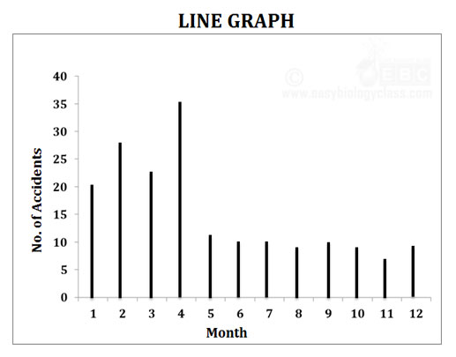
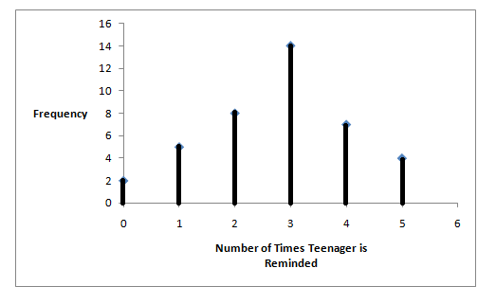
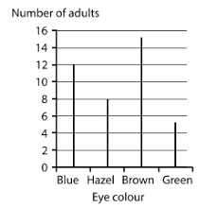
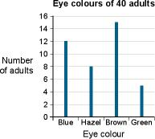
LINE DIAGRAMS:

Slide 4
Properties
All the drawn bars should have equal width
Equal space may be provided between each bars
The height of bars or rectangles should be proportional to their magnitude
Bars should be drawn on same plane.
It may be horizontal or vertical
Magnitude may be written on top of bars
Wherever possible bars should be arrange left to right in order of their magnitude

Slide 5
Types of Bars Diagram
Simple Bar Diagram:- It is most commonly used one
Subdivided or component Bar Diagram:- Sub-divided bar diagrams are useful not only for presenting several items of a variable or category graphically but also facilitates comparisons of different parts or component to the whole.

Slide 6
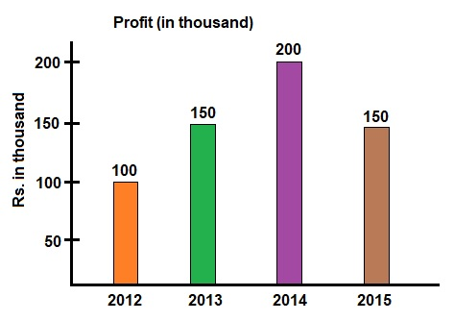
Simple Bar Diagram

Slide 7
Following points should be kept into mind
The order of different parts or components of bars should be same in all bars. The largest component on the top of bars.
Index or key showing different parts having different colour, shades, dotes etc. should be indicated.
If should not be used if number of parts exceeds to 10.

Slide 8
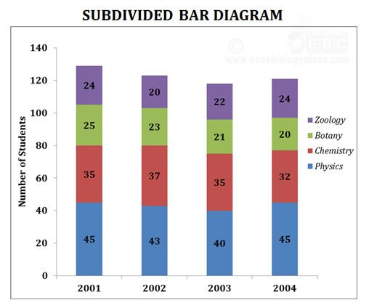
Simple Sub-divided Bar Diagram

Slide 9
Percentage Bar diagram
When relative change in component parts are important, then it is used. All bars heights are same.
It calculate percentage of each components of bars.

Slide 10
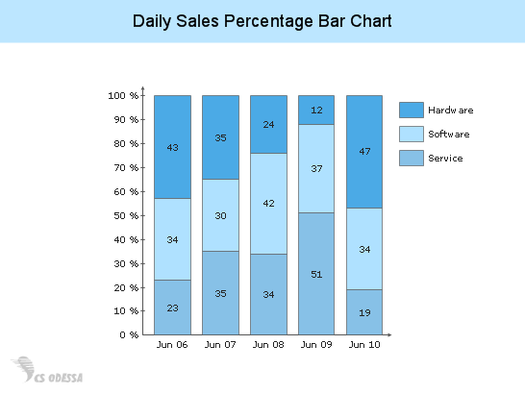
Percentage Sub-divided Bar diagram

Slide 11
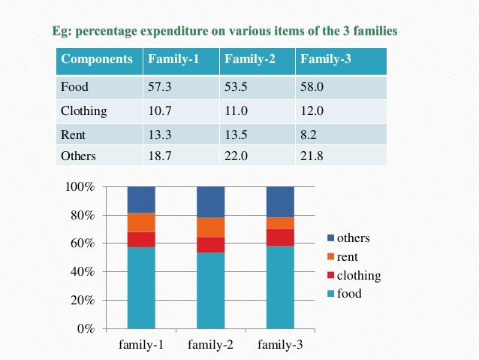

Slide 12
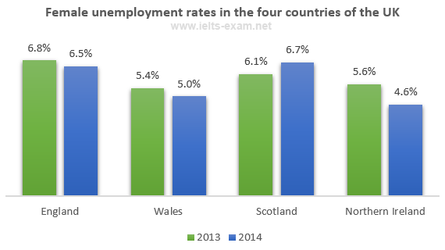
Percentage Simple Bar diagram

Slide 13
Multiple Bar Diagrams
When more than one variables are to be presented, Multiple Bar diagrams may be used. Its drawing is same to that of simple Bar diagram.
A set of adjacent bars is one for each variable is drawn proper and equal spacing is given between different sets of the bars.
To distinguish between different bars in a set, different colours, shades dotting or crossing may be used. Key or index to this effect may be given.

Slide 14
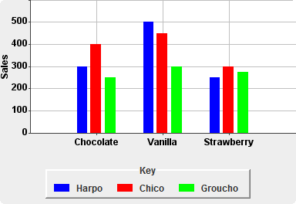
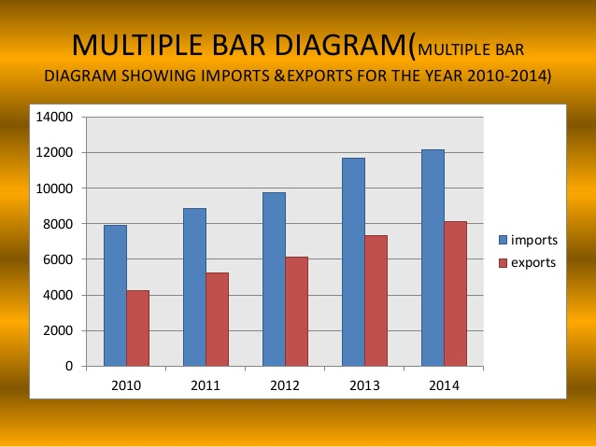
Multiple Bar Diagrams

Slide 15
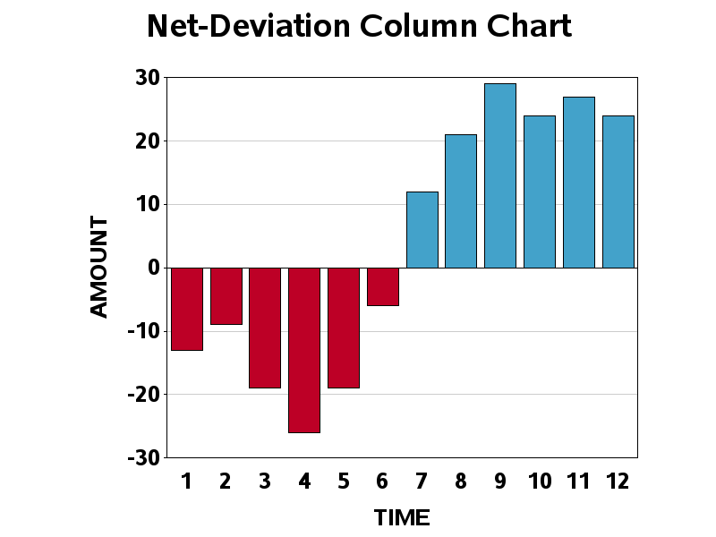
Deviation Bars - It is also Called as Bilateral Bar Diagrams and used to depict plus (surplus) and minus (deficit) directions from the point of reference. The net Quantities which have both positive and negative values.

Slide 16
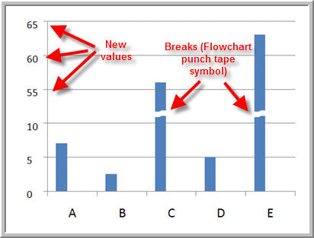
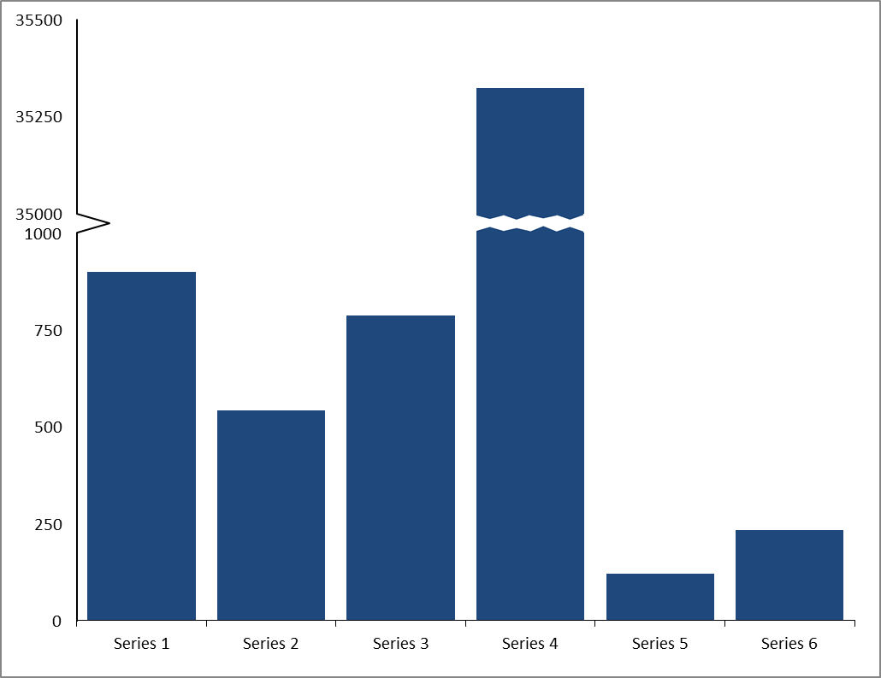
Broken Bars - The observation of a variable presents extreme variation, then smaller values of observation appear to small in size in comparison to larger one in form of Bars. Thus Broken Bars are used to present such kind of data graphically.

Slide 17
Thanking You

