Slide 1
Structure and morphology of Bacteria
DR. SUDHA KUMARI
Assistant Proffecer
Department of Veterinary Microbiology Bihar Veterinary College
Unit -1
Theory
General & Systematic Veterinary Microbiology

Slide 2
Structure of Bacteria
The structure of bacteria is known for its simple body design. Bacteria are single-celled microorganisms with the absence of the nucleus and other cell organelles hence, they are classified as prokaryotic organisms.
Bacteria (the singular is a bacterium) are single cell organisms that can live in different media.
Unicellular organisms belonging to the prokaryotic group where the organisms lack a few organelles and a true nucleus”.

Slide 3
Structure of Bacteria- In cross section organised in 4 layers as
1. Extramural layer- this comprises to slime layer and capsule which lie external to cell wall.
2. Surface appendages- This consists of flagella and pili . Structures projects from the cell surface.
3. Cell envelop-consists if cell wall and cytoplasmic membrane
. 4.Cytoplasmic inclusion-Consists of nucleoid, ribosomes, mesosomes ,volatile granules and plasmid.

Slide 4
Flagella
Slime layer
Cytoplasmic membrane
Cell wall
capsule
ribosomes
Nuclear body or nucleoid Cell
Fimbria
mesosome
Fig. Structure of a Typical Bacteria

Slide 5
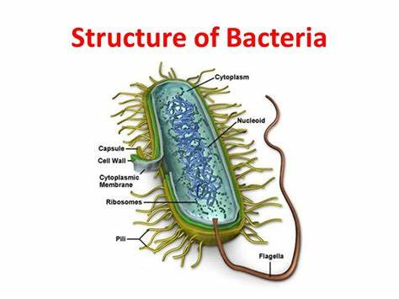
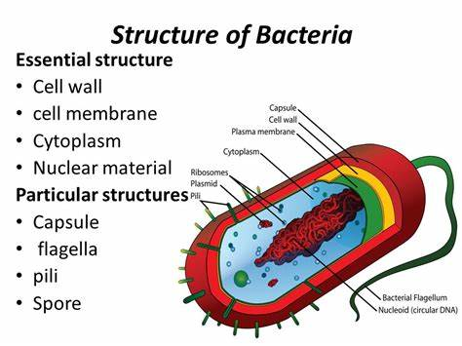

Slide 6
Slime layer and capsule-
Extracellular gelatinous accumulation of viscid materials around the external surface of the cell wall of bacteria capsule.
The bacterial capsule is a very large structure of many bacteria. It is a polysaccharide layer that lies outside the cell envelope, and is thus deemed part of the outer envelope of a bacterial cell.
It is a well-organized layer, not easily washed off, and it can be the cause of various diseases.
When it diffuses into the surrounding medium and remains as a loose undermarcated secretion as in leuconostoc, it is known as slime layer.

Slide 7
Function of capsule-
Enhances bacterial virulence by inhibiting phagocytosis. Loss of capsule may render the bacterium avirulent. Bacteria tend to lose capsules repeated subcultures.
Acts as protective covering against antibacterial substance such as, bacteriophages, phagocytes, enzyme etc.
Capsule antigen is specific for bacteria and can be used for identification and typing of bacteria.
Diagnostic importance e. g. Mac-Fadyean reaction in Bacillus anthracis and Quelling reaction in case of pneumococcus sp.

Slide 8
Some eg . of Capsulated gram-negative bacteria:
Escherichia coli (in some strains)
Pseudomonas aeruginosa
Salmonella
Klebsiella pneumoniae
However, some gram-positive bacteria may also have a capsule:
Bacillus anthracis
Streptococcus pyogenes synthesizes a hyaluronic acid capsule.
Streptococcus epidermidis, Staphylococcus aureus

Slide 9
Flagella and Motility-Hair like Helical structure emerge from cell wall.Compsed of flagellin protein and known as H- antigen
Monotrichous, e.g. Vibrio cholerae
2.Amphitrichous e.g. Spirillum serpens
3.Lophotrichous e.g. Bartonella bacillifornis
4. Peritrichous e.g. Escherichia coli
Fuction-
1. It is the organ of locomotion.
2. Motile aerobic bacteria show positive chemotaxis towards higher oxygen concentration.

Slide 10
3. Motility helps in invasiveness as power of locomotion helps in penetrating through epithelial barrier and viscid mucous membrane.
4.Due to continuous changing of place, the rate of uptake of nutrient solvent is increased.
Fimbriae of pili- Some gram-negative bacteria possess another type of filamentous appendages which are numerous, thinner and shorter than flagella.

Slide 11
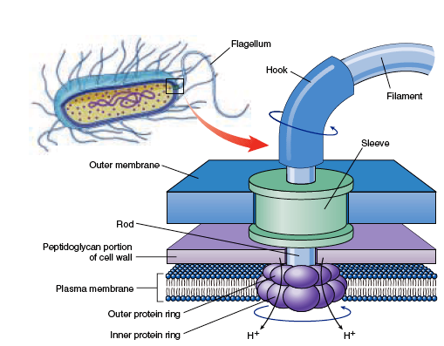

Slide 12
Functions :------
1.Ordinarily pili helps in the adherence of symbiotic bacteria to host cell.
2.Pili helps in the attachment of donor and recipient cells in bacterial conjugation and these pili are called sex pili.
3.It helps in the virulence by acting as a colonization antigens.
4. The majority of fimbriae bacteria adhere to red blood cells of many species causing haemagglutination.

Slide 13
Cell wall of bacteria-
Rough and rigid structure,
20-25 nm in thickness and weighs about 20-25% of dry weight of the cell.
Rigid part is peptidoglycan which is a mucopeptide composed of N-acetyl muramic acid and N-acetyl glucosamine molecules alternating in chains, cross linked by peptide sub units.

Slide 14
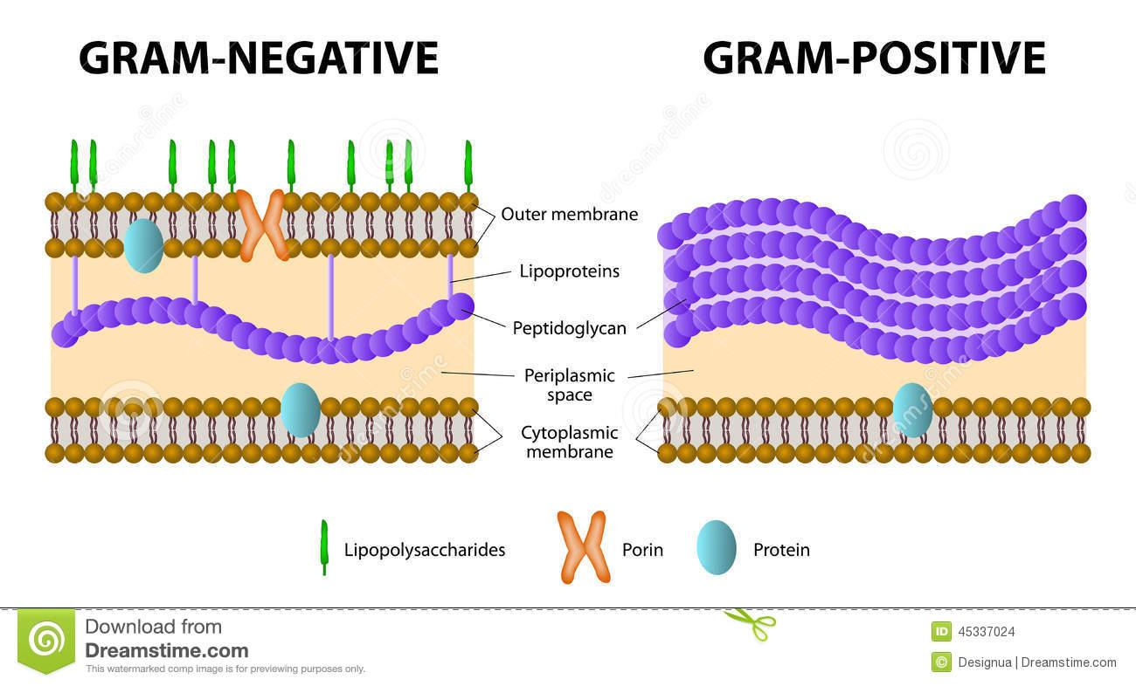
Different between gram- negative & gram- pogetive bacterial cell wall

Slide 15
Chemical structure of bacterial cell wall –
Divided in to four layers-
Slime layer and capsule,
Surface appendages includes flagella and fimbriae ,
Cell envelop i.e. Cytoplasmic membrane and cytoplasm containing granular part, nucleoid, ribosome etc.
Function of cell wall of bacteria-
Shape of the bacteria,
Protection to the cell against osmotic damage,
Takes part in the cell division,
Posses target site for antibiotics, lysozymes and bacteriophages, carries bacterial antigens.

Slide 16
ENDOSPORE
An endospore is a dormant, tough, and non-reproductive structure produced by some bacteria in the phylum Firmicutes.
The name "endospore" is suggestive of a spore or seed-like form (endo means within), but it is not a true spore (i.e., not an offspring).
Bacteria produce a single endospore internally.
The spore is sometimes surrounded by a thin covering known as the exosporium, which overlies the spore coat.
The spore coat, which acts like a sieve that excludes large toxic molecules like lysozyme, is resistant to many toxic molecules and may also contain enzymes that are involved in germination.

Slide 17
The arrangement of spore layers is as follows:
Exosporium
Spore coat
Spore cortex
Core wall
The position of the endospore differs among bacterial species and is useful in identification.
The main types within the cell are terminal, sub terminal, and centrally placed endospores.

Slide 18
Terminal endospores are seen at the poles of cells, whereas central endospores are more or less in the middle.
Subterminal endospores are those between these two extremes, usually seen far enough towards the poles but close enough to the center so as not to be considered either terminal or central.
Lateral endospores are seen occasionally.
Examples of bacteria having terminal endospores include Clostridium tetani, the pathogen that causes the disease tetanus.
Bacteria having a centrally placed endospore include Bacillus cereus. Sometimes the endospore can be so large the cell can be distended around the endospore. This is typical of Clostridium tetani.

Slide 19
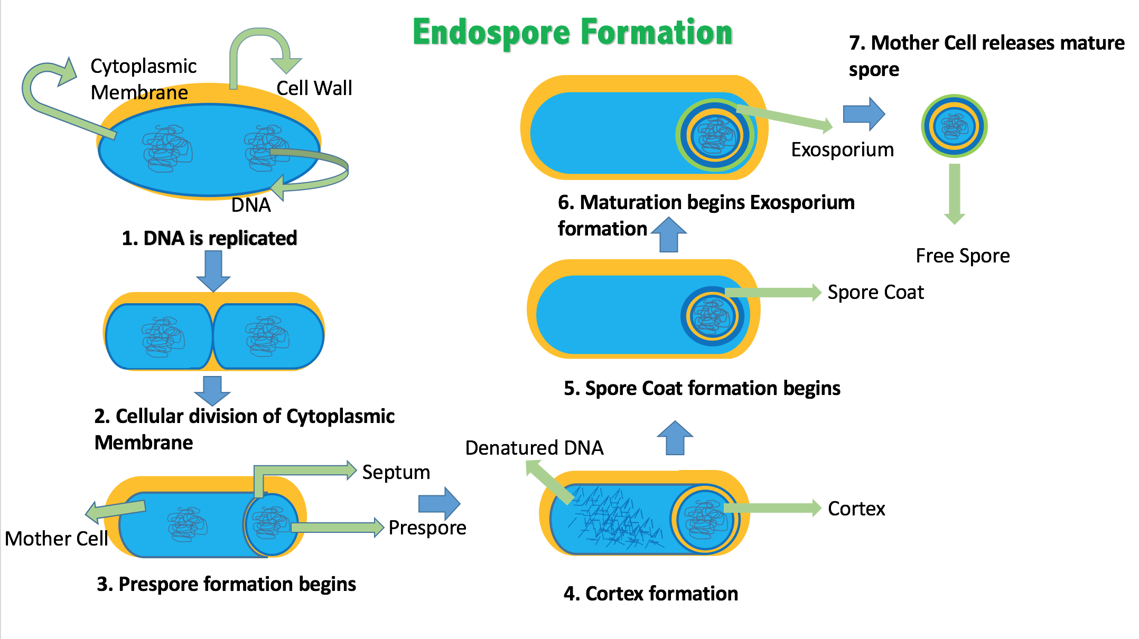

Slide 20
