Slide 1
Vetero-Legal Aspects of Wounds
Unit-7
Dr. Vivek Kr. Singh & Dr. Pallav Shekhar
Assistant Professor
Bihar Veterinary College

Slide 2
The vetero-legal wounds may be classified as-
Bruises (Contusions)
Abrasions
Incised wounds
Lacerated wounds
Punctured wounds
Gunshot wounds

Slide 3
BRUISES or CONTUSIONS
Bruises or contusions are injuries which are caused by a blow from a blunt weapon
Characterised by painful swelling and crushing or tearing of the subcutaneous tissue without dissolution of integrity of skin

Slide 4
Age: Age of the Bruise is determined by the colour change on the skin
These colour change start from periphery and ends to the centre
The colour is red and turns blue or bluish black with in 3 days, become greenish on 5th -6th day and yellow from 7-12th day

Slide 5
Difference between Ante mortem and Post mortem Bruises
Swelling and Colour Changes
Absent

Slide 6
ABRASIONS
Abrasions are injuries involving loss of the superficial epithelial layer of the skin
Produced by a blow or a fall on a rough surface.
Abrasions caused during life appear as bleeding surface and soon converted into reddish brown crust or scab
Abrasions produced after death are dark brown and there is complete absence of bleeding

Slide 7
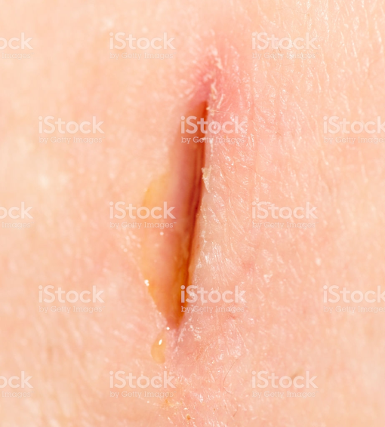
Incised wound
It is produced by sharp cutting instruments
It is mostly intentional
Character: Always broader than the edge of the weapon
It is some what spindle shaped with gapping
Its edges are smooth, even, clean cut, well
defined and usually everted
Bleeding is intensive

Slide 8
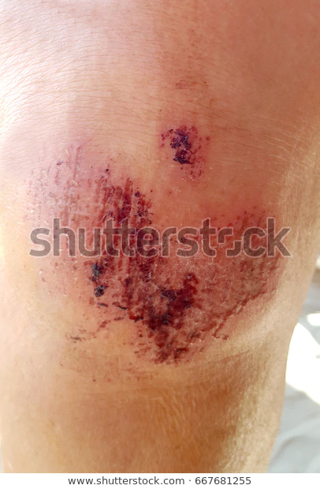
Lacerated wound
These wound do not corresponds in shape or size to the object producing them. Their edges are torn, jagged, irregular and swollen or contused

Slide 9
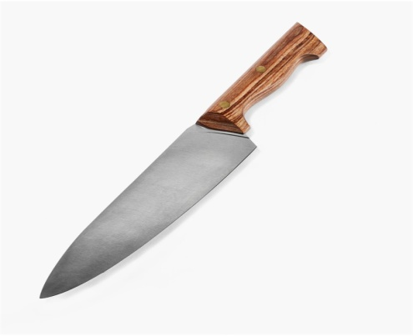
Punctured wound
They are popularly called stab and are termed as penetrating wound.
Character: The wound is wedged shaped
The depth of a punctured wound is much larger than its length or width
There may be little external haemorrhage, but profuse internal haemorrhage.

Slide 10
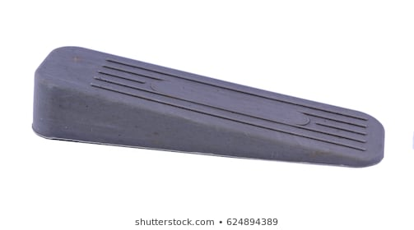
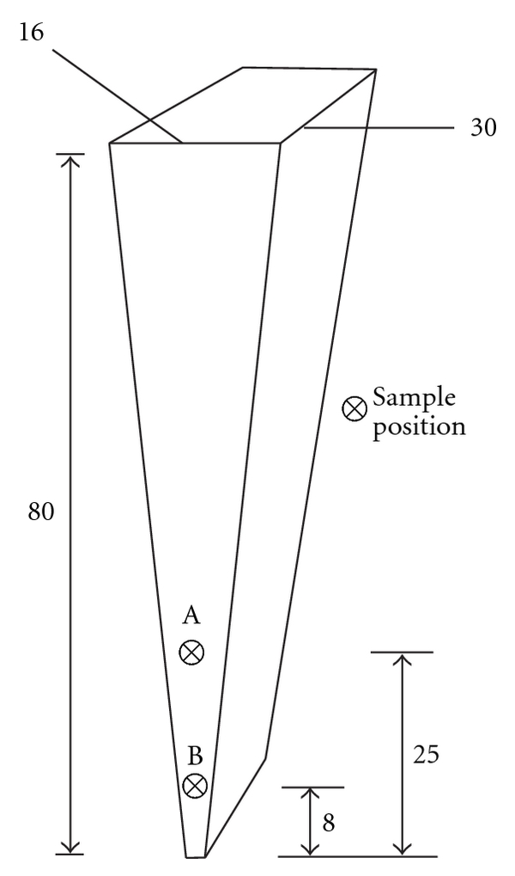
Wedge shaped

Slide 11
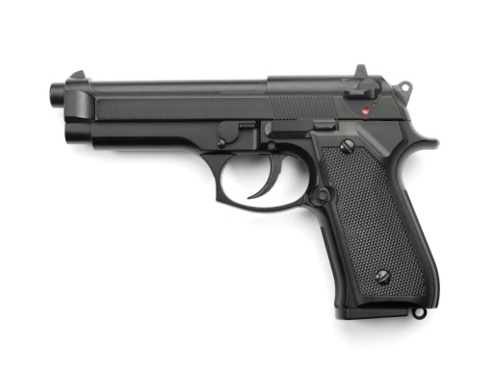
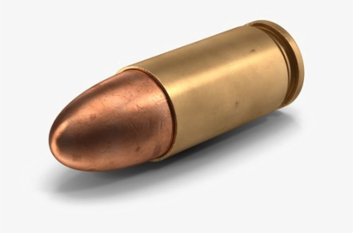
Firearm wounds/Gunshot wounds
The appearance of these wounds depend upon
The kind of the weapon employed
The nature of projectile
The velocity of the projectile
The range at which the weapon was fired
The part of body struck

Slide 12
Conical bullet produces punctured wounds
If fired from close, then entrance is lacerated, surrounding skin is blackened and tattooed
No blackening or scorching is found if the fire arm is discharged from distance of more than 4 feet
Timing of Firing: Black discharge of potassium sulphide mixed with carbon is found in the barrel of the firearm. Upto 5 -6 hrs it form strong alakaline solution

Slide 13
Simple or Grievous or Dangerous injury
A simple injury is one which is neither extensive or serious and which heals rapidly without leaving any permanent deformity or disfiguration
Grievous Injury
Emasculation
Injury at eye
Injury at ear, joint, Head or face, fracture or dislocation of bone

Slide 14
Difference between Ante mortem and Post mortem wound
Haemorrhage- Blood not easily washed
Retraction of the edge of the wound
Signs of inflammation and reparative process.
Easily fractured
Callus formation
Easily washed out.
Do not gap
Absent
Difficult to fractured
No callus formation

Slide 15
Thanks

