Slide 1
ANIMAL GENETICS & BREEDING
Biostatistics and Computer Application
Course No. AGB Lecture no. – 9
UNIT - I
Regression
Dr K G Mandal Department of Animal Genetics & Breeding Bihar Veterinary College, Patna Bihar Animal Sciences University, Patna

Slide 2
Regression
Regression measures the average relationship between two variables.
Concept of regression was given by Francis Galton.
It is denoted as ‘b’.
b_{yx} means regression of y on x, where, y is dependent variable and x independent variable.
b_{xy} means regression of x on y, where, x is dependent variable and y is independent variable.

Slide 3
In case of correlation, r_{xy} = r_{yx}
In case of regression, b_{yx} ≠ b_{xy}
Regression coefficient: It measures the amount of change in dependent variable for unit change in the independent variable.

Slide 4

b_{yx} = $\frac{Cov.xy}{Var.x}$ =$\frac{ ∑XY − ∑X∑Y/N}{∑X2 −\left(∑X\right)2/N}$
Likewise,
b_{xy} = $\frac{Cov.xy}{Var.y}$ = $\frac{∑XY − ∑X∑Y/N}{∑Y2 −\left(∑Y\right)2/N}$

Slide 5
Relationship between correlation & regression:
r_{xy} = $\sqrt{bXY.bYX}$
b_{xy} = $\frac{Cov.xy}{Var.y}$x$\frac{6x}{6x}$ = $\frac{Cov.xy}{6y.6y}$x$\frac{6x}{6x}$
= $\frac{Cov.xy}{6y.6x}$x$\frac{6x}{6y}$ = r. $\frac{6x}{6y}$

Slide 6

Similarly,
b_{yx} = $\frac{Cov.xy}{Var.x}$x$\frac{6y}{6y}$ = $\frac{Cov.xy}{6x.6x}$x$\frac{6y}{6y}$
= $\frac{Cov.xy}{6x.6y}$x$\frac{6y}{6x}$ = r. $\frac{6y}{6x}$

Slide 7
b_{xy}.b_{yx} = r. $\frac{6x}{6y}$ x r $\frac{6y}{6x}$ = r²
= r²
r = $\sqrt{\text{b}\text{xy}\text{.}\text{byx}}$
Thus, Coefficient of correlation = Geometric mean of two regression coefficients.

Slide 8
Properties of regression coefficient:
Both the regression coefficients i.e., byx and bxy have the same sign. i.e. either both will be positive or both will be negative.
r_{xy} will also have the same sign as that of byx & bxy.
If one of the regression coefficients is more than one, then other will be less than one.
Regression coefficient ranges from – ∞ to + ∞.
continued …………..

Slide 9
5. Regression coefficients have the same unit as that of the unit of original observation (data).
6. The arithmetic mean of two regression coefficients is more than one [½(bxy + byx) ≥ 1].
7. The maximum value of b_{xy} . b_{yx} = 1, because b_{xy}.b_{yx} = r² & maximum value of r = 1, so r² = 1.

Slide 10
Test of regression coefficient:
Regression coefficient is tested through t – test at n -2 df where n is the pair no. of observations.
Testing formula:
t_{(n-2)df} = $\frac{byx}{S.E.(b)}$
S.E. b_{yx} = $\sqrt{\frac{\left[∑y2 −(∑y\right)2/n] −b[∑xy −∑x∑y/n] }{\left(n −2\right)[∑x2 −\left(∑x\right)2/n ]} }$

Slide 11
Interpretation:
If the calculated value of t at 5% or 1% level of significance is more than the tabulated value of t at (n-2)df and corresponding level of significance (5% or 1%) then the regression coefficient is said to be significant.

Slide 12
Use of Regression Coefficient:
1. To find out the amount of change takes place in the dependent variable for unit change in independent variable.
2. To determine the degree of resemblance between relatives.
3. To estimate heritability through regression of offspring on parent.
4. To predict the value of dependent variable for any known value of the independent variable.

Slide 13

Prediction equation:
Y – Y = b (x – x)
1. y’ = y + b_{yx} (x – x)
On the basis of correlation coefficient:
y ‘ = y + r $\frac{sy}{sx}$ (x – x)
x ‘ = x + r $\frac{sx}{sy}$ (y – y)
Where, y ‘ = Predicted value of y.
x ‘ = Predicted value of x.
Y = average value of y variable
x = average value of x variable

Slide 14
Computation of regression coefficient
On the basis of following data of x and y variables, find out regression coefficient of y on x and regression coefficient of x on y. b_{yx} & b_{xy} ?
X | Y | XY | X² | Y²
10 | 11 | 110 | 100 | 121
12 | 12 | 144 | 144 | 144
14 | 13 | 182 | 196 | 169
16 | 14 | 224 | 256 | 196
18 | 15 | 270 | 324 | 225
20 | 16 | 320 | 400 | 256
22 | 17 | 374 | 484 | 289
24 | 18 | 432 | 576 | 324
26 | 19 | 449 | 676 | 361
28 | 20 | 560 | 784 | 400
30 | 21 | 630 | 900 | 441
∑X = 220 | ∑Y = 176 | ∑XY = 3740 | ∑X² = 4840 | ∑Y² = 2926

Slide 15

∑X = 220 ∑Y = 176 ∑XY = 3740 ∑X² = 4840 ∑Y² = 2926
(∑X)2 = 220*220 = 48400 (∑Y)2 = 176*176 = 30976
bxy = $\frac{Cov.xy}{Var.y}$ = $\frac{∑XY − ∑X∑Y/N}{∑Y2 −\left(∑Y\right)2/N}$= $\frac{3740 −220x176/11}{2926 −30976/11}$
= $\frac{\text{3740 – 3520}}{\text{2926 −2816}}$ = $\frac{220}{110}$ = 2

Slide 16
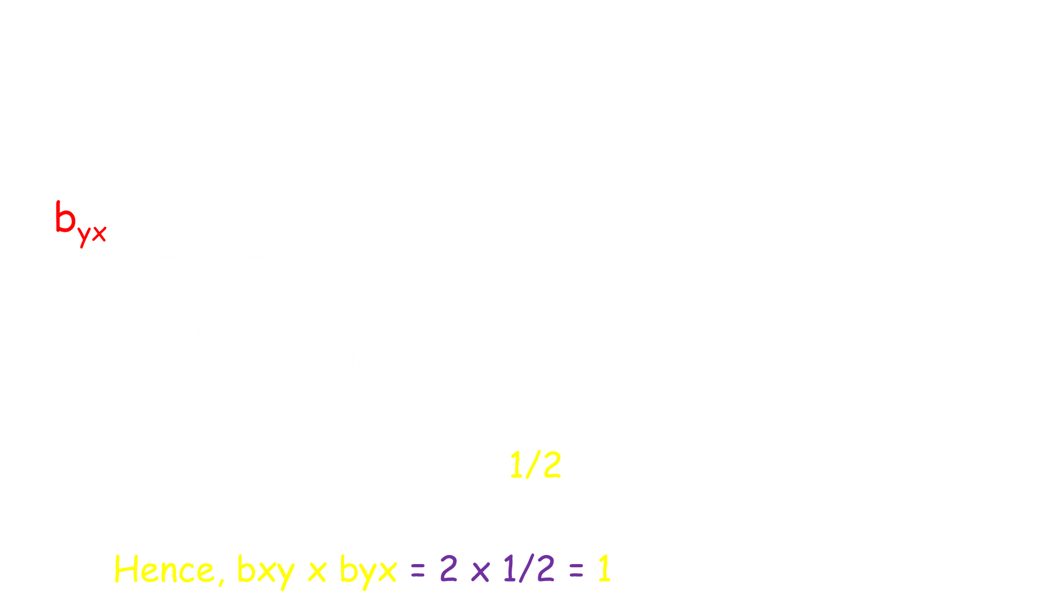
∑X = 220 ∑Y = 176 ∑XY = 3740 ∑X² = 4840 ∑Y² = 2926
(∑X)² = 220*220 = 48400 (∑Y)² = 176*176 = 30976
b_{yx} = $\frac{∑XY − ∑X∑Y/N}{∑X2 −(∑X)2/N}$
= $\frac{\text{3740 – 220 }\text{x}\text{ 176/11}}{\text{4840 – 48400/11}}$
= $\frac{\text{3740 – 3520}}{\text{4840 – 4400}}$ = $\frac{220}{440}$ = 1/2
Hence, bxy x byx = 2 x 1/2 = 1

Slide 17
Regression equation:
Y = a + b_{X}
y = a + b_{X}
Exercise no. 1. Find out the regression coefficient of average birth weight (y) on litter size (x) in mice from the following information. Also estimate regression coefficient of litter size on birth weight and correlation coefficient between litter size and birth weight.
Litter size (x) = 4, 5, 6, 7, 8, 9, 10, 11, 12, 13
Av. Birth wt(g) (y) = 6, 6, 5, 5, 4, 4, 3, 3, 2, 2

Slide 18

Prediction equation:
1. y’ = y + b_{yx} (x – x)
On the basis of correlation coefficient:
y ‘ = y + r $\frac{sy}{sx}$ (x – x)
x ‘ = x + r $\frac{sx}{sy}$ (y – y)
Where, y ‘ = Predicted value of y.
x ‘ = Predicted value of x.
Y = average value of y variable
x = average value of x variable

Slide 19
Exercise no.2. Milk production of a cow was estimated to be 2800 kg in her first lactation. Predict how much milk she will produce in her second lactation with the following information.
Average 1st lactation milk yield (X) = 2400 kg
Average 2nd lactation milk yield (Y) = 2600 kg
b_{YX} = 0.60

Slide 20
THANK YOU

