Slide 1
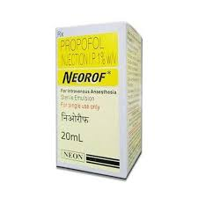
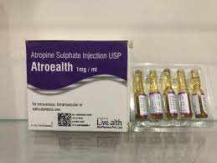
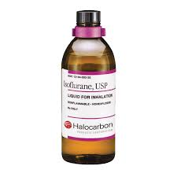
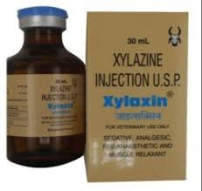
Anaesthesiology
Anticholinergic and tranquilizing agents
By
Dr. Rajesh Kumar
Assistant Professor
Department of Surgery

Slide 2
Pre-anaesthetic agent:
Agent who are usually given to prepare the patient for administration of anesthetic agent.
Uses
To reduce the amount of general anaesthetic
To calm the patient so that anesthesia can be administrated without bright and struggling.
To reduce gastric and intestinal motility and prevent vomiting while the patient is under anesthesia.

Slide 3
Classification of pre anaesthetic agent :
(a)Anticholinergic agent
(b) Tranquilizers or neuroleptics.
(c) Sedative
(d) Opoid analgesic agent / Nacrotic.

Slide 4
Anticholinergic agent
Anticholinergic inhibit parasympathetic nerve impulses by selectivity blocking the binding of the neurotransmitter acetylcholine to its receptor in nerve cells.
Atropine Sulphate
Inhibits the muscarinic action of acetylcholine on structure innervated by post galglionic cholinergic nerve and on smooth muscle which respond to endogens, but not inverted.

Slide 5
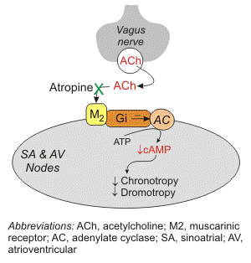
Effect of atropine sulphate
Cardiovascular system
Respiratory system
Other physiological function

Slide 6
Metabolism :
Dog excretes some part of atropine intact via kidney and remaining part undergoes hepatic metabolism.
Cat metabolizes the majority of the atropine in the liver
Doses:
Cattle = .04 to .06 mg/kg b.w. S/C or I/M
Dog /Cat = .04 mg I/M or S/C
Horse = .02 mg to .05 mg I/M or S/C
Sheep/Goat = .7mg/kg B.W. I/M or S/C
Contraindication Overdose

Slide 7
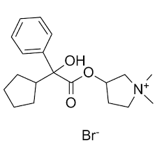
Glycopyrrolate
It is a synthetic quaternary ammonium anticholinergic drug. It is five times more potent than atropine sulphate
Dog = .01 to .02 mg/kg B.W. I/M or S/C
Horse = .0015 to .003 mg/kg B.W I/M or I/C

Slide 8
Tranquilizers
Primary uses is to relieve anxiety
As pre-anesthetic sedative
To restrain the animals during examination or large animals during transport
To prevent animals from licking would or chewing bandages and splints
Used as an antiemetic

Slide 9
Tranquilizers commonly used in veterinary practice are
(i)Phenothiazine derivative
(ii) Benzoidiazepines
(iii) Butyrophenone.

Slide 10
Phenothiazine derivatives include:
(i) Chlorpromazine hydrochloride
(ii) Triflupromazine hydrochloride
(iii) Promethazine hydrochloride
(iv) Propiopromazine hydrochloride
(v) Acetyl promazine
(vi) Promazine
Acetyl Promazine is most commonly used phenothiazine derivatives in small animals, horse and wild animals.
All the phenothiazine tranquilizers have same physiological effects on a patient, varying only in potency and duration of action. Duration of action is 3-6 hours, but it may be much longer in patient with hepatic dysfunction

