Slide 1
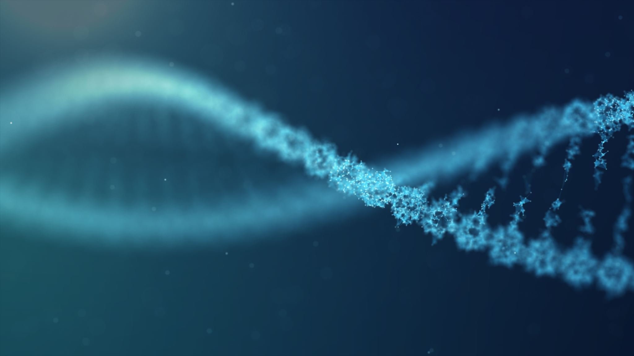
BIOCHEMISTRY OF NUCLEIC ACIDS
Chemistry of purines and pyrimidines

Slide 2
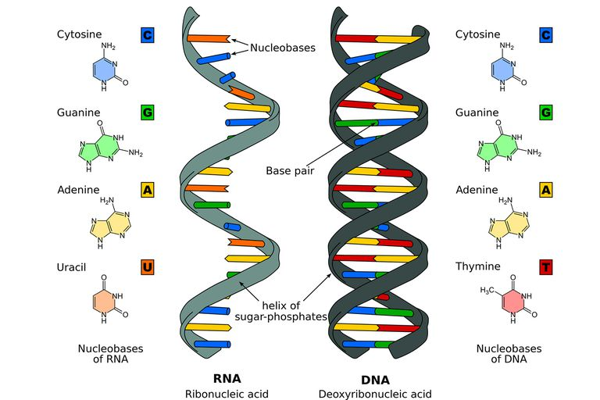
Nucleic Acid
Long chains of repeated nucleotides
A nucleotide consists of:
1- Nitrogenous base
2- Pentose sugar
3- One or more phosphate groups

Slide 3
History
1944
Avery, MacLeod & McCarty - Strong evidence that DNA is genetic material
1950
Chargaff - careful analysis of DNA from a wide variety of organisms. Content of A,T, C & G varied widely according to the organism, however: A=T and C=G (Chargaff’ Rule)
1953
Watson & Crick - structure of DNA (1962 Nobel Prize with M. Wilkens, 1962)

Slide 4
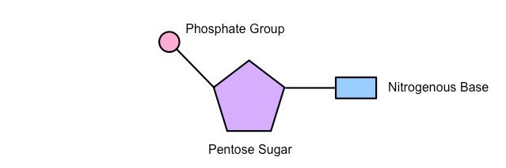
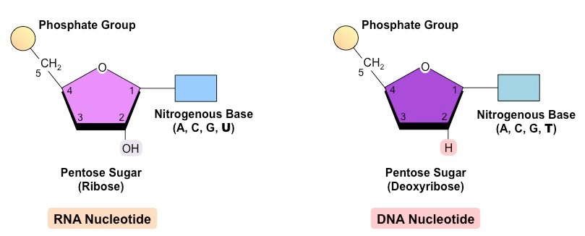
Nucleotide
Contains
Nitrogenous Base
Pentose Sugar
Phosphoryl group

Slide 5
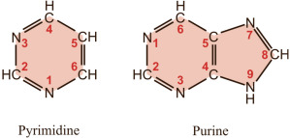
Nitrogenous Bases
Aromatic Heterocyclic compounds with Nitrogen atom
Purine – Consist of pyrimidine ring fused to an imidazole ring
The atoms of purine ring are numbered in the anticlockwise manner
Pyrimidine- Similar to benzene/ pyridine, containing nitrogen at position 1 and 3 of six membered ring
Atoms in pyrimidine ring are numbered in clockwise direction

Slide 6
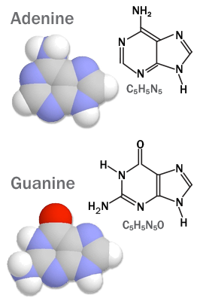
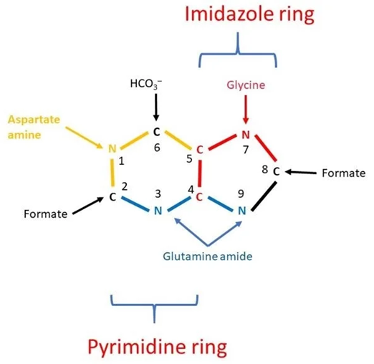
Purine
Major Purine bases are
Adenine
Guanine

Slide 7
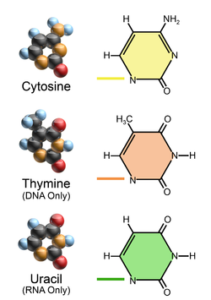
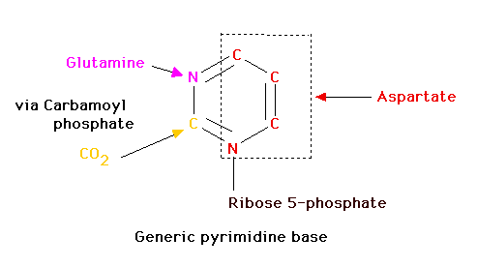
Pyrimidine
Cytosine
Thymine
Uracil

Slide 8
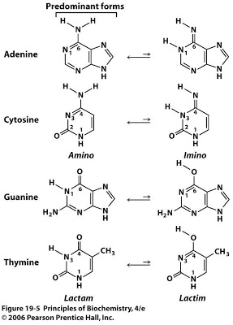
Tautomerism of Bases
The group with oxo functional group show tautomerization
Present as
Keto (lactam)
Enol (lactim)

Slide 9
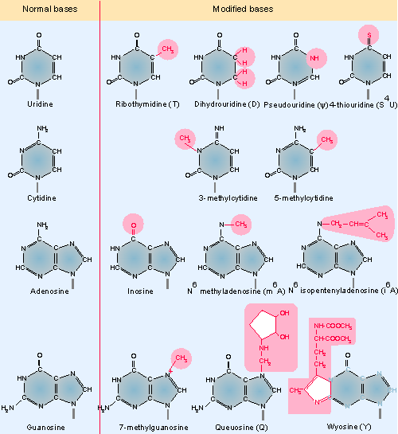
Minor bases in nucleic acids
5-methylcytosine, N4-acetylcytosine, N6 methyl adenine, N6 dimethyl adenine & N7 methylguanine, 5-methylcytosine, 5-hydroxymethylcytosine, Dihydroxyuracil
Due to:
Methylation, Hydroxymethylation, Glycosylation, Alteration of atoms
Help in the recognition of specific enzymes.

Slide 10
Purine bases of plants
Plants contain certain methylated purines.
Caffeine (1,3,7-trimethylxanthine):
It is found in coffee.
It acts as a stimulant.
Theophylline (1,3-dimethylxanthine):
Present in tea leaves.
It acts as a bronchial smooth muscle relaxant.

Slide 11
Special Bases
Present in the free state in the cell

Slide 12
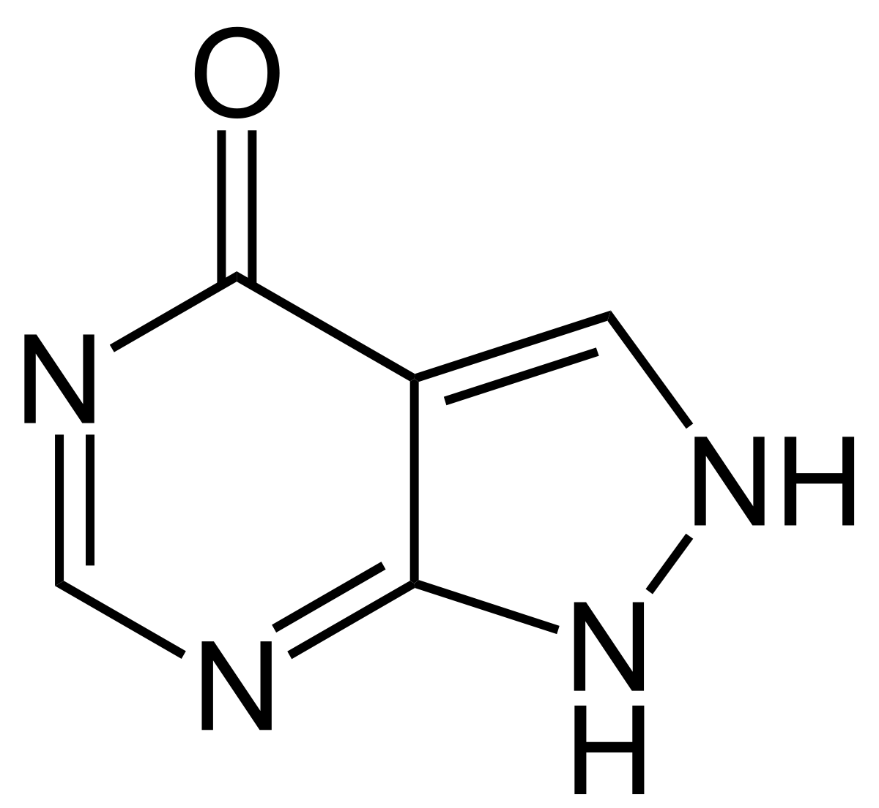
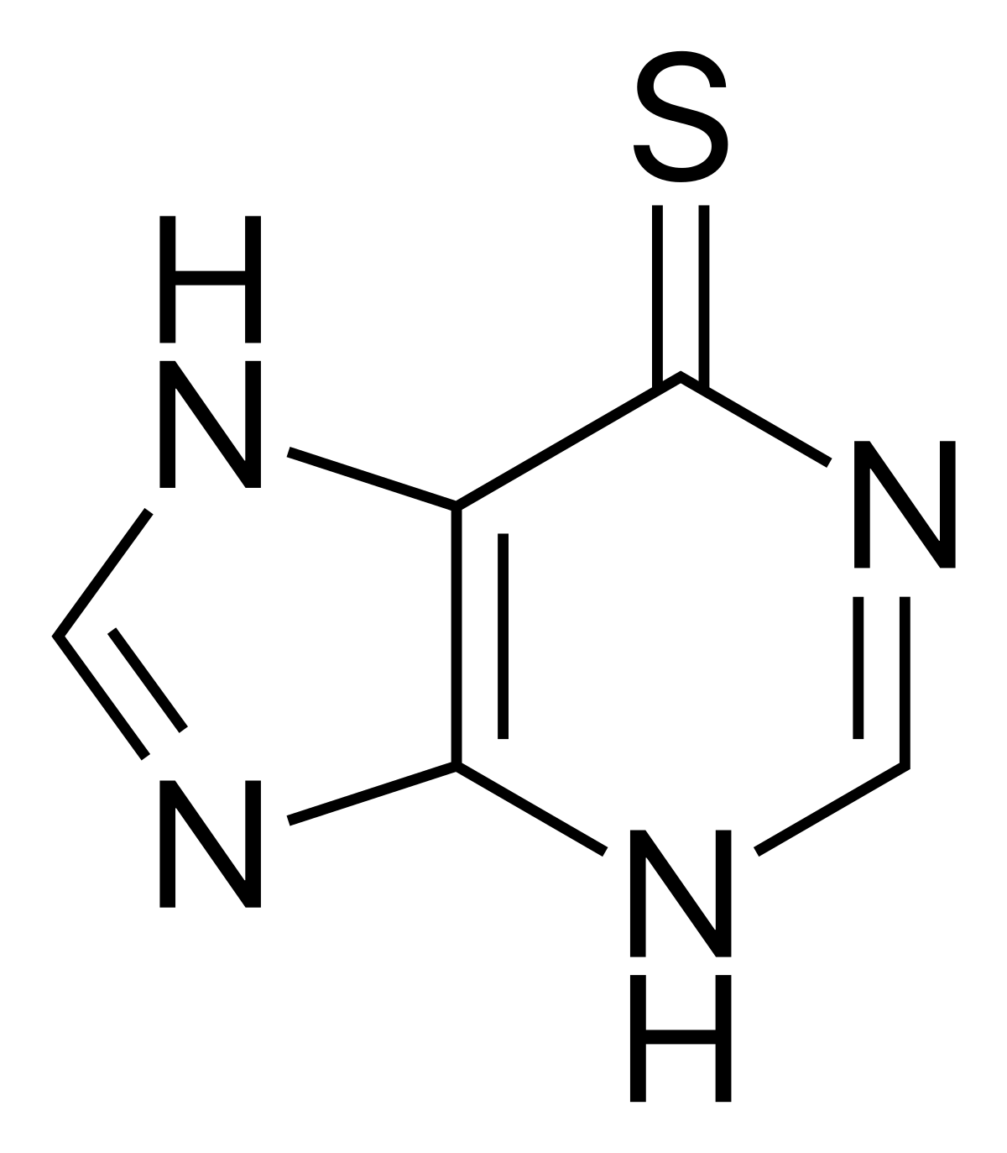
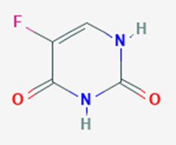
Analogues
Allopurinol:
Inhibits xanthine oxidase & used in the treatment of hyperuricemia (gout)
6-mercaptopurine:
It inhibits purine nucleotide synthesis & used as an anticancer drug
5-fluorouracil:
It inhibits the enzyme thymidylate synthase.
It is used in the treatment of cancer

Slide 13
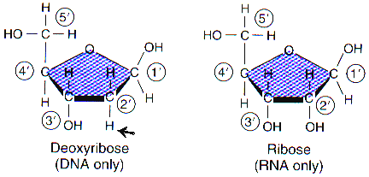
Pentose Sugar
DNA & RNA are distinguished based on the pentose sugar present
DNA contains β-D-2-deoxyribose
RNA contains β-D-ribose
Absence of the 2′ hydroxyl group in deoxyribose is responsible
for much greater chemical stability of DNA
The increased flexibility of DNA
which allows DNA to assume the double-helix conformation

Slide 14
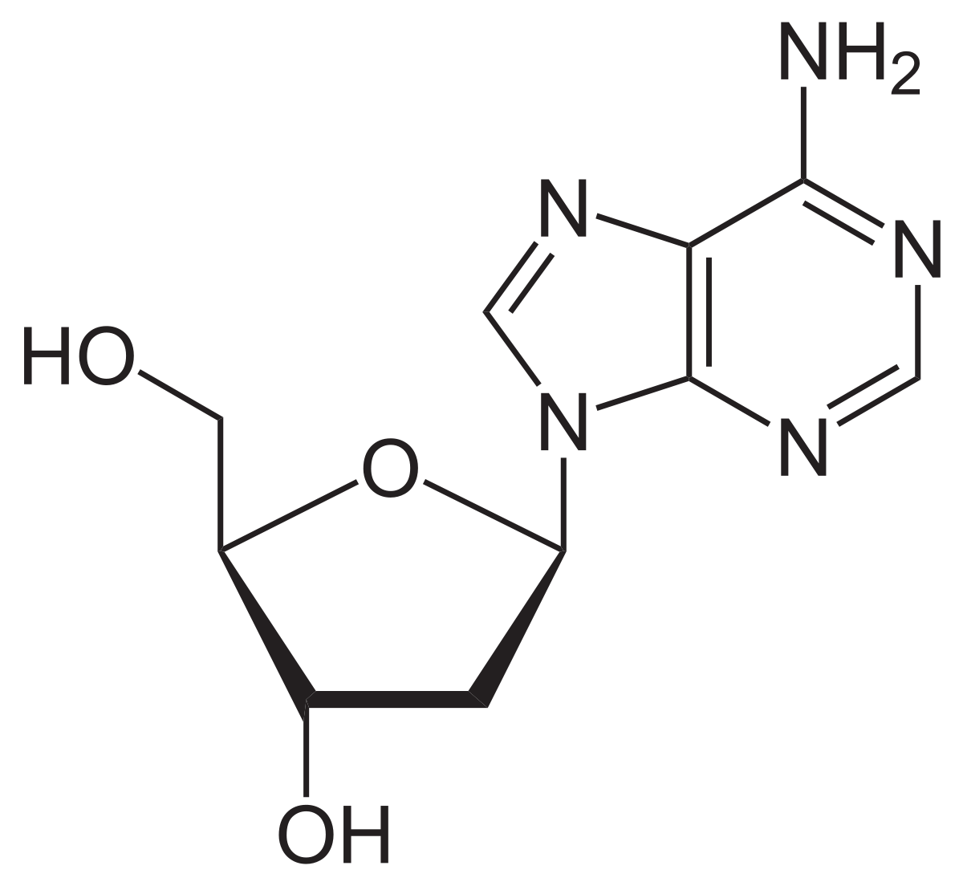
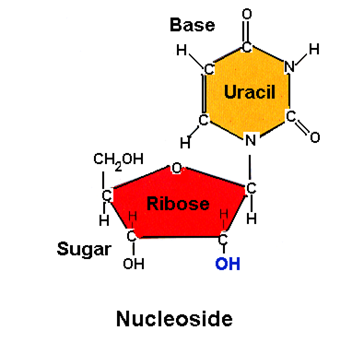
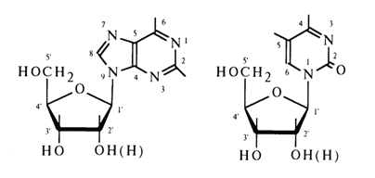
Nucleoside
Composed of nitrogenous base and Pentose sugar
N-glycosidic bond between nitrogen of base and sugar carbon
Nucleosides with purine bases have the suffix – sine while pyrimidine nucleosides end with - dine

Slide 15
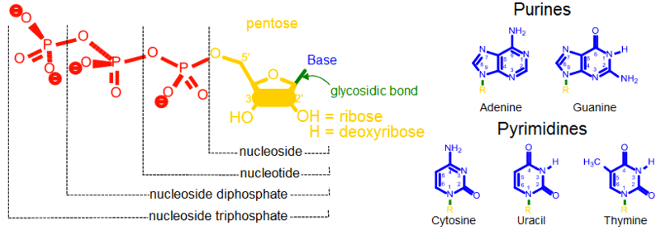
Nucleotide

Slide 16
Principal Nucleotides
Ribonucleotides are named as
Adenine = Adenosine monophosphate (AMP)
Guanine = Guanosine monophosphate (GMP)
Cytosine = Cytidine monophosphate (CMP)
Thymine = Thymidine monophosphate (TMP)
Uracil = Uridine monophosphate (UMP)
Deoxyribonucleotides are named as
Adenine = Deoxyadenosine monophosphate (dAMP)
Guanine = Deoxyguanosine monophosphate (dGMP)
Cytosine = Deoxycytidine monophosphate (dCMP)
Thymine = Deoxythymidine monophosphate (dTMP)
Uracil = Deoxyuridine monophosphate (dUMP)

Slide 17
Functions of Nucleotides
Nucleic acid biosynthesis- DNA, RNA
Energy production and transduction - ATP
Protein biosynthesis - GTP
Intra- and intercellular signal transduction - cAMP
Carrier of methyl group in the form S-adenosyl methionine (SAM)
Components of coenzymes: NAD, FAD

Slide 18
Properties of Nucleotides
1. Negative charge at physiological pH
Mononucleotides have a negative charge at physiological pH
Nucleosides and or free purine or pyrimidine bases are uncharged at physiological pH

Slide 19
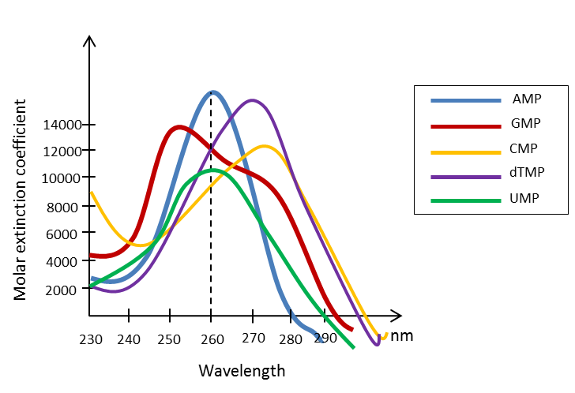
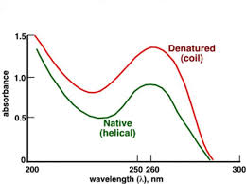
2. UV light absorption
The conjugated double bonds of the heterocyclic bases of purines and pyrimidines ensure that nucleosides, nucleotides and polynucleotides absorb UV
Their spectra are pH- dependent but all common nucleotides absorb light at a wave length close to 260 nm at pH 7,0
Nucleotide and nucleic acid concentrations thus often are expressed in terms of ‘absorbance at 260 nm’

Slide 20
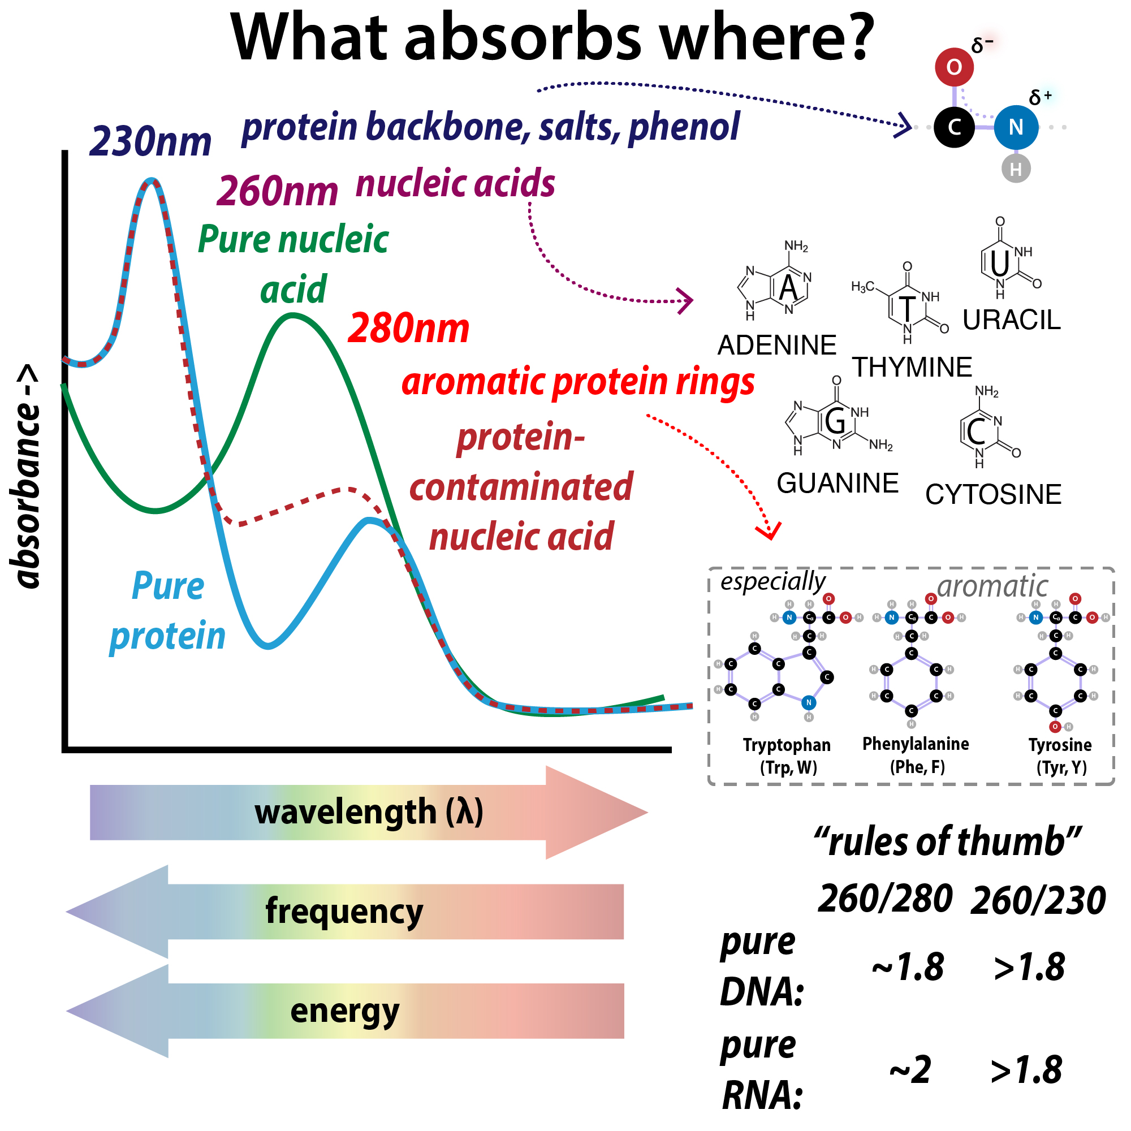
What absorb where?

Slide 21
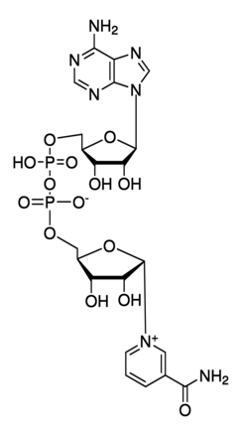
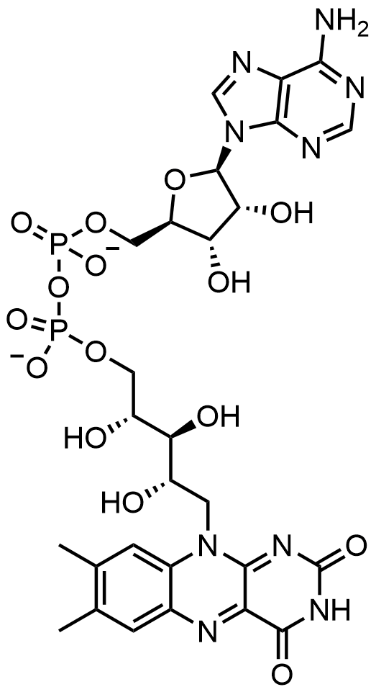
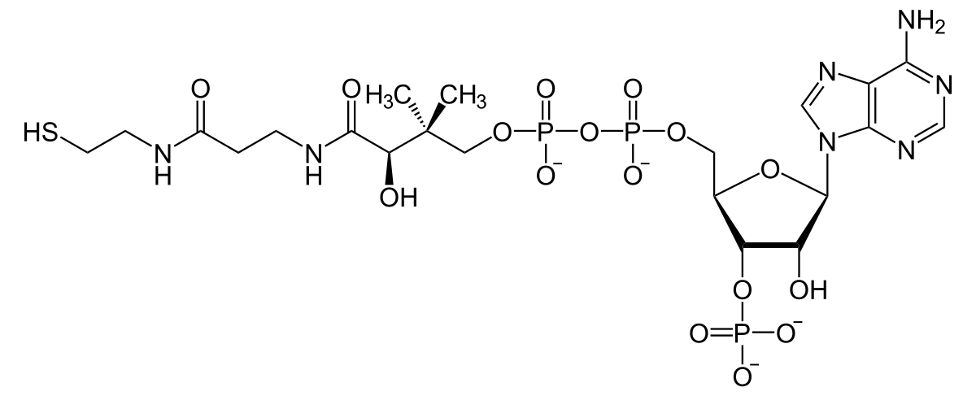
3. Incorporated in coenzymes
AMP is present in many coenzymes
NAD⁺
FAD
CoA

Slide 22
4. High group transfer potential
Due to acid anhydride bonds
allows them to participate as group transfer reagents in various reactions
cleavage of an acid anhydride bond is coupled with a highly endergonic reaction such as protein synthesis or nucleic acid synthesis
ADP and ATP are substrates and products, respectively, for oxidative phosphorylation
ATP serves as the major biologic transducer of free energy

Slide 23
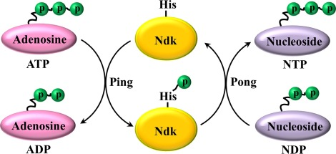
Nucleoside diphosphate kinases, found in all cells, catalyzes the reaction

