Slide 1


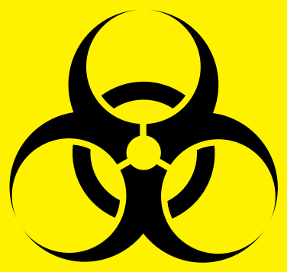
Biohazards

Slide 2
Biohazard: Biological hazards refer to organisms or organic matters produced by organisms that are harmful to human health.
  These include bacteria, virus, parasites, fungi and their toxins.
  These may cause harm to human in the form of infections, allergy and poisoning.
Biosafety: The containment principles, technologies and practices that are implemented to prevent the unintentional exposure to pathogens and toxins, or their accidental release
Biosecurity: Control of accidental and deliberate release of biohazardous material

Slide 3
Biohazard levels, more commonly referred to as “biological safety levels” or “biosafety levels,” are classifications of safety precautions necessary to be applied in the clinical microbiology laboratory depending on specific pathogens handled when performing laboratory procedures.
Laboratory facilities are designated as basic –
  Biosafety Level 1,
  Basic – Biosafety Level 2,
  Containment – Biosafety Level 3,
  Maximum containment – Biosafety Level 4.

Slide 4
Biosafety level designations are based on a composite of the design features, construction, containment facilities, equipment, practices and operational procedures required for working with agents from the various risk groups.
Biohazardous Agents may be classified by Risk Group (RG) that are required biosafety precautions.
The risk group classification is used for laboratory work only.

Slide 5
Risk Group 1 (RG1)/Biohazard level 1
Agents that are not associated with disease in healthy adult humans.
Example: Bacillus subtilis, canine hepatitis, Escherichia coli etc.
Handling these agents require minimum safety measures like gloves, masks etc.

Slide 6
Risk Group 2 (RG2)/Biohazard Level 2
Agents that are associated with human disease which is rarely
serious.
Preventative or therapeutic interventions are often available.
E.g., hepatitis A, B, and C, influenza A, Lyme disease, Salmonella, mumps, measles, scrapie, dengue fever.
Laboratory personnel can carry out diagnostic tests on the specimens but need to wear gloves, facial protection, and a gown.
Additionally, standard precautions at this level should be applied when handling clinical samples from the current outbreak investigations of acute respiratory distress syndrome (ARDS) caused by COVID-19..

Slide 7
Risk Group 3 (RG3)/ Biohazard Level 3
Agents that are associated with serious or lethal human disease.
Preventive or therapeutic interventions may be available
High individual risk
Low community risk.
Example: West Nile virus, SARS virus, tuberculosis, typhus, Rift Valley fever, HIV, yellow fever, and malaria.

Slide 8
Risk Group 4 (RG 4)/ Biohazard Level 4
Agents that are likely to cause serious or lethal human disease
Preventive or therapeutic interventions are not usually
available
High individual risk
High community risk
Example: Bolivian and Argentine hemorrhagic fevers, Marburg virus, Ebola virus, hantaviruses, Lassa fever virus and Crimean-Congo hemorrhagic fever.

Slide 9
There are no bacteria in this group.
Only specific persons can work with these viruses.
It requires them to wear a positive pressure personnel suit, with a segregated air supply.
There is no treatment available for these viruses, and extreme isolation precautions are mandatory.

Slide 11
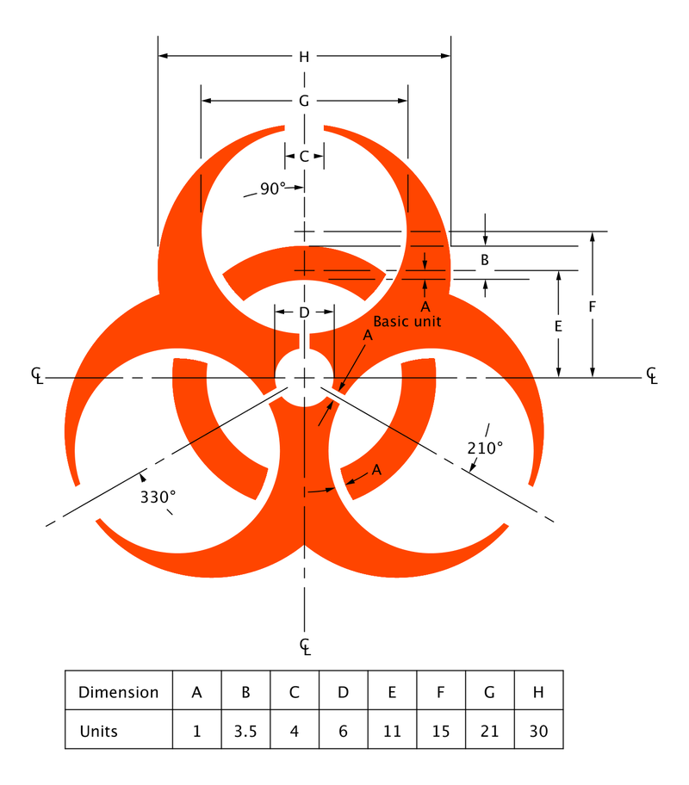
The Biohazard Symbol with dimensions as defined in https://archive.org/stream/federalregister39kunit#page/n849/mode/1up

Slide 12
Thanks

