Slide 1
Department of Veterinary Medicine Bihar Veterinary College, Patna – 800 014 (BASU, Patna)
Diseases of Respiratory System(Class-6)
(Pneumonia )
Dr. Ranveer Kumar Sinha Assistant Professor cum Junior Scientist
E-mail: ranveervet@rediffmail.com

Slide 2
Pneumonia in dogs ad cats
Definition:
Inflammation of the lung tissue that usually preceded by bronchitis (bronchopneumonia)
It is characterized clinically by fever, coughing dyspnea and hypoxemia.
Etiology:
Predisposing factors:
• Environmental exposure to dusts and smoke
• secondary to heart diseases (Heart Failure)
• Factors lowering defense mechanism of animals such as stress

Slide 3
Etiology
Infectious causes:
Viral Pneumonia:
canine distemper virus infection
2. adenovirus types 1 and 2
3. parainfluenza virus
4. complicated feline upper respiratory tract infection

Slide 4
Etiology
Parasitic Pneumonia :
1. lungworms (strongylus)
2. from the migration of other worms through the lung (Toxocara)
Bacterial Pneumonia:
1. Primary infection by P. multocida, Escherichia coli, Streptococcal spp., Klebsiella spp., Staphylococcus spp.
2. Secondary to severe kennel cough particularly in young puppies.

Slide 5
Etiology
Allergic Pneumonia:
Fungal Pneumonia:
1. Coccidioidomycosis immitis,
2. Cryptococcus neoformans
Aspiration Pneumonia:
1. Secondary to megaesophagus
2. improperly administered medications (eg, oil or barium) or food (forced feeding); it may also follow suckling in a neonate with a cleft palate.

Slide 6
Clinical signs
1. Rapid breathing (tachypnea)
2. Respiratory distress (Dyspnea)
3. Productive cough (Coughing is frequent, painful and, in the final stages, they can be produced by such severe paroxysms that the animal becomes exhausted rapidly)
4. Fever and Depression
5. Mucopurulent nasal discharge

Slide 8
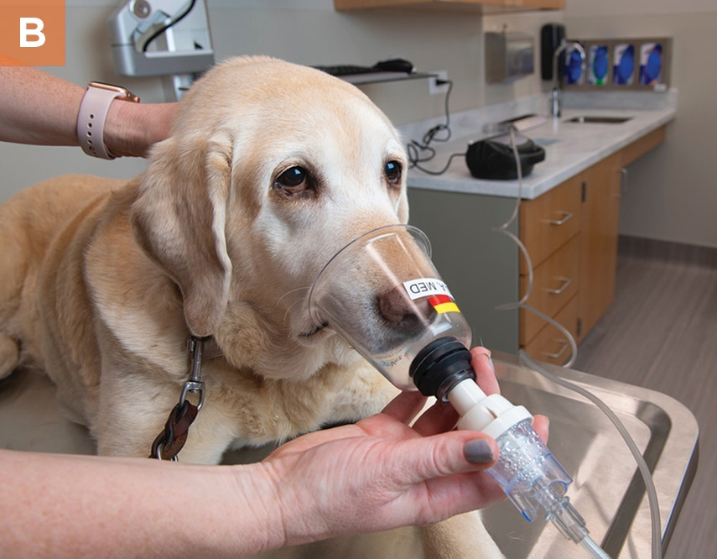

Slide 9
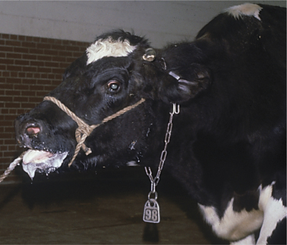

Slide 10
Clinical signs
6. Anorexia
7. Restlessness (laziness)
8. weight loss, depressed activity or exercise intolerance
9. The tongue, gums, and lips may appear bluish (cyanosis)
10. Lung sounds are often abnormal with a “crackle” upon auscultation when the dog takes a deep breath

Slide 11
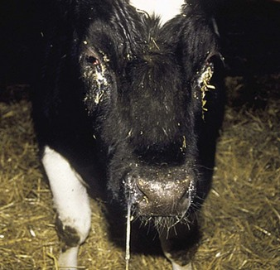

Slide 12
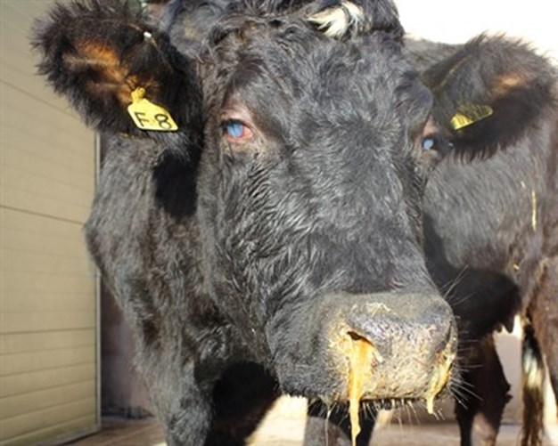

Slide 13
Diagnosis
• Case History
• Clinical signs
• Lab Exam:
Complete blood count (CBC)
Airway cytology
Culture (tracheal wash cytology and culture and sensitivity)
• Chest X-rays

Slide 14
Treatment
I- Hygienic Treatment:
• Plenty of fluids and warmth
• Rest
II- Medicated Treatment:
1. Antibiotics for at least three weeks or longer
2. Humidified oxygen for animals that have trouble breathing

Slide 15
Treatment
3. Airway humidification to assist in expectoration of secretions
4. Percussion of the thorax to help loosen and remove secretions
5. Expectorants
6. Bronchodilator therapy
7. Cough suppressants

Slide 16
THANKS YOU !

