Slide 1
Fourth Professional UNIT 3 RADIOLOGY-5 F
CONTRAST RADIOGRAPHY
Dr. Ramesh Tiwary
Assistant Professor
Deptt. of Vet. Surgery and Radiology

Slide 2
Contrast media
Substances that attenuates the beam to a different degree than the surrounding tissue
Used to enhance areas of the body that have the same attenuation of surrounding tissue
Contrast media increases contrast on film

Slide 3
Basic Radiographic Opacities
Radiographic image: It is produced when x- ray goes through the body part: penetration and absorption,
hence==➔ What you got??
Basic radiographic opacities
Air Fat Water Bone Metal/+Contrast
BLACK➔GREY ➔ GREY ➔ GREY➔ WHITE

Slide 4
Contrast Radiography
Tissue radio density and its surrounding is deliberately altered, for better visualization and demarcation.
Group of radiographic procedures performed by administration of a contrast medium
What for??
Visualization of individual organs
Enhance lesions in a particular organ
Some physiologic information
Always performed after a survey radiograph

Slide 5
Contrast Media
Positive Contrast Media
(absorb X rays = radiopaque)
Barium (inert, not metabolized or absorbed)
Liquid
Paste
Iodine: Tri – iodinated derivatives of benzoic acid
Ionic-Diatrizoate, Iothalamate (Anion)
Sodium, Meglumine (Cation)
Non – ionic
Iohexol, Iopamidole
The elements used for positive contrast should have atomic number (Z) above 50. Example - ⁵⁶Barium, ⁵³Iodine

Slide 6
Negative Contrast Media
(do not absorb X rays = radiolucent)
Air
Carbon dioxide
Nitrous oxide

Slide 7
Not used with ruptured GIT as it will lead to inflammation, formation of granulomatus mass and fibroma.
Barium Sulphate preparation
Insoluble
Non absorbable by GIT

Slide 8
Water Soluble Iodine Compound
Commonly used contrast medium having low osmolarity.
Sodium salt of Iothalamic
Meglumine salt of Iothalamic
Sodium salt of Ditriazoic
Meglumine salt of Ditriazoic

Slide 9
Water soluble organic iodine. Very useful in liver functions Excreted exclusively through biliary-system Hence used for outlining biliary system and gall bladder Mostly used as IV Intravenous preparations – Meglumine iodoxamate, ioglycamate, iotroxate. Oral preparation :- Sodium iopodate, iopanoic acid
CHOLECYSTAPAQUES

Slide 10
Viscous and Oily preparation
Used for Myelography if Non-iodine low osmolarity medium not available.

Slide 11
EXAMPLES OF CONTRAST RADIOGRAPHY
Dacrocystorhinography : Nasolacrymal duct
Sialography : Salivary gland
Bronchography : Bronchioles
Reticulography : Reticulum
Pneumocystography : Abdominal Cavity
Intravenous Pyelography : Urinary tract
Myelography : Spinal Cord
Arthrography : Joints
Fasciography : Tendon and associated structures
Osteomedullography : Channels of long bones.
Angiography : Arteries
Urethrography : Urethra
Cystography : Urinary Bladder

Slide 12
Principles
A
B
C
submucosal or intramural mass
extrinsic mass
mucosal mass

Slide 13
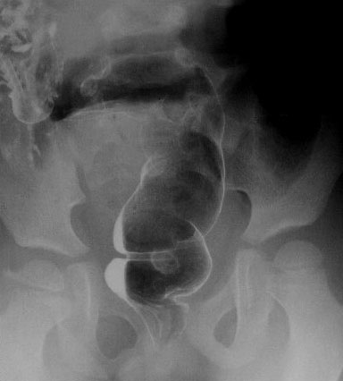
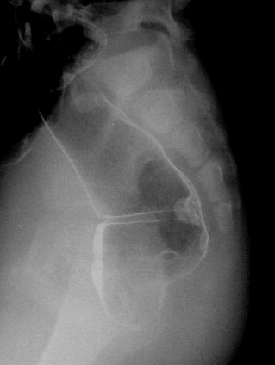
Mucosal Mass
A
B

Slide 14
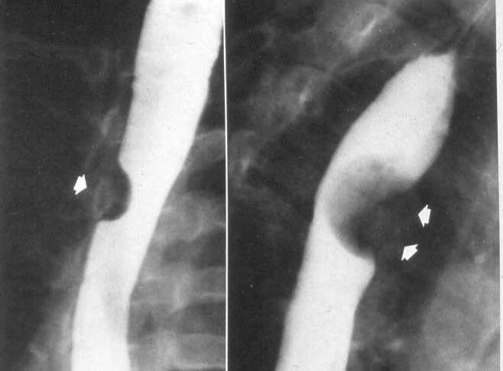
Sub Mucosal or Intra mural mass

