Slide 1
CANINE PARVOVIRAL INFECTION
Etiology:
It is infectious diseases of dogs worldwide, caused by canine parvovirus-2 (CPV-2),a non-enveloped SSDNA virus of Genus-Parvovirus.
The virus require rapidly dividing cells for replication
It can survive for long periods (over 1 year) in the environment.
Host affected:
Dogs, especially less than 12 weeks of age. But, can also occur in unvaccinated or improperly vaccinated adult dogs.
Transmission:
Fecal-oral route and virus that persists on fomites.
Virus is shed for a few days before the onset of clinical signs

Slide 2
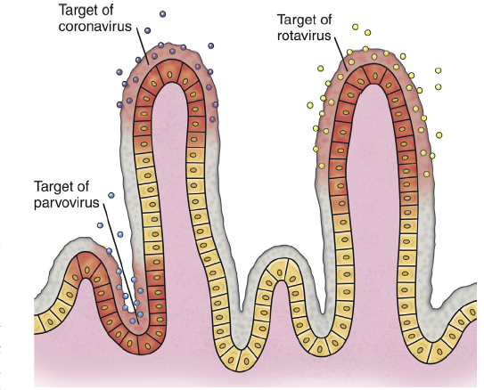
Risk factors:
The severity of clinical signs depends on:
Virus strain
Host immunity, which is affected by stressors such as weaning and overcrowding, maternal antibody, and the presence of concurrent infections such as other enteric viral and parasitic infections.
canine parvovirus, replicate and destroy crypt epithelial cells

Slide 3

Pathogenesis:
Virus
Starts replication in lymphoid tissues of oropharynx, mesenteric lymph nodes, bone marrow and thymus and viremia developed
GI tract
Bone Marrow
Epithelium of the tongue, oral cavity, esophagus, and intestinal tract, and especially the germinal epithelial cells of the intestinal crypts
Lymphopenia &Neutropenia and also due to sequestration of neutrophils in damaged gastrointestinal tissue.
Malabsorption and increased intestinal permeability
Important points to Know
Dogs with canine parvoviral enteritis have evidence of disordered coagulation
Infection of the dam by CPV-2 variants early in gestation can lead to infertility, resorption, or abortion
Puppies that are Infected in utero or up to 2 weeks of age may develop viral myocarditis
Secondary bacterial infection
Results in clinical signs of fever, lethargy, inappetence, vomiting, diarrhea, rapid dehydration, and
abdominal pain. Diarrhea is often liquid, foul-smelling, and may
contain streaks of blood or frank blood

Slide 4
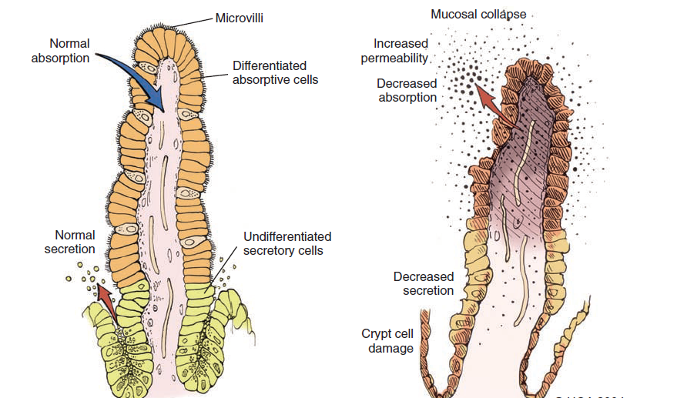
A
B
Fig. : A-Normal intestinal villus showing cellular differentiation along the villus
B-Parvovirus-infected villus showing collapse and necrosis of intestinal villus.

Slide 5
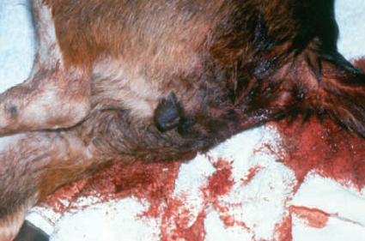
Physical Examination Findings
CPV infection has been associated with three main tissues — GI tract, bone marrow, and myocardium — but the skin and nervous tissue can also be affected.
GI tract and Bone marrow involvement:
Vomiting is often severe and is followed by diarrhea, anorexia, and rapid onset of dehydration.
Th e feces appear yellow-gray and are streaked or darkened by blood
Elevated rectal temperature (40 ° to 41 ° C [104 ° to 105 ° F]) and leukopenia (mainly lymphopenia) may be present, especially in severe cases.
Death within 2 days after the
onset of illness due to
gram-negative sepsis or
disseminated intravascular
coagulation, or both.

Slide 6
Canine Parvovirus-2 Myocarditis
CPV myocarditis can develop from infection in utero or in pups younger than 6 weeks of age.
They often die after a short episode of dyspnea, crying, and retching.
The spectrum of myocardial disease in individuals is wide and can include any of the following:
Acute diarrhea and death, without cardiac signs;
Diarrhoea and apparent recovery followed by death, whichoccurs weeks or months later as a result of congestive heart failure; or
Sudden onset of congestive heart failure, which occurs in apparently normal pups at 6 weeks to 6 months of age.
Cutaneous Disease:
Skin lesions included ulceration of the footpads, pressure points,
and mouth and vaginal mucosa.
Vesicles in the oral cavity and erythematous patches on the abdomen and perivulvar skin were also present.

Slide 7
Diagnosis:
Clinical signs and symptoms i.e th e sudden onset of foul-smelling, bloody diarrhea in a young dog (under 2 years of age) is oft en considered indicative of CPV infection
Laboratory tests
CBC (leukopenia, neutropenia, and lymphopenia)
Abnormal coagulation test
Cardiac troponin I is a plasma marker for myocardial
damage.
Biochemical tests (often shows hypoproteinemia, hypoalbuminemia, and hypoglycaemia)
Detection of Organism
Fecal ELISA antigen tests(specific but less sensitive)
PCR methods.
Antibody Detection
Serology is not the best method to diagnose CPV infection, because most dogs are vaccinated against it or have been previously exposed to the virus.

Slide 8
Therapy: The primary goals are to
Restoration of fluid and electrolyte balance
Preventing secondary bacterial infections
Fluid therapy should be continued for as long as vomiting or diarrhea (or both) persists
Hypoglycemia and hypokalemia are common and should be corrected through additions to the IV fluids.
A combination of a penicillin and an aminoglycoside (use cautiously) for best antibacterial spectrum.
Parenteral third-generation penicillins or cephalosporins can be used as sole treatment alternatives to achieve the desired spectrum
Antiemetics (Metoclopramide hydrochloride and prochlorperazine) have proved helpful in most dogs with persistent vomiting.
Ondansetron and dolasetron(serotonin receptor antagonists) are also effacious.
After recovery from viral enteritis, intestinal parasites should be treated with a broad-spectrum anthelmintic such as fenbendazole.

Slide 9
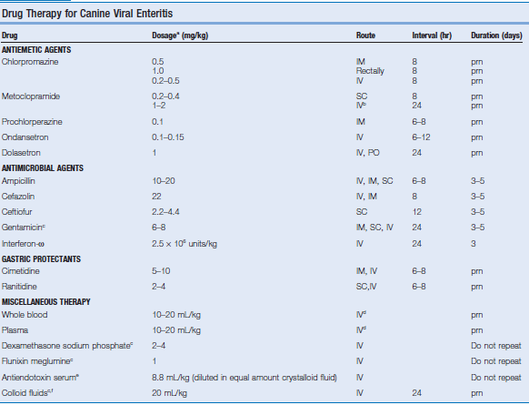

Slide 10
Prevention:
Vaccination:
Both attenuated live and inactivated CPV vaccines are available.
Attenuated live vaccines should never be administered to pregnant bitches because they may cause disease in the developing fetus.
Monovalent CPV vaccines administered by the intranasal route and commercially available
The age at which a pup should be vaccinated successfully can be predicted through determination of the MDA titers by serologic tests.
Pups from a bitch with low protective titer of antibody to CPV can be successfully immunized by 6 weeks of age, but in pups from a bitch with a very high titer to CPV, MDA may persist much longer.
Pups of unknown immune status can be vaccinated with a high-titer-attenuated live CPV vaccine at 6, 9, and 12 weeks of age

Slide 11
CANINE DISTEMPER
Canine distemper virus (CDV), belongs to the genus Morbillivirus (family, Paramyxoviridae).
CDV is closely related to human measles virus and rinderpest virus
Dogs and other Canidae such as coyotes, foxes, and wolves; Procyonidae (raccoons, pandas); Mustelidae (ferrets, mink, skunks, otters). Large wild Felidae can also be affected
Infection of dogs can lead to a severe, multisystemic disease that primarily affects the gastrointestinal, respiratory, and neurologic systems
Brachiocephalic dogs have a lower prevalence than dolichocephalic breeds.
World wide
ETIOLOGY
HOST AFFECTED
DISTRIBUTION

Slide 12
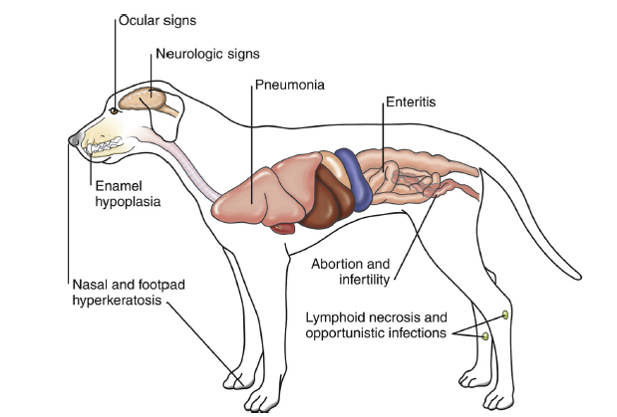
Fig: Anatomic sites
targeted by virus

Slide 13
Oronasal contact with virus in secretions or excretions, droplet nuclei, and large particle aerosol transmission
MODE OF TRANSMISSION
PATHOGENESIS
Virus
Monocytes within lymphoid tissue
in the upper respiratory tract and tonsils
Lymphatics and Blood
Entire RE System

Slide 14


Viral haemagglutinin
+Host Receptor (SLAM, Signalling lymphocytic activating molecules SLAM is expressed by immature thymocytes, activated lymphocytes, macrophages, and dendritic cells
Direct viral destruction of the lymphocyte population (CD4+ T cells), which occur within the blood, tonsils, thymus, spleen, lymph nodes, bone marrow, mucosa-associated lymphoid tissue, and hepatic Kupffer cells
Initial Lymphopenia and Transient Fever
Subsequently, 8-9 days post infection,
there is a second stage of cell-associated viremia and fever
After that it infects, respiratory, GIT, CNS, SKINS &additional Lymphoid cells
In this stage, CDV infects a variety of cell lineage
(Epithelial, mesenchymal, neuroendocrine, and hematopoietic cells, and forms intracytoplasmic but also intranuclear inclusions)
Shedding of virus from all secretions and excretions at 5 days post infection, Before clinical singns

Slide 15
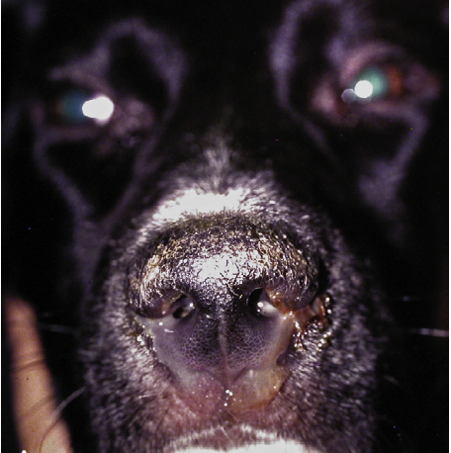
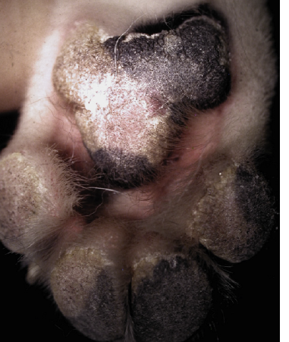
CLINICAL SIGNS
The clinical signs depends on:
virus strain, the age and immune status of the host, as well as concurrent infections with other viruses and bacteria
Respiratory form: fever, bilateral serous and nasal ocular discharges, conjunctivitis, and a non-productive cough and Secondary bacterial infection due to secondary bacterial infection lead to the development of mucopurulent nasal and ocular discharges and bacterial bronchopneumonia, with tachypnea, productive cough, lethargy, and decreased appetite.
GI form: It lead to inappetence, vomiting, diarrhea, electrolyte abnormalities, and dehydration.
Hyperkeratosis of nasal planum
Hyperkeratosis of foot pad

Slide 16
Nervous form: the neurologic signs are often progressive due to neuronal necrosis and atrophy, and generally do not resolve, so dogs that recover often have residual neurologic deficits.
“Old dog encephalitis” is a misnomer, poorly characterized progressive immune-mediated demyelinating leukoencephalomyelitis , which occurs weeks to years after recovery from the acute infection and is difficult to diagnose.
A Myoclonus (involuntary twitching of isolated muscle groups) or chorea is common, when affected puppies are at rest.
A “chewing gum” seizures, which localized to the head and jaw, with accompanying foamy hypersalivation.
Other neurologic signs include obtundation, seizures, tremors, opisthotonos, tetraparesis, paraparesis, delayed placing reactions, ataxia, and, less commonly, behavioral abnormalities, compulsive pacing, and vestibular signs such as a head tilt, nystagmus, strabismus, and circling
Ocular form : include blepharospasm, photophobia, uveitis, chorioretinitis, keratoconjunctivitis sicca (KCS), keratitis, and optic neuritis, which may be associated with blindness.

Slide 17
Enamel and dentin hypoplasia in recovered animal.
Cutaneous form: There is hyperkeratosis in the regions of footpad and nasal planum epithelium. Puppies with hyperkeratosis, also known as “hardpad,” have thickened, crusty footpads that resemble those of adult dogs.
The most common secondary infections in distemper are secondary bacterial infections that contribute to bronchopneumonia is Bordetella bronchiseptica.
The transplacental infections may cause h infertility, stillbirth, or abortion and with neurologic signs in puppies that are less than 4 to. 6 weeks of age
Dogs that have recovered from CDV infection may develop enamel hypoplasia/chorea/keratoconjunctivitis Sicca/gold medallion lesions(healed chorioretinitis, a hyperreflective circular lesions).

Slide 18
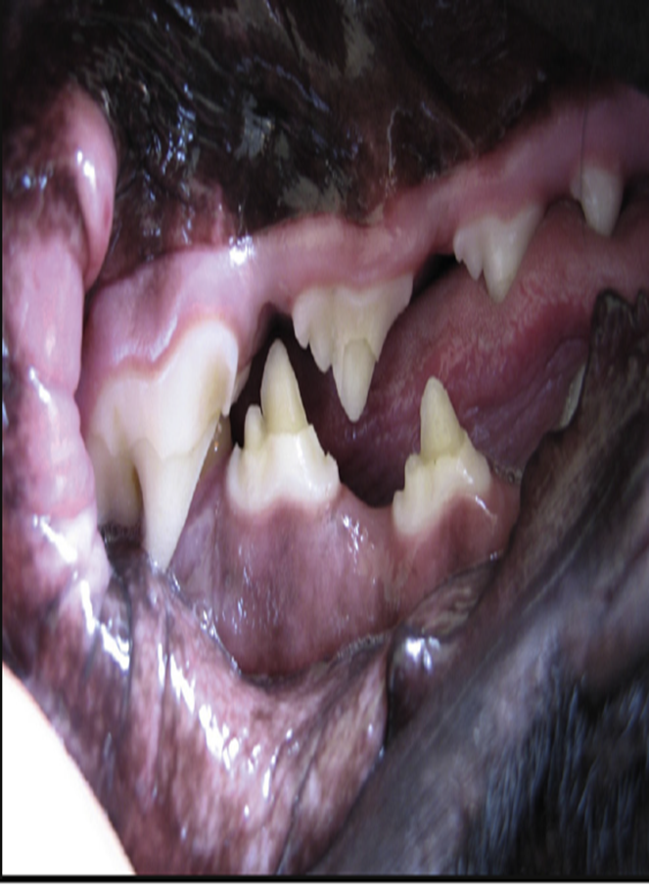
DIAGNOSIS:
Clinical signs and sypmtoms, especially myoclonus.
In dogs with respiratory signs, the presence of conjunctivitis, blepharospasm, and ocular discharge should raise suspicion for distemper.
Distemper should always be considered as a diagnosis in young dogs with neurologic signs
Microbiologic Tests: This includeVirus Isolation, Cytologic Demonstration of CDV Inclusions, ELISA assays, Serology, RT-PCR.
Enamel hypoplesia

Slide 19
TREATMENT and PROGNOSIS:
Dogs with severe respiratory and gastrointestinal disease require:
IV fluids
Antimicrobial drugs/antimicrobial drug combinations, such as ampicillin and a fluoroquinolone
Antiemetics
A single IV dose of dexamethasone or tapering anti-inflammatory doses of glucocorticoids has been advocated to halt or reduce the severity of progressive CNS signs.
Oral vitamin A and C may be advocated
Anticonvulsants such as diazepam and, for chronic management, potassium bromide or phenobarbital can be used to treat seizures and prevent the spread of a seizure focus.
Note:The prognosis for dogs with severe neurologic signs is poor.

Slide 20
Immunity and Vaccination
Immunity to CDV requires antibodies as well as cell-mediated immunity
Disease can be prevented through immunization with attenuated live or recombinant vaccines
Attenuated live vaccines should be given >than 6 weeks of age
For dogs older than 16 weeks of age that are brought to the veterinarian for their first vaccination, two doses of vaccine should be given 3 to 4 weeks apart.
Notes to be remember:
Attenuated live CDV vaccine virus can cause encephalitis when administered to immunocompromised dogs and puppies less than 6 weeks of age.
Postvaccinal encephalitis usually occurs 3 to 20 days after vaccinationassociated with certain batches of vaccines that contain the Rockborn strain.
Attenuated live CDV vaccines to dams immediately after whelping has been associated with the development of encephalitis in the puppies

Slide 21
INFECTIOUS Canine hepatitis
(ich / Rubarth's disease)
Dr. Anil Kumar
Asst. Professor
Dept. of VCC
Unit-5

Slide 22
canine adenovirus 1(CAdV-1), a DNA Virus
Systemic disease
Any age but, young dogs, in the first 2 years of life, are more likely to die than older one
ETIOLOGY:
Dogs and other candis including foxes, wolves, coyotes, skunks, and bears
The virus has a predilection for hepatocytes, vascular endothelium, and mesothelium
In dogs, causing acute hepatitis, respiratory or ocular disease.
HOST RANGE
Most often via the oral route by contact with urine from infected dogs.
Recovered animal shed virus up to 6 months in their urine
TRANSMISSION

Slide 23


PATHOGENESIS
VIRUS ENTERS THROUGH
ORAL ROUTE
VIREMIA (4-8Days) & MULTIPLICATION AT TONSILS AND SPREAD TO LOCAL LYMPH NODES
GOES TO THE SYSTEMIC CIRCULATION & DISSEMINATED TO OTHER TISSUES AND BODY SECRETIONS
Cytotoxic effect
of Virus
BONEMARROW
&LYMPHOID TISSUES
HEPATIC/RENAL/OCCULAR PARENCHYMA
ENDOTHELIAL CELLS OF MANY TISSUES
LEUKOPENIA, ANAEMIA AND FEVER
HEPATITIS/ Ag &Ab complex GLOMERULONEPHRITIS/UVEITIS
SEROSALHAEMORRHAGE

Slide 24
CLINICAL FINDINGS
PERACUTE FORM:
Death within few hour after the onset of clinical signs
Survived viraemic period animals have vomition, abdominal pain and diarrhoea with or without haemorrhage.
High temperature, enlarged tonsils and red colouration of buccal mucosa.
ACUTE FORM:
Starts with apathy, anorexia and High body temperature, followed by vomition or diarrhoea
Faeces often blood tinged with abdominal pain.
‘’Saddle curve” like fever.
Increased pulse and respiration
Tonsilitis, pharyngitis, laryngitis, coughing and hoarse lower respiratory sounds and pneumonia.
Dog shows intense thirst, haemorrhagic buccal mucosa and abdominal tenderness
Tucked up abdomen with pain on palpation at liver region
Defective clotting mechanism
“ Blue Eye disease”, a transit corneal opacity due to haemorrhage and ulceration of eyes
Subacute form:
Common >1 year of age
Mild rise of body temperature (103-104 ⁰F)
Mild photophobia
Enlarged tonsils
Recovered easily but weight regaining is very slow.

Slide 25
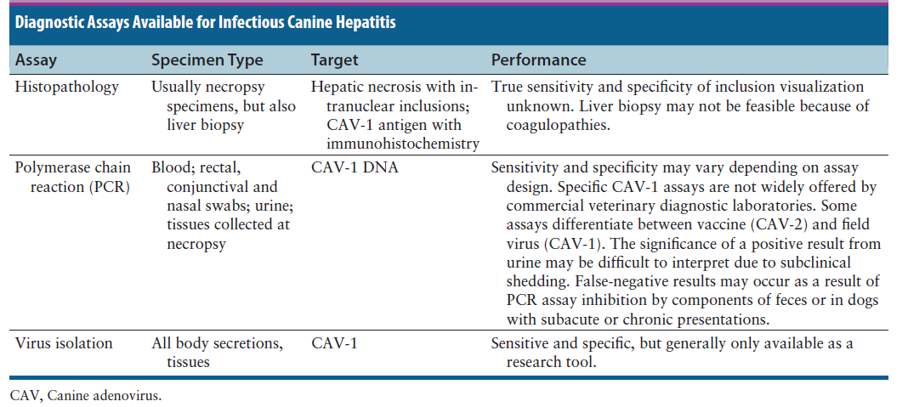
Diagnosis:
It may be suspected in any dog less than 1 year of age that has a questionable vaccination history and signs of fever, respiratory, gastrointestinal, and hepatic disease, and certainly in any young dog that develops corneal edema.

Slide 26
Treatment and Control:
Dogs with acute ICH require supportive care and consists primarily of fluid therapy, including crystalloid fluids and blood products.
Antiemetics, antacids, sucralfate, whole blood or plasma transfusions, and colloids such as hetastarch.
Partial or total parenteral nutrition for those that do not tolerate enteral feeding.
Management of hepatic encephalopathy with lactulose enemas, oral lactulose (in the absence of vomiting), and poorly absorbed oral antimicrobial drugs such as ampicillin may also be indicated.
The use of parenteral broad-spectrum antimicrobial drugs should be considered for dogs with hemorrhagic gastroenteritis that may develop bacteremia as a result of bacterial translocation.
For severe corneal edema and uveitis, use topical ophthalmic preparations that contain glucocorticoids and atropine to prevent development of glaucoma.

Slide 27
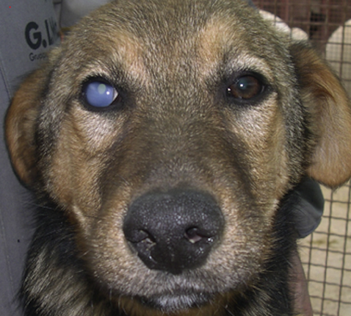
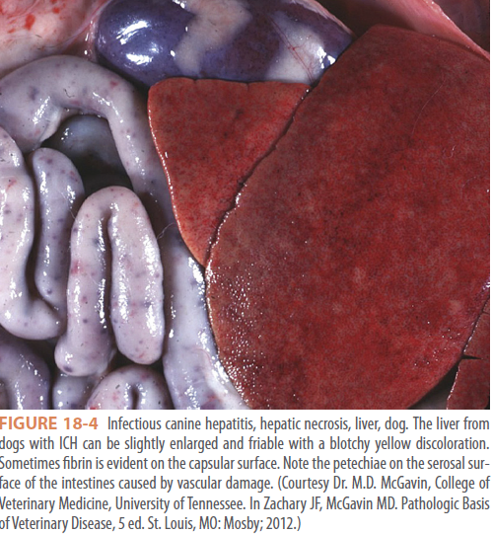
Prevention:
Immunization:
Vaccines should be administered every 3 to 4 weeks from 6 weeks of age, with the last .vaccine given no earlier than 16 weeks of age.
Proper disinfection, isolation, and prevention of overcrowding and other co-infections, which may worsen disease.
There is no evidence that CAV-1 infects humans.
Young adult dog with corneal edema

Slide 28

RABIES
Anil Kumar
Asst. Professor
Dept. of VCC
Unit-6

Slide 29
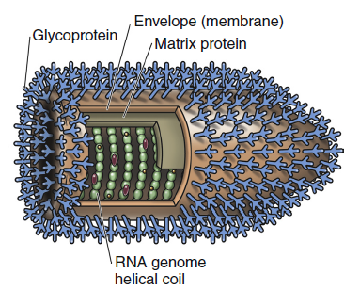
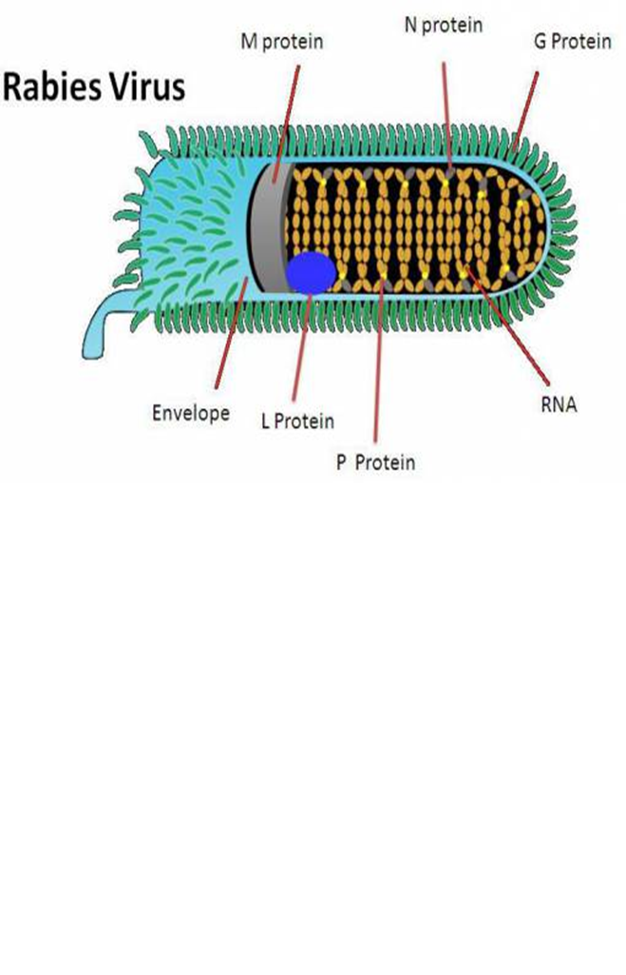
RABIES
Etiology
Bullet-shaped, enveloped RNA virus that belongs to the genus Lyssavirus, of Rhabdoviridae family
Rabies is a deadly, zoonotic, neurologic disease.
Readily inactivated by a variety of disinfectants, soaps, ultraviolet light, and heat.
There are seven lyssavirus genotypes, where classical rabies virus belongs to genotype 1.
The remaining six lyssavirus genotypes primarily infect bats and less frequently cause fatal human encephalitis, which is clinically indistinguishable from classical rabies

Slide 30
Host affected
All warm-blooded animals
Mode of transmission
Biting, with inoculation of saliva containing the virus
Highly susceptible hosts include wolves, foxes, coyotes, jackals, dogs, cattle, raccoons, skunks, bats, and mongooses.
Moderately susceptible hosts include cats, ferrets, primates, sheep, goats, and horses.
Large majority of the cases occur after a dog bite
Other routes of transmission corneal or solid-organ transplantation in human patients
Aerosol transmission, such as that occurring within caves containing large numbers of bats
Dogs, wild carnivores, and bats are considered the main natural reservoirs of rabies virus.
Ingestion of infected tissues or milk

Slide 31
Incubation Period
In dogs IP varies from a week to many months
The outcome after a bite from a rabid animal include:
The proximity of the bite site to the central nervous system (CNS)
The degree of innervation of the bite site
The age of the host (young animals are more susceptible)
The amount of virus inoculated, and
The neuro-invasiveness of the rabies virus variant involved
The course of rabies typically lasts 3 to 8 days in dogs
Most rabies cases in dogs develop within 21–80 days after exposure, but the incubation period may be shorter or considerably longer.

Slide 32
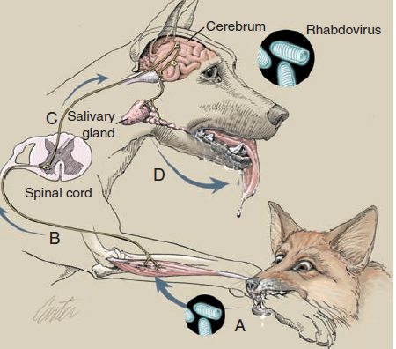

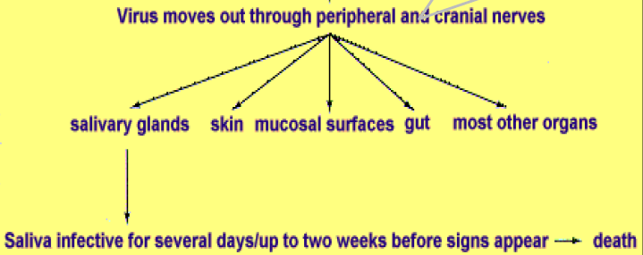
PATHOGENESIS:
Rabies virus enters peripheral nerves, or may replicate in myocytes and spread to motor nerve endings(A)
Retrograde intra-axonal (centripetal) spread to the CNS occurs in peripheral motor nerves (B)
Virus replicates in spinal cord neurons and spreads rapidly throughout the nervous system, causing progressive lower motor neuron paralysis(C)
Virus enters the brain, causing cranial nerve defi cits and behavioral changes
centrfugally
Hematogenous spread does not occur
(Art by Kip Carter © 2004 University
of Georgia Research Foundation Inc.)
Presence of virus in the saliva indicates that the CNS has been infected.

Slide 33
Types of Rabies virus
Street Virus
Fixed Virus
The virus isolated from natural occurring cases.
it is naturally occurring virus. It is found in saliva of infected animal.
It produces Negri bodies
Incubation period is long i.e. 2wkks to more than 1year.
It is pathogenic for all mammals
It Can’t be used for preparation of vaccine
The virus which has a short, fixed and reproducible incubation period
2. It is prepared by repeated culture in brain of rabbit such that its pathogenicity is reduced & fixed
3. It does not form Negri bodies
4. Incubation period is constant between 4-6 days
5. It can pathogenic for humans under certain conditions
6. Is used for preparation of antirabies vaccine

Slide 34


The classical course of canine rabies is divided into three phases:
Prodromal phase
Excitative (furious) phase
Paralytic phase (dumb rabies)
Prodromal phase:
Behavioural changes may occur.
Aggressive and highly strung dogs may become friendlier than usual and ordinarily friendly dogs may become shy and seek secluded areas or become snappy and irritable.
The temperature may rise slightly, the pupils may dilate and the nictitating membrane may cover the eye.
Excessive salivation may occur.
Clinical Signs

Slide 35
Excitative (furious) phase:
The dog becomes severely agitated and restless and sometimes develops the urge to roam. It is most dangerous at this stage because of its urge to bite anything that it encounters.
In most cases an altered phonation (a characteristic high pitched bark) develops, caused by paralysis of laryngeal muscles.
Spasms and paralysis of the pharyngeal muscles make swallowing difficult and lead to drooling.
If the dog does not die during one of the characteristic convulsive seizures the disease usually progresses to muscular incoordination, paralysis, coma and death.
The posture and expression is one of alertness and anxiety, with pupils dilated.
Noise may invite attack. Such animals lose caution and fear of people and other animals.

Slide 36
The paralytic phase (dumb rabies) :
Occurs when the excitative phase is extremely short or absent.
The most characteristic sign is the "dropped jaw“ caused by paralysis of the masseter muscles. Often, choking sounds as if a bone were stuck in the throat are made and attempts to remove this "bone“
Cattle
Furious rabies can be dangerous, attacking and pursuing people and other animals.
Lactation ceases abruptly in dairy cattle.
The usual placid expression is replaced by one of alertness.
The eyes and ears follow sounds and movement.
A common clinical sign is a characteristic abnormal bellowing, which may continue intermittently until shortly before death.

Slide 37
Horses and mules
Frequent distress and extreme agitation accompanied by rolling, may be interpreted as evidence of colic.
As in other species, horses may bite or strike viciously and, because of their size and strength, become unmanageable in a few hours. People have been killed outright by such animals.
These animals frequently have self-inflicted wounds.
Based on history and clinical signs
Immunofluorescence microscopy on fresh brain tissue (medulla oblongata and cerebellum ) , which allows direct visual observation of a specific antigen-antibody reaction, is the current test of choice.
Molecular testing, including real-time PCR
The WHO recommends methods for the detection of rabies virus antigens, amplicons, and antibodies
DIAGNOSIS

Slide 38
Management of wound
Cauterization or application of oil, turmeric etc on should be avoided
Not stitched the wound at least within 24-48 hr of injury
Tetanus toxoid and Antibiotics for wound healing.
All dogs and cats should be vaccinated for rabies at 3 or 4 months of age (depending on state legislation), with a booster dose 1 year later, then every 3 years with approved inactivated vaccines, or annually with recombinant vaccines
Dogs and cats less than 1 year of age are not considered immunized until 28 days after the initial vaccination
Oral vaccinia-vectored recombinant rabies vaccines, used in wild animals such as raccoons, coyotes, and gray foxes
Treatment
Prevention and Control

Slide 39
The modified live SAD B19 strain, the V-RG recombinant, and SAG2 vaccines
Post-exposure prophylaxis (PEP) is administered to humans after a bite from a known or suspected rabid animal.
It consists of an injection of human rabies immune globulin (H-RIG), ideally with at least half of the whole dose in the region of a bite site as soon as possible within the first 7 days of the bite, followed by vaccination by the intramuscular route on days 0, 3, 7, 14, and 28 in the upper deltoid muscle.
Oral Vaccination of Feral and Wild Animals
Human

Slide 40
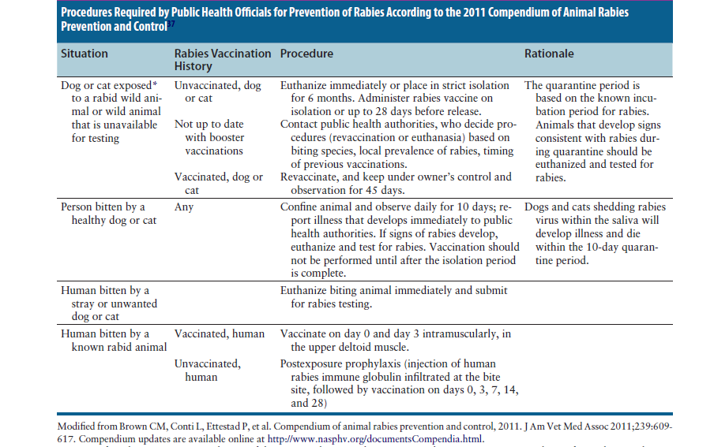

Slide 41
DOG VACCINATION
Vaccines (contain antigens) help prepare the body’s immune system to fight the invasion of disease-causing organisms
Purpose:
To prevent death from horrible diseases
To prevent illness
The requirement for travel (eg, rabies) or kennelling (eg, Bordetella species)
Immune Response:
Initial exposure to a pathogen or vaccine triggers a primary adaptive immune response during which immunoglobulin M (IgM) synthesis predominates
Continued or repeated exposure to the same pathogen stimulates a secondary adaptive response during which antibody synthesis escalates and changes to the immunoglobulin G (IgG) type.

Slide 42
TYPES OF VACCINE:
Infectious
Non-infectious
Infectious:
Contain organisms that are attenuated to reduce virulence (i.e. ‘modified live virus)
Organisms are intact and viable
Replicating within the animal
Not producing significant tissue pathology or clinical signs of infectious disease
Induce robust cell-mediated and humoral (antibody-mediated) immunity—Parenteral route
Some are administered directly to mucosal sites (i.e. intranasal or oral vaccines) where they inducing relevant protective mucosal immunity
Recombinant vectored vaccines
An animal that lacks maternally-derived antibody (MDA) an infectious vaccine will generally induce protection with a single dose

Slide 43
Non-infectious:
Also known as killed or inactivated vaccines
Inactivated but antigenically intact virus or organism
Unable to infect, replicate or induce pathology or clinical signs
Generally require an adjuvant to increase their potency and usually require multiple doses to induce protection
Administered parenterally
Less likely to induce both cell mediated and humoral immunity
Generally have a shorter duration of immunity compared with infectious vaccines
The vaccination guidelines separate vaccines into 2 groups:
Core vaccines: offer protection against highly contagious, life-threatening infections or infections that pose a significant threat to human health (e.g, rabies)
The core vaccines are those that confer protection against infection by canine distemper virus (CDV), canine adenovirus (CAV; types 1 and 2) and canine parvovirus type 2 (CPV-2) and its variants

Slide 44
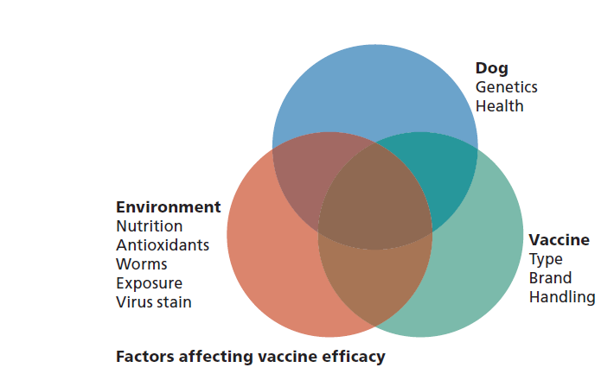
Noncore vaccines: offer protection against less serious health threats to dogs or threats that pose a regional/on the basis of the geographical and lifestyle exposure risks
It is ultimately the decision of the individual veterinarian or practice to establish which vaccines in a protocol are designated core or noncore.

Slide 45
Vaccination Schedule for Dogs: Core and Non-core Vaccines
Dog Vaccine | Initial Puppy Vaccination (at or under 16 weeks) | Initial Adult Dog Vaccination (over 16 weeks) | Revaccination | Comments
Rabies (killed) | 3 months of age In high risk areas a second dose may be given 2–4 weeks after the first | Single Dose SC/IM | A single dose | Revaccinate annually in endemic areas Core vaccines If vaccination is performed earlier than 12 weeks of age, the puppy should be revaccinated at 12 weeks of age.
MLV or Recombinant Canine Distemper Virus/ MLV Parvovirus /MLV Adenovirus-2 / MLV Parainfluenza Virus | 6–8 weeks of age, then every 2–4 weeks until 16 weeks of age or older | Two doses 2–4 weeks apart SC/IM | Administer a single dose of a combination vaccine within 1 yr following the last dose in the Initial Vaccination series | Core vaccines Parainfluenza Virus-Non-core Protective response lasting beyond 3 yr
Canine influenza virus(H3N8) killed adjuvanted, parenteral | 2doses 2–4 weeks At >6 weeks of age | Two doses 2–4 weeks apart | Annually | Non-core
Canine Coronavirus (killed and MLV), Parenteral | 12 weeks Booster 3 weeks after primary vaccination | SC/IM | - | Infections are usually subclinical or cause mild clinical signs

Slide 46
Dog Vaccine | Initial Puppy Vaccination (at or under 16 weeks) | Initial Adult Dog Vaccination (over 16 weeks) | Revaccination | Comments
Leptospira (killed) 4-serovar Canicola Icterohaemorrhagia Grippotyphosa Pomona | Two initial doses, 2 to 4 wk apart 8 to 9 wk of age | Two initial doses, 2 to 4 wk apart regardless of the age | Annually SC | 4-serovar leptospirosis vaccines are available in combination with CORE vaccines
Bordetella bronchiseptica (live avirulent bacteria, B. bronchiseptica + CPiV (MLV) B. bronchiseptica +CPiV (MLV) +CAV-2 (MLV) | As early as 3 weeks of age. | A single dose | Intranasal Annually | Available as a single product or incombination with CPiV or with both CPiV and CAV2 Transient (3–10 days) coughing, sneezing, or nasal discharge may occur
Borrelia burgdorferi (Lyme borreliosis (killed whole bacterin) | Initial dose at 12 wks of age or older. A second dose is given 2–4 weeks later. | 2 doses, 2–4 weeks apart | Parenteral Annually Prior to the start of tick season | only in dogs with a known high risk of exposure Risk of vector tick exposure is HIGH

Slide 47
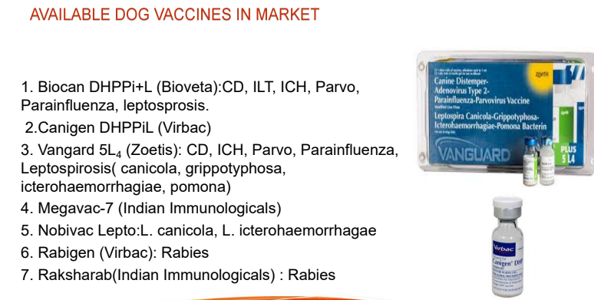

Slide 48
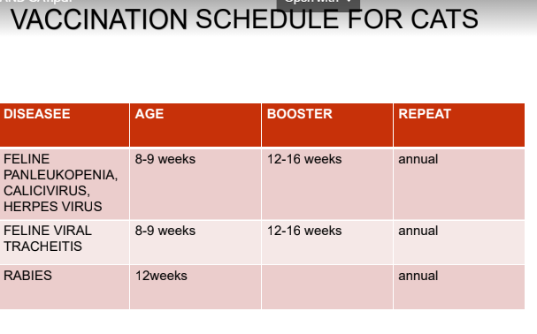

Slide 49
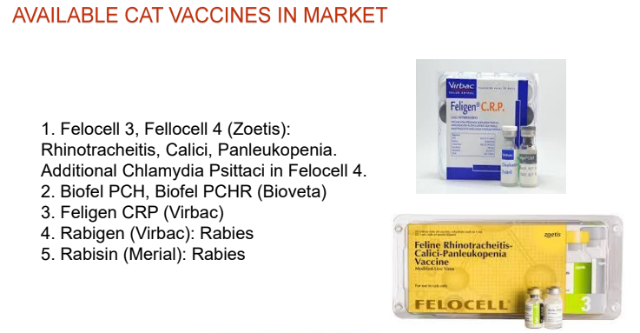

Slide 50
De-worming Scheduled
Age of Pet | Scheduled | Comments
6-12 wks | Every fortnight | Pregnant animals should be de-wormed at mating, then about at 6 wks of pregnancy
12wks-6 Months | Every Month
6Months-Adult | At every 3 months
Key Points:
Optimum storage temperature that is usually between 2–8°C
Freeze-dried vaccines should be reconstituted immediately before use with appropriate diluent
Syringes and needles for vaccines should not be re-utilized
Vaccine injection sites should not be sterilized with alcohol or other disinfectant as this may inactivate infectious (MLV) vaccines
Vaccines should be ‘in date’ and precise details of batch numbers, components and site of injection should be noted in the animal’s medical record.

